Slide 1



Multi-attribute, Multimodal Bias Mitigation in AI Systems HORIZON-RIA Project ID: 101070285
MAMMOth Highlights
Dr Symeon (Akis) Papadopoulos
MAMMOth Coordinator, Principal Researcher @ CERTH/ITI Dr Alexia Zoumpoulaki
Applied AI Researcher @ Exus AI Labs Dr Lara Younes
Staff Machine Learning Engineer @ IDnow
Future Ready - 16 April 2026

Slide 2










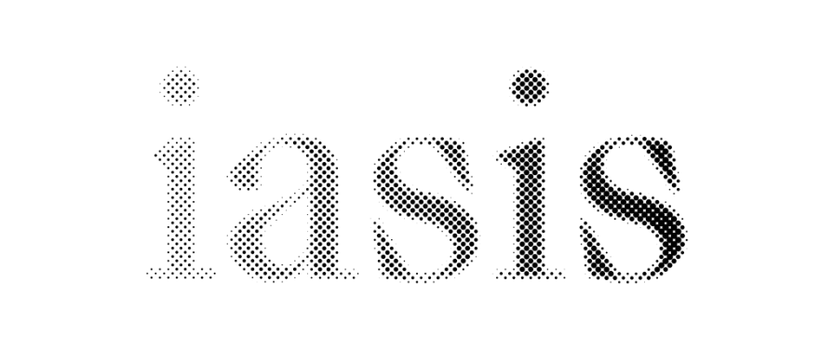

Partners

Slide 3

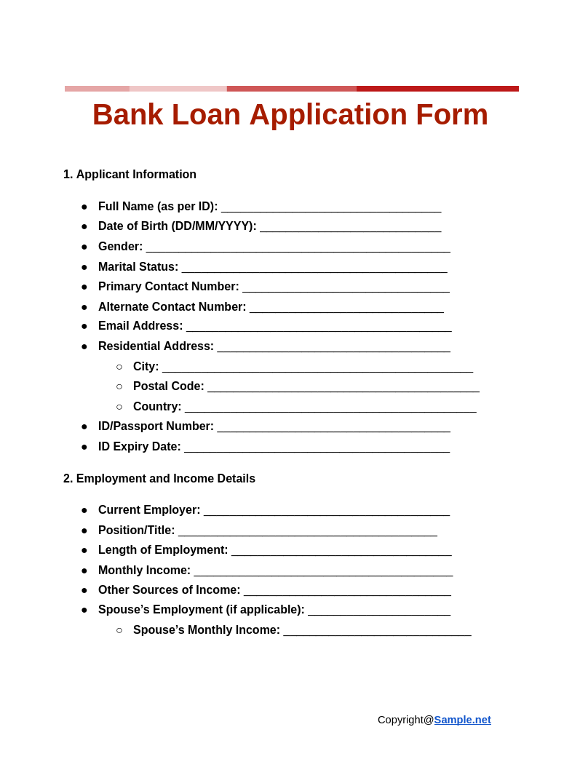

Typical AI Bias Assessment Scenario
Data + Annotations
Building & Testing AI Models
Attributes + Target Var.
AI Bias Assessment

Slide 4
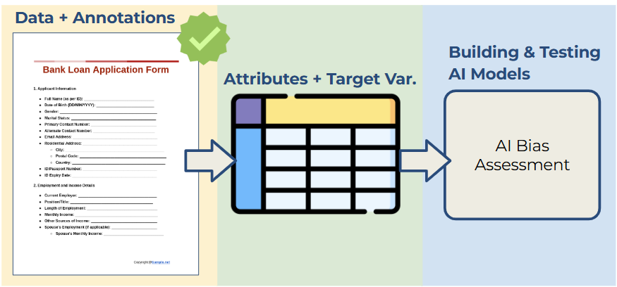
Limitations
Focus on classification
(vs. generative AI)
Single protected attribute
(vs. multi- attributes, proxy attributes)
Single bias metric (vs. multiple metrics)
Structured data
(vs. text, images, networks, etc.)

Slide 5
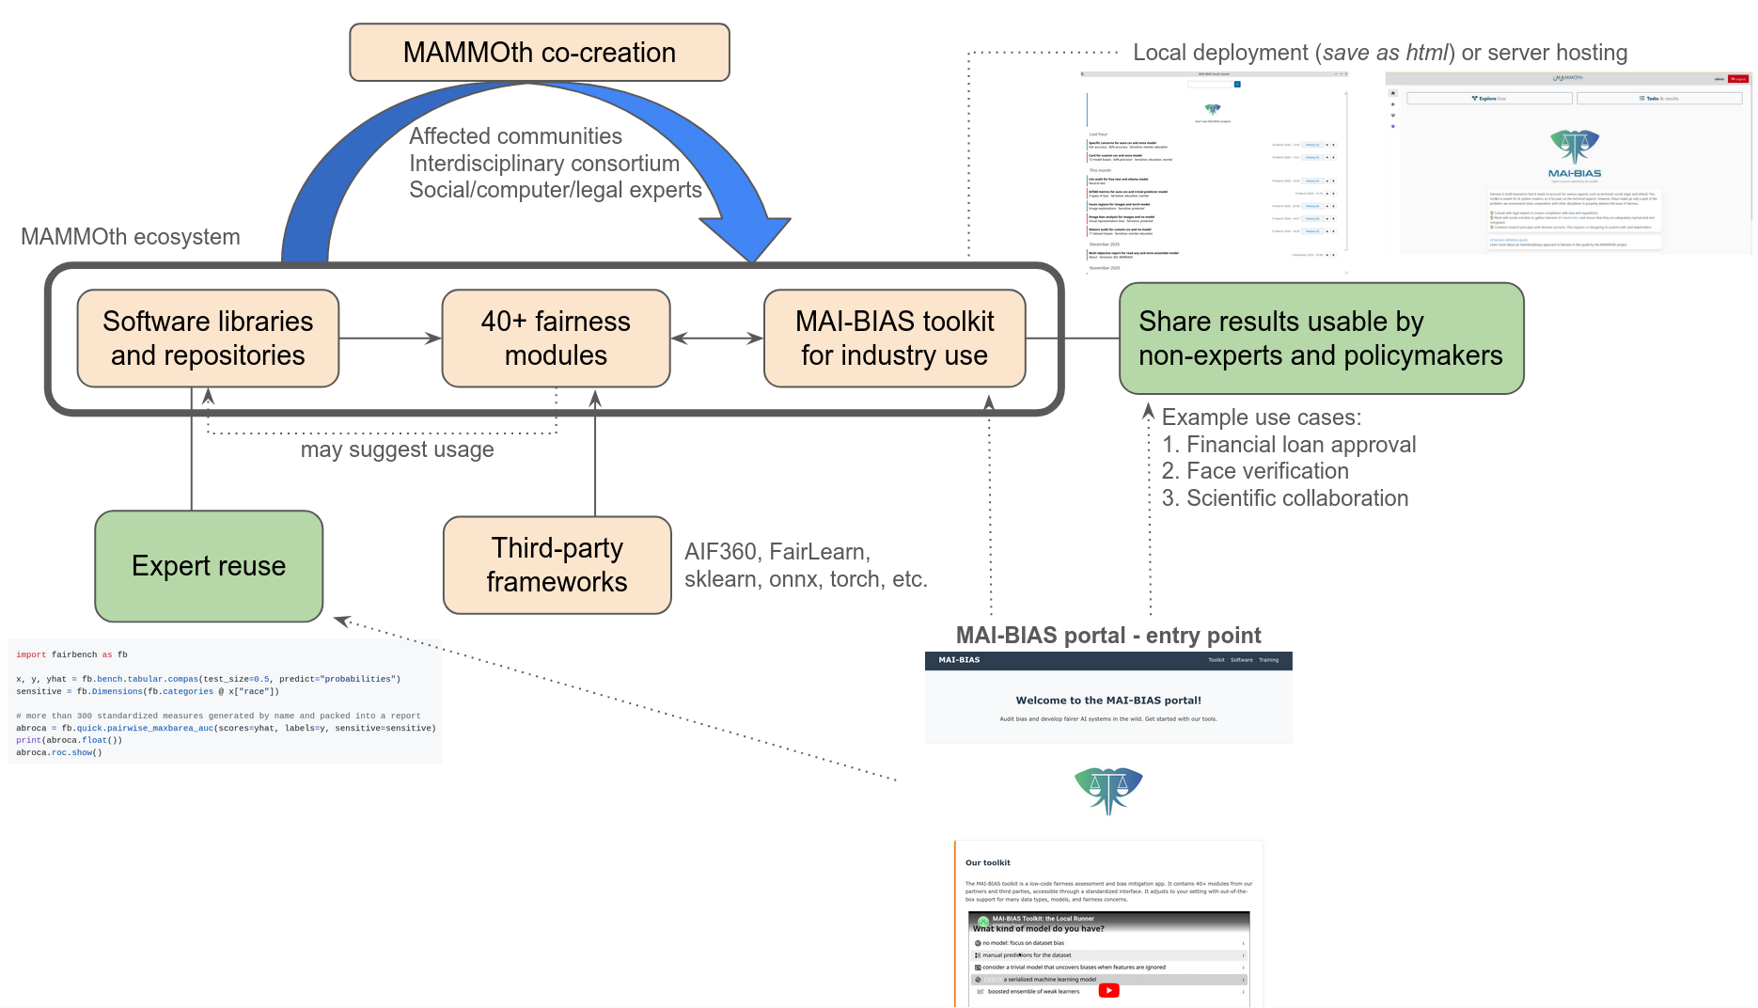
MAMMOth Software Results

Slide 6
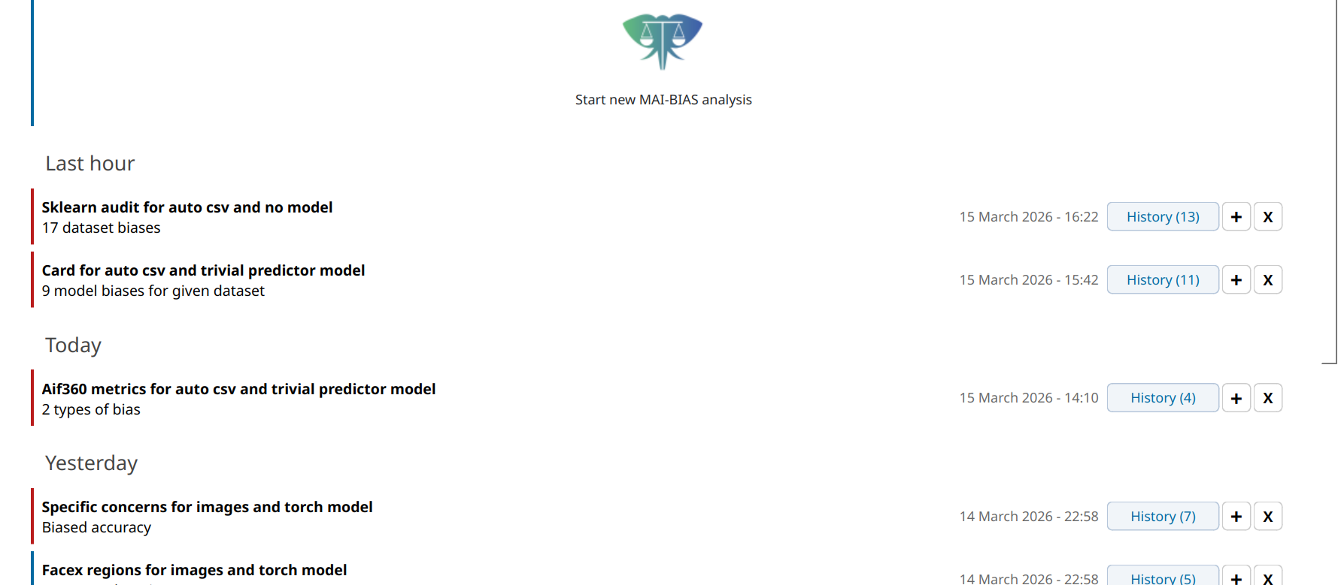
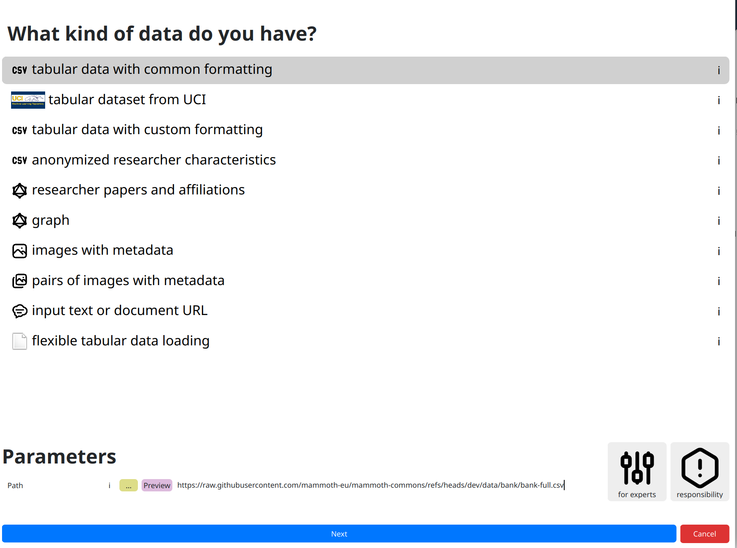
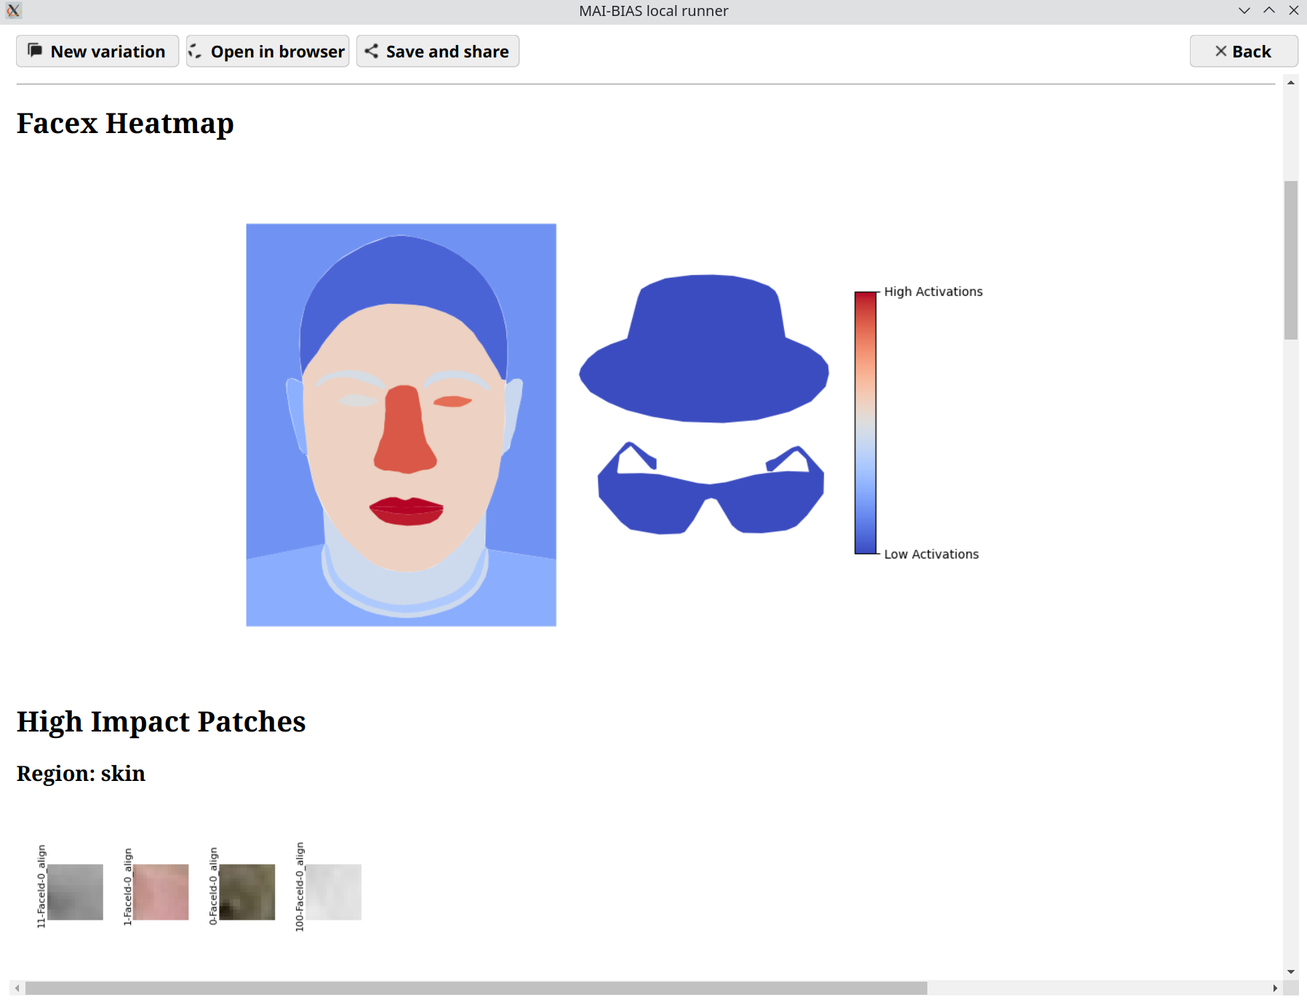
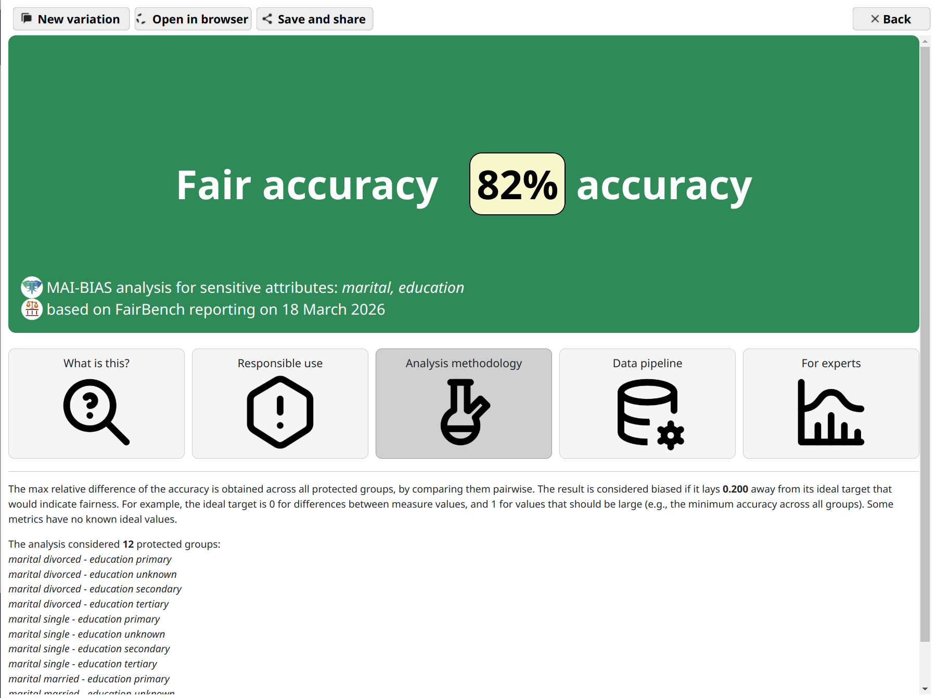
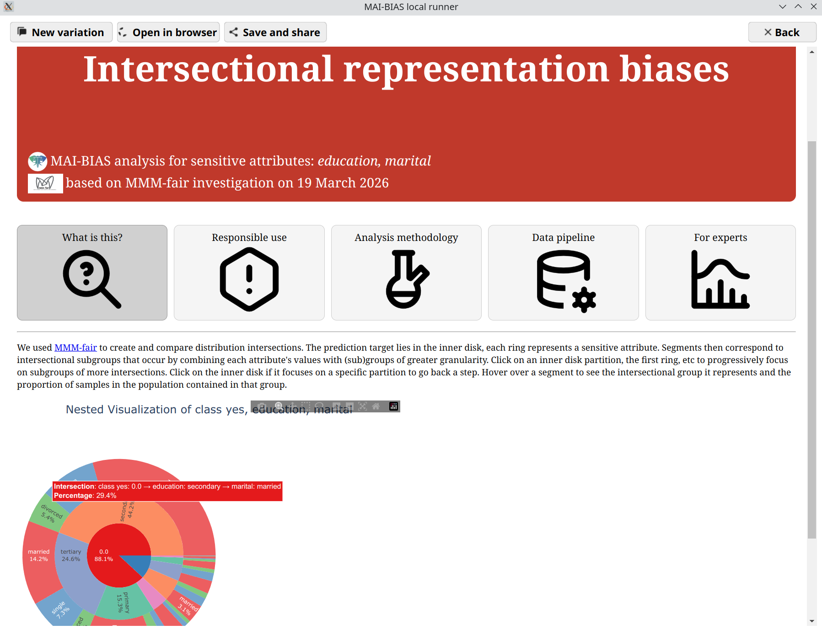
MAMMOth AI Bias Toolkit
A toolkit for bias analysis and mitigation
https://mammoth-eu.github.io/mammoth-commons/

Slide 7


Repositories to Support Bias Mitigation
FairBench
VB-Mitigator
mmm-fair
A comprehensive AI fairness exploration framework offering support for multiple metrics
A framework facilitating the integration, evaluation and comparison among visual bias mitigation methods
A unified framework for exploring and operationalizing multi-fairness trade-offs
LEARNING &
ADAPTATION
Tutorials (Jupyter notebooks)
13 selected key project assets have been published on the AI on Demand platform

Slide 8
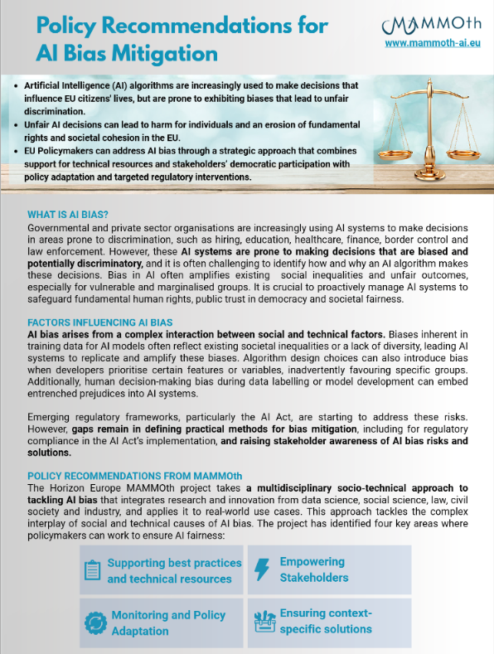
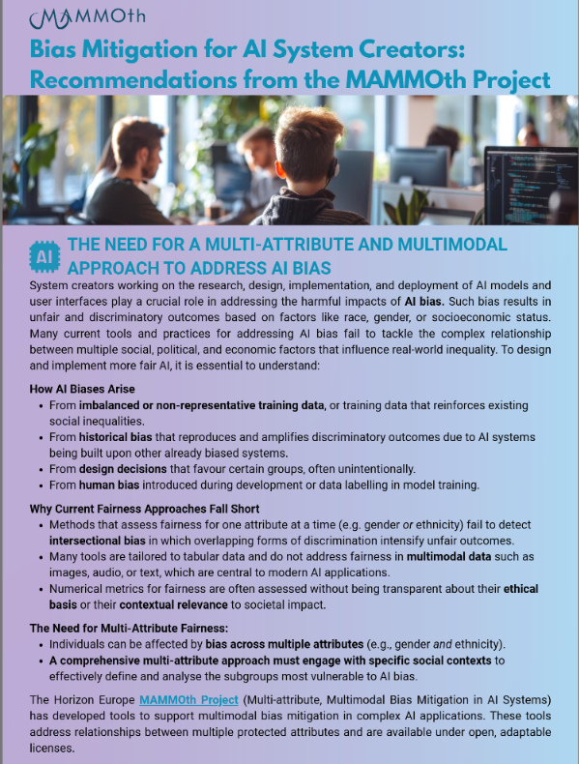
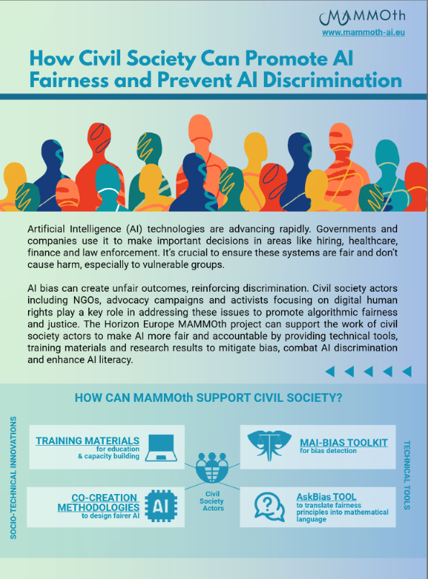
Policy Recommendations
Targeted recommendations for specific stakeholder groups:
1) EU and national-level policy makers;
2) civil society actors;
3) AI system creators.
https://mammoth-ai.eu/results/project-recommendations/

Slide 9
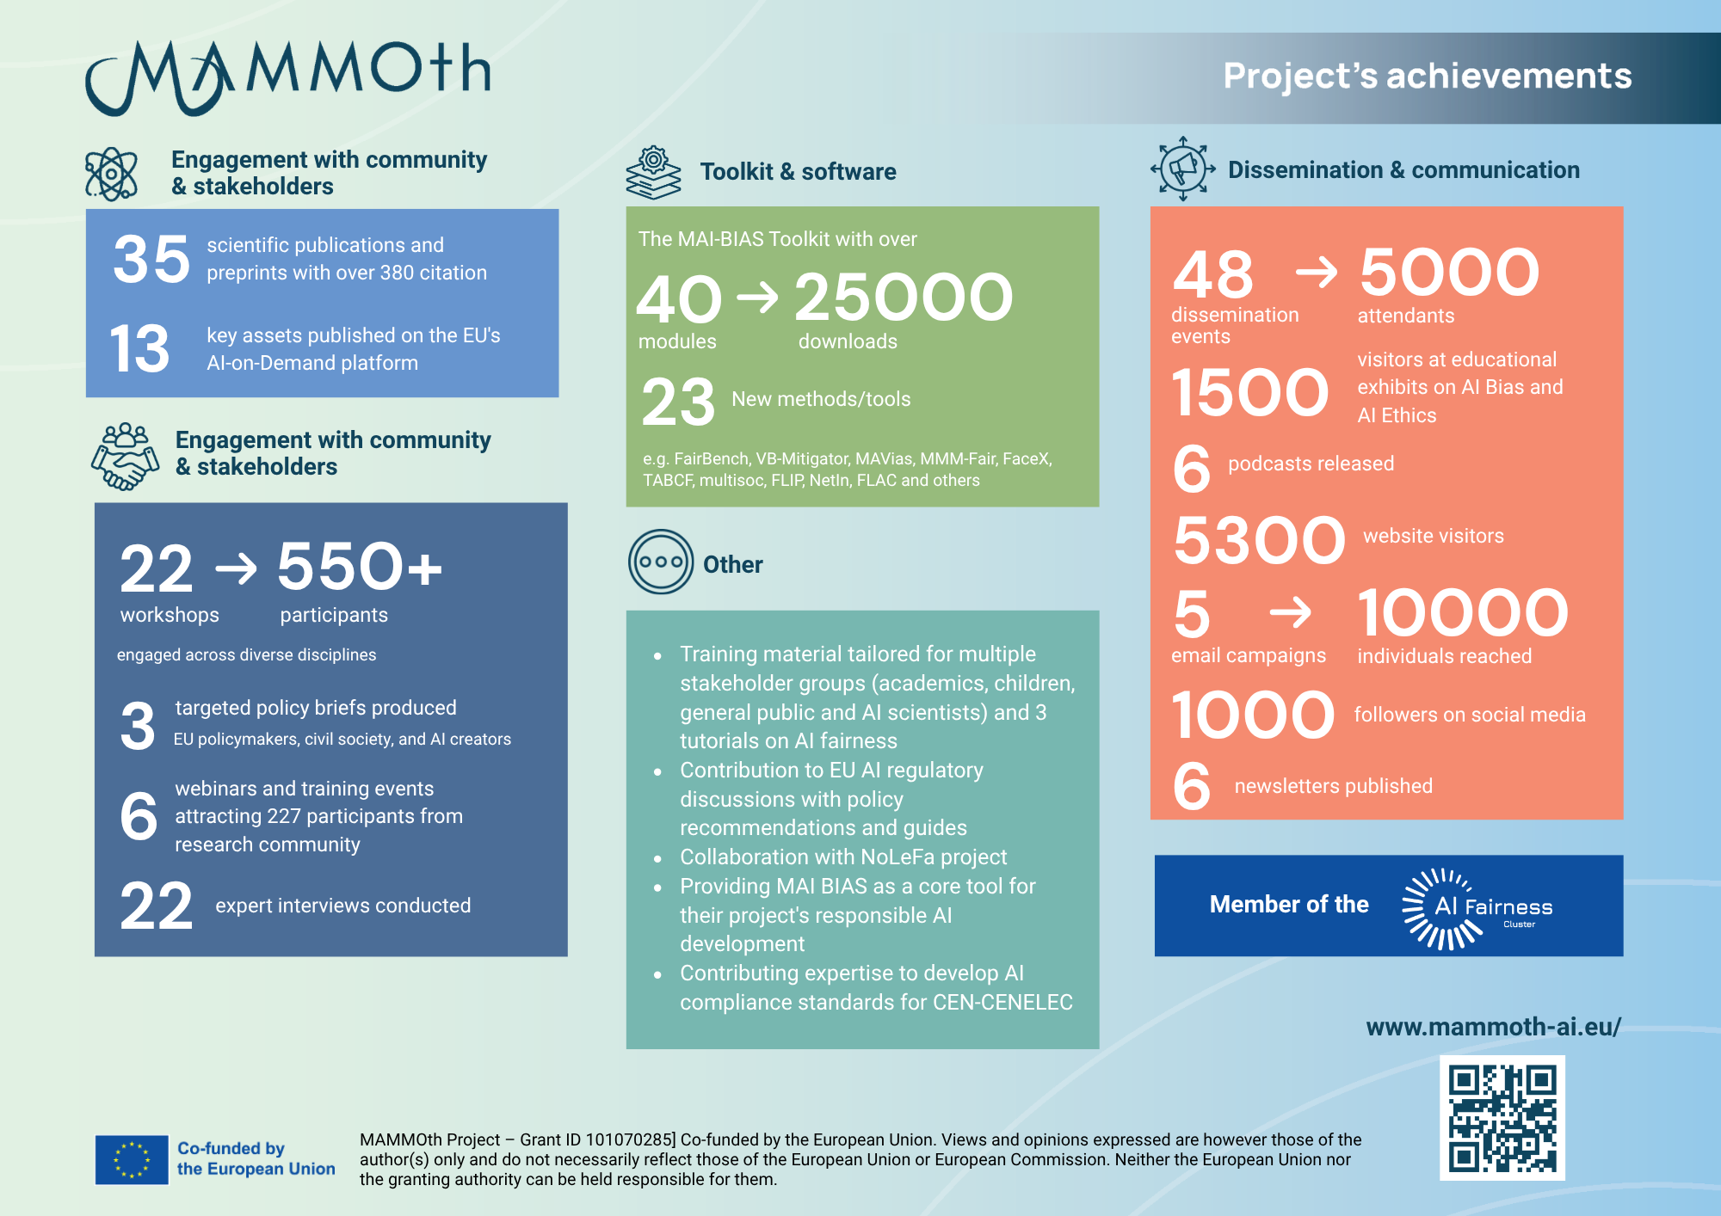

Slide 10

Algorithm-Based Decision Making in finance: User profiling/credit scoring/debt repayment
UC1
Identify attributes contributing to AI bias in credit scoring and debt repayment.
Develop and test an algorithmic decision-making system that reduces bias in financial services

Slide 11
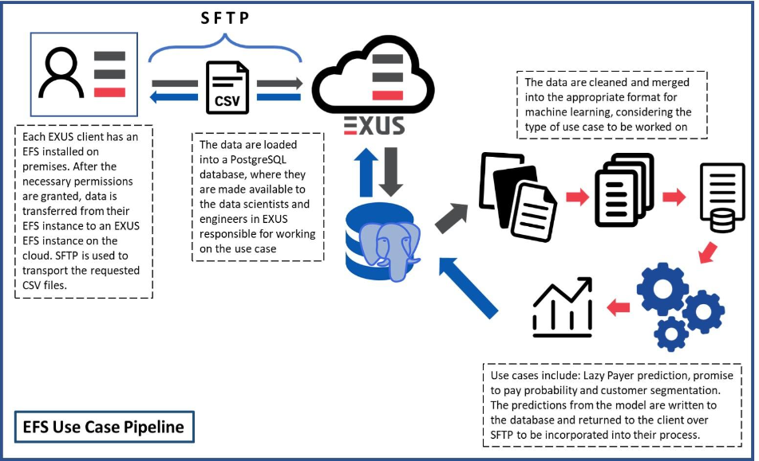
EFS - EXUS
Context of the UC1
EFS AI tasks
Customer Segmentation Problem
Defaulter Prediction Problem
Lazy-payer or self-cured identification problem
Promise to Pay Prediction Problem
High Risk Identification Clients

Slide 12
UC1 - Key takeaways
The results serve as a baseline for fairness-aware debt collection strategies.
Bias Was Detected in Both Model and Data:
Female borrowers, especially younger women, were underrepresented and misclassified more often as high-risk.
Disparities were confirmed across key fairness metrics (MCC, Kappa, ΔFPR, ΔFNR).
Dataset imbalance and model behavior both contributed to unfair outcomes.
Mitigation Strategies Explored:
Class (Ratio) augmentation offered the best fairness-performance trade-off.
Results showed reduced subgroup disparities with minimal synthetic distortion.
No drop in accuracy, confirming effectiveness of mitigation.

Slide 13

Decision making in authorization systems: Digital Identity verification
UC2
Remote Face verification in the context of digital identity authentication or KYC
Address unequal access of the minorities to the online services

Slide 14

IDnow.
Remote identity verification for KYC
Remote Face verification in the context of digital identity verification
Is the person submitting the ID card the same person to whom belong the ID card, not an impostor​

Slide 15




IDnow.
Remote identity verification for KYC
Why bias mitigation in biometric services for KYC counts?
Global standard: meet regulatory requirements | Fight Fraud | Elevate trust | Decrease Losses

Slide 16
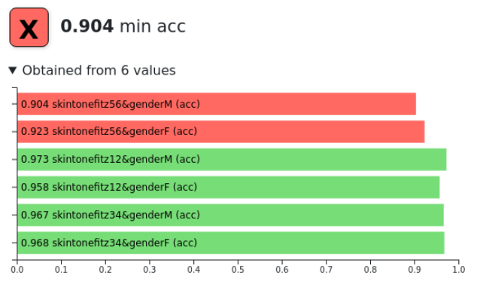
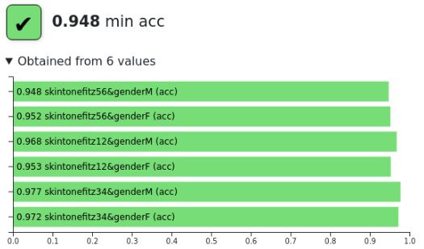
UC2 - Key takeaways
Global performance: Model assessment before and after bias mitigation
Model bias analysis: intersectional assessment before (left) and after (right) mitigation.
Target for Worst Group Accuracy (WG Acc.) > 94%
achieved after mitigation
Gain of 4pp on min Acc
No problematic bias to gender

Slide 17



Thank you for your attention!
Dr Symeon (Akis) Papadopoulos
MAMMOth Coordinator, Principal Researcher
Head of mever.gr / papadop@iti.gr
Funded by the European Union under Grant Agreement ID: 101070285. UK participant in Horizon Europe Project MAMMOth is supported by UKRI grant number 10041914 (Trilateral Research LTD). Views and opinions expressed are however those of the author(s) only and do not necessarily reflect those of the European Union or European Commission or UKRI. Neither the European Union nor the granting authority nor UKRI can be held responsible for them.

Slide 18
Our Approach
Co-creation & Analysis
Development
Evaluation & Training
Interviews with AI Experts
New AI fairness and bias definitions
Benchmarking on public datasets
Co-creation workshops with underrepresented communities
Bias mitigation method development
Evaluation on use case scenarios and datasets
Multi-disciplinary co-creation workshops
Library development
Demonstrations and qualitative feedback
Toolkit development
Training material and outreach
Use cases & requirements analysis
Component development and integration

Slide 19
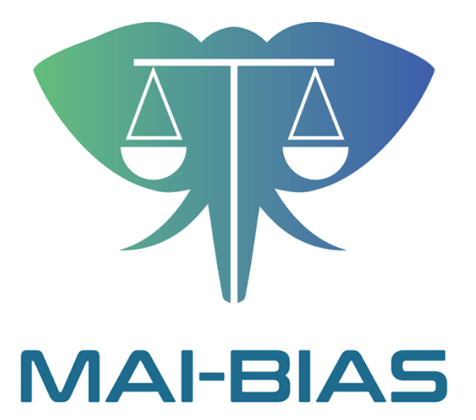
MAMMOth AI Bias Toolkit
A toolkit for bias analysis and mitigation
A combination of project’s and third-party research results to AI system creators
Analyses saved models and datasets
Modalities: tabular data, images, graphs, etc.
Exploration: bias quantification, explainability, suggestions for mitigation methods, etc.
40+ modules and growing
https://mammoth-eu.github.io/mammoth-commons/

Slide 20
Scientific Results - Some Highlights
Multi-dimensional bias definition and measurement (Roy et al., 2023; Krasanakis & Papadopoulos, 2024; Swati et al., 2024; Roy et al., 2024; Roy et al., 2025; Swati et al., 2025)
Assessing and mitigating bias in computer vision - face attribute classification and face verification (Fabbrizzi et al., 2024; Sarridis et al., 2023a; Sarridis et al., 2023b; Sarridis et al., 2024; Melzi et al., 2024a; 2024b; Maragkoudakis et al., 2023; Baltsou et al., 2024; Moussa et al., 2025; Sarridis et al., 2024; Sarridis et al., 2025)
Bias in networks - homophily, assortativity, core-periphery (Neuhäuser et al., 2023; Karimi & Oliveira, 2023; Ureña-Carrión et al., 2023; Stier et al., 2024; Cartier van Dissel et. al., 2025- graph neural networks (Krasanakis & Papadopoulos, 2023; Krasanakis et al., 2024)
Emerging methods (Ghodsi et al., 2024; Panagiotou & Ntoutsi, 2023; Panagiotou et al., 2024a; Panagiotou et al., 2024b; Ramanaik et al., 2024)
AI in education (Heeg & Avraamidou, 2023; Avraamidou, 2024; Heeg & Avraamidou, 2024)
Co-creation in AI fairness (Slesinger et al., 2024; Gibin et al., 2025)
21 / 24

Slide 21
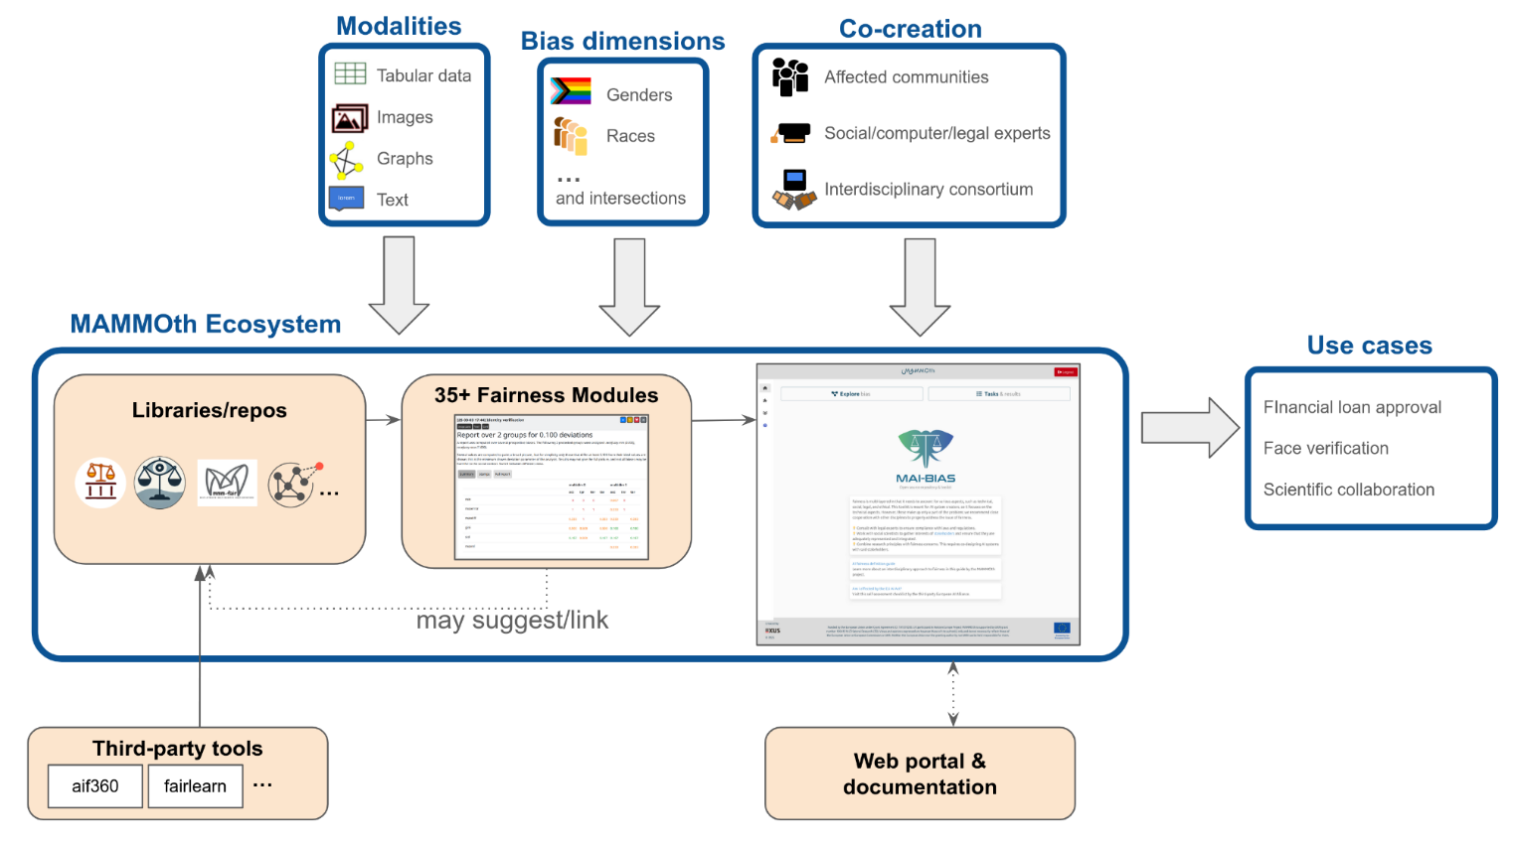
The MAMMOth Framework
11 / 24

Slide 22
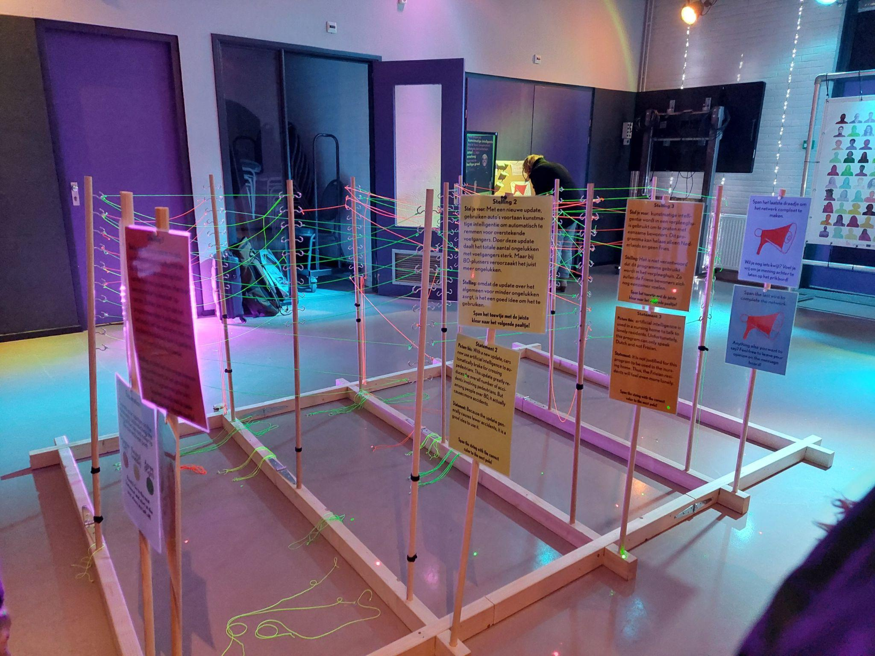
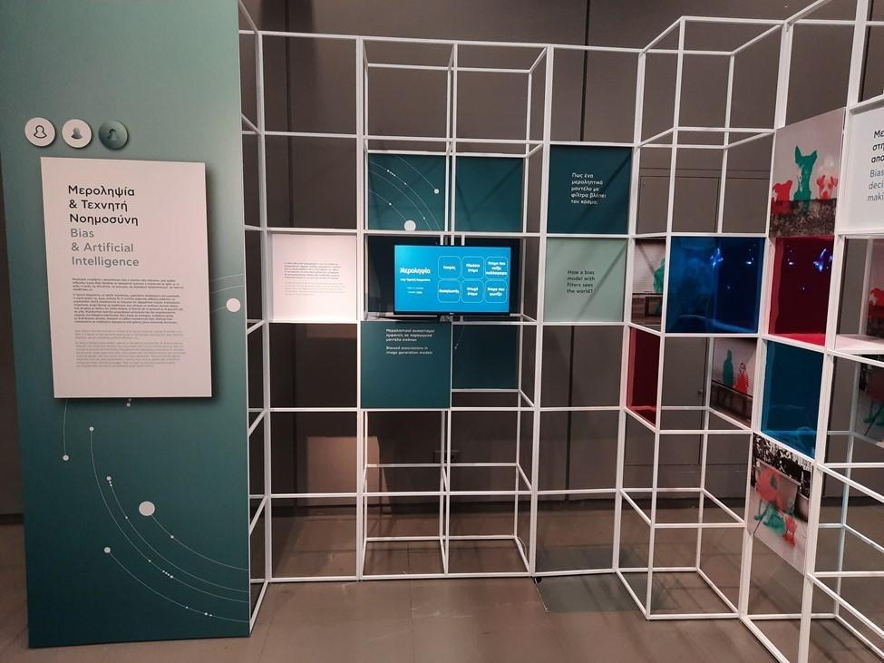
Diffusion of Research Outcomes
Training material about AI literacy for the general public, children and academics
5 Webinars
4 Podcasts
Organised 32 workshops/training or awareness raising events
Researchers’ Night & Open Days in Greece, Netherlands, Germany
Exhibitions by RUG in Netherlands & CERTH in Greece
Regular social media communications
22 / 24

