Slide 1

Future Ready Event:
Turning R&I into Impact
Cécile HUET, PhD
Head of Unit Excellence in AI and Robotics
European AI Office

Slide 2


Trustworthy AI: Building on Today’s Ecosystem
from the lab…
EIC / InvestEU
…to the market
Ecosystem of Excellence
EDIHs (European Digital Innovation Hubs)
PPP
R&I
Networks of Excellence
AI on Demand Platform
TEFs (Testing and Experimentation Facilities)
HORIZON EUROPE
DIGITAL EUROPE

Slide 3

Project portfolio of Advancing Trustworthy AI
- Verifiable robustness
- Transparency
- Energy efficiency
- Learning approaches: Hybrid AI , learning & reasoning, imitation learning, human in the loop
Addresses: confidence estimation, certification, safety by design
Safety by design
Certification
Edge to cloud
Energy efficient
Low latency
privacy
Hybrid
Planning and schedulling
Vefication
Safety
Human in the loop
Certification
Faireness
Hybrid AI
Knowledge graphs
Explainability
Learning & reasoning
Forecasting
Verification
Imitation learning
robust resilient
AI
Energy optimisation
Confidence estimation

Slide 4
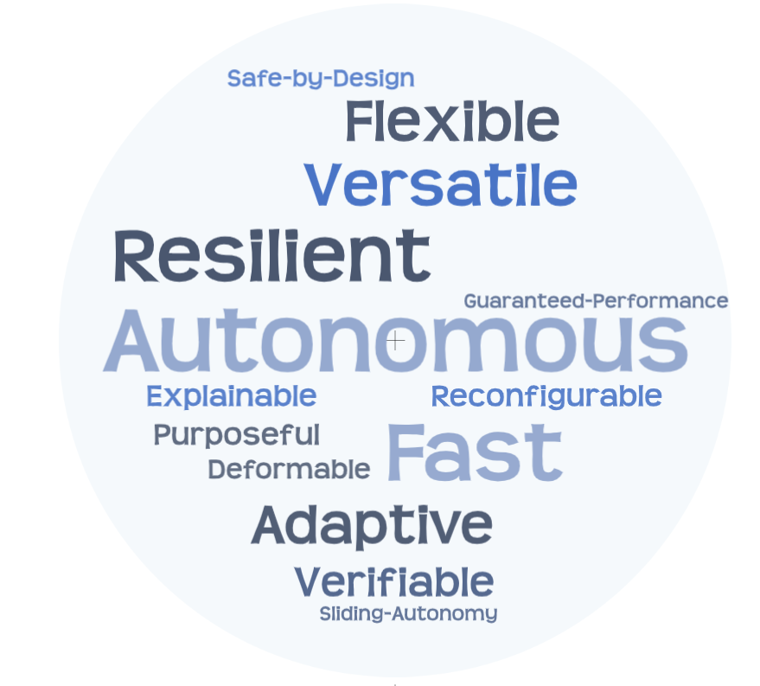
Pushing the limit of robotics cognition
AI – Powered Robotics
APPLICATION SECTORS
Manufacturing
Social Robots Museum guide / Edutainment
Logistics/Retail
Agrifood
Water cleaning (microrobots)
Health: Prosthetics / targetted drug delivery
ADVANCED CAPABILITIES

Slide 5


AI, Data and Robotics at work
Cobot
Industry 5.0
Drones
Inspection & Maintenance (Oil & Gas)
Hybrid AI & Collective Intell.
Diagnostic & Climate
Drones
Assist & Safety Berry Harvesting
Robot Assist.
Eye Surgery
Soft Manip
Health & Food
Distributed Decision support & Cobots
Production lines
AI, Data and Robotics for the Green Deal
Portable Robotics
Recycling
Food production
& Green deal index
Precision Forestry
Maintain
Wind Turbine
Optimise
Waste Water Mgt
Pesticide & Fertilizer reduction
Snake Robotics
Pipeline Inspection & Repair
Federated & Continuous learning
Metallurgy
Waste sorting / Battery

Slide 6
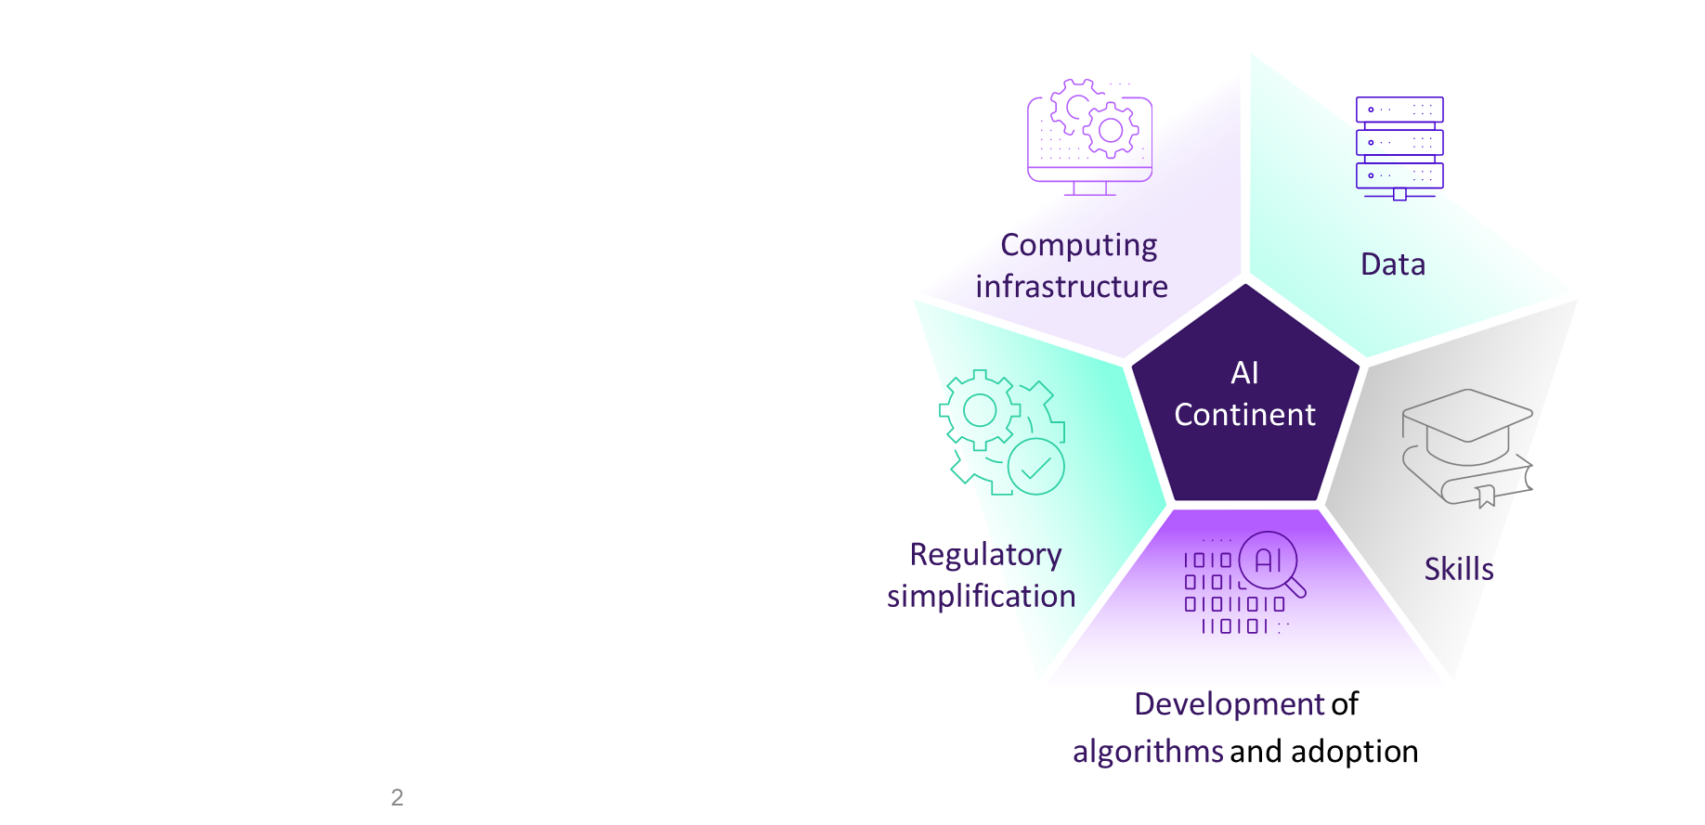
TOWARDS THE CREATION OF THE AI CONTINENT
APPLY AI Strategy
Tech Sovereignty
AI First policy
competitiveness in 10 strategic sectors (incl robotics, manufacturing, healthcare) + public sector +AI in science

Slide 7
Some actions
End-user driven approaches
Support for entrepreneurship/start-ups
Acceleration pipelines
Technology/AI models development
End-user driven Testing

Slide 8
Today’s event➔ Maximise the impact of our programme
Showcase projects success stories
Link to the topics groups – influence future strategies
Opportunities – uptake of projects results
Promote synergies and collaboration
AIoDemand Platform – show/share your results

Slide 9


Thank you!

