Slide 1
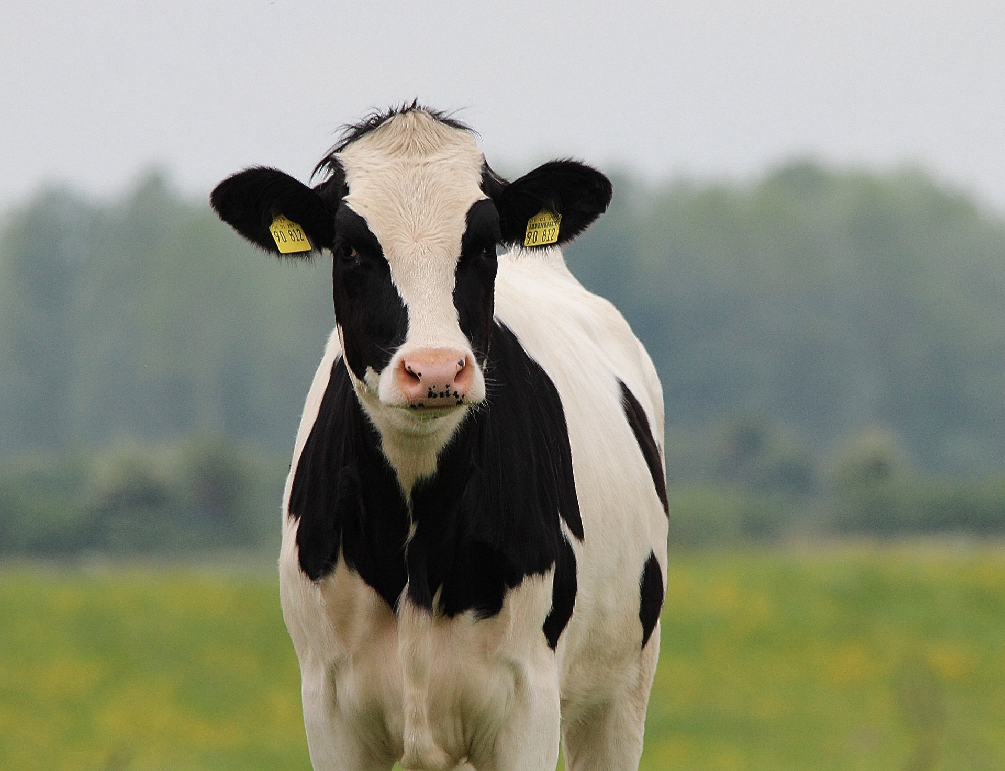



Advanced, trustworthy Ai and Data solutions for individualised automated milking & feeding of dairy cows
Presenter Name: | Spyros Zormpas
Organisation: | CYRIC
R&D Project Manager (Coordinator)
Funded by the European Union. Views and opinions expressed are however those of the author(s) only and do not necessarily reflect those of the European Union or HADEA. Neither the European Union nor the granting authority can be held responsible for them.
This work has received funding from the Swiss State Secretariat for Education, Research and Innovation (SERI)

Slide 2







Meet The Consortium
Industrial & SME Partners
Academia & Research Partners
CYPRUS
NETHERLANDS
SPAIN
GREECE
Project Coordinator
Switzerland
AUSTRIA
GREECE
2

Slide 3
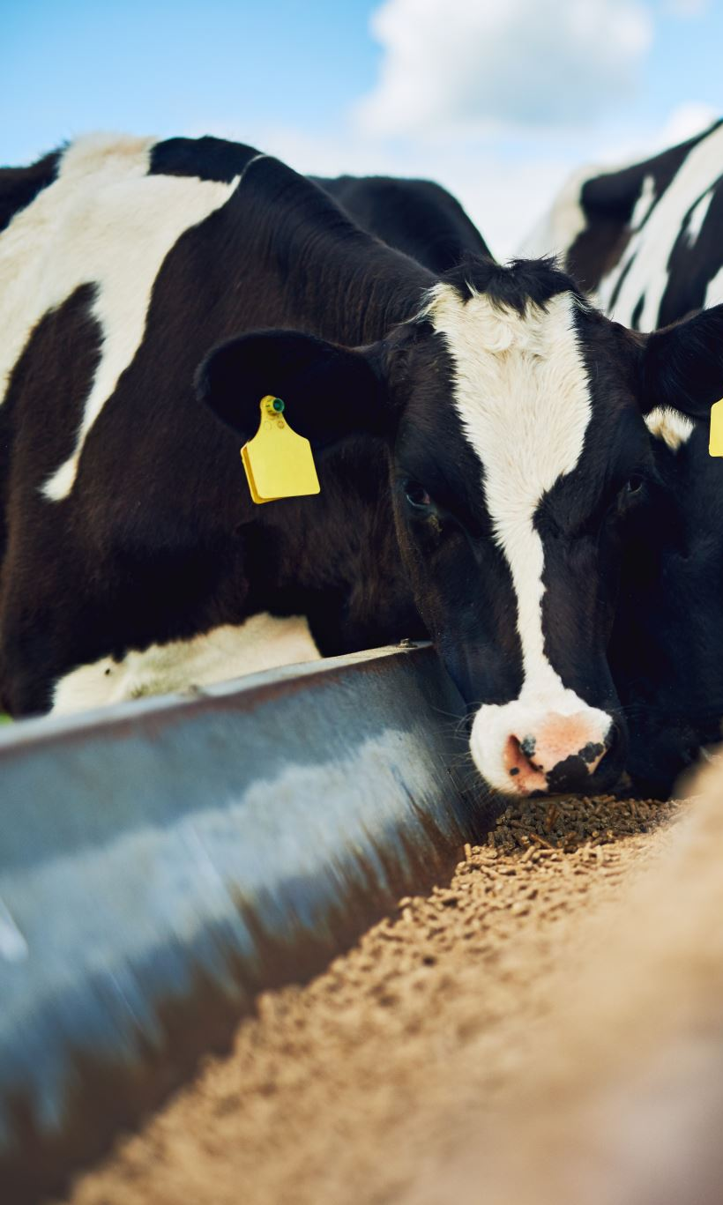
Project Approach
Overall challenge
Increased production with fewer raw materials for an improved impact on society, animals, climate and biodiversity.
dAIry 4.0 addresses current challenges by combining AI, Data and Robotics solutions to upgrade the Automated Milking Systems (AMS) capabilities with measurable results to be demonstrated through real-world use cases.
Overall solution
dAIry 4.0
3

Slide 4

Project Objectives
animal status classifier
actuation modules
Decision Support System (DSS)
validation & demonstration
uptake of the technology
Development of an improved AI-based module using multi-source information for classifying the cows at individual animal level.
Upgraded modules for individualized milking, feeding and partitioning of milk for further optimization of the Voluntary Automated Milking System (AVMS).
A novel DSS to be developed for enabling stakeholders to track, monitor and control parameters for high level farm goals.
Initial tests within R&D facilities and Complete system validations within six farms to test the system in real-world scenarios.
Wide-scale and audience-specific communications to demonstrate the value of project outcomes.
dAIry 4.0
4

Slide 5
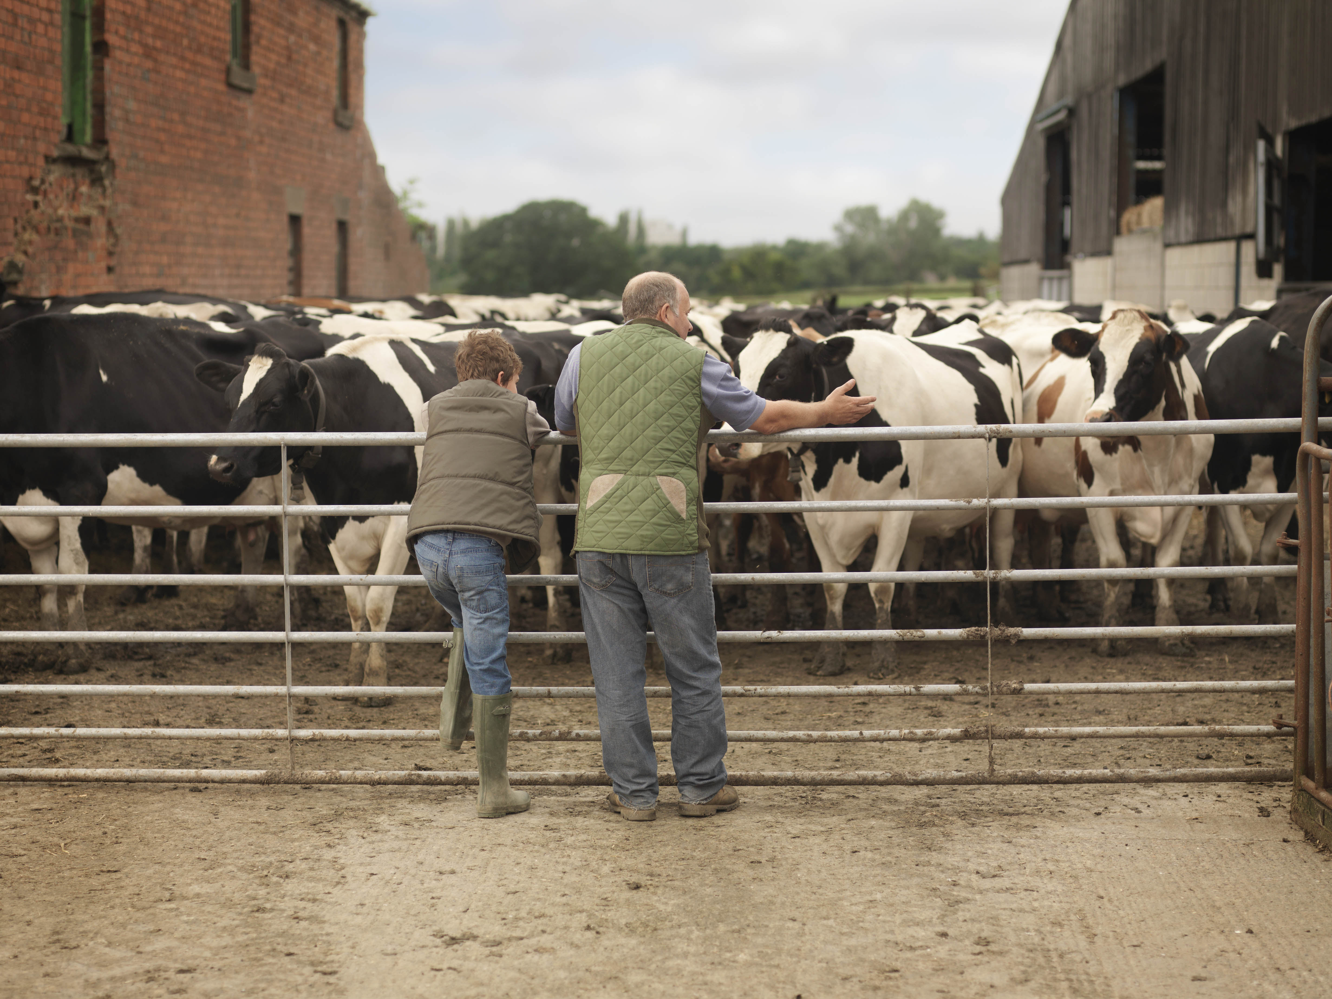
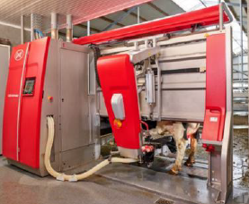
Expected Outcomes
outcome 1
Development of hardware modules including the novel milk analyzer based on mid-IR spectroscopy, new modules for visual inspection and updated modules for individualized milking, feeding and milk partitioning. All to be integrated together for an upgraded AVMS.
Extend current capabilities of existing data management platform with the development of a novel DSS based on new simulation models, where a digital twin of a farm will provide individualized decision support for stakeholders.
outcome 2
dAIry 4.0
5

Slide 6
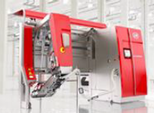
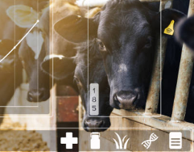

Validation & Demonstration: Use Cases
Initial testing phase
For the initial testing period, the new hardware and software modules will be tested within R&D facilities of project partner LELY to ensure successful integration of all components and required data analysis is achieved.
Actual validation phase through real-world scenarios
In total 6 farms will be used for the validations (located in the Netherlands) already collaborating for R&D activities relevant to AMS robots will be included to demonstrate the overall solution with different cow breeds, different farm sizes, feed ratios and other differing factors.
dAIry 4.0
6

Slide 7
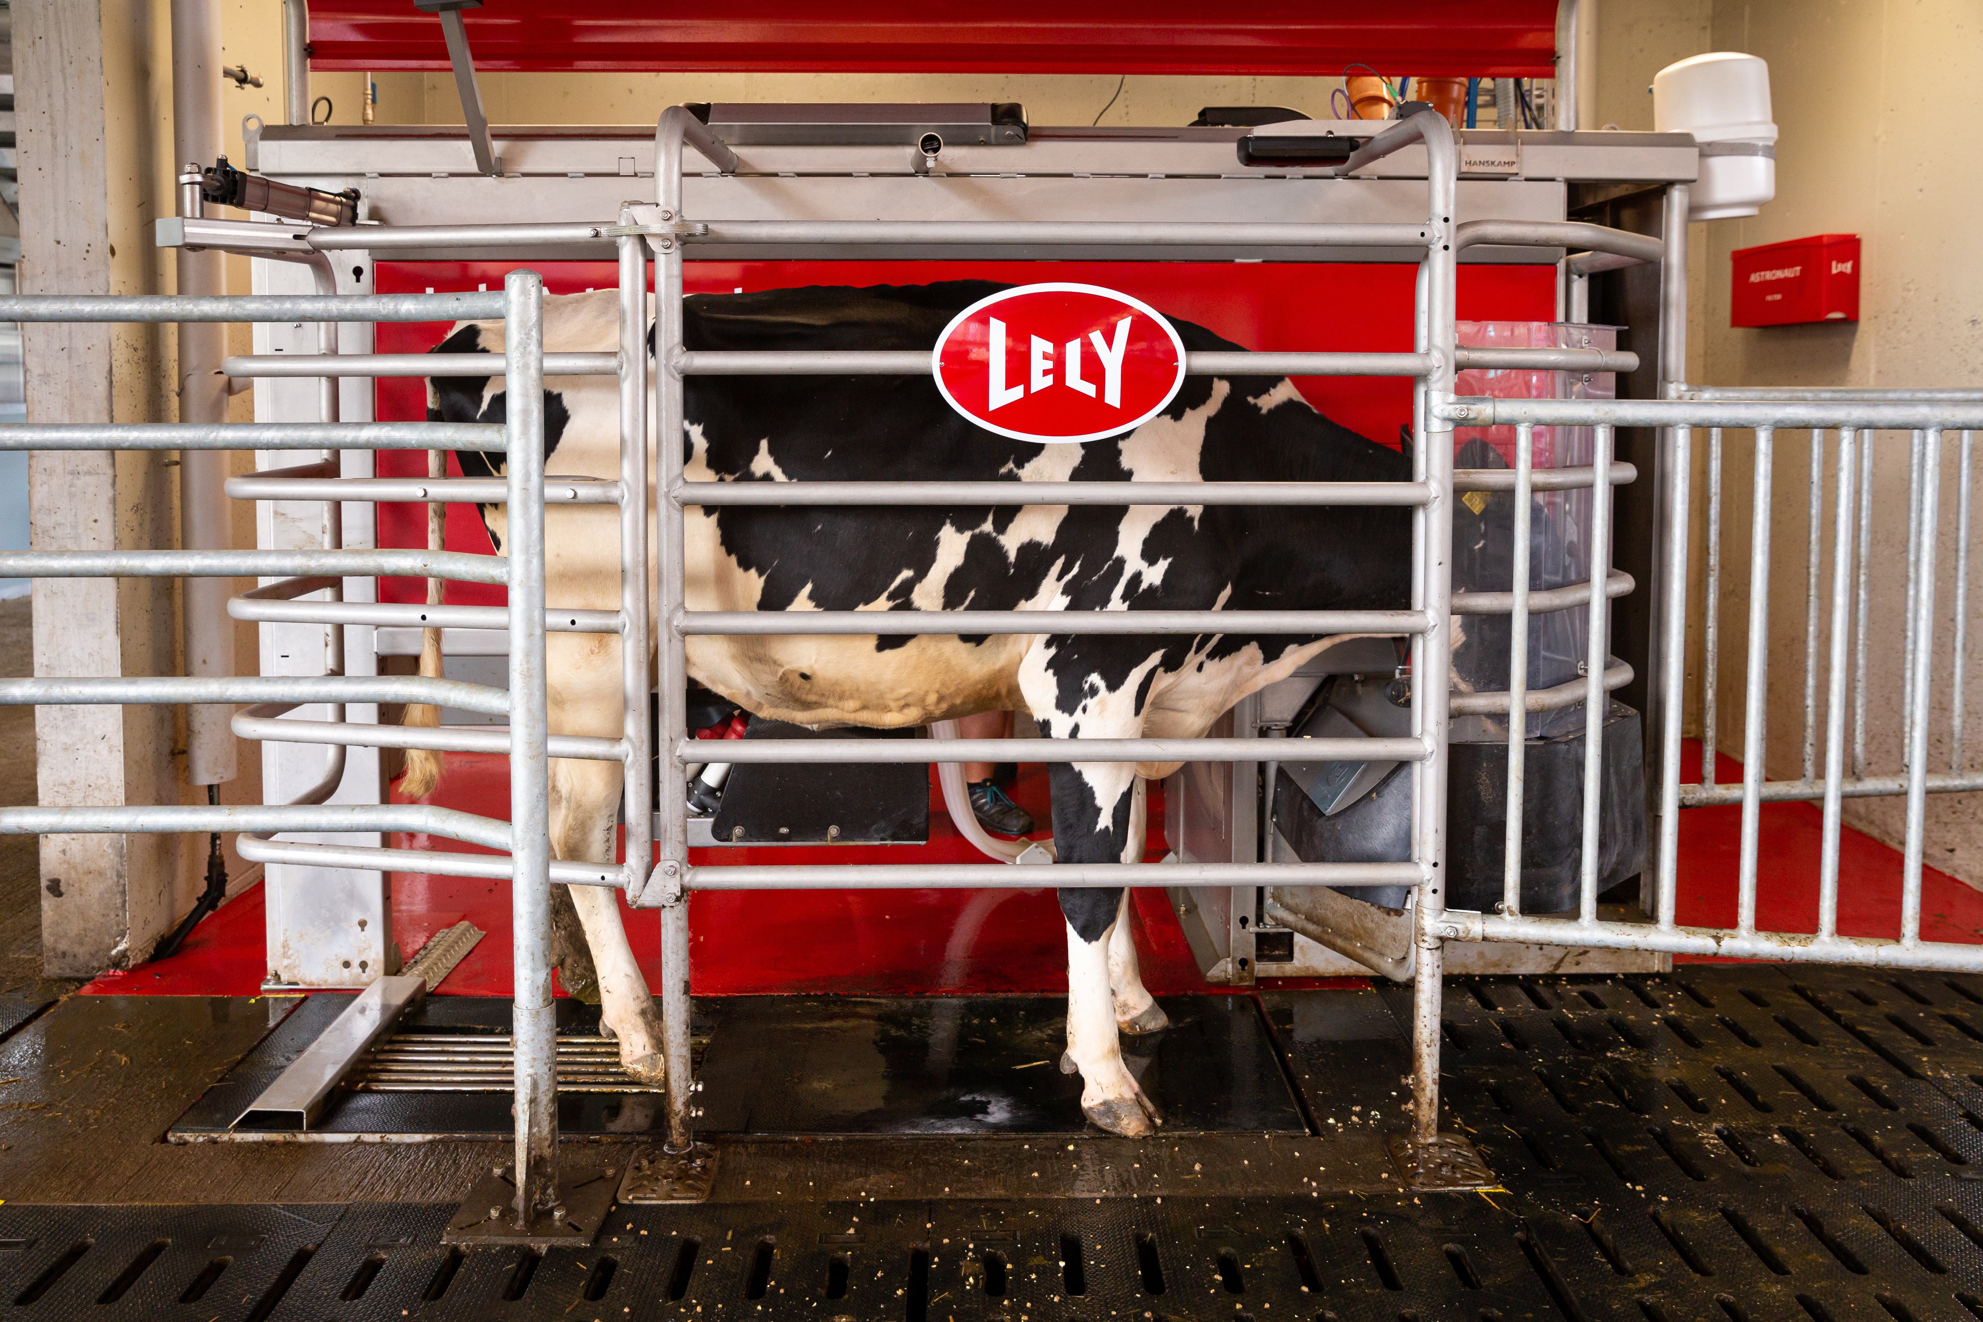

dAIry 4.0 approach
Vision module
Mobile lab milk quality analyser
Milk partitioning module
Milking module
Feeding module
Gating module
Animal Status Classifier
Decision Support System
Simulator
Digital Twin of the farm
dAIry 4.0 cloud platform
LELY Astronaut A5 Next
Eye Temperature
Body Condition Score
Rumen motility
Udder Health
Rumen motility
BCS
Udder/teats health
Eye Temperature
Milk Quality
Health Indicators
Predictions
Vision Module
Overall animal classifier
Input data
Machine learning models
Milk quality analysis
Explanations
LELY’s Horizon
Explainable AI
Third party API
dAIry 4.0
7

Slide 8
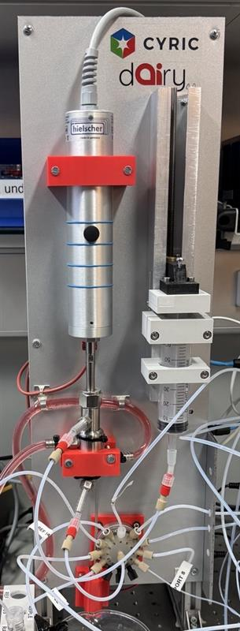
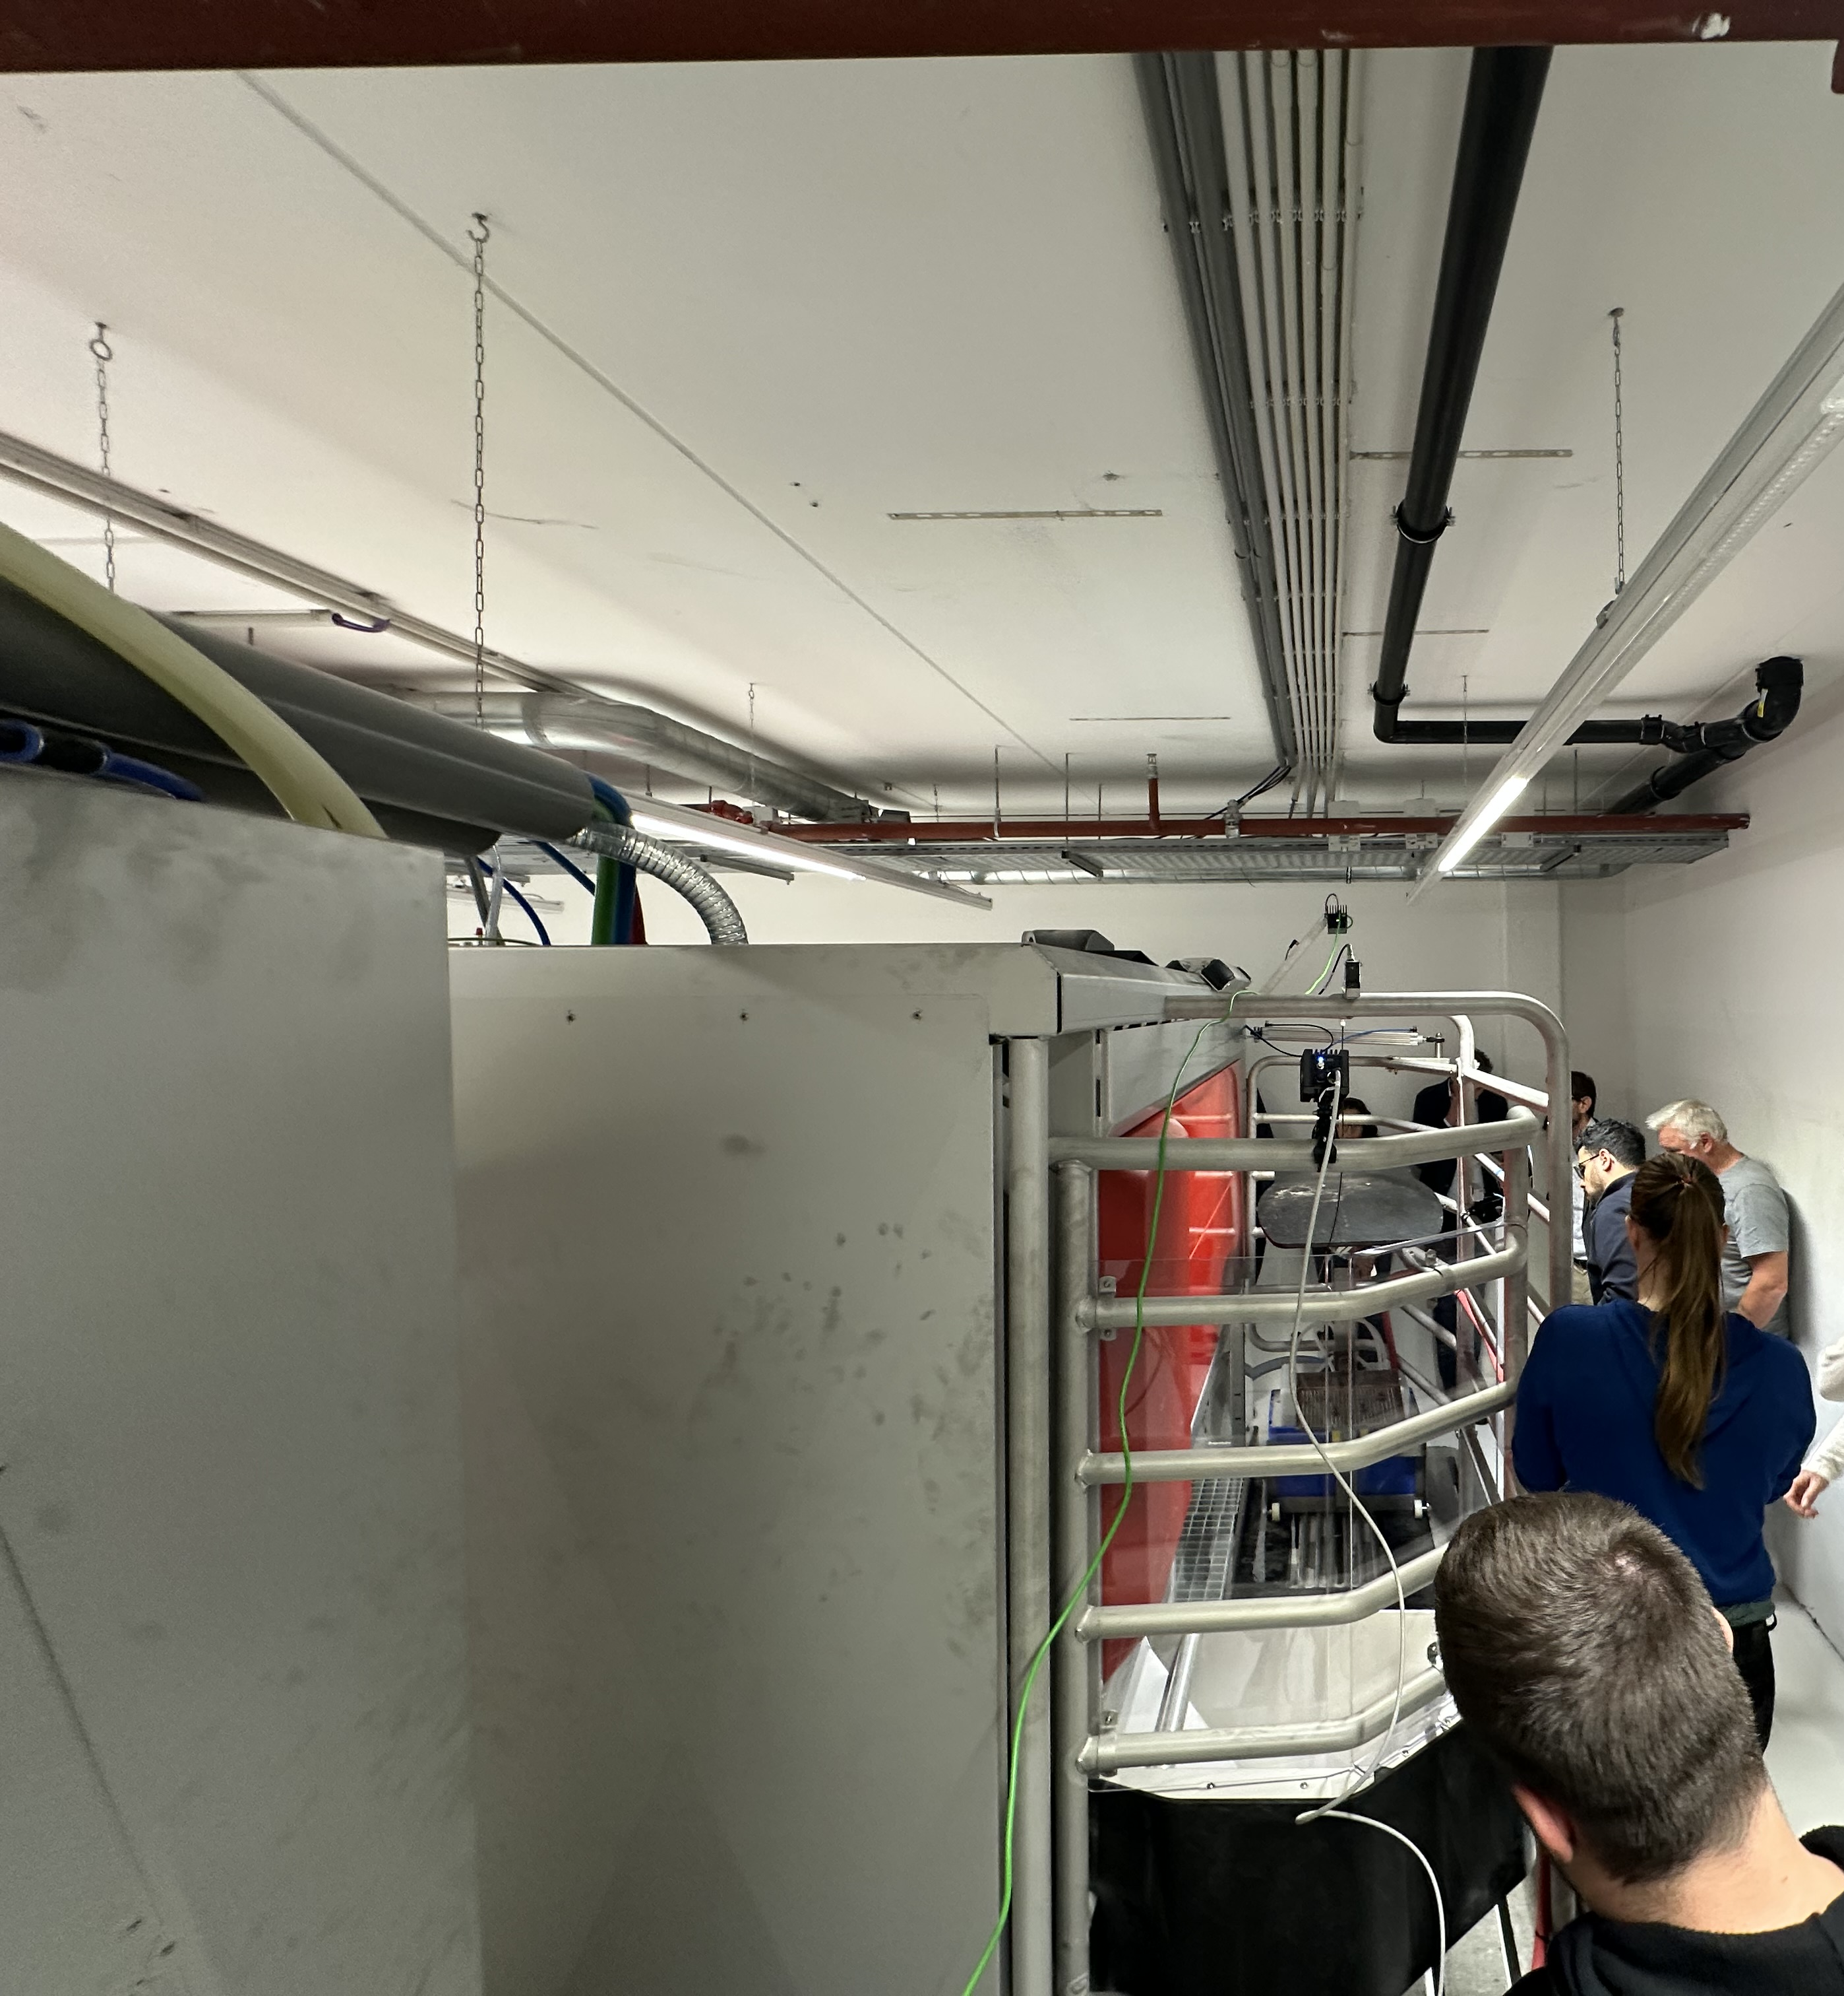
Results
Balanced Detector
First integration of the vision module on a lab prototype (controlled environment)
Preliminary classification rules were established, categorizing cows
Initial internal experiments showed promising accuracy (~95%) in vision submodules
New milk partitioning module (filtration based on a syringe filter-based device for milk filtration and sonication)
Lab validation of the milk analyser (confirmed feasibility of reaching analysis time target <3 minutes
The cloud-based data platform is operational, handling real-time and historical data streams with API getway
Synthetic data validation demonstrated reliable risk detection and recommendations within <5 minutes
Indiviualised milking, feeding, gating control and milk partitioning modules were delivered in their first versions
Milking parameters were optimized, and feed efficiency calculations were demonstrated
Sensor Housing
EC-QCL
Flow Cell
dAIry 4.0
8

Slide 9
Results (dAIry 4.0 cloud platform)
System Architecture
Initial integration with Lely 3rd party APIs
Multi-user access
Technology stack selection
Modules Integration
System Field Testing
Initial integration with DSS, Simulator, Feeding module
Finalize integration with all related modules
Preliminary testing of the dAIry 4.0 cloud platform
Foundational framework of the project
Platform documentation through Open API Documentation (Swagger)
Establish the initial link with Animal Status Classifier
Further integration with Lely 3rd party APIs
Entire system evaluation and validation
Overall system monitoring
Field testing of the dAIry 4.0 cloud platform
dAIry 4.0 Cloud Platform includes data from:
Farms: 6 Pilot sites in Netherlands
Animals: More than 11,000 - 1500 for the validations
Data Availability: Data for about two years, daily from March 2025
  Animal historical data also available
Detailed well-documented APIs
dAIry 4.0
9

Slide 10
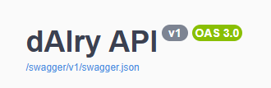
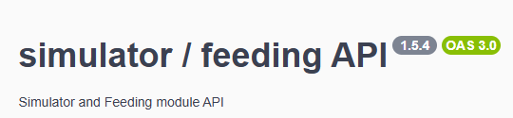

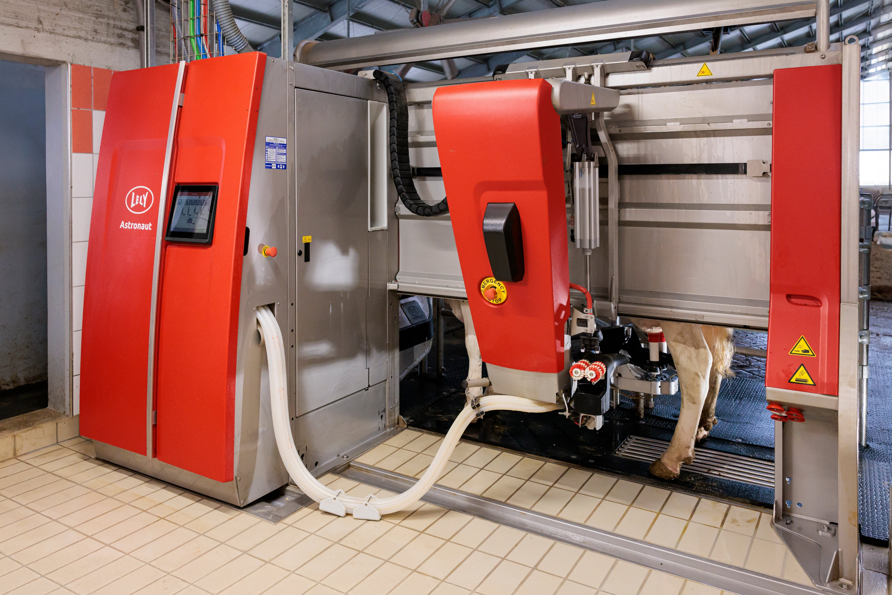
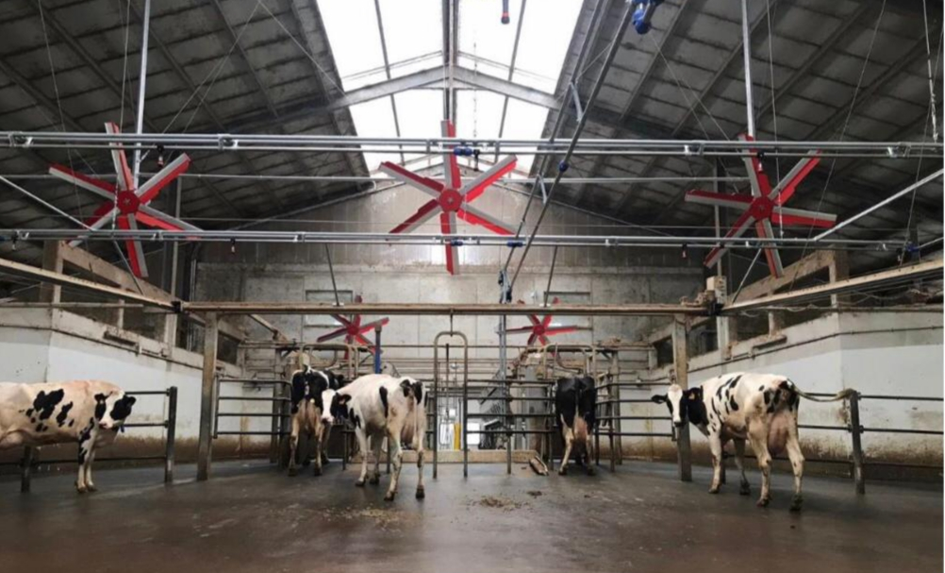
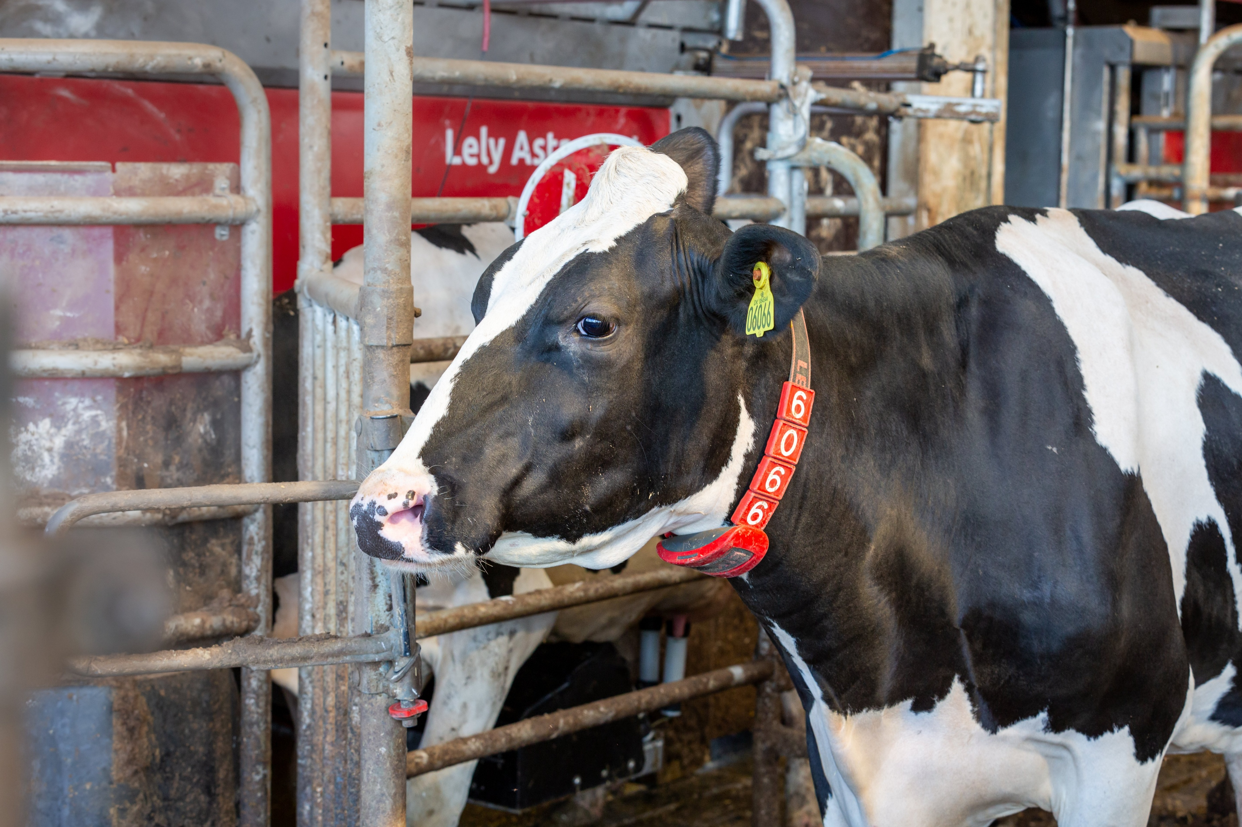
Results (Simulator)
Individual cow data
5 years projection
(farm economical analysis)
1. Farm expansion
2. Heat Stress mitigation
3. Enhanced heat detection
dAIry 4.0
10

Slide 11
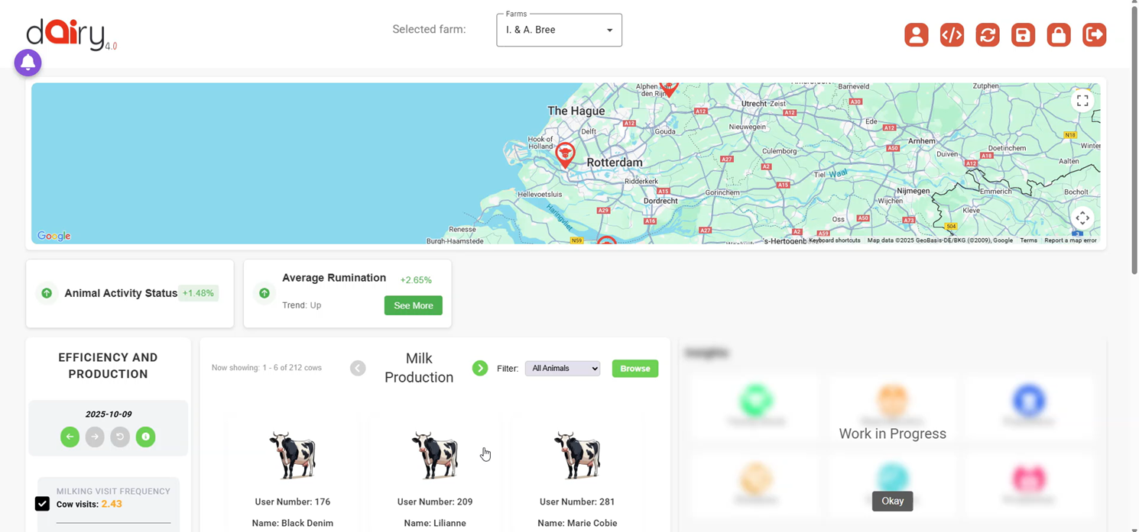
Results (dAIry 4.0 UI)
Efficiency and production
Milk production
Average rumination
Notification (and preferences)
Farm selection, interactive map
dAIry 4.0
11

Slide 12
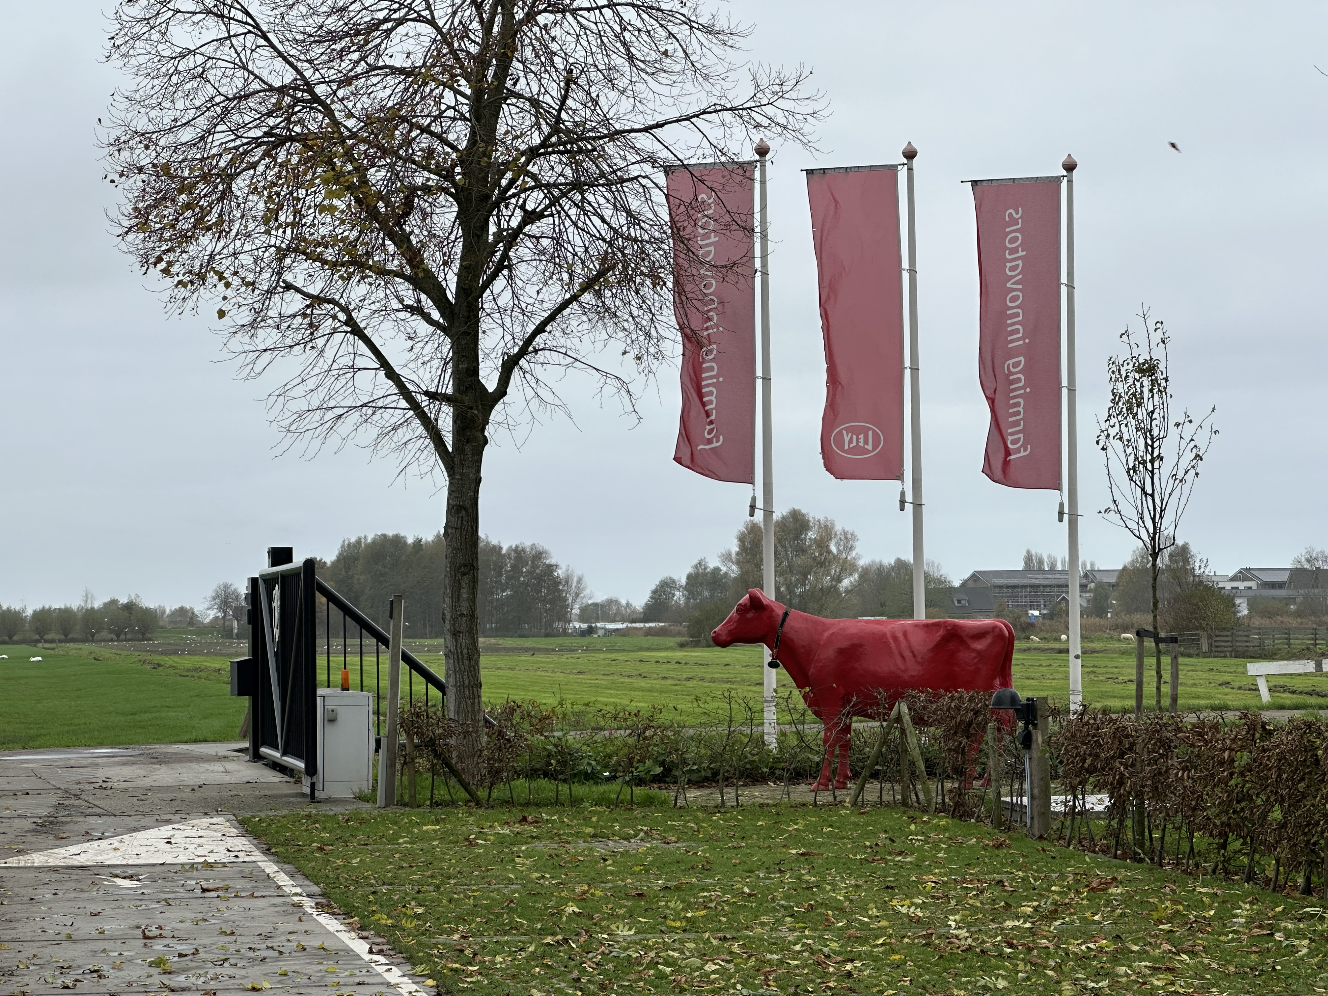
Future perspectives
Annotate and train more data to improve robustness for most of the modules
Integrate outputs of all modules with the DSS
Milk quality analyser (all modules to be integrated into the same device, same housing)
All these data and modules to feed the DSS and the dAIry 4.0 platform.
Integration of all submodules into the milking robot (AMS)
Start validation phase in 6 pilot farms.
  dAIry 4.0 platform
  Vision submodules
  Milking, feeding, gating modules
  Mobile lab for milk quality analysis
  DSS, Simulator, Digital Twin
From validated components to deployable systems.
dAIry 4.0
12

Slide 13
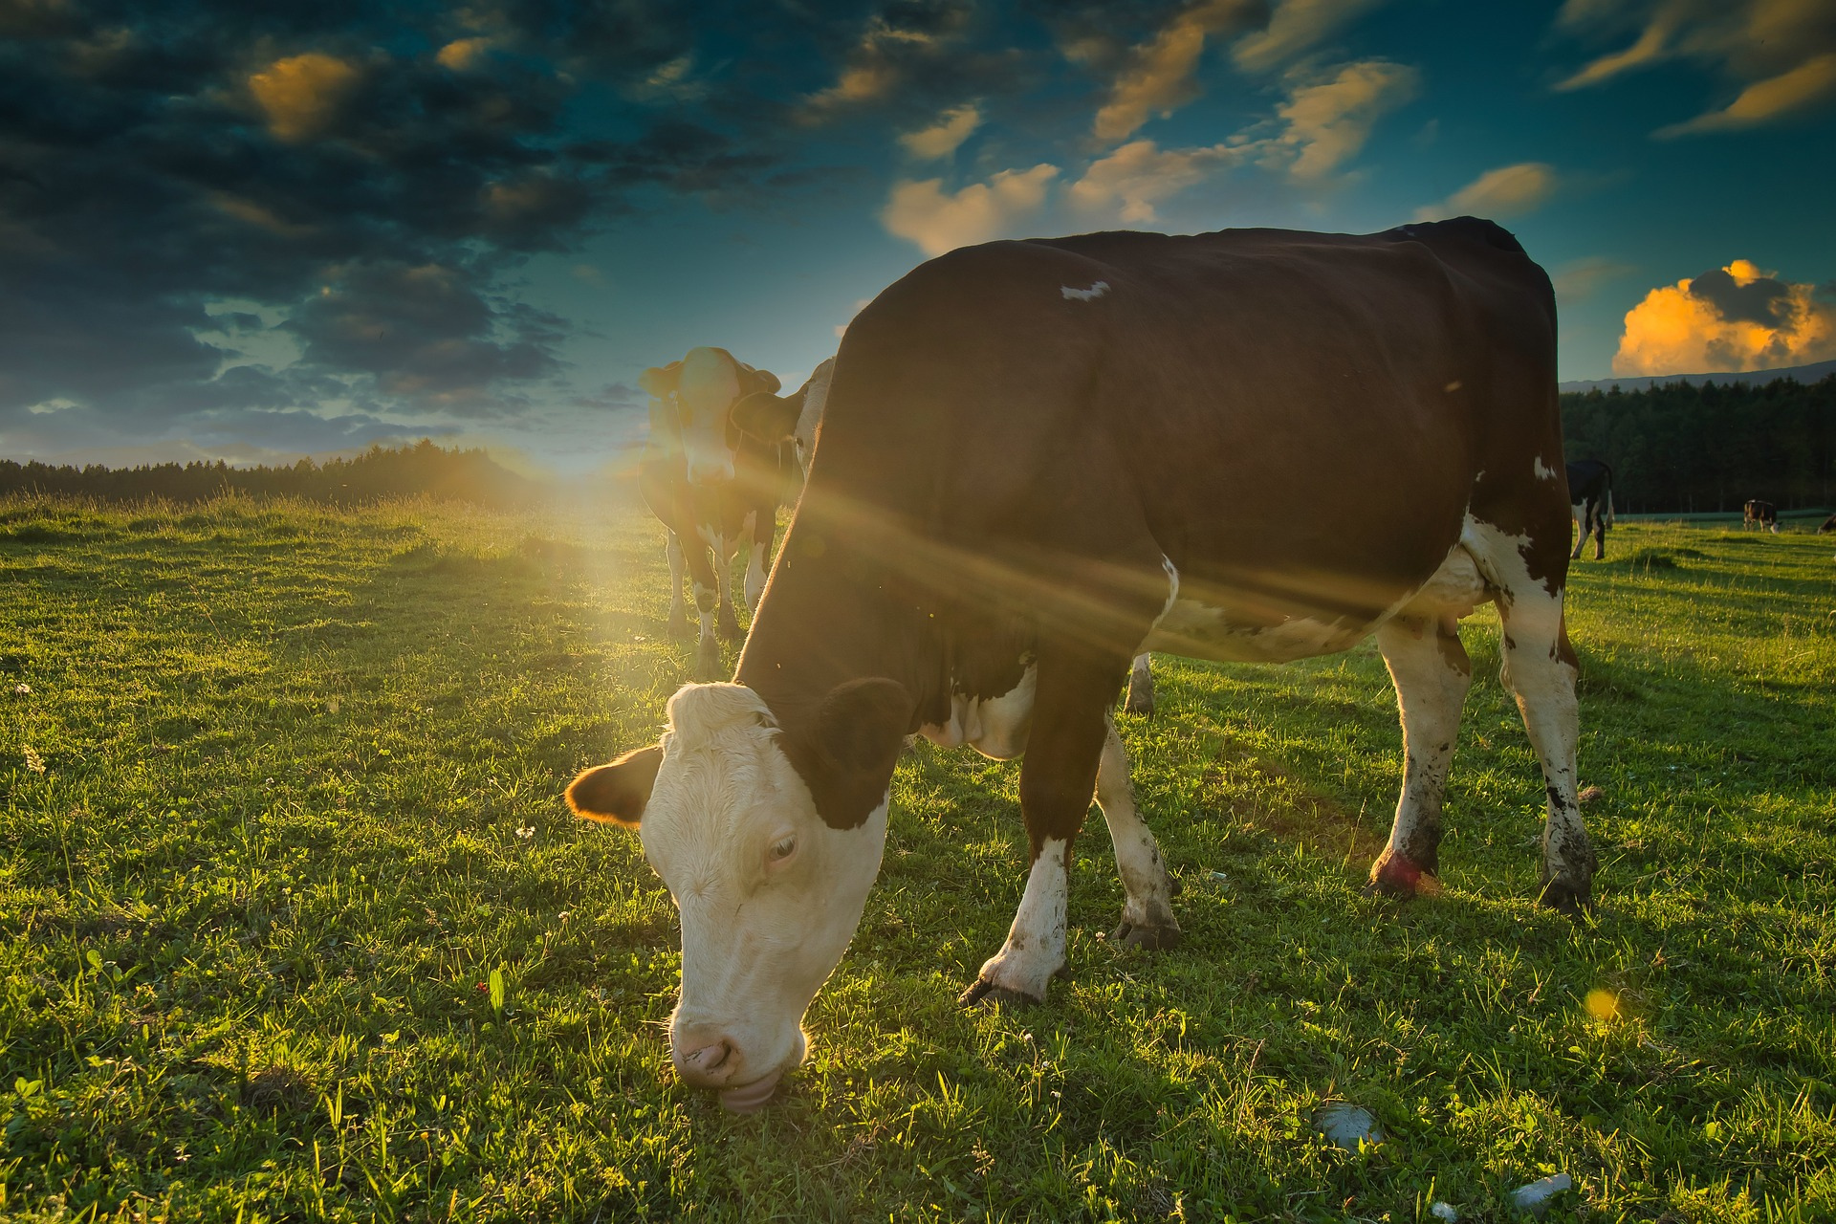



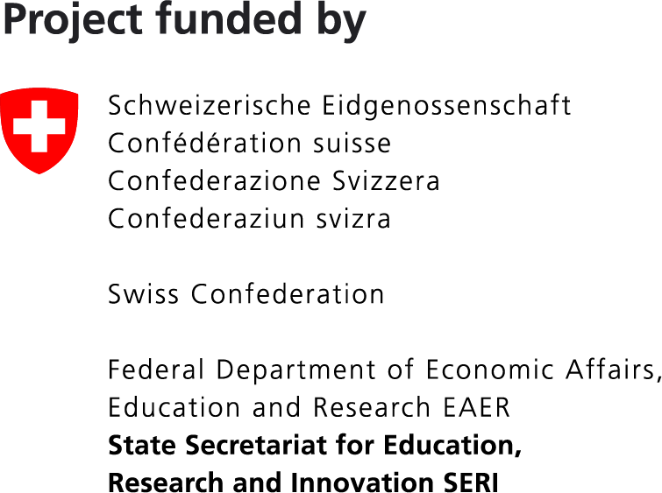

For more information, please contact:
Email: info@dairy40.eu
Website: https://dairy40.eu/
https://www.linkedin.com/company/dairy40
https://www.facebook.com/dAIry40
https://www.youtube.com/@dAIry4.0
Funded by the European Union. Views and opinions expressed are however those of the author(s) only and do not necessarily reflect those of the European Union or HADEA. Neither the European Union nor the granting authority can be held responsible for them.
This work has received funding from the Swiss State Secretariat for Education, Research and Innovation (SERI)

