Slide 1
roboTics and Artificial intelligence Living labs improving Operations in PV Scenarios
Daniel Albuquerque (EDP)
Project Coordinator
2026-04-16

Slide 2
Introduction

Slide 3
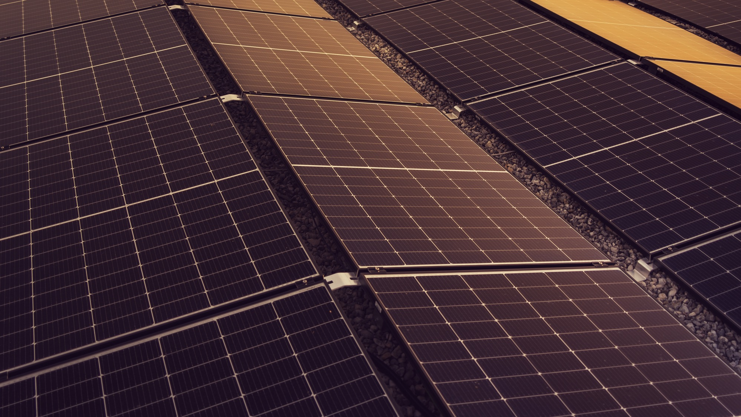
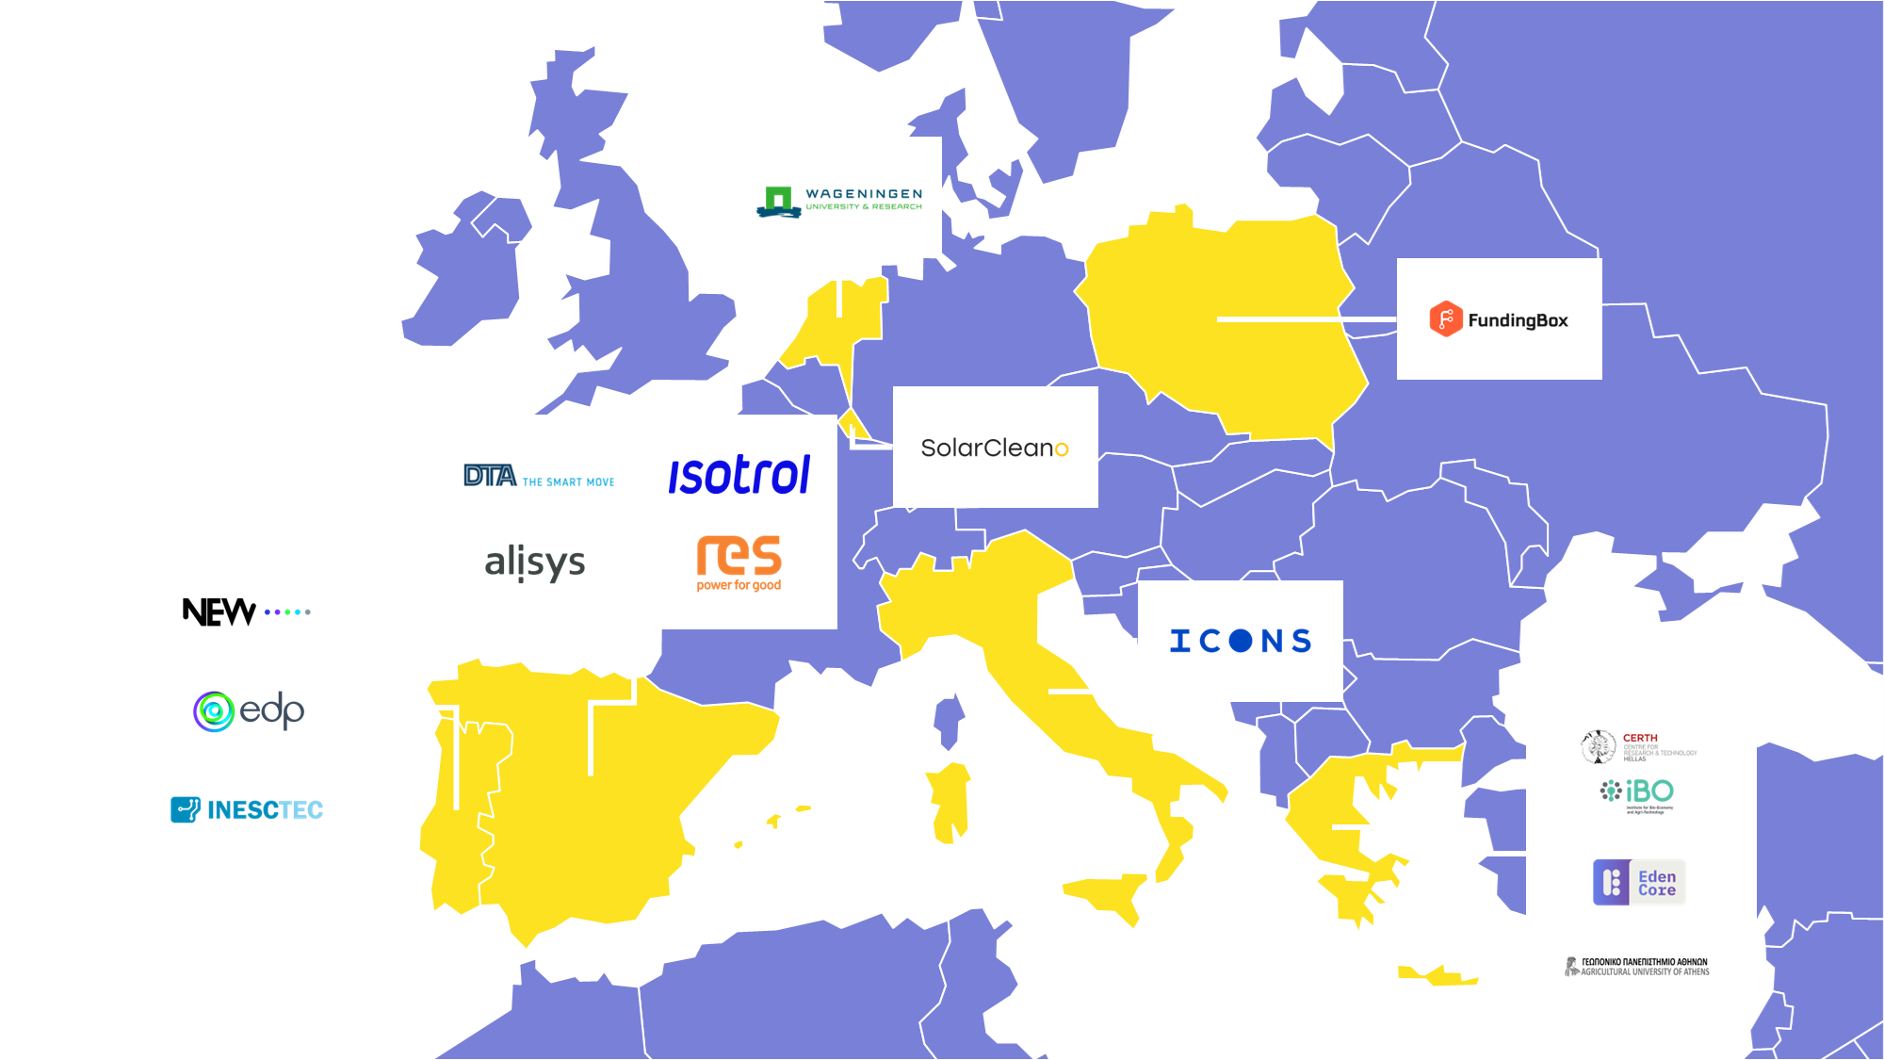

Scope
Start Date: October 2023
End Date: September 2026
Duration: 36 months
Budget: 10.5M€
Open Call: 1.8M€
TRL: 6-7 (by the end of the project)
What is TALOS?
Develop autonomous robotic and digital solutions to perform O&M tasks in PV plants.
Where will it be demonstrated?
Land-based PV
Floating PV
AgriPV
Which O&M tasks will be automated?
Monitoring
Inspection
Cleaning
Vegetation management
Crop management

Slide 4
Success stories

Slide 5
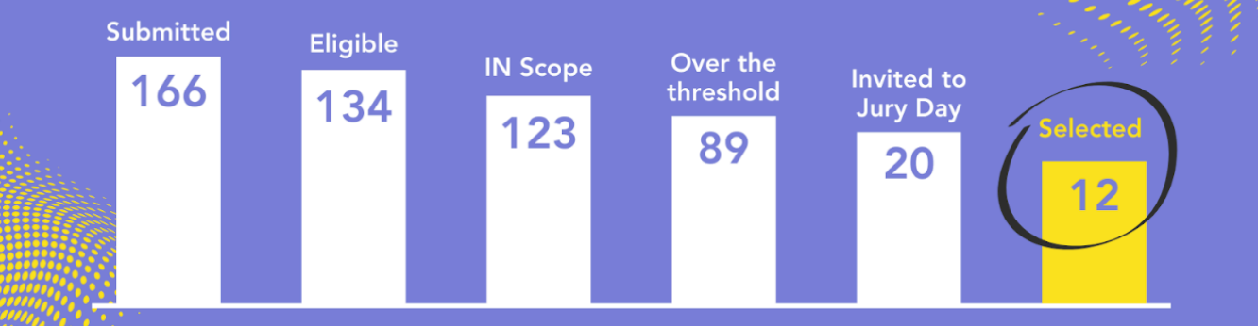
Success story #1 – Open Call (1/2)
Open Call ideation process started in an early stage of the project
Energy & Agri-food sectors jointly addressed
End user driven challenge definition
Strong coordination between FundingBox, ICONS, and EDP
Clear path from prototype to real pilots

Slide 6


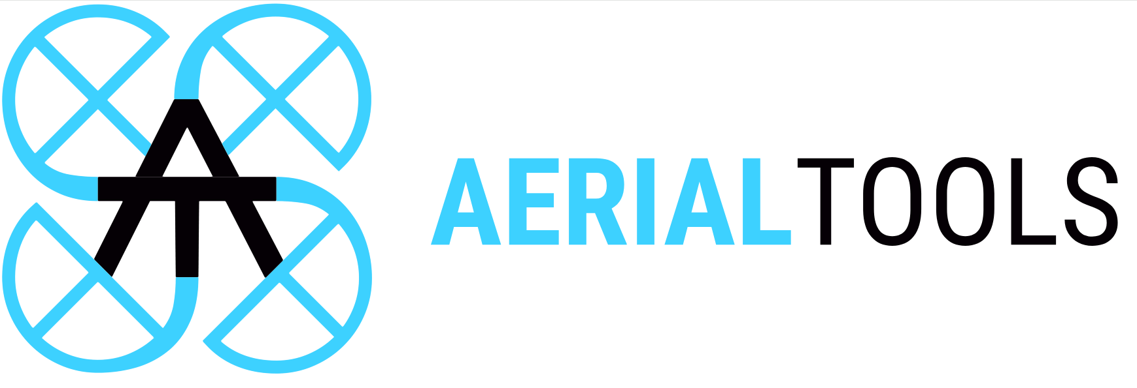

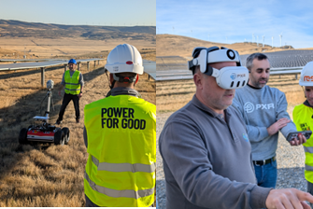
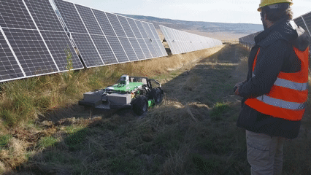
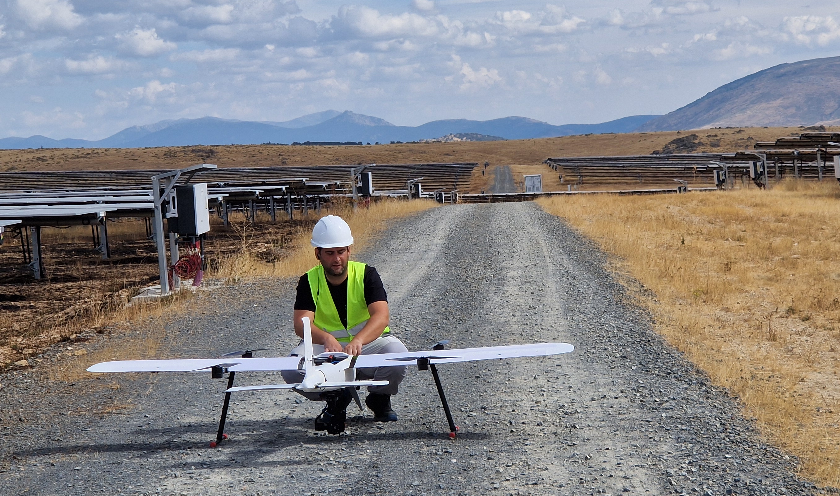
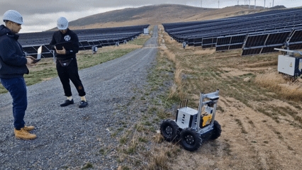




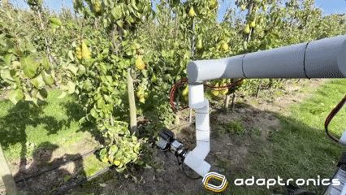
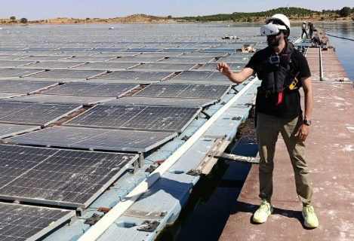
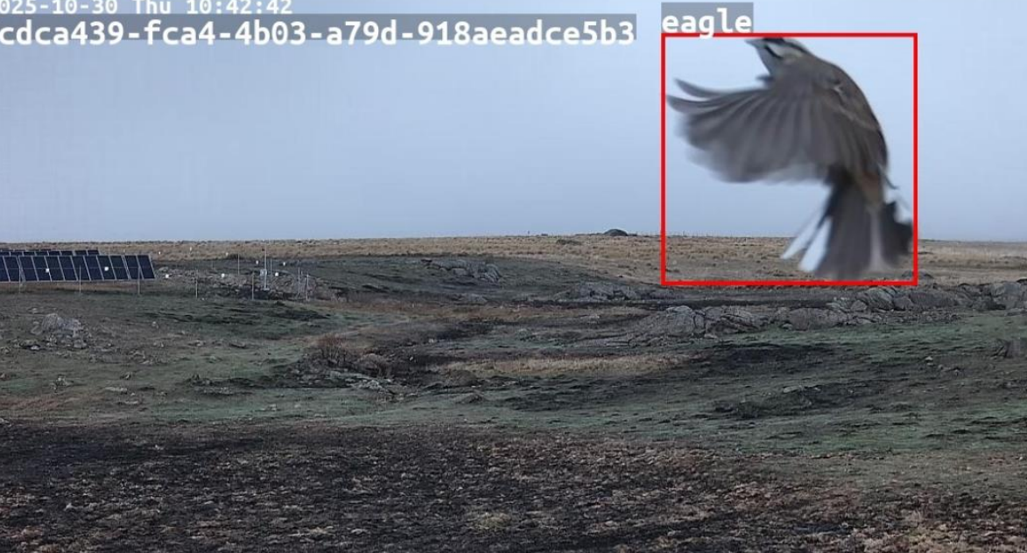
Success story #1 – Open Call (2/2)
Project: TERRA by
Solution: Immersive VR telepresence
Status: Validated
Quality of results:
Project: ARAVI by
Solution: Veg. manag. + Inspection
Status: Validated
Quality of results:
Project: BVLOS-RAISI by
Solution: BVLOS inspection
Status: Validated
Quality of results:
Project: PERCEIVE by
Solution: 3D reconstruction
Status: Validated
Quality of results:
Project: PVGrow by
Solution: Crop monitoring
Status: Validated
Quality of results:
Project: FRUITURE by
Solution: Crop harvesting
Status: Validated
Quality of results:
Project: CLARO-XR by
Solution: eXtended-Reality tool
Status: Validated
Quality of results:
Project: ATHINA by
Solution: Fauna intrusion monitoring
Status: Validated
Quality of results:

Slide 7
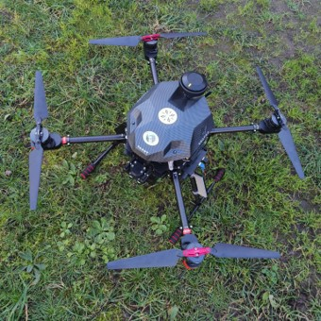

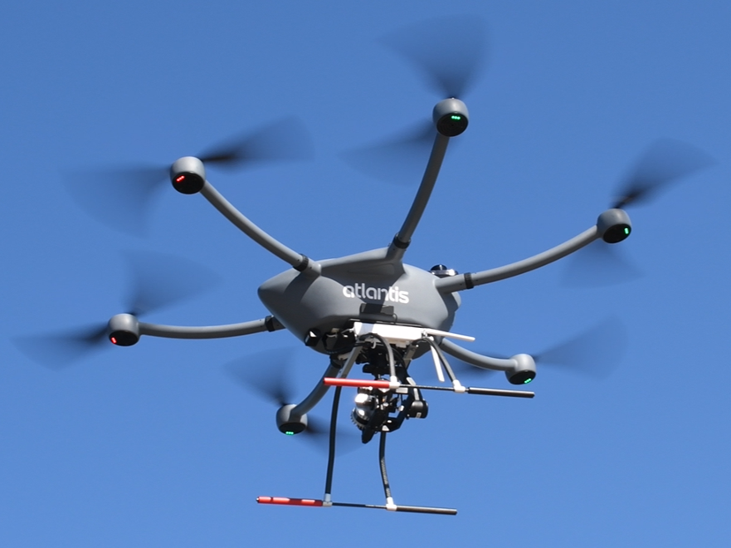
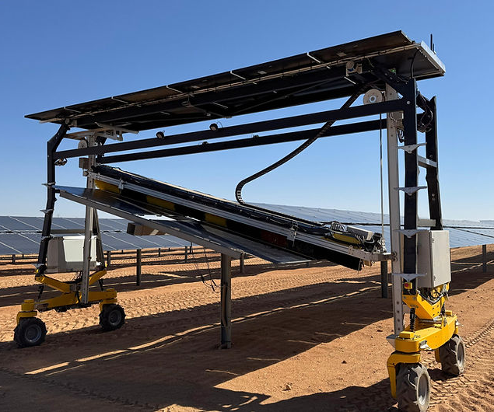
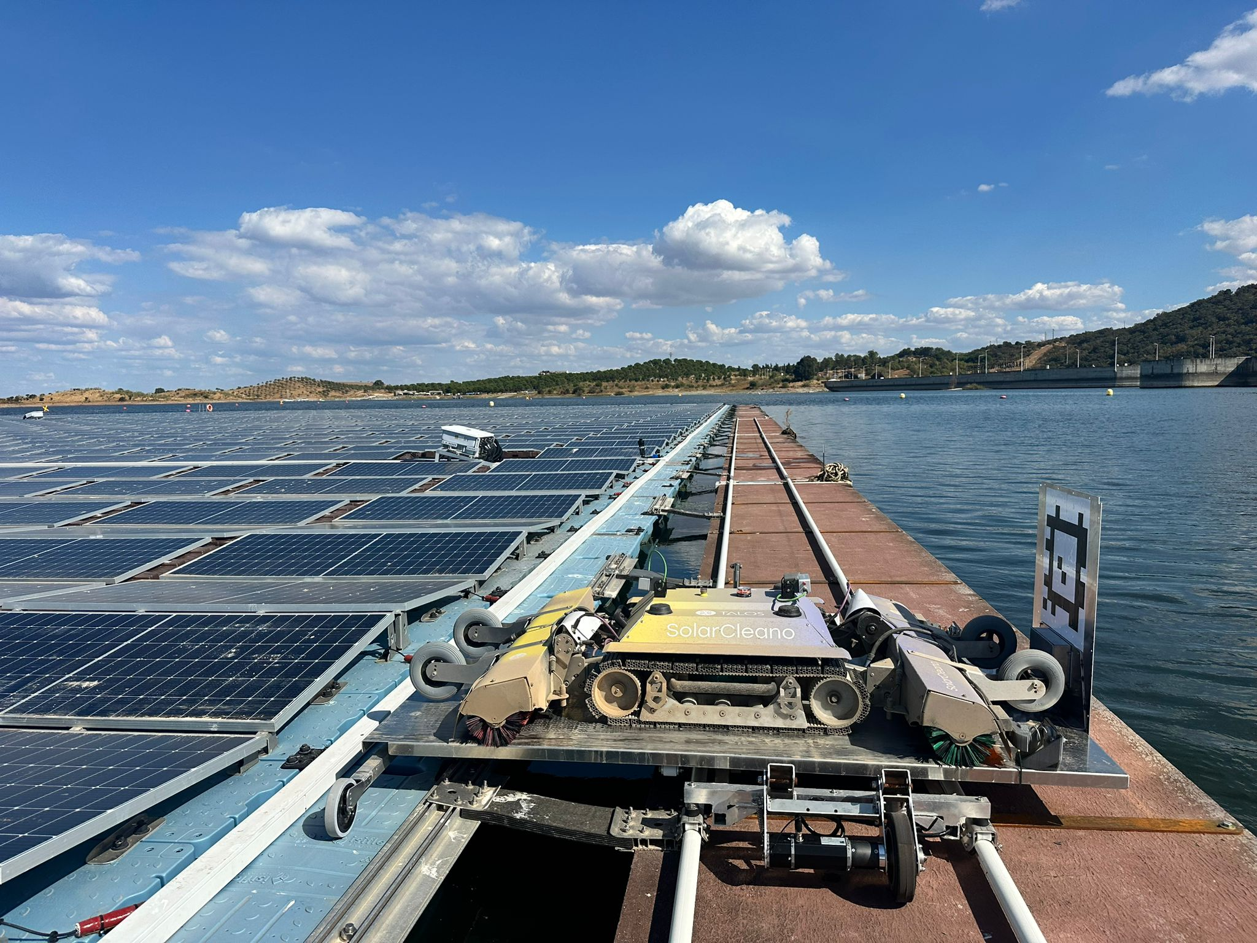
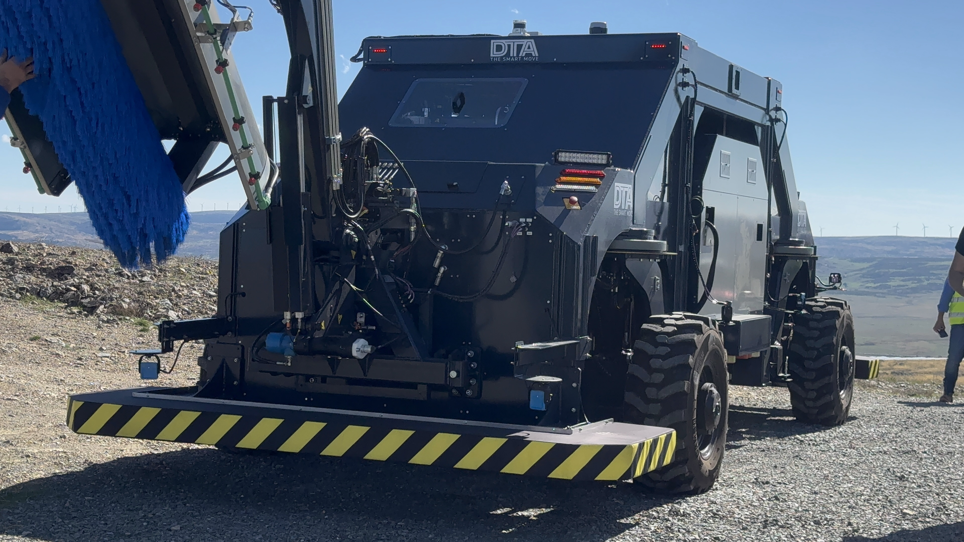
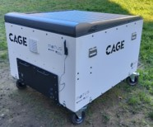
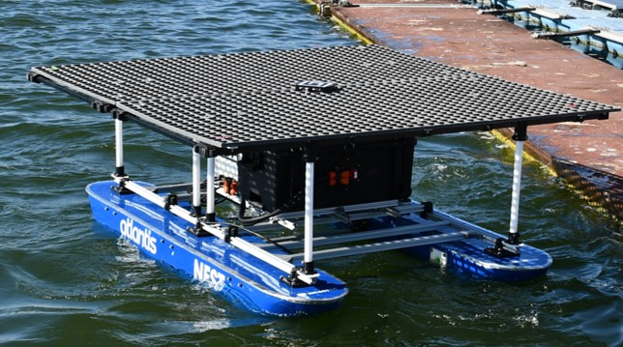
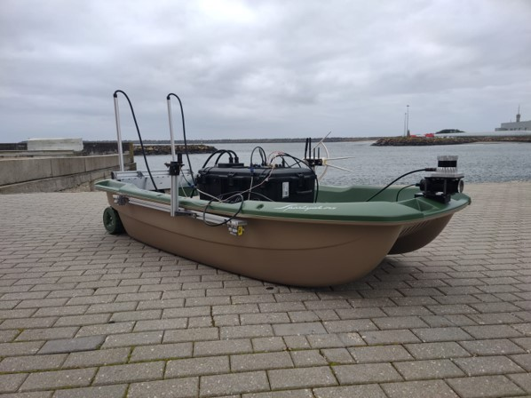
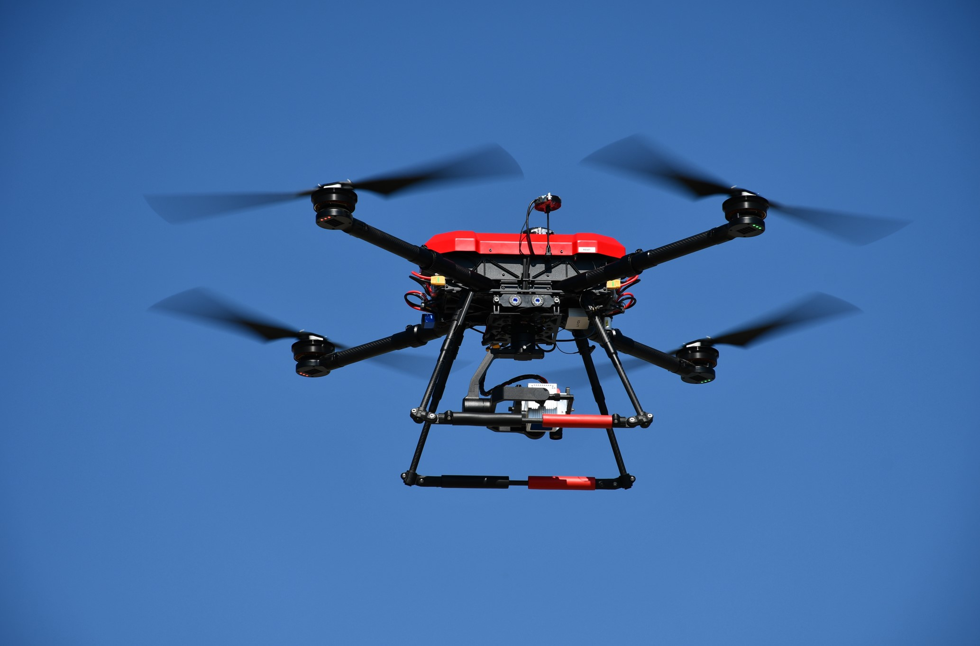


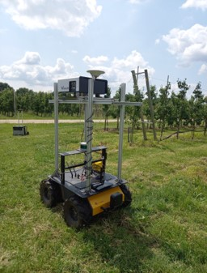

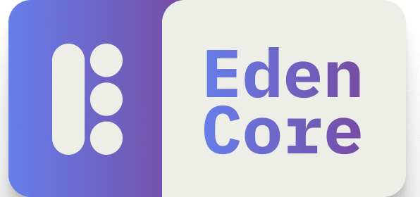
Success story #2 – Integrated ecosystem
Inspection
Cleaning & Mowing
TALOS ecosystem: 30+ solutions
12 robotic
>6 digital
12 from Open Call
Monitoring & Orchestration
Crop monitoring
Robot fleet management
AI-based anomaly detection
HiTL approach
SCADA integration
Smart charging
Digital Twins
Mission planning
TALOS UI Platform
AI recommendation engine

Slide 8
Call to action

Slide 9
Call to action
FSTP works — a proven best practice that should be expanded in future Work Programmes
Outdoor automation is the real frontier — PV farms push robotics beyond lab assumptions (connectivity, navigation, robustness)
BVLOS is a bottleneck — procedures must evolve to unlock European technology competitiveness
Dual land use can accelerate PV scale‑up — but energy‑food‑water trade‑offs demand deeper research
From R&I to uptake — TALOS results are now using CL4 proof‑of‑market mechanisms to create market-ready solutions

Slide 10
Thank you!
talosproject.eu
info@talosproject.eu
@Talos_EUproject
TALOS EU PROJECT

