Slide 1
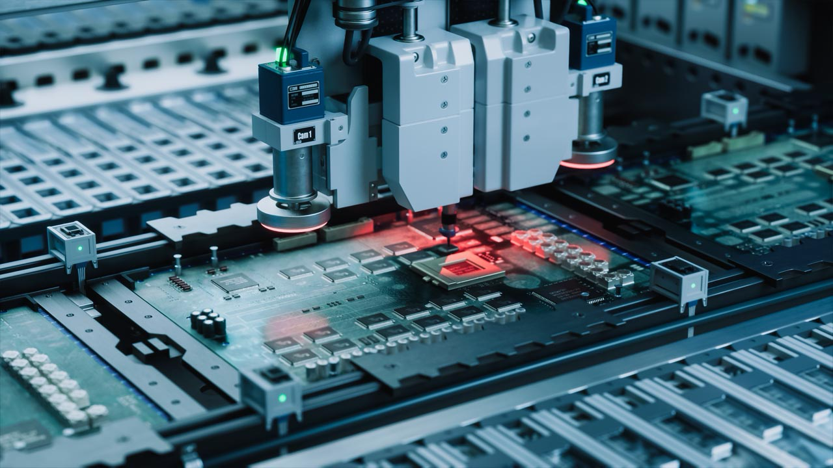








|

Slide 2
Cultivating ADR excellence. Bridging the gap to industrial impact.
Future-Ready 16 apr 2026

Slide 3
Standing at the Tech leadership
crossroads of

Slide 4
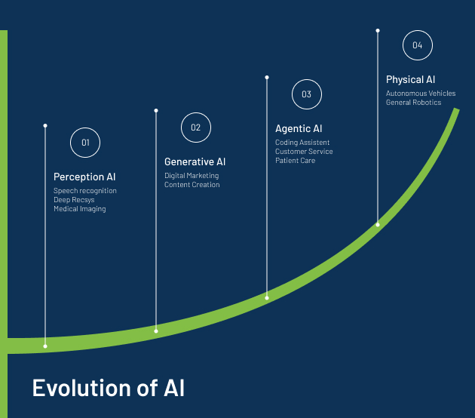
AI Trends
From uni-modal to multi-modal models
From next token prediction to reasoning
From machine learning to neurosymbolic AI
From chat to agents
From language models to world models
Notes:
While the world is slowly figuring out the potential uses and misuses of large language models, new breakthrough are already appearing on the horizon.
Companies are investing billions in developing new interfaces for foundation models.
The images on the left shows NVIDIA’s Isaac gym, reinforcement learning for robots and the image on the right, show a robot learning to manipulate objects using the GPT4 large language model and reinforcement learning.

Slide 5
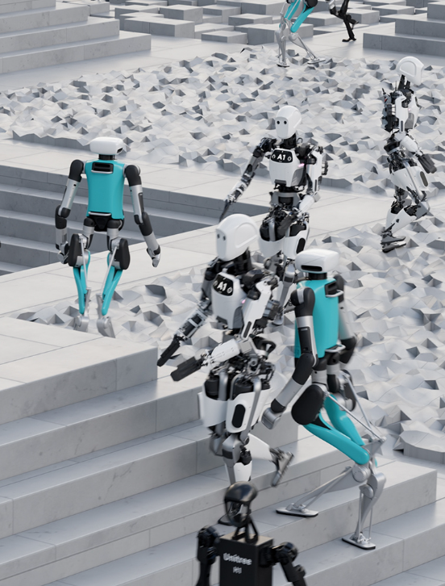

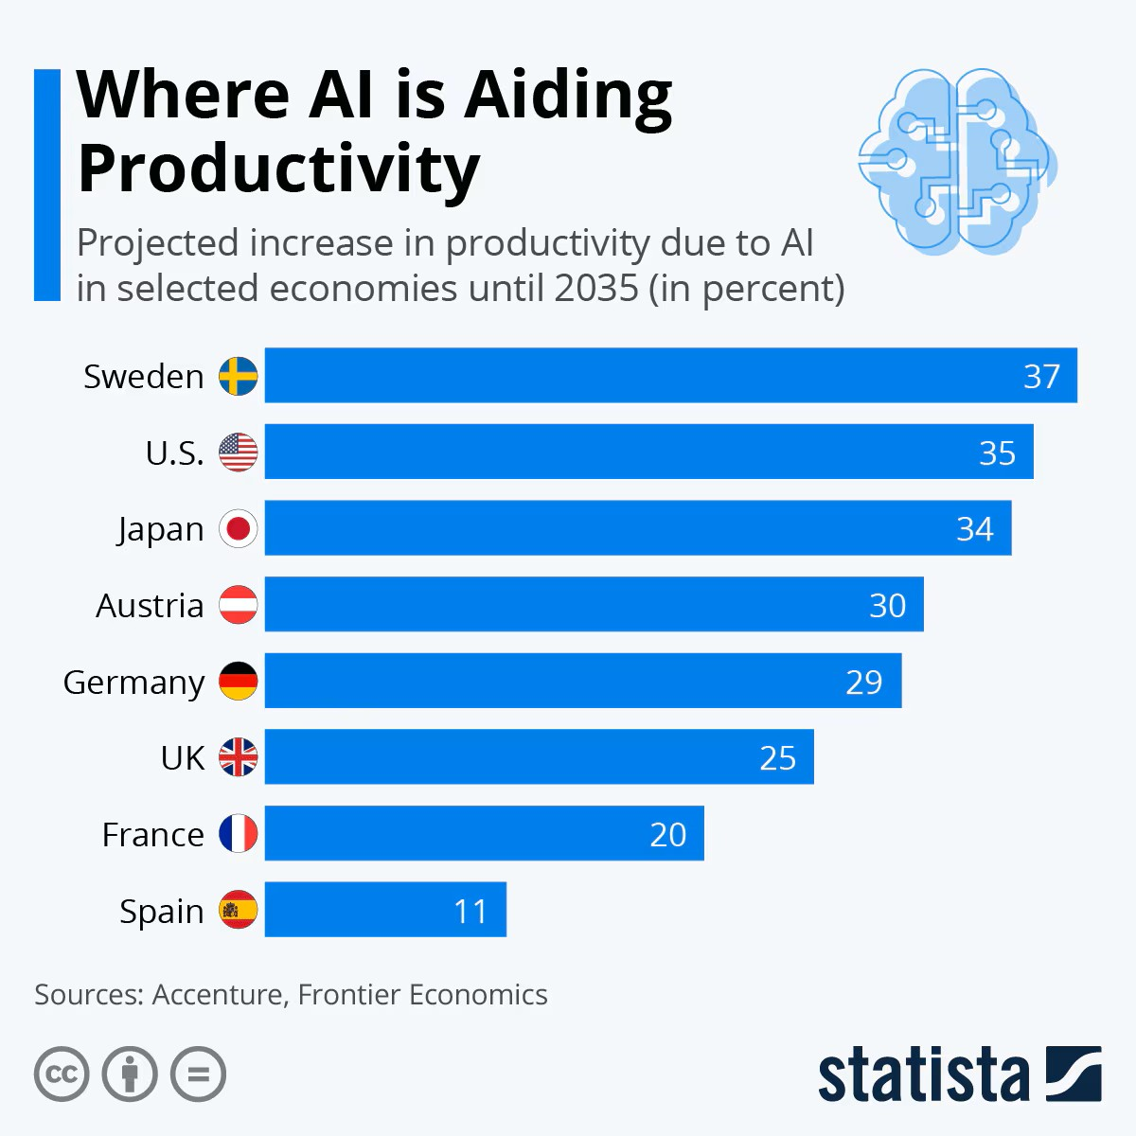
Notes:
While the world is slowly figuring out the potential uses and misuses of large language models, new breakthrough are already appearing on the horizon.
OpenAI, NVIDIA are investing billions in developing new interfaces for foundation models. The images on the left shows NVIDIA’s Isaac gym, reinforcement learning for robots and the image on the right, show a robot learning to manipulate objects using the GPT4 large language model and reinforcement learning.
Important because:
1. Technology trends across AI, Data, Robotics technologies are converging, meaning new applications are emerging all the time.
2. Research from companies such as OpenAI and NVIDIA are demonstrating innovations across the technology stack. Challenging existing paradigms and players in both robotics and AI.

Slide 6
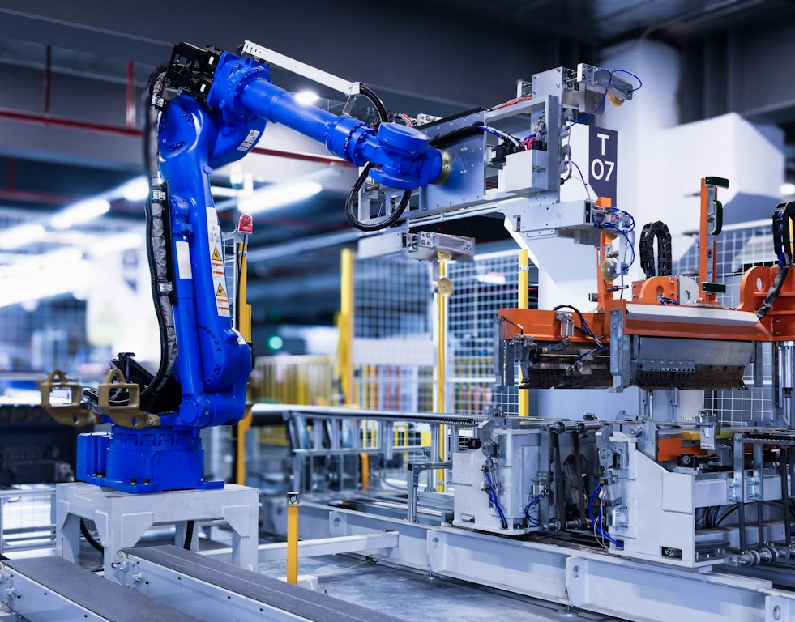
Vision Goals
Mission
Notes:
Adra has been build as a single poitn of contact for the European commission.
State: union or intersections. AI, Data, Robotics (AND/OR) go to Adra. Default, go to for any questions.
EC needs advisors. Effective messaging.
Clean up the machinery (effective instruments, bureaucracy)
Very important vision of bringing the three domains together. SOmethig brilliant. Bold - state the union. Very explicit in engendering interest from the MS.
WHy it is even more important today. (Mentioning Draghi’s report) – mentioned in second part. What we are doign next.
SHow graphically the community. Multi-stakeholder communities (research, industry, gov). Associated countries etc.
Challege how the framework programmes are managed – be bold.
10-15 ADR organisations around Adra that as a focal point we can support communication and simplify the landscape.
Explain what type of support we need and when we need it. Stimulate a desire to assist and help. CALL TO ACTION (What is in it for the MS?). This is about speed. Soon and decisevly, we will be acted upon. SOlutions orientated.
Part of something bigger. Support their national interests, their national champions.
Vertical/Horizontal. We help to filter insights coming up. Help them be the voice to express their interests.
Horizontally as a community.
Review the MoU and be clearer on what has been agreed. Delivered on our committements int he following ways...WHat we did and what we will do.

Slide 7

A united Community of Excellence
Single Point of contact: Adra is the EC’s primary partner for advancing AI, data, and rootics R&I in Europe
Integrated Network: Connecting AI, Data & Robotics expertise across Europe
Multi-Stakeholder Collaboration: Industry + Research + Academia + Government
Research Excellence: Europe’s top minds in ADR technologies
Industry Bridge: Transforming research into market solutions
Geographic Reach: Active presence across Member States
Rapid Mobilisation: Ready expertise for strategic initiatives
|
Notes:
By forming a high-speed pipeline from lab to market, we empower European researchers and developers to build world-leading ventures. As a strategic partner to both industry and the European Commission, ADRA directly support groundbreaking research and de-risk investment in disruptive technologies to secure Europe’s position in the global ADR race.
The European Union’s leadership in Artificial Intelligence, Data and Robotics innovation is pivotal for driving economic growth, digital sovereignty, and global competitiveness.
Adra want a vision for Europe in which the continent can lead in development and deployment of technology, where there is a seamless interaction between Human and technology. Where the interaction is safe and trusted.
This is a powerful vision, which require deep technology changes and the emergence of new, currently unavailable value chains in Europe and to do this.
To achieve this vision, the unification of ADR must be blended and create convergence across software and hardware.

Slide 8

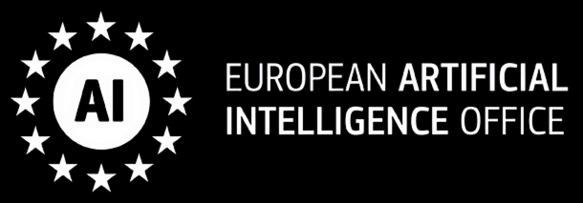
AI, Data and Robotics PPP (2021-2030)
European commission (Public side)
Adra Association (Private side)
Sovereignty
Industry
Research
Social Impact
Secure European autonomy in AI, Data & Robotics
Boost competitiveness through digital & green transformation
Achieve global research excellence
Drive solutions for climate, health, energy & security
Notes:
In order to solve these challenges, alignment between public & private sector is required and might be a third-way, in the context of these global challenges.
Adra was founded to be the private side of the public-private partnership with the Commision (now the AI office) by 5 associations, BDVA, eu robotics , and 3 AI associations Claire, ellis and EurAI. All associations are granted seats in the governance board.
The European Commission have committed to invest 1,3 Billion euros into research in this sector through its Horizon Europe program. This means the EU launches around 200 hundred projects in this sector. Almost 100 are already running. The private side commits to match this with an equal sum of investment.

Slide 9
SRIDA: ADRA’s Big ticket R&I priorities
Read the SRIDA
Ground-breaking technological foundations in ADR
Effective and Trustworthy General Purpose ADR
An interoperable and integrated framework for data and model ecosystems
Next generation smart embodied robotic systems
Developing ADR technology for the sciences
Research, innovation, and tools for compliance

Slide 10
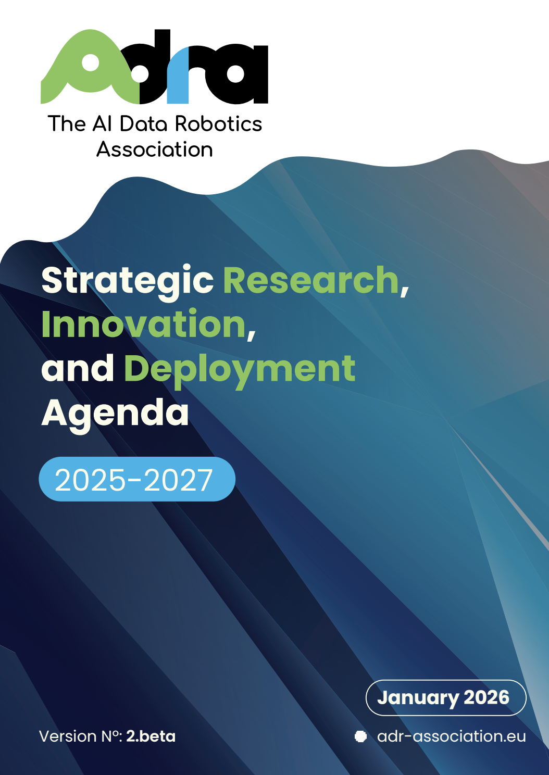
Read document

Slide 11
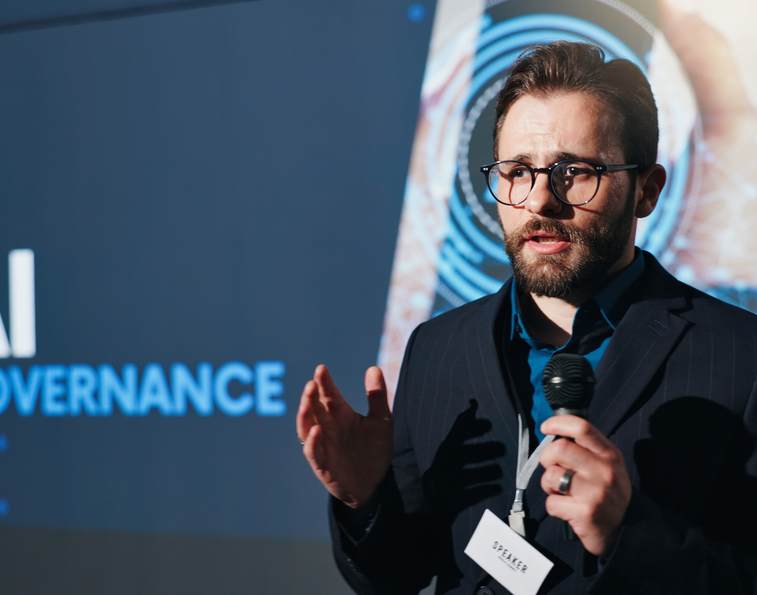
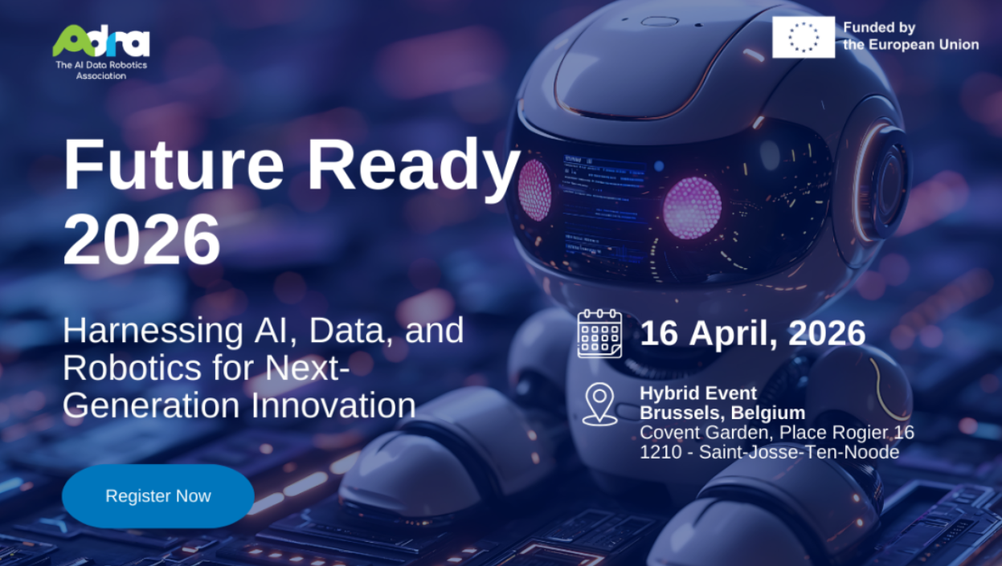
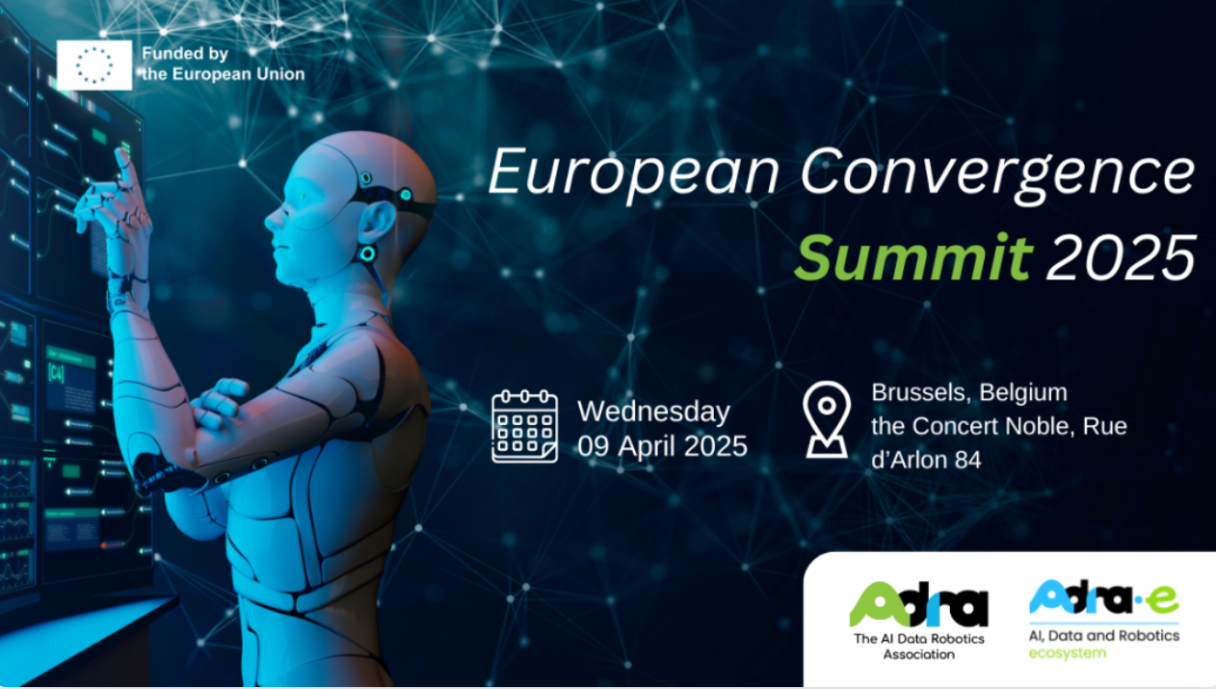
Key Events Shaping ADRA’s Ecosystem Engagement
ADRA’s key events connect the ecosystem and accelerate collaboration, innovation and strategic impact across Europe.
AI, Data & Robotics Forum (ADRF)
is a multi-stakeholder event exploring trends and priorities. ADRF is a deployment-oriented forum where the conversation is grounded in the real-world connecting end-users with with disruptive, bottom-up innovation.
Future Ready (FR) serves as a platform to showcase cutting-edge results, discuss key challenges, and unlock value. FR facilitates learning between successful projects, establishing space for collaboration, peer learning and scaling ideas.
European Convergence
Summit (ECS) is a high-level summit that connects ADR experts with policy-maker. The Summit moves beyond theory to blueprint an actionable DeepTech and industrial strategy for Europe
Notes:
ADRF: https://adrforum.eu/
Future ready: https://adr-association.eu/events/future-ready-demand-solutions-ai-data-and-robotics
ECS: https://adr-association.eu/events/european-convergence-summit-ecs-2025 Together, these events help ADRA build community, shape strategic discussions and drive meaningful progress in Europe’s AI, data and robotics landscape.

Slide 12

Align Accelerate
Act
5 Strategic pillars to enhance European competitiveness and productivity

Slide 13

1. Strategic Research Innovation and Deployment Agenda (SRIDA)
Foundation models are becoming both a commodity and critical infrastructure
Current dependency on non-EU technologies creates risks
Need for European values-aligned AI development
Establishment of ADR Research and innovation committee
From digital AI to physical AI
From automation to Human-AI teaming
Towards Cyber Resilient and Trustworthy AI
|

Slide 14
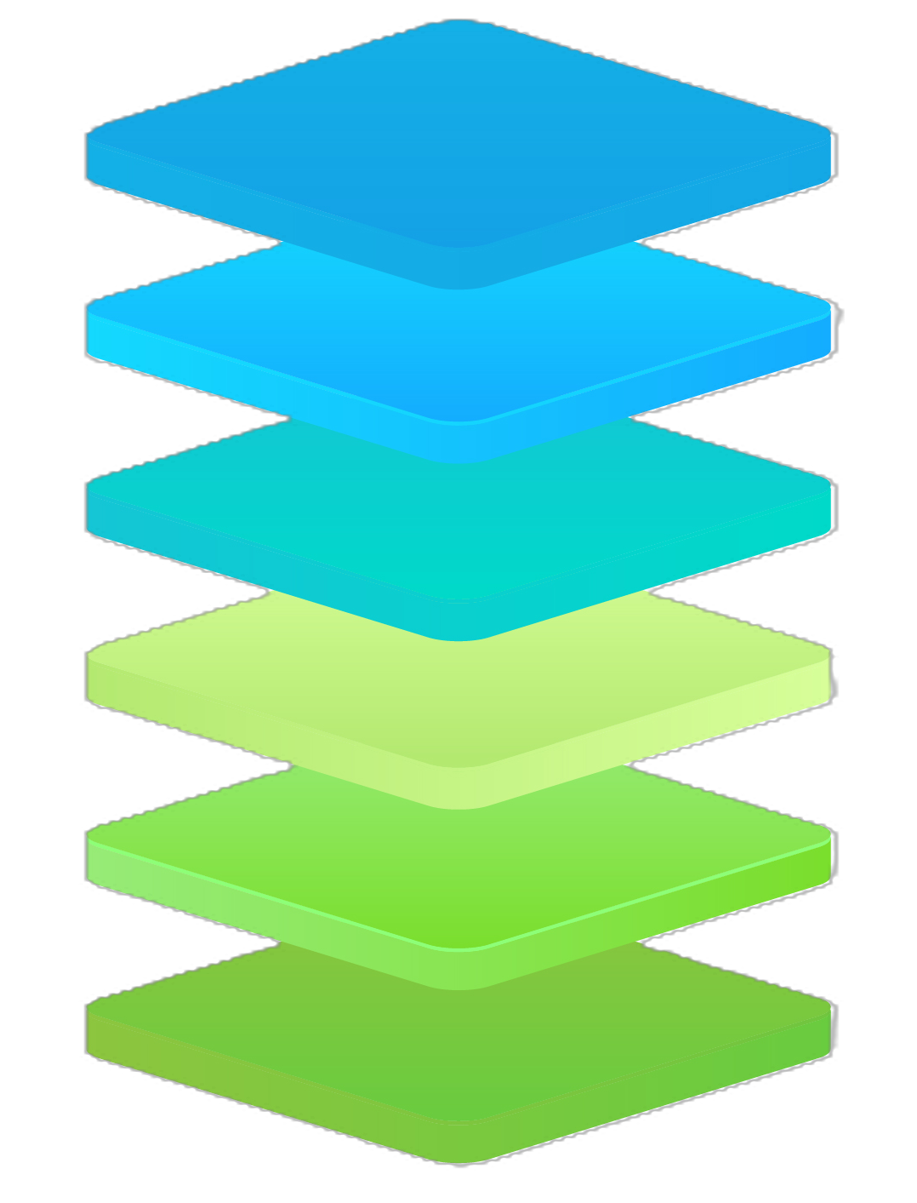
AI Technology Stack
Focus Areas
The full AI stack sovereignity
Trustworthy GenAI development
Robotics – AI ecosystem integration
Advanced R & D Research: Neurosymbolic AI – Learning and reasoning
1. User applications
2. Model Operations (MLOps)
3. Foundation Models
4. Fine Tuned Models
5. Cloud & Infrastructure
6. Compute
Industrial Strategy
Strengthening EU competitiveness
Build comprehensive AI Factories
Support supply chain resillience
Foster reaserch-industry collboration
Key investments
Large-scale testbeds and deployment
Foundation model reflecting EU values
Human-centric innovation and skills
Cross-border coordination
Notes:
But also looking into our crystal balls to understand the State of the ART.

Slide 15
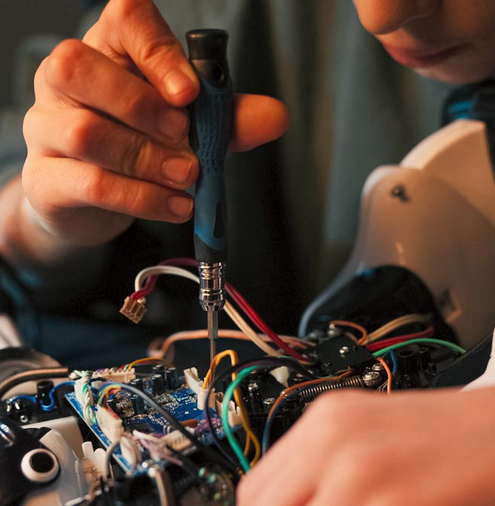
2. AI and Robotics Catalyst (ARC): Embodied intelligence for industry
Identify high-impact applications of Physical AI -enabled robotics in the manufacturing industry to serve as reference points for Europe’s Intelligent Robotics Roadmap
Deliverables
Broad consultation on representative industrial ecosystem (end-users)
Market Pull in complement to Technology Push
High-impact challenges for competitiveness, societal development, and European autonomy
Required pre-competitive technology capabilities & infrastructures
More info

Slide 16

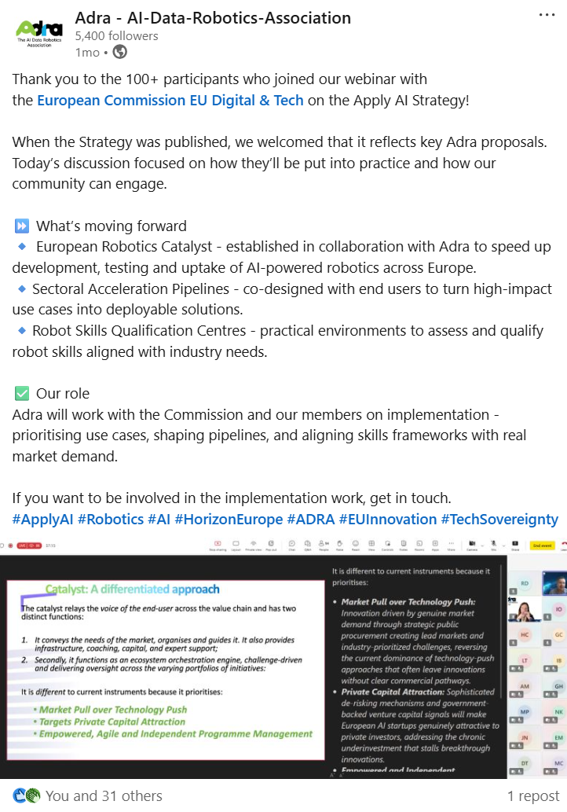

Apply AI
To support AI uptake in the robotics sector, the Commission will:
Establish a Catalyst for the uptake of European Robotics, bringing together developers and user industries to accelerate the development and uptake of European solutions replying to market needs. This will be done in collaboration with the AI Data and Robotics Association ²¹.
More info
Communication from the commission to the European Parliament and the council
16
Notes:
The Apply AI focus on robotics came from the AI-powered robotics strategy, which was driven by the ADRA topic groups.
For Adra, robotics isn't just another application of AI; it’s the critical engine that moves AI from our screens into the physical world. I’d say our reasoning boils down to four key points.
First, it's about embodiment and creating AI’s that are situationally aware. Both in terms of the cultural context that they are operating in, but also an awareness of the physical space.
As a result, we believe that for an AI to become truly intelligent and robust, it needs to encounter physics. It has to learn by interacting with the messy, unpredictable real world, not just by analysing static datasets from the internet. A robot is forced to perceive, navigate, and react in real-time. That’s how we get AI that can truly generalize and adapt.
Second, this interaction creates incredibly valuable data.
The data a robot gathers through its sensors—vision, touch, and so on—is grounded in nature and cause and effect. This is fundamentally different and much richer and this real-world data is the fuel we need to train the next generation of powerful, grounded AI models.
Third, it's a 'forcing function' for trust. When you have a robot operating in a factory next to a person, or in a hospital, there's no room for error. Safety, reliability, and ethics become non-negotiable engineering problems, not just abstract principles. This focus on building inherently trustworthy systems is central to the European vision for AI and gives us a key strategic advantage.
Finally, and perhaps most importantly: tangible economic and societal value. This entire approach is designed to bridge the gap between Europe's world-class research and real-world market adoption.
For an AI to become truly robust it needs to encounter physics
The data a robot gathers is grounded in nature and cause and effect.
The physical world is a 'forcing function' for trust.
Ensuring tangible economic and societal value.

Slide 17
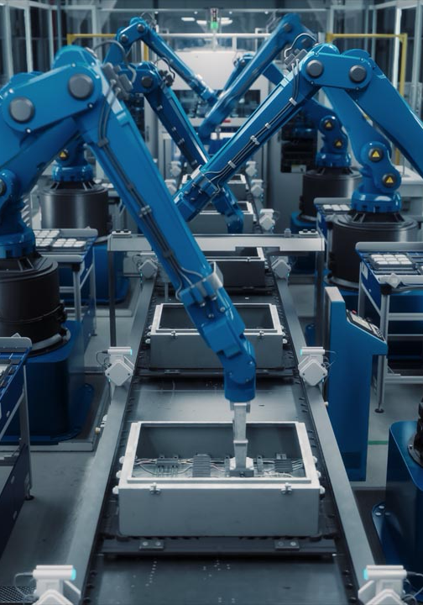
3. Challenge-to-champion: stage-gate approach to innovation
Accelerate progress through early TRL levels, application discovery and quicker deployment
Bridge gap between applied Research and Industry (end-user) needs and drives skills development
Acceleration pipelines to drive innovation across the whole maturity lifecycle and target critical sectors.
|

Slide 18
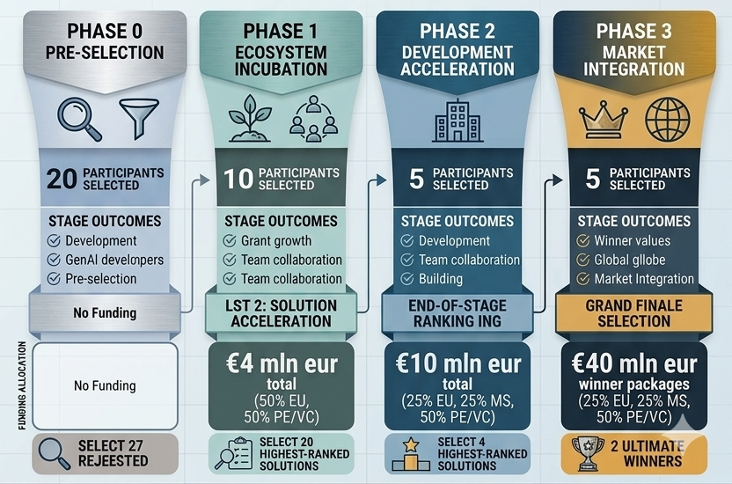

Slide 19
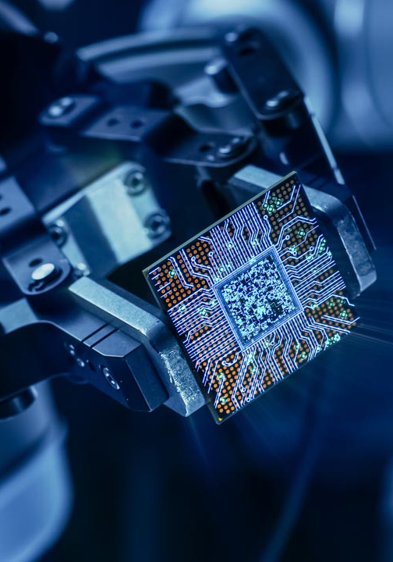
4. International AI Standards
Huge opportunity for European manufacturers to create and certify quality products and structure value-chains
Open Software and Model Interoperability: Industry-driven standards to ensure that European software and hardware technologies remain portable and are not tethered to any single provider’s proprietary toolchain or "black box" optimization pipeline.
Decouple Hardware from Software Architecture: Enforce the use of open standards at the hardware-software boundary and in high-performance networking. This allows for a heterogeneous ecosystem where components are modular.
Standardisation TG
|

Slide 20
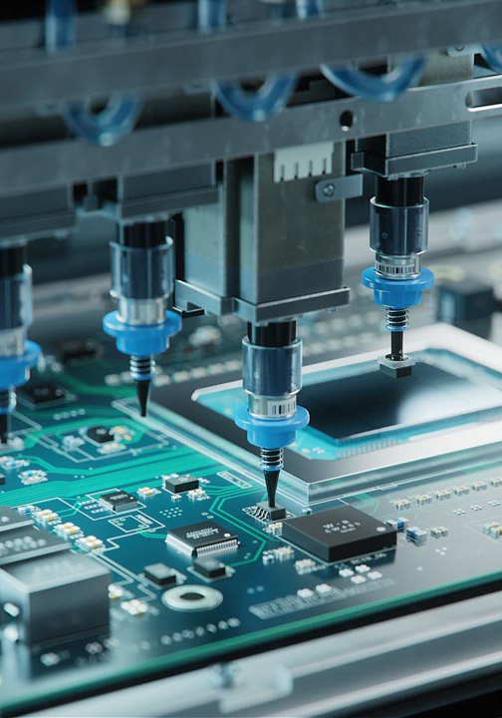
5. Creating consonance across member state ecosystems
Overcome fragmentation in priorities, funding, and policy to concentrate focus and investments
Achieving multi-level alignment of objectives across layers of European governance
Identifying shared priorities and ensuring these pan-european challenges support access to the whole European market.
Insights
Fostering a more open and competitive market requires investable European champions in AI and Robotics
Downstream effects, enabling rise and development of large AI-native industrial ecosystems in Europe
Challenge-based instruments create product market-fit and delivery-based competitiveness.
|

Slide 21
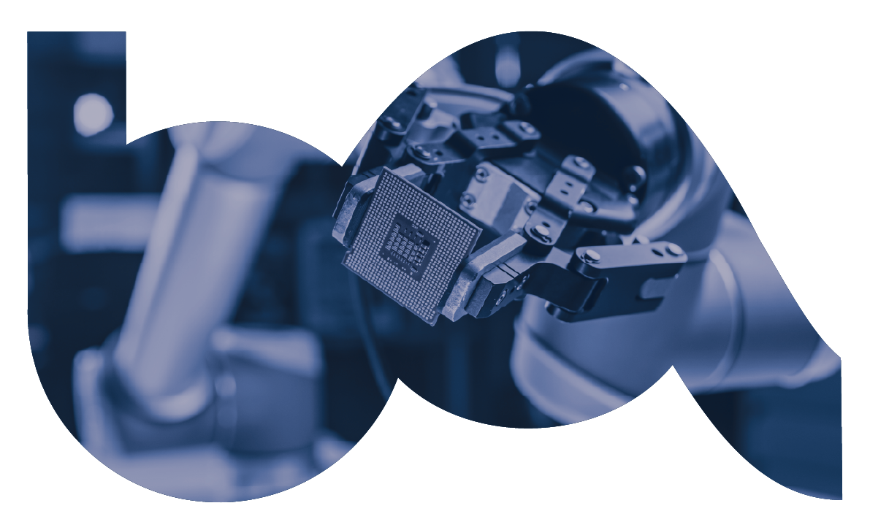

The Adra Team
Meet the team
21

Slide 22
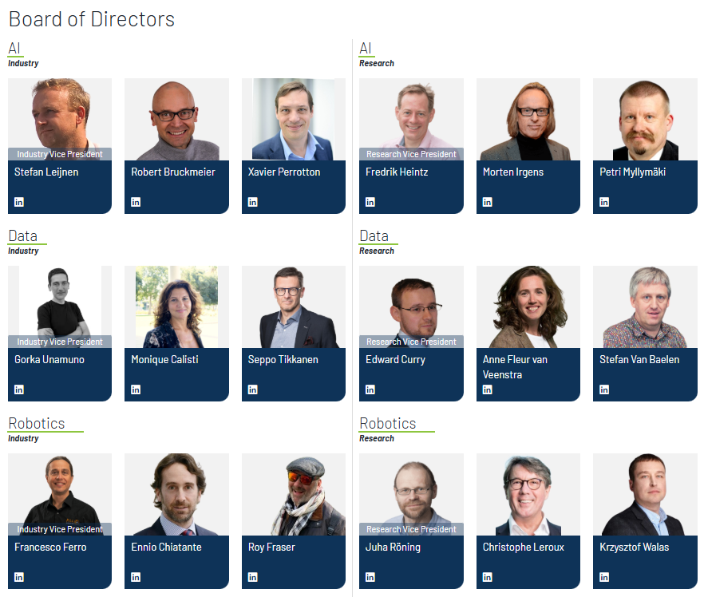
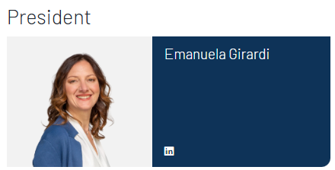

Representing EU and Horizon Europe associated country innovation ecosystems
22

Slide 23

Orchestrating the ADR Ecosystem
Community Alignment and Implementation Excellence
Acting as the Primary Conduit between Policy and Practice
Leading Knowledge Transfer Across the Stakeholder Network
Facilitating High-Impact Community Collaboration
Streamlining Expert Consultation and Feedback Loops
Driving Participation Excellence in Strategic Calls
Syncing Domain Expertise with Implementation Realities
Rapid-Response Mobilization for Critical Policy Topics
Shape Europe’s Digital future!
Become an Adra member

Slide 25
ADRA Topic Groups

Slide 26




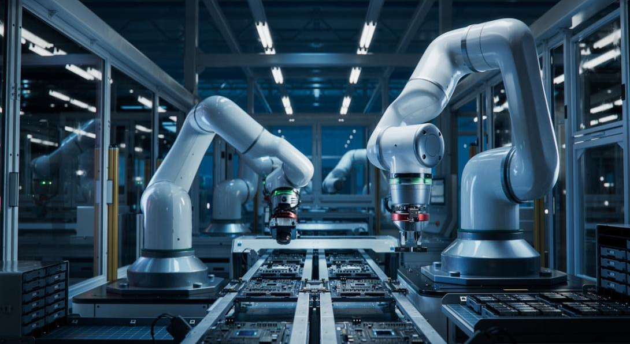



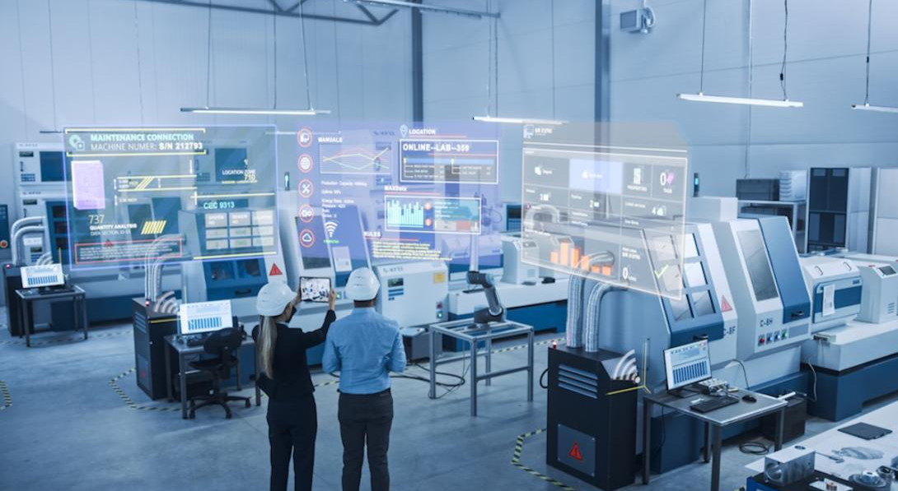
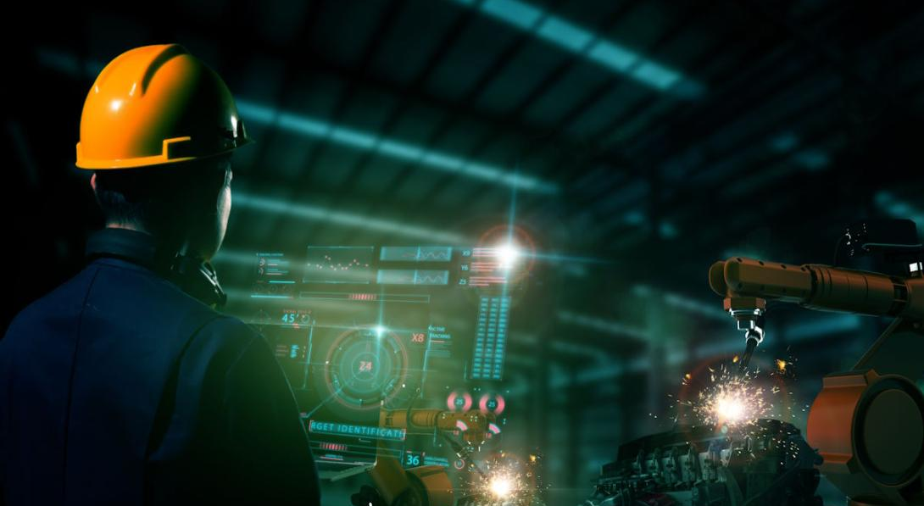


18 Topic groups
Notes:
I would merge this and the next one. I’m not sure the number gives anything without the context of where they are underpinned.

Slide 27
18 Topic groups (TG)
Strategic Task Forces (TF)
Cross-Cutting Groups
Vertical-Specific TGs
SRIDA TF
Catalyst TF
Generative AI TF
Ecosystem Mapping & Information Repository
Innovation & Technology Uptake
Education & Work Transformation
Policy
Standardization
Ethical and Legal
Energy & Sustainability
Agrifood Systems
Healthcare Innovations
Legal & Regulatory
GenAI for Manufacturing
Digital Twins
Inspection and maintenance
Defence
Mobility & Smart Urban Solutions
Technology Innovation
Generative AI Applications
AI-powered Robotics
ADR for the sciences

Slide 28
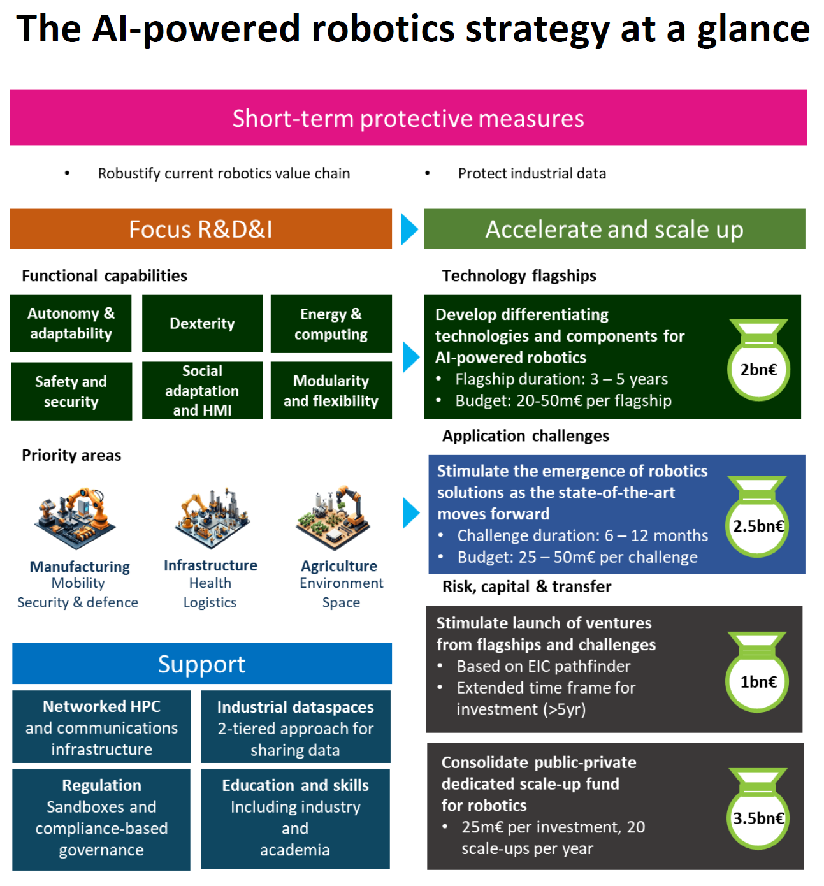
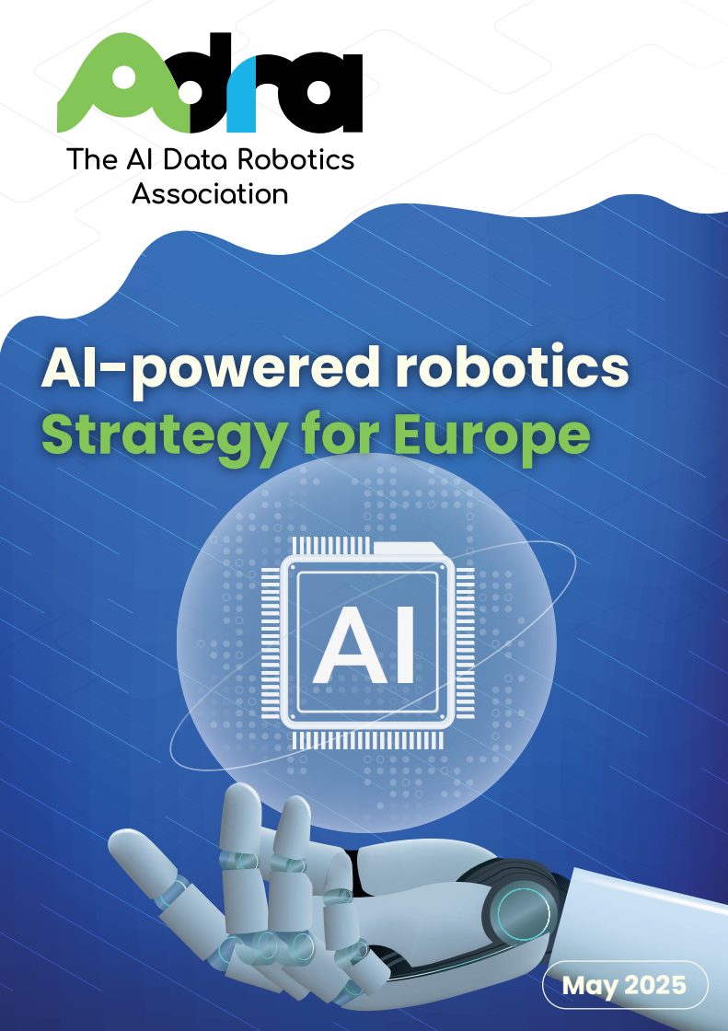
AI Powered robotic strategy
Accelerate the capabilities of European AI-powered robotics solutions
Autonomy and adaptability
Frugality
Safe operation and human-centered interaction
Bring AI-powered robotics solutions and components to market more effectively
Prioritize high-impact applications
Promote connected, shared data and computing infrastructures,
Deploy an ambitious challenge-based approach
Build up a robust European robotics ecosystem
Take urgent action to protect the existing EU robotics industry. I
Scale up and address the gaps in the robotics value chain
Improve capital flows and risk-taking
Facilitate compliance with regulations
Educate the scientists, engineers and citizens
Read document
28

Slide 29
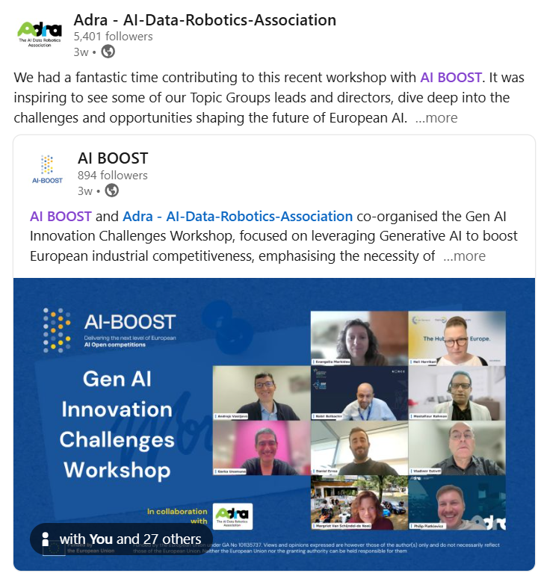
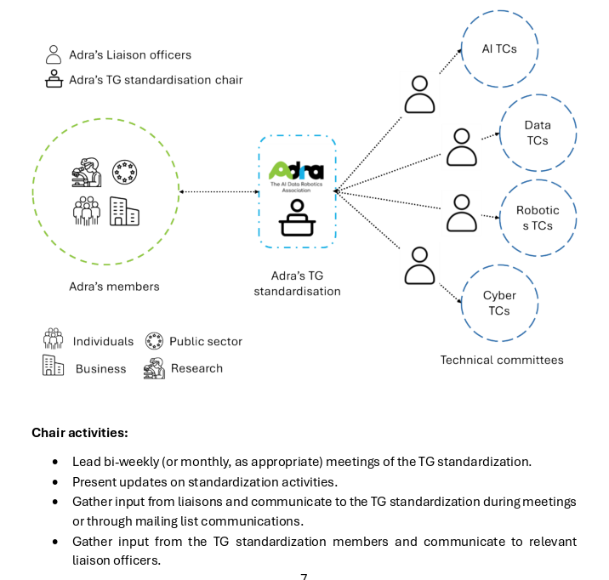
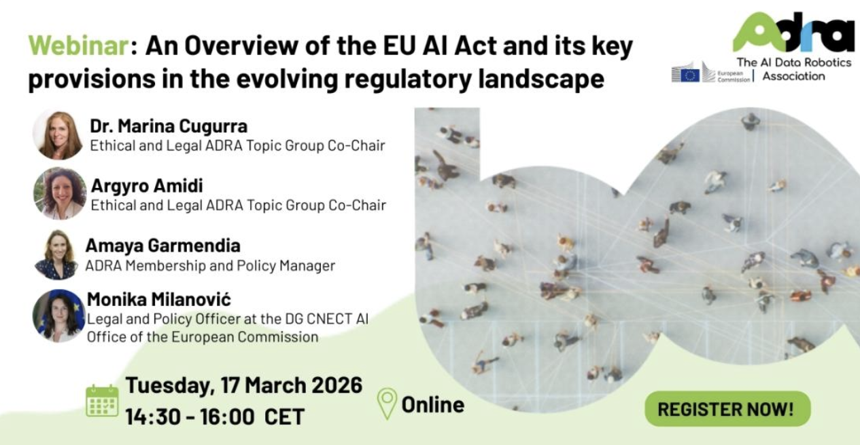
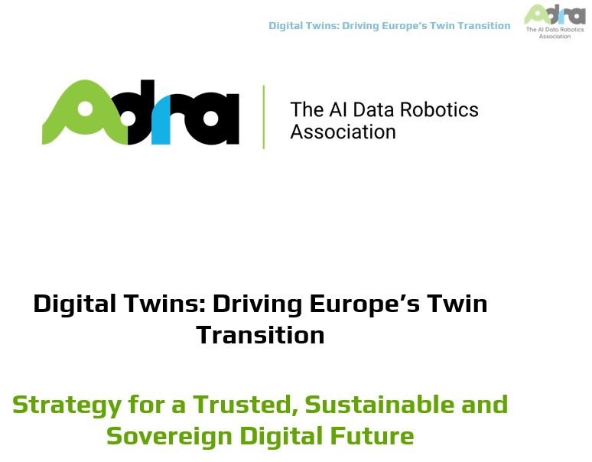
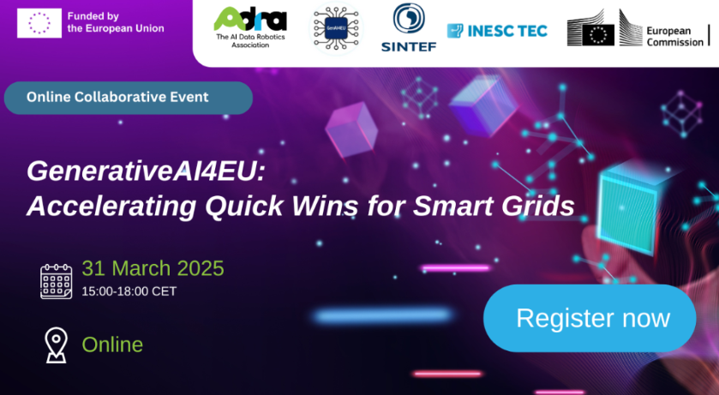
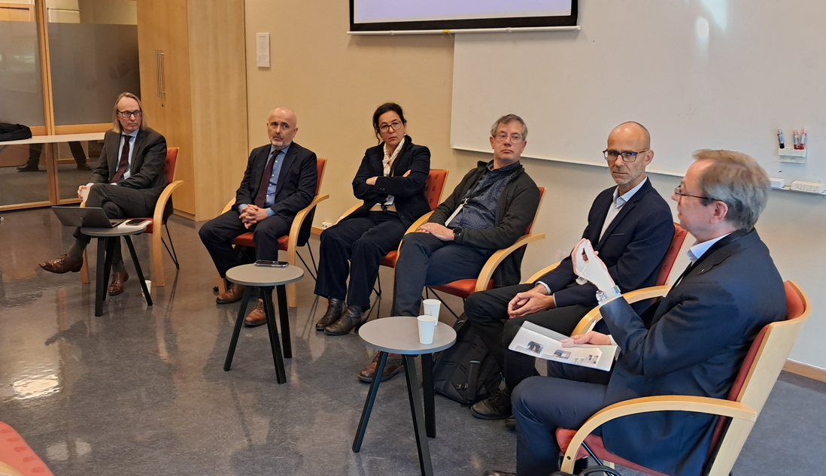
A Snapshot of Topic Group Activities
Notes:
Accelerating quick wins for smart grids (GENAI4EU)
Digital Twin TG (Technology Roadmap)
Mobility and Smart Urban Places TG (Roadmapping activities)
GenAI4Robotics TG (AI-powered robots)
Policy TG (Engaged with EP/UN)
Standardization (Joined JTC21 & Engagement Strategy)
Defence TG (KO ADRF)
AI BOOST (Mobility, Manufacturing and SRIDA TF contributed to challenges topics)
Hybrid Warfare (Defence TG)
An overview of the AI Act

Slide 30
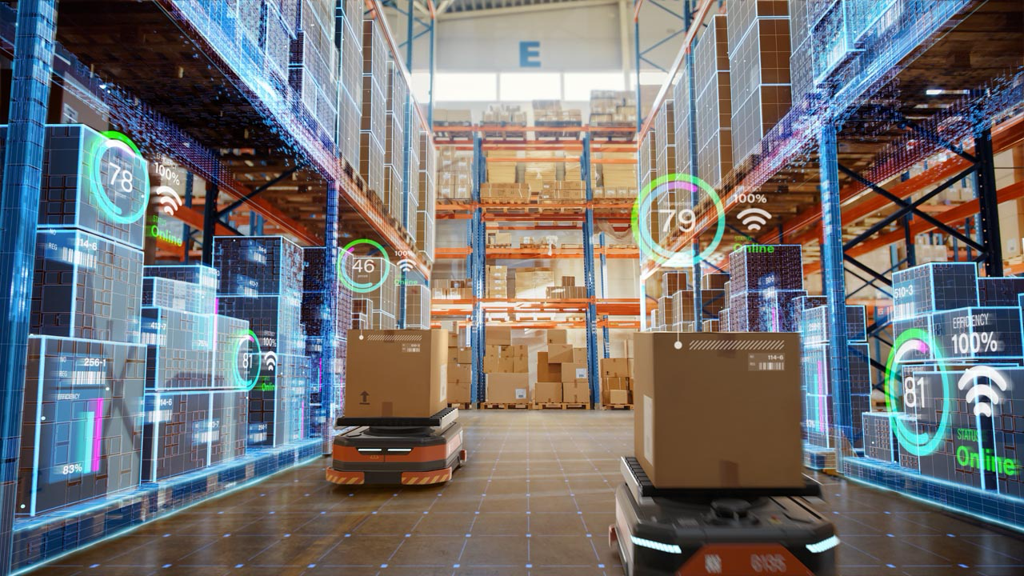
Membership Foundation Value

Slide 31
Building Europe's Innovation Ecosystem
Influence the European Agenda: Directly shape the regulatory and funding landscape by contributing to the SRIDA and participating in ADRA’s Public-Private Partnership (PPP) with the European Commission.
Forge Strategic Connections: Act as a linchpin between industry use-cases and cutting-edge solutions by networking across sectors and accessing shared R&D infrastructure.
Fuel ADR Innovation: Secure funding and resources for Physical AI and robotics through exclusive access to R&I programming and early intelligence on EU funding calls.
Driving Collaboration
Co-create High-Stakes Solutions: Join specialized Topic Groups to access deep expertise and co-design pioneering projects through cross-border collaborations.
Orchestrate Ecosystem Synergy: Engage in pre-competitive R&D to build shared IP and leverage collective insights to solve complex technological challenges.
Unite for Global Impact: Connect with a vibrant community at the AI, Data, and Robotics Forum (ADRF) to profile Europe’s DeepTech reputation and solve industry-wide hurdles.
|

Slide 32
Advancing Strategic Initiatives
Direct EU Strategy: Translate your business interests into actionable policy recommendations and shape the long-term R&D agendas that drive future growth.
Gain Strategic Foresight: Leverage the "Inside Track" for up-to-the-minute insights on ADR developments and benchmark your progress against Europe’s top leaders.
Lead Market-Driven Innovation: Utilize exclusive market intelligence and technical roundtables to design impactful initiatives that navigate the future digital economy.
Empowering Impact
Achieve Tangible Results: Generate new business, intellectual property, and market success by translating strategic goals into actionable results.
Enhance Capacity & Performance: Boost efficiency through peer learning and exclusive workshops on Physical AI, ensuring your organization is equipped for future technological contexts.
Magnify Your Global Voice: Establish your organization as a thought leader by engaging with top-tier decision-makers and exercising governance rights on the ADRA Board of Directors.
|

Slide 33

Team Adra Secretariat
Our Team comprises professionals from diverse backgrounds, each bringing a wealth of experience and specialised skills to their roles.
33
Notes:
Include everyone in the team.

