Slide 1
Future Ready​
HaDEA’s role in supporting EU-funded R&I actions
within the Horizon Europe ADR partnership​
Jean-Francois Junger
European Health and Digital Executive Agency (HaDEA)
B2 –Unit Digital

Slide 2
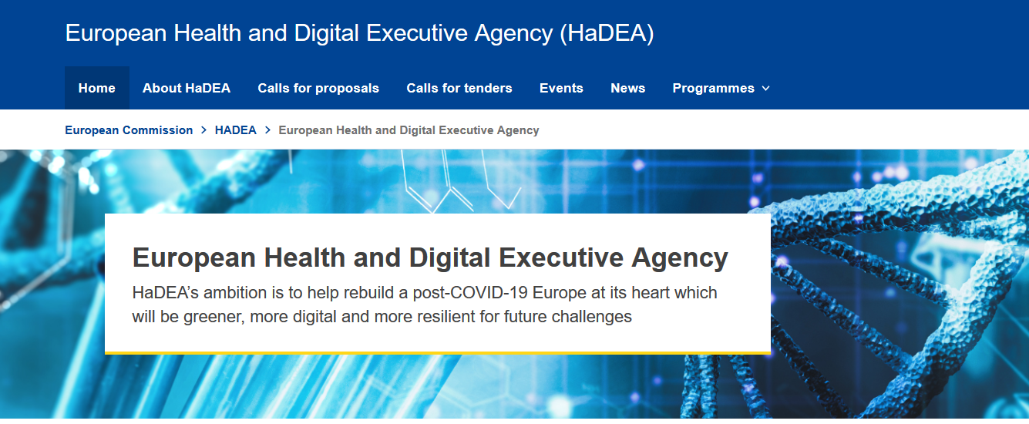
1. General Overview HaDEA
HaDEA since 1st April 2021 (https://hadea.ec.europa.eu)

Slide 3

The programmes we manage
Health
Food
Digital
Industry
Space
EU4Health -
Horizon Europe – Health Research
Single Market Programme (SMP): Food Safety
Horizon Europe – Digital
-
Connecting Europe Facility – Digital
-
Digital Europe Programme
Horizon Europe – Industry
Horizon Europe – Space

Slide 4



2. Digital in HaDEA
HORIZON EUROPE (FP9, 2021-2027, €95.5 billion)
EURATOM
Specific Programme: European Defence Fund
Specific Programme implementing Horizon Europe & EIT*
Exclusive focus on civil applications
Fusion
Pillar I
Excellent Science
Pillar II
Global Challenges & European Industrial Competitiveness
Pillar III
Innovative Europe
Exclusive focus on defence research & development
European Research Council
Health
Culture, Creativity & Inclusive Society
Civil Security for Society
Digital, Industry & Space
Climate, Energy & Mobility
Food, Bioeconomy, Natural Resources, Agriculture & Environment
European Innovation Council
Fission
Research actions
Marie Skłodowska-Curie
Clusters
European Innovation Ecosystems
Research Infrastructures
European Institute of Innovation & Technology*
Development actions
Joint Research Centre
Joint Research Center
Widening Participation and Strengthening the European Research Area
Widening participation & spreading excellence
Reforming & Enhancing the European R&I system
* The European Institute of Innovation & Technology (EIT) is not part of the Specific Programme

Slide 5

How we work with DG CNECT
European Commission Defines the policy Defines strategy, objectives and priority areas/work programmes Selects actions for co-financing Makes programme decisions Evaluates the programme and the Agency's performance | HaDEA (Executive Agency) Turns policy into action Manages the project lifecycle: Organises calls for proposals and external evaluations Monitors technical/financial implementation of projects Manages communication actions (Info days, website, publications) Provides feedback to policy making

Slide 6
HaDEA and the HE ADR Partnership

Slide 7
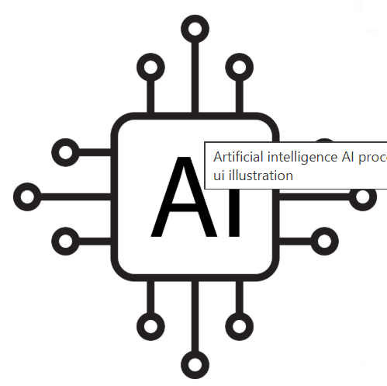

HaDEA and the HE ADR Partnership
AI for sustainable manufacturing | 3 | 18 M€
AI for human empowerment | 5 | 33,5 M€
Trustworthy AI | 2 | 13,5 M€
AI & Robotics for societal challenges | 3 | 22,3 M€
Explainable AI | 4 | 29 M€
Generative AI | 3 | 17,5 M€
AI & Computing Continuum | 4 | 31 M€
General purpose AI | 4 | 37,5 M€
Robotics for smart manufacturing | 4 | 36 M€
Robotics for industry optimisation | 6 | 19 M€
Increase robotics capacity | 4 | 34 M€
Human-Robot interaction | 3 | 29,5 M€
Robotics for Green | 6 | 58 M€
Soft Robotics | 2 | 18,5 M€

Slide 8


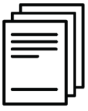
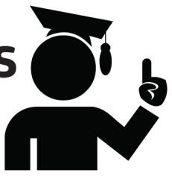



HaDEA helps turning policy into action
Grant Lifecycle
Major tasks of HaDEA
Call for proposals
Key feedback to DGs
Technical and financial follow-up
Evaluation and Selection
Preparation of
Grant Agreements

Slide 9
Thank you!
Jean-Francois.Junger@ec.europa.eu
https://hadea.ec.europa.eu
http://ec.europa.eu/horizon-europe

