Slide 1




Future Ready 2026
Harnessing AI, Data, and Robotics for Next-Generation Innovation
16 April, 2026
WELCOME!

Slide 2

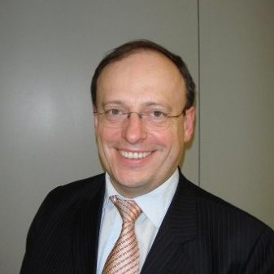
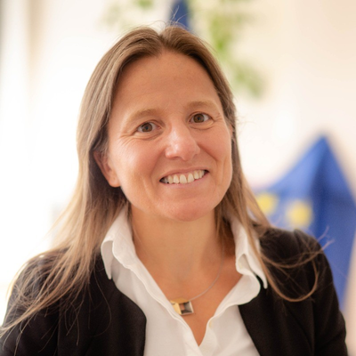
Future Ready 2026
Harnessing AI, Data, and Robotics for Next-Generation Innovation
16 April, 2026
Philip Piatkiewicz
Secretary General, Adra
Jean-Francois Junger
Deputy Head of unit
(HaDEA)
Cécile Huet
EC Head of Unit Robotics and AI Innovation and Excellence

Slide 3
Future Ready 2026
Harnessing AI, Data, and Robotics for Next-Generation Innovation
16 April, 2026
Lunch & Networking
12:30-14:00

Slide 4
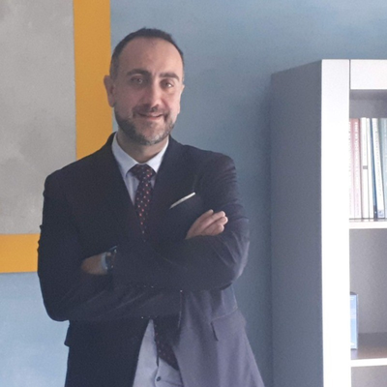
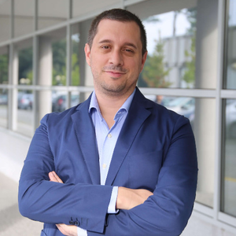
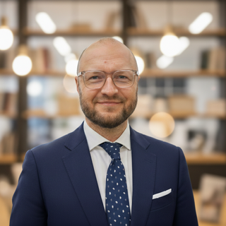
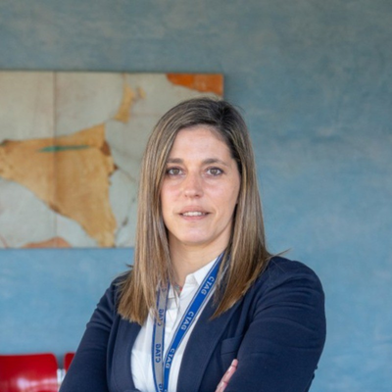

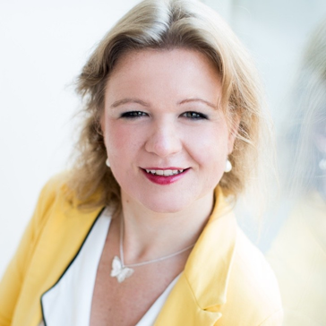
Future Ready 2026
Philip Piatkiewicz
Secretary General, Adra
Harnessing AI, Data, and Robotics for Next-Generation Innovation
16 April, 2026
Victor Afonso
CTAG – Centro Tecnológico de Automoción de Galicia
Ricardo Bessa
INESC TEC
Krzysztof Lipiec
Łukasiewicz - PIAP
Iria Galiñanes Romero
CTAG – Centro Tecnológico de Automoción de Galicia
Margriet Van Schijndel-de Nooij
Eindhoven University of Technology
Françoise Siepel
University of Twente

Slide 5
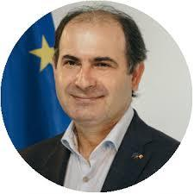


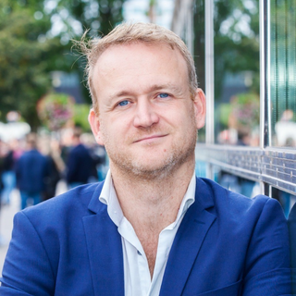
Future Ready 2026
Harnessing AI, Data, and Robotics for Next-Generation Innovation
MODERATOR
Philip Piatkiewicz
Secretary General, Adra
16 April, 2026
Cécile Huet
EC Head of Unit Robotics and AI Innovation and Excellence
Viorel Peca
EC Head of Unit
Diva Tommei
28Digital
Isabelle Seigrist
Sandborn
Stefan Lijnen
AI Coalitie 4 Nederland | AIC4NL

Slide 6
Future Ready 2026
Harnessing AI, Data, and Robotics for Next-Generation Innovation
16 April, 2026
Wrap up and lessons learned

Slide 7
Future Ready 2026
Harnessing AI, Data, and Robotics for Next-Generation Innovation
16 April, 2026
Thank you!

