Slide 1
Energy Topic Group
Ricardo Bessa, ricardo.j.bessa@inesctec.pt
Future Ready 2026, 16 April 2026, Brussels

Slide 2
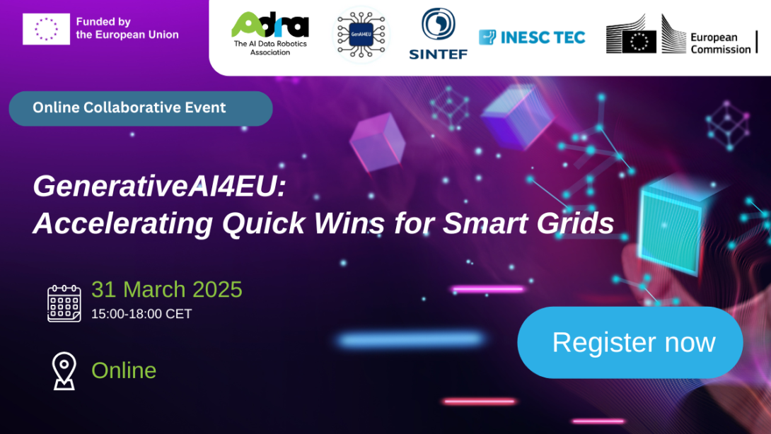
Organization of webinar GenerativeAI4EU: Accelerating Quick Wins for Smart Grids
Key messages
High-impact GenAI use cases are emerging now: forecasting, anomaly detection, planning, workforce support
Foundation models & LLMs can transform energy systems: from prediction tools to system-level intelligence and decision support
Productivity & resilience gains are immediate: supporting workforce shortages, improving efficiency, reducing emissions
Integration with physical systems is the next frontier: combining AI with grid assets, IoT, and real-time control
Scaling requires European ecosystem alignment: data spaces, compute infrastructure, regulation (AI Act), and skills

Slide 3
SRIDA big ticket contribution
Objective
Cost-effective integration of renewables from local to national/cross-border scale
Use AI and data to enhance decision-making across time and spatial scales
Why it matters
Increasing complexity: renewables, electrification, distributed resources
Explosion of heterogeneous data (grid, IoT, satellites, drones, consumers)
What AI enables
Real-time control and resilience (e.g., extreme events, faults)
Modeling complex and uncertain systems (e.g., congestion management)
Faster simulations via data-driven/physics-informed models
Improved forecasting using multi-source data
Better decision support (explainability for human operators)

Slide 4

SRIDA big ticket contribution
Roadmap
Short-term
Focus on local energy communities (data sharing enablers)
Advance RL, physics-informed AI, neuro-symbolic AI
Develop AI assistants and human-AI collaboration
Medium-term
Build energy-specific foundation models
Combine AI + physical models + expert systems
Evaluate edge vs centralized AI architectures
Long-term
Autonomous, self-healing energy systems
Cross-sector integration (energy–mobility–water)
Full interoperability (AI + legacy systems + humans)

Slide 5

















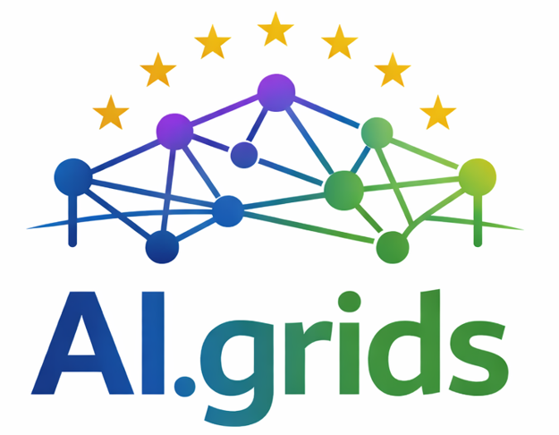







Introducing AI.grids - Building the first pan-European AI foundation model for power grid operations
Pan-European collaboration between TSOs, DSOs, research institutes, and technology providers
Development of a foundation AI model trained on diverse grid data
more than 20 industrial players and RTOs onboard

Slide 6

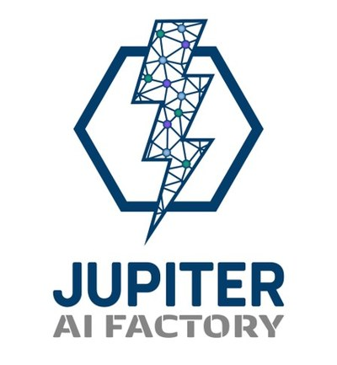

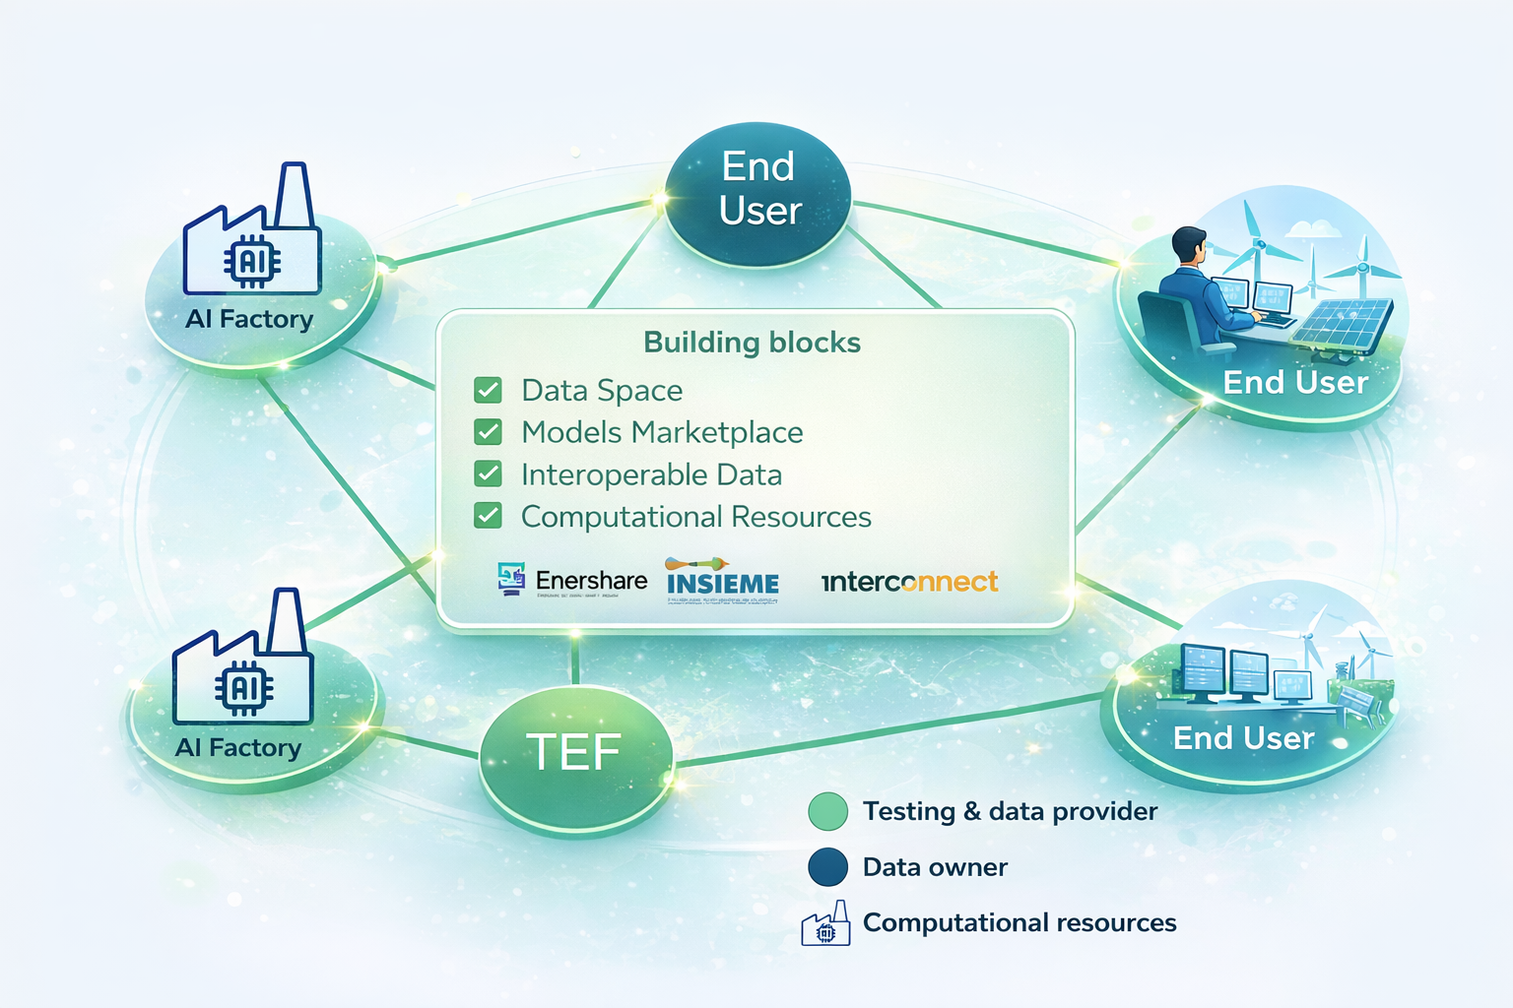



AI.grids vision and building blocks
Our key principles
Share data and models leveraging the Common European Energy Data Space (CEEDS)
Exploit HPC resources from all 3 Energy AI TEFs
Leverage data & assets made accessible by the Energy AI TEFs
Train the Foundation Model on multiple EU AI Factories (EuroHPC JU)

Slide 7
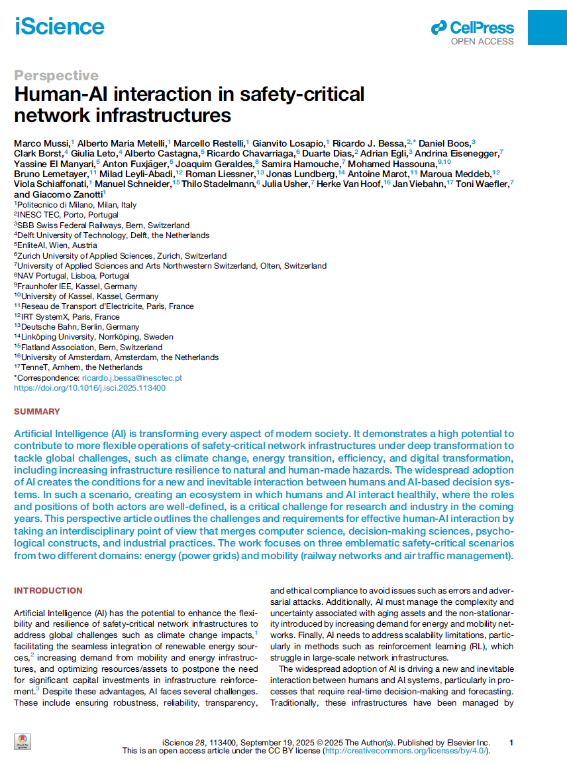

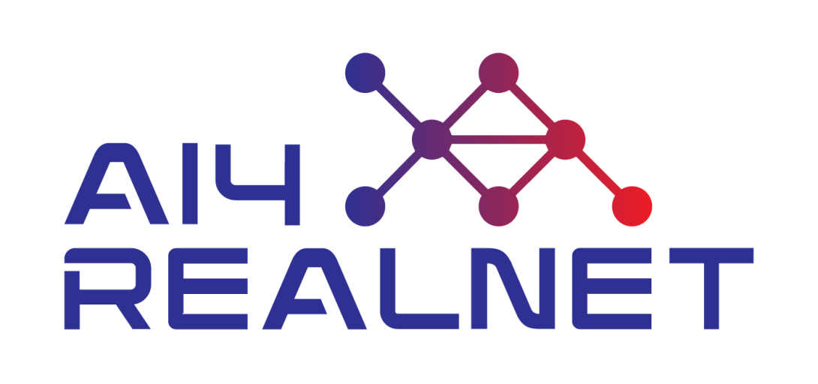
Beyond foundation models
research
success story

Slide 8
Next steps for the topic group
Increase the number of stakeholders in the topic group (in particular, end-users)  yet, it should be interdisciplinary
Organize workshops/webinars for promising AI, Data, and Robotics areas in Europe, e.g., neurosymbolic AI, edge & physical AI, human-centric AI (assistants)
Prepare joint position papers/funding proposals
Facilitate collaboration and knowledge sharing across members  create working sub-groups, share datasets/tools, and exchange best practices
Define and prioritize key use cases and pilot projects  similar to the AI-grids initiative, but requires industry involvement and a blending of in-kind contributions and funding

Slide 9
Join the Energy Topic Group

