Slide 1




Digital Twin Topic Group
JOIN US!
Iria Galiñanes $| 16 April 2026$

Slide 2
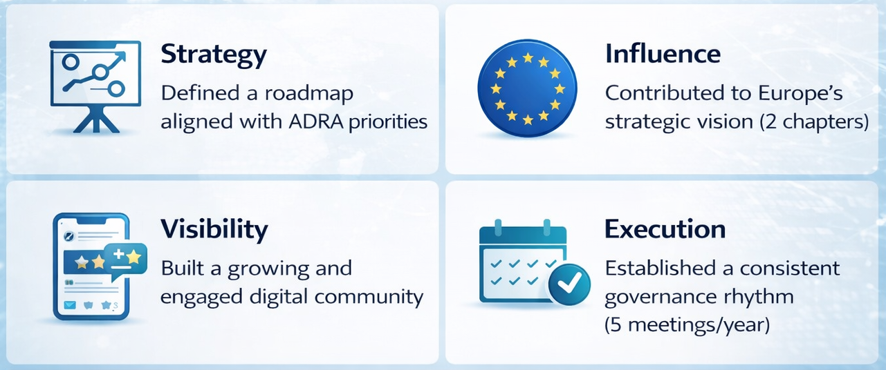
MANUFACTURING & DIGITAL TRANSFORMATION | DRIVING IMPACT
Notes:
In the past year, we’ve focused on four things: aligning strategy, influencing Europe, building visibility, and ensuring execution discipline.”

Slide 3


MANUFACTURING & DIGITAL TRANSFORMATION | SHAPING EUROPE’S VISION ON DIGITAL TWINS
The Digital Twin group co-authored two strategic chapters:
European Sovereignty in Digital Twins
Vision for the Present and Future of Digital Twins
Scan me

Slide 4
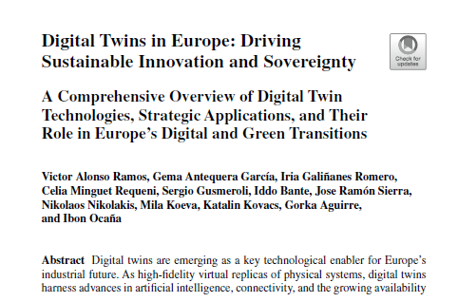
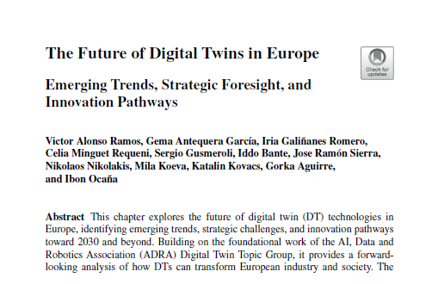
MANUFACTURING & DIGITAL TRANSFORMATION | SHAPING EUROPE’S VISION ON DIGITAL TWINS
Two strategic contributions to Europe’s vision:
The Future of Digital Twins in Europe
→ Identifying emerging trends and innovation pathways
→ Strategic foresight for Europe 2030 and beyond
Digital Twins in Europe
→ Enabling Europe’s digital and green transition
→ Focus on industrial applications and strategic autonomy
Notes:
“We contributed to Europe’s Digital Twin strategy from two angles: enabling today’s industrial transformation, and anticipating future innovation pathways

Slide 5
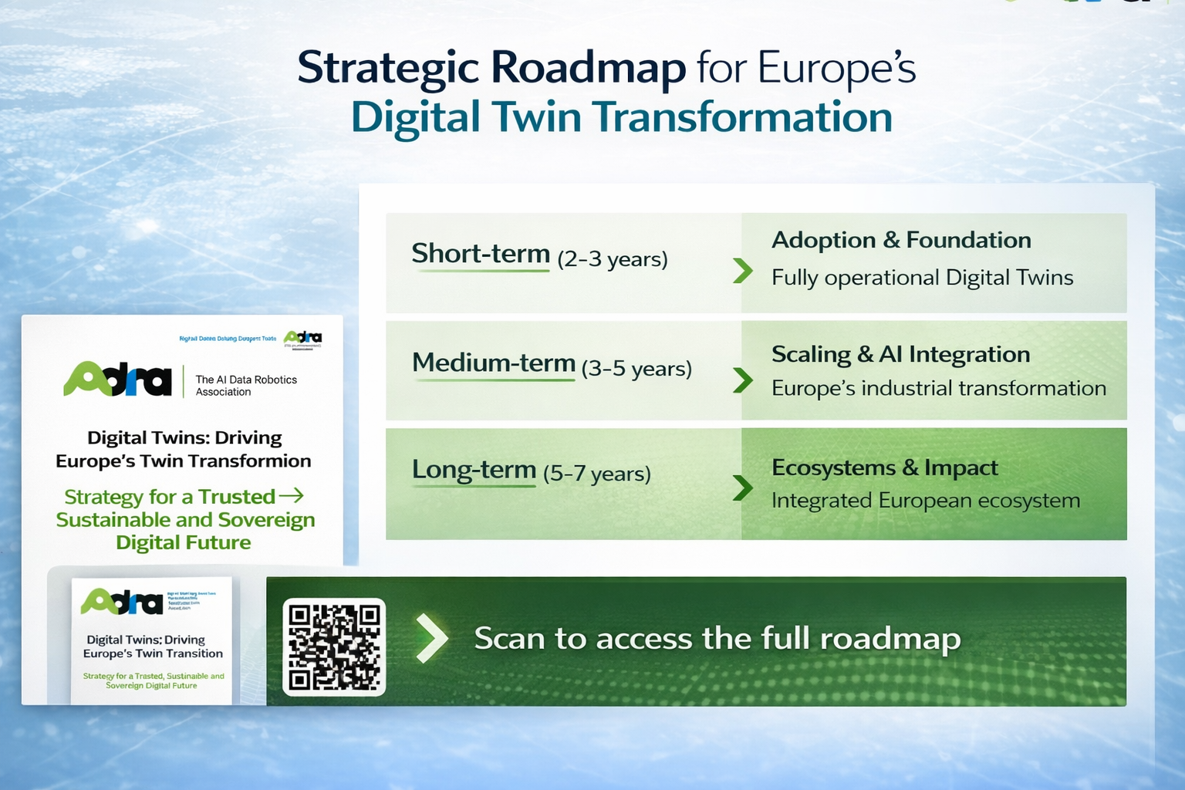
MANUFACTURING & DIGITAL TRANSFORMATION | ROADMAP
Scan to access the full roadmap

Slide 6


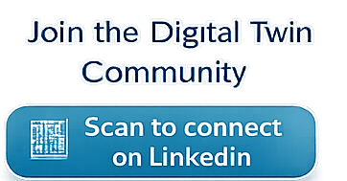

MANUFACTURING & DIGITAL TRANSFORMATION | BUILDING VISIBILITY & COMMUNITY
We have established and grown the Digital Twin Topic Group within ADRA
Increase visibility of group members
Share strategic milestones across the ecosystem
Position Europe at the forefront of Digital Twin Innovation

Slide 7
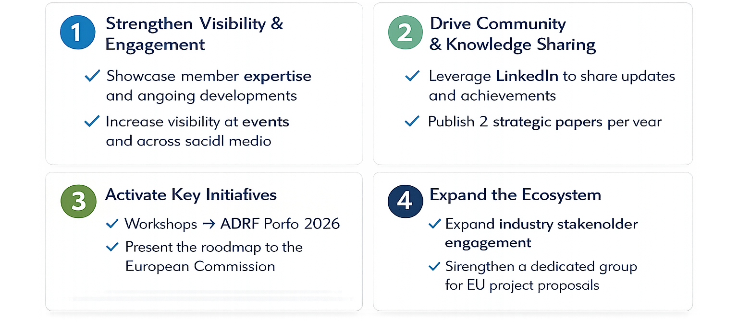
MANUFACTURING & DIGITAL TRANSFORMATION | NEXT STEPS

Slide 8
DIGITAL TWIN TOPIC GROUP
WORK WITH US TO BOOST THE FUTURE!
Iria.galinanes@ctag.com
Gema.antequera@ctag.com
Victor.alonso@ctag.com

