Slide 1
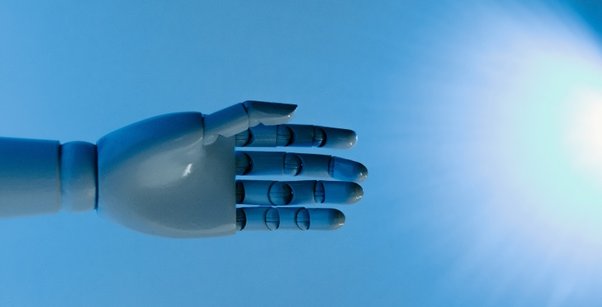




Healthcare TG
Dr. Françoise J. Siepel
Associate professor /
Technical physician
Robotics and Mechatronics
University of Twente

Slide 2





Adra - Accelerating the growth of future AI, Data, and Robotics technologies to address global challenges in healthcare.
adr-association.eu
A joint initiative by:

Slide 3

Building a European Healthcare Innovation Ecosystem
Leverage Europe’s strengths in healthcare systems, medical expertise, and ADR technologies (AI, Data & Robotics)
Ensure openness and inclusiveness across healthcare stakeholders to enable adoption and trust
Foster structured dialogue between healthcare providers, industry, research, and policymakers
Maintain balance between clinical needs, technological innovation, and regulatory requirements
Build on existing healthcare networks, hospitals, and innovation ecosystems
Ensure representation of all key actors:
Healthcare providers (hospitals, clinicians)
Start-ups & SMEs
Industry
Regional healthcare ecosystems

Slide 4








From research to uptake of ADR technologies
Real-world deployment
Scalable adoption
Clinical relevance
Topic Group
DIHs
Digital Innovation Hubs
eDIH
TEFs
Testing & Experimentation Facilities
Innovation, Tech transfer
Uptake
European Network
Regional nodes
Healthcare
Technology or sectorial
Support to SME

Slide 5
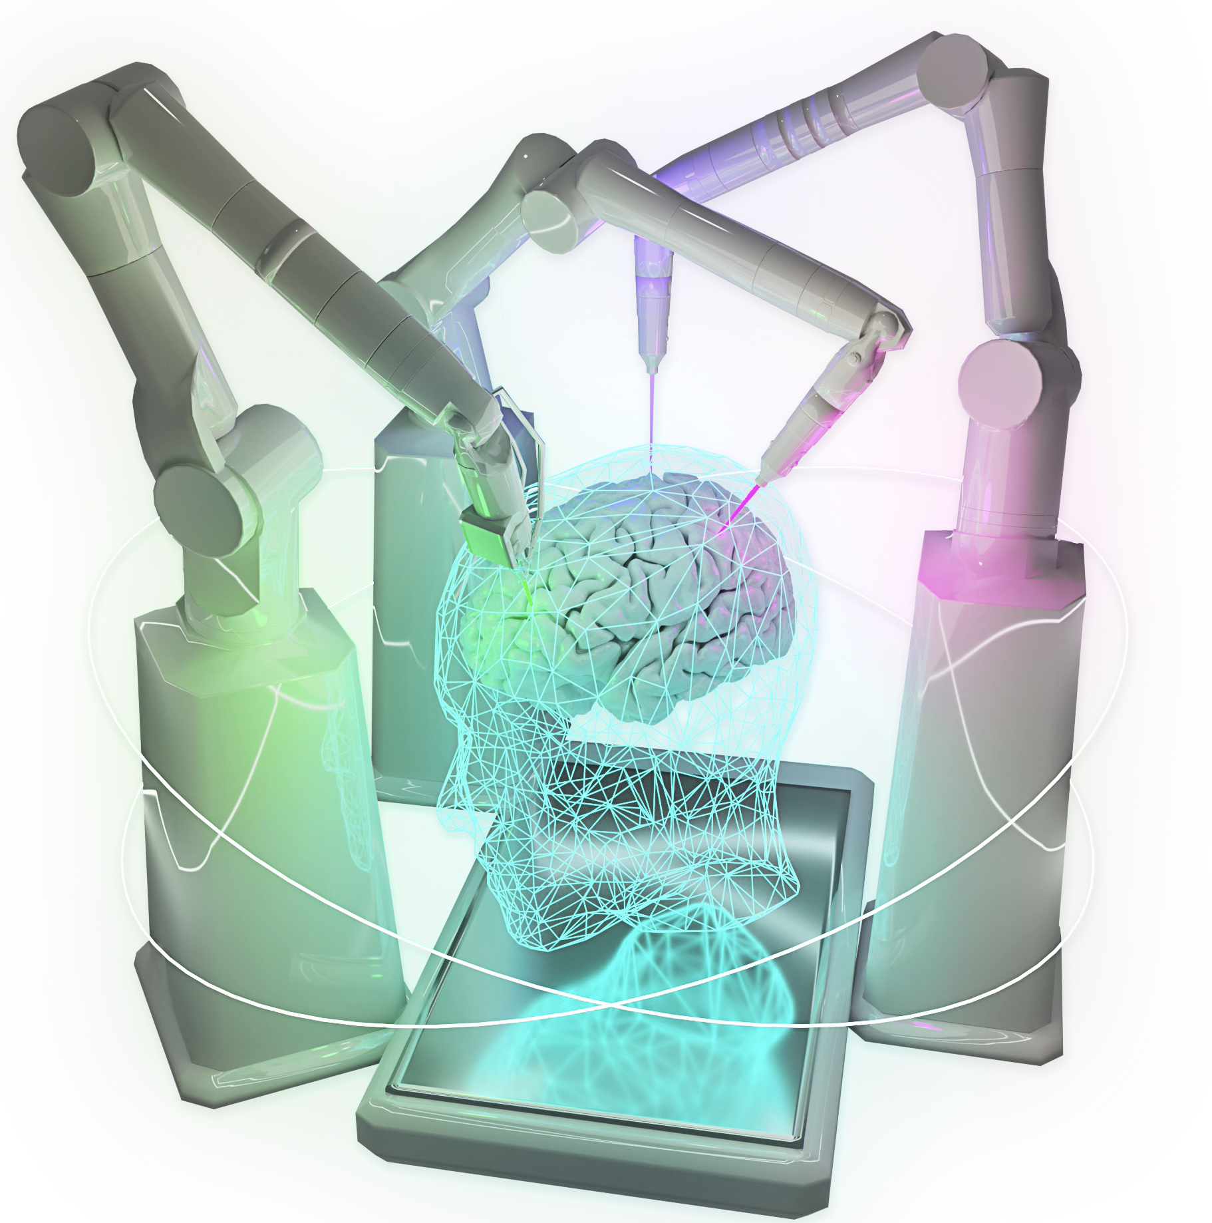
Focus areas
AI in clinical workflows Decision support, Diagnostics, Prediction
Robotics in care delivery Diagnostics, Intervention, Rehabilitation, Assistance, Logistics
Health data Infrastructure Interoperability, Access, Governance
System resilience Preparedness, Response, Recovery
ADRF’23 TEF health

Slide 6
ADRA Healthcare Roadmapping Framework - data collection
AI, Data & Robotics
Clinical AI, prediction, robotics
Infrastructure
Cloud, EHDS, hospital IT
IP & Knowledge
Research, data, clinical knowledge
Technology
Healthcare
Healthcare Services
Hospitals, care systems
Human Capital
Clinicians, skills, workforce
Supply Chains
Devices, software, procurement
Governance
Regulation & Standards
AI Act, MDR, GDPR
Ecosystem & Governance
ADRA, DIH, EDIH
Deployment & Scaling
Pilots → scale, reimbursement
Resilient, Scalable Healthcare Systems
Better outcomes & Sustainable care

Slide 7
TG insights: the role of ADR technology in healthcare
From Reactive to Predictive Systems
ADR enables risk stratification and early intervention. Shift from reactive care to proactive system management
Prevention & Workforce Support
AI-driven triage improves prioritisation. ADR reduces clinician burden and helps prevent burnout.
Faster & Smarter Response
ADR enhances real-time decision-making. Optimises capacity and staff scheduling.
Resilience & System Recovery
ADR systems accelerate return to equilibrium. Strengthens system resilience during crises.
AI, Data & Robotics are reshaping healthcare systems to anticipate, respond, and recover more effectively.

Slide 8
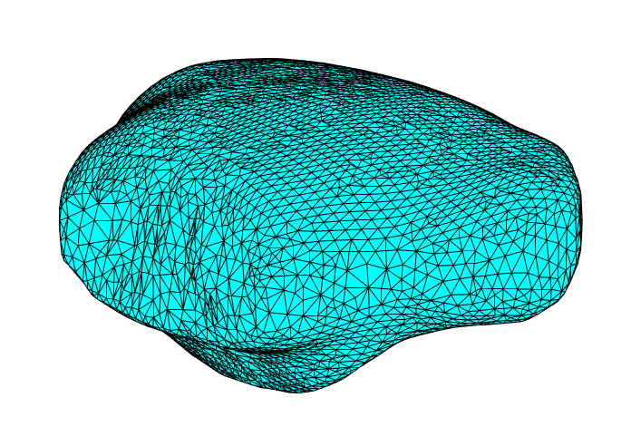
The role of ADR technology in healthcare
ADR is transforming healthcare across clinical, operational, and system levels:
Predictive analytics (AI+Data): Supports risk stratification, demand forecasting, and clinical decision-making e.g. early detection models improving patient outcomes and resource planning
Advanced diagnostics and intervention: AI enhances imaging and diagnostics; robotics supports precision in procedures and interventions e.g. improved consistency in complex or repetitive clinical tasks
Healthcare operations and efficiency:
AI streamlines documentation and administrative workflows
Robotics automates transport, logistics, and routine physical tasks reducing delays and improving workflow efficiency

Slide 9
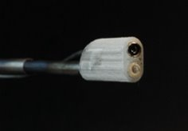
The role of ADR technology in healthcare
Integrated system performance: Data (insight) + AI (decision support) + Robotics (execution) e.g. coordinated patient flow, resource allocation, and operational management
Care beyond traditional settings: Digital tools and assistive technologies enable home-based and community care models reducing pressure on hospitals and improving patient experience
WHO Europe – Digital Health & Health Systems
European Commission – European Health Data Space
OECD – Health System Performance & Workforce
Lancet Digital Health / Nature Medicine

Slide 10
Understanding societal needs in healthcare
To align with societal expectations, ADR must respond to structural healthcare needs:
Accessibility and affordability: Digital and automated care pathways expand access while reducing system costs e.g. remote monitoring enabling care outside hospital settings
Equity and quality: Data-driven decision-making supports consistent care delivery across regions and populations e.g. integrated datasets improving diagnostic accuracy and reducing variation
Safety and reliability: AI and robotics enhance precision and standardisation in clinical and operational processes e.g. automated medication management reducing errors in dispensing and tracking

Slide 11
Understanding societal needs in healthcare
Trust and transparency: Strong frameworks such as the General Data Protection Regulation and EU AI Act support safe and ethical deployment
combined with validated and explainable systems in practice
Workforce and productivity: Automation and robotics reduce administrative and physical workload e.g. hospital staff still spend significant time on logistics and coordination tasks

Slide 12
Resilience
Why Resilience Matters:
Increasing pressure from aging populations & workforce shortages
Growing frequency of health crises (e.g. pandemics)
Need to maintain continuity of care under stress
Current challenges in Europe:
Fragmented systems limit coordinated crisis response
Data silos reduce real-time decision-making capacity
Workforce strain impacts adaptability & recovery speed

Slide 13
Healthcare Topic Group Progress
From exploration towards structured understanding Consolidated insights across AI, Data & Robotics in healthcare
Defined key system roles: predict, prevent, respond, recover
From technology towards system perspective Shifted focus from individual solutions towards healthcare system impact
Identified key domains
From insights towards roadmapping Developed a system-level framework linking:
Technology, healthcare delivery and governance/deployment
From discussion towards action Identified priority use cases (triage, capacity planning, automation)
Structured Engagement
Knowledge Building
Workshops & Co-Creation

Slide 14
Outlook
Establish a Common EU Healthcare and Tech Framework
Align Regulatory Policies Support SMEs and Startups
Facilitate Fast Scale-Up
Promote Dual-Domain Education
Build Crisis-Ready Expertise

Slide 15



Get in touch - healthcare
adr-association.eu
f.j.siepel@utwente.nl
https://www.linkedin.com/in/françoise-siepel-583995168/
https://mobile.twitter.com/adra_eu_

Slide 16






A Joint Initiative by
www.adr-association.eu

