Slide 1
AI-on-Demand Platform
Empowering European AI Research and Industry
Future Ready, 16.04.2026: Harnessing AI, Data, and Robotics for Next-Generation Innovation
Dr. Joachim Köhler, Fraunhofer IAS
Notes:
Good morning. / Good afternoon. / Good evening.
I’m very happy to be here today together with my colleagues … — and all of you. Thank you for the invitation.
We’re here to talk about something that is no longer an experiment, but more like - a new kind of reality.
As we know, Europe is waking up to AI. From research labs to boardrooms, from universities to startups — the question is no longer whether AI matters. The question is: how will Europe build AI, use it, and own it — on our own terms?
That’s the story behind the AI-on-Demand Platform. A story about sovereignty, collaboration, and scale.

Slide 2
From research labs to boardrooms, AI adoption is hitting exponential growth across the continent.
Startups scaling to unicorns, enterprises transforming operations, capital flowing at record levels.
This isn't potential anymore...
...it's proven momentum.
Notes:
Over the past five years, AI has moved from research papers to boardroom decisions.
Startups are scaling to unicorns; enterprises are embedding AI into every process. Venture capital, public investment, and policy attention have reached record levels.
Yet — despite this energy — Europe still struggles to turn scientific excellence into economic strength.
We have world-class research, but we often lack the platforms that turn research into accessible, scalable products.
The AI-on-Demand Platform is here to change that — to make sure that European innovation doesn’t stop at the lab door.

Slide 3







European AI Landscape
Europe is proceeding with a strong emphasis on trust, compliance, and human-centric design.
Europe has strong AI expertise and capabilities. The problem is slow industrial adoption and fragmented innovation efforts often done in silos.

Slide 4

Market Landscape & AIoD Opportunity
Global AI: rapid advances + vertically integrated stacks → vendor lock-in risk
Adoption gap: many organisations still in pilots → need operational pathways
Strategic opportunity: Europe leads on trustworthy AI → make it deployable at scale
AIoD’s Opportunity
Reduce friction, orchestrate service infrastructure, operationalise compliance, provide a unified view of AI assets and resources stored across the AI landscape to limit research fragmentation.

Slide 5


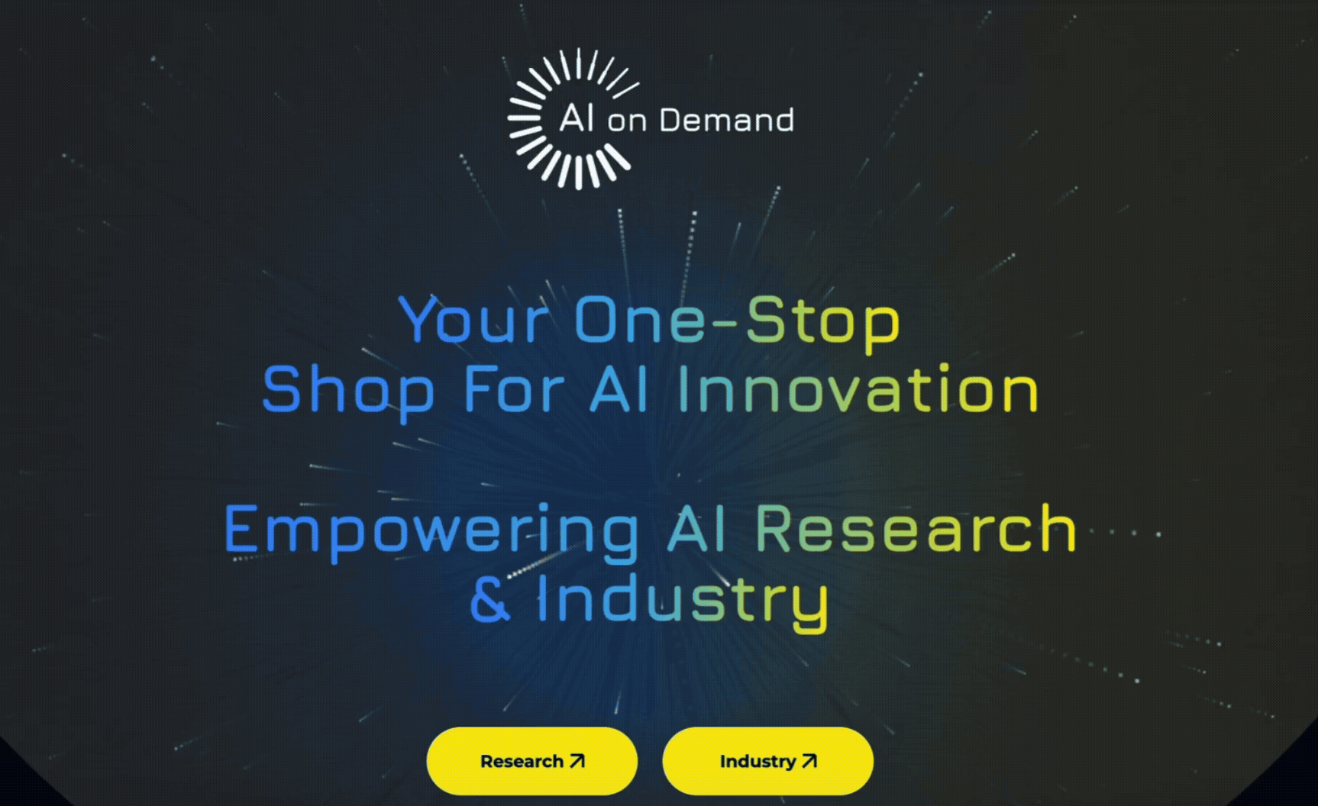

AIoD tackles a key European challenge of fragmented efforts.
It connects and empowers them.

Slide 6

EU projects
TEFs
AI Factories
Startups
SMEs
Researchers & Developers
HPC Providers
AI Providers
EDIHs
Policymakers
Public administrations

Slide 7

The Mission
Unifying Europe’s fragmented AI landscape with a trusted, open-for-all platform that nurtures innovation and competitiveness in local businesses and EU member states.
Notes:
The mission of the AI-on-Demand Platform is to build that sovereignty — by creating a thriving European AI ecosystem where research, industry, and public services collaborate seamlessly.
It’s about excellence and openness —with trust, transparency, and European values built in.
The idea is not to reinvent everything, but to connect what already exists — the projects, datasets, tools, and people — into one powerful, visible, and interoperable network.
We are not competing with Europe’s innovators. We are amplifying them.

Slide 8
The Vision
Spearheading a new era for European AI – an open, collaborative ecosystem where research, industry, and public services come together to create scalable and trustworthy AI technology.
Notes:
The vision is straightforward yet bold: one platform, one entry point for European AI.
A place where researchers, startups, tech providers, EU projects, and EU AI initiatives, such as Digital Innovation Hubs, meet — to build, share, and grow AI together.
Think of it as the European “home” for AI — where excellence is made visible, where collaboration is frictionless, and where trust is the default.
What makes this vision unique is its inclusivity. It’s not for one type of actor — it’s for everyone contributing to Europe’s AI capacity.

Slide 9

Unique value proposition
AIoD is the only trustworthy entry point to Europe’s blooming AI ecosystem, offering standardised access to multiple open-source LLMs, sovereign interoperability, matchmaking, and a marketplace on a single online platform.

Slide 10
Unique selling points
Accessible one-stop shop to the entire AI lifecycle: Made for companies and organizations of any maturity level, from assessing needs to commercializing solutions
Operations under European values: Transparency, ethics, and compliance with EU regulation guaranteed
Freedom to do your thing: Vendor-independent and open-source principles to increase innovative potential
Pan-European reach: Scale your ideas and business through all EU member states inside a unified ecosystem

Slide 11
For Researchers & Innovators
Explore. Build. Share.
Notes:
For researchers, AIoD is not a static library — it’s a living, collaborative ecosystem.

Slide 12
Key Challenges
Researchers & Developers
Access to AI infrastructure
Availability of data sets, tools and services
Weak connections to industry and application partners
Transitioning research outputs to deployable solutions
Lack of community to share results and find collaboration opportunities

Slide 13




AIoD for Research
1
Find and use relevant resources, tools, and services.
2
Use the platform to share updates and connect with the AI community.
3
Access AI educational courses and resources.
4
Build or deploy components, services, or tools.
Notes:
Through the AI Catalogue, the AI Builder, and the RAIL lab, users can find datasets, tools, and services tailored to their work.
They can also connect, co-develop, and share their results — turning isolated research into visible, reusable European assets.

Slide 14
For Industry, SMEs & Public Services
Build. Train. Operate.
Notes:
Let's move to the industry gateway now.
The industry access of the AIoD is tailored towards the entire AI lifecycle
The logic is simple: Build. Train. Operate.

Slide 15



AIoD is a one-stop platform for companies to build, test, and scale AI solutions—faster, more securely, and with full visibility across the European market.
• A single-entry point to trusted tools, infrastructure, and partners
• Built for real business needs: speed, control, and growth
• Designed for European companies that want to innovate and scale responsibly
Build. Train. Operate.

Slide 16
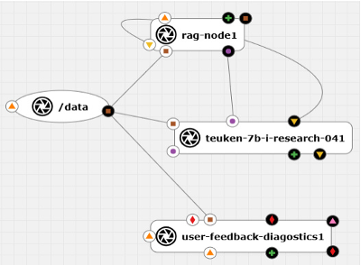
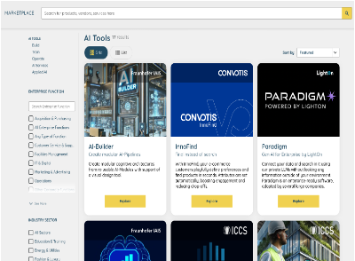
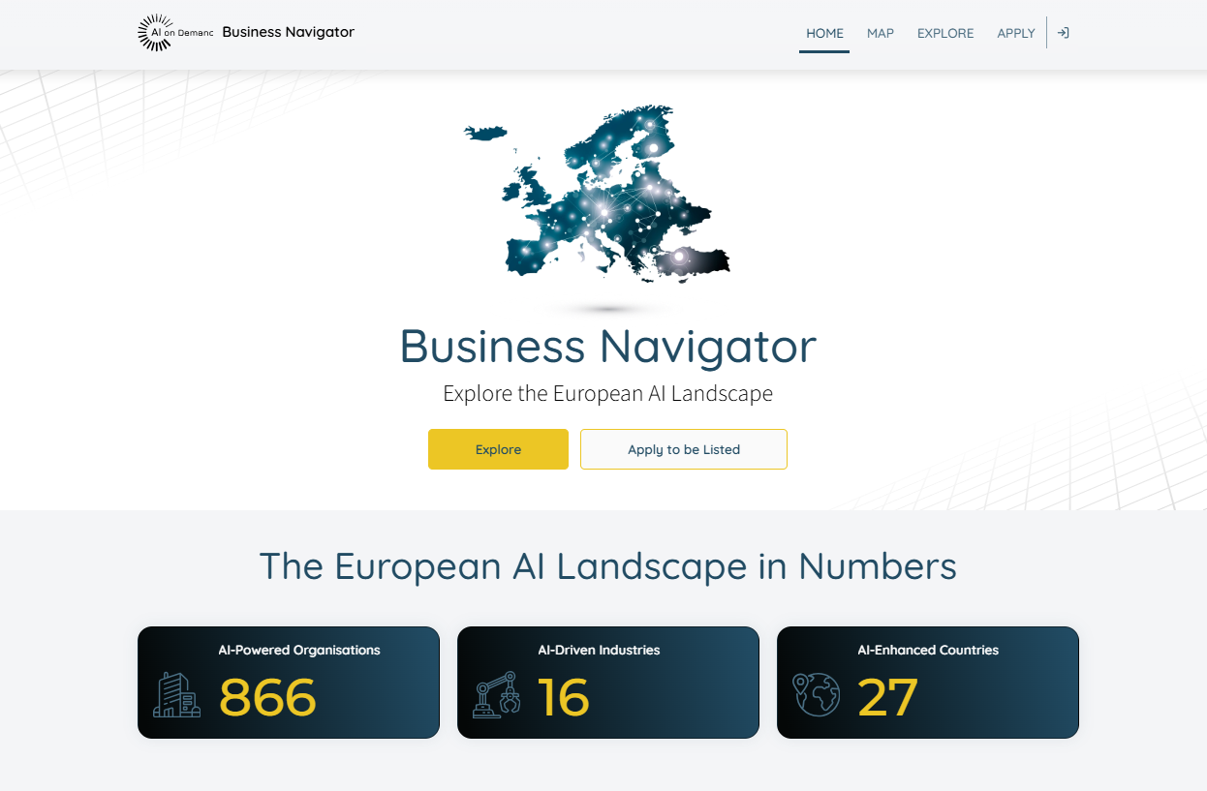
A look into AIoD's core offerings
DevOps tools
Built-in tools that let you develop, test, and run AI solutions directly on the platform. DevOps helps you build and launch.
Marketplace
A place where you can publish, find, and reuse AI models, datasets, and services. Marketplace helps you publish or reuse AI solutions.
Business Navigator
A tool that helps you find the right AI solutions, partners, and funding based on your needs.
Business Navigator helps you find the right match.
Notes:
Here we have a short overview of the core components of the industry / public sector gateway. The idea behind is to make it easier for European organizations (from startups to research institutions) to develop, deploy, and commercialize AI solutions in a trusted, interoperable way.
Let’s start with the DevOps tools. This part of the platform provides the technical backbone for building and operating AI. It includes workflow engines, cloud resources, and large-language-model services. Essentially, everything needed to accelerate the process of training, validating, and deploying AI models. You can think of it as the engineering layer that connects data, models, and compute in a consistent pipeline. For example, you can define workflows visually, automate experiments, integrate feedback loops, and move from prototype to production much faster. This is particularly important for European AI developers, because it allows them to work within a standardized and sovereign infrastructure, not depending entirely on non-EU cloud providers.
The second component is the AI Marketplace. Here, we bring together the supply and demand sides of AI: companies and startups can publish their AI tools, datasets, and services, while users can discover, compare, and later purchase these resources. It supports different pricing models, meaning providers can monetize their AI assets and end-users can easily integrate them into their own solutions. So, in a way, the Marketplace is the commercial and discovery hub of, helping to connect innovation with real business needs.
And finally, the Business Navigator — a tool for mapping and exploring the European AI landscape. It provides an interactive view of AI companies and initiatives across Europe. Users can visualize business contacts on a map, filter and identify collaboration opportunities. It’s especially valuable for investors, SMEs, and policymakers who want to understand where AI activity is happening and how ecosystems are connected. Essentially, the Business Navigator turns data about Europe’s AI actors into a strategic intelligence tool.

Slide 17
Why join the
AI-on-Demand platform?
For Research & Innovation
Metadata Catalogue - Search 500,000+ AI assets
Connect with partners and funding through smart ecosystem navigation
Accelerate development with ready-to-use, low-barrier AI tools
For Business & Industry
Gain visibility across Europe through a trusted AI platform
Scale AI efficiently using secure, high-performance infrastructure
Deploy with confidence in a reliable, enterprise-ready environment
Access trustworthy AI aligned with European values and regulations
Notes:
As a recap:
Benefits for Business & Industry: For businesses — a marketplace, low-code tools, HPC access, secure deployment, and visibility across Europe.. A full pipeline from concept to commercialization.
Benefits for Research & Innovation: Over half a million AI assets, RAIL labs, metadata catalogues, RoboCompass for robotics ethics, and more. It’s the European research infrastructure made practical.

Slide 18

AIoD Open Call
Apply now!
Apply now for up to €60,000 in EU funding
We are looking for market-ready AI solutions to be integrated into the AI-on-Demand Platform and deployed across Europe
Application period open until 8 June 2026, 17.00 CEST
8-month programme starting Sept 2026

Slide 19
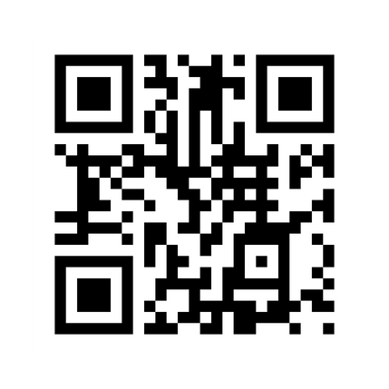
Would you like to know more?
The platform is live. The tools are ready. The ecosystem is growing.
Explore the platform today and be part of Europe’s AI future
https://www.aiodp.eu/
Notes:
The platform is live. The tools are there and more is coming as we speak. The ecosystem is growing.
This is your invitation to explore it — to test it, to use it, to shape it.
You’ll see how these ideas translate into a real, operational platform.

