Slide 1
AI for critical infrastructures – Success story
ADRA’s Future Ready 2026: Harnessing AI, Data, and Robotics for Next-Generation Innovation
Ricardo J. Bessa (INESC TEC, Project Coordinator), Bruno Lemetayer (RTE, End User)

Slide 2
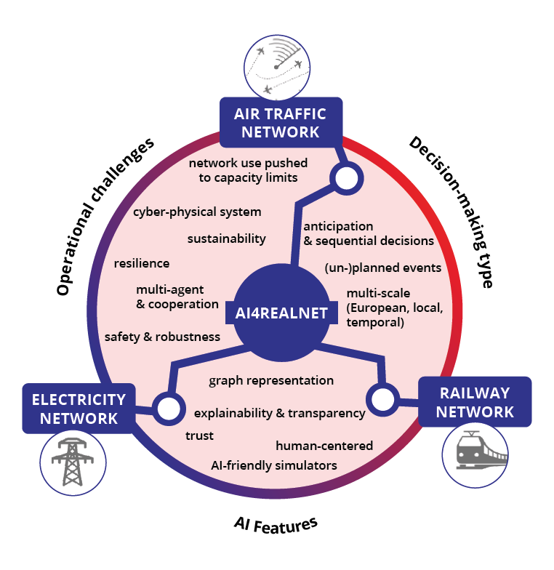
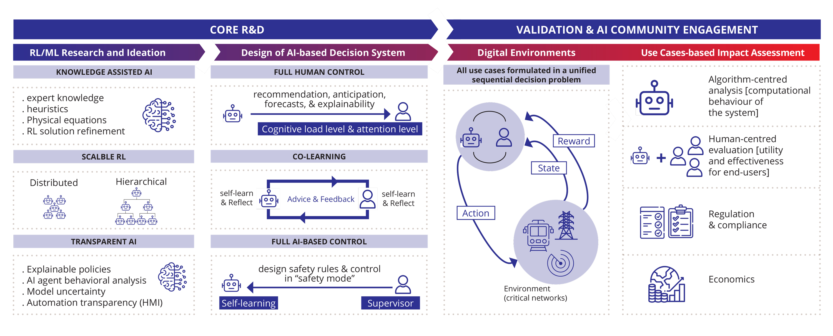
AI4REALNET in a nutshell
GOALS
Develop the next generation of decision-making methods powered by supervised and reinforcement learning, which aim at trustworthiness in AI-assisted human control, human-AI co-learning, and autonomous AI with human “director”
Boost the development and validation of novel AI algorithms via open-source AI-friendly digital environments

Slide 3
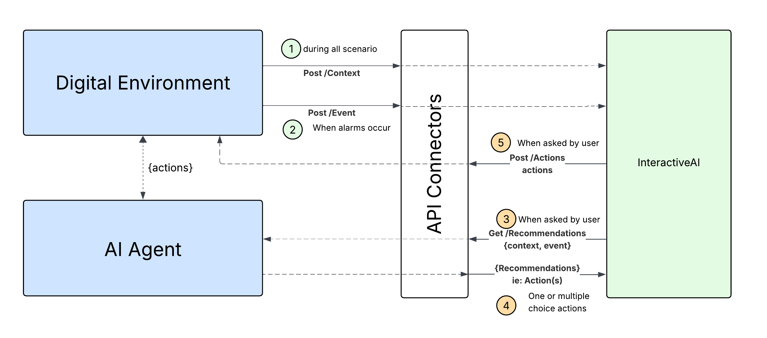


AI4REALNET interactions and software
all results are open-source

Slide 4
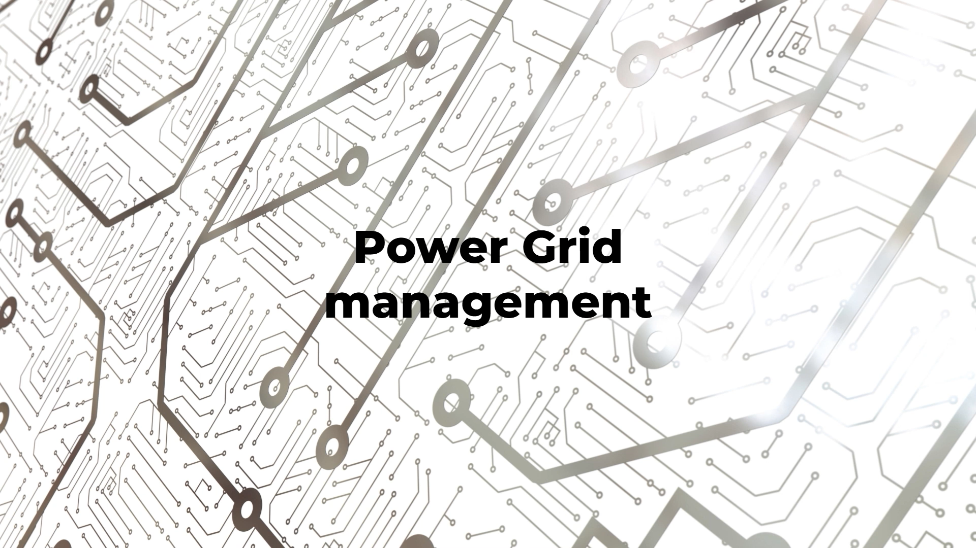
Human-AI interaction: power grid example

Slide 5
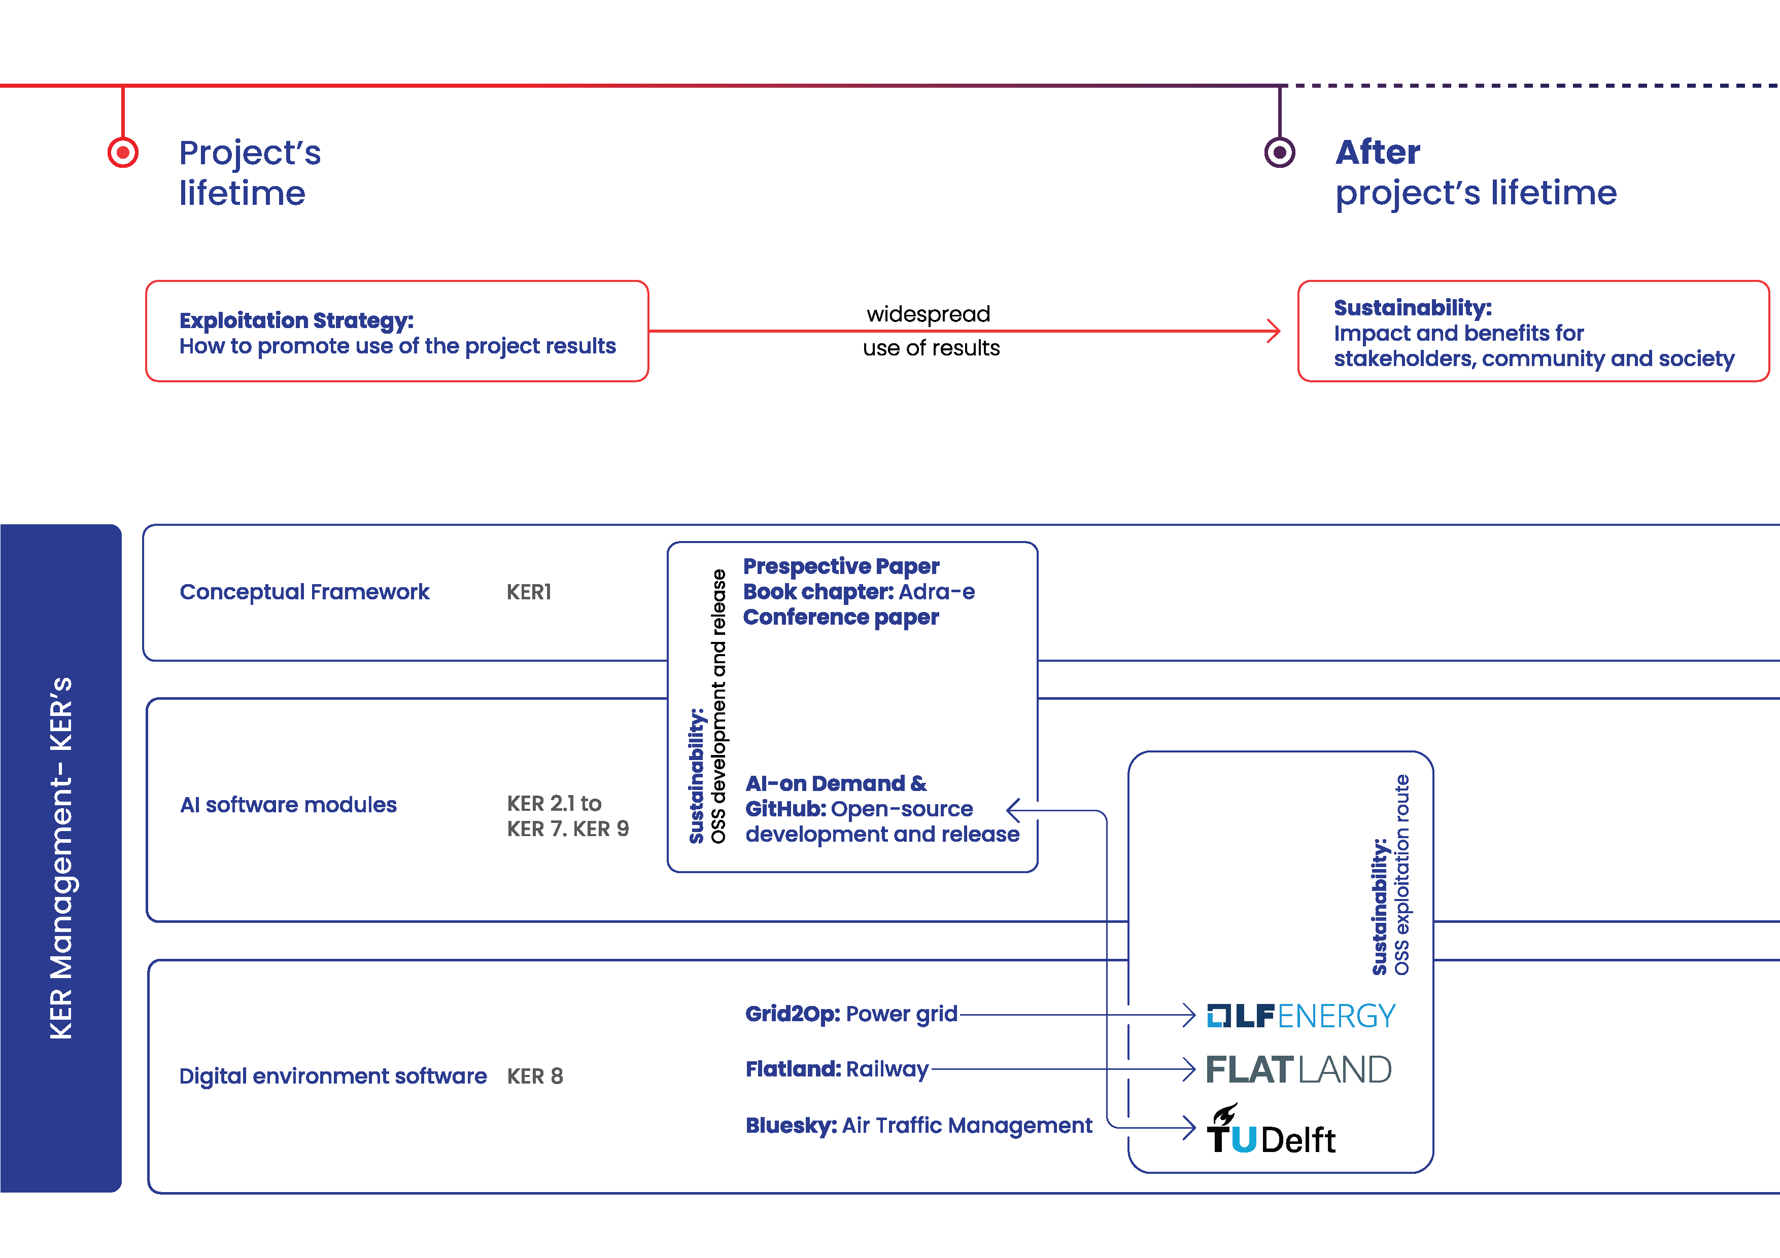


Exploitation pathways
already integrated in LF Europe
AINETUS

Slide 6

AssistFlux : An AI Assistant for grid operations
RTE, French TSO | 100 000 km of HV lines
Dispatchers analyze grid security to prepare operations in D-1
3 to 5 curative actions must be prioritized per constraint
Exhaustive exploration of all available actions is computationally too costly
How to select relevant curative actions from thousands of candidates ?
The solution : AssistFlux, an AI –powered assistant that predicts curative topological actions to relieve N-1 constraints, zone by zone across the French grid
Target deployment: 30 zones covering the entire French transmission network

Slide 7
AssistFlux: 2 key contributions from AI4REALNET
AssistFlux is based on supervised learning: the model is trained on historical grid situations paired with action effectiveness scores, computed by simulation. At inference, it predicts the most relevant actions without running exhaustive computations.
Challenge 1 – Training: how do you define a good action?
The training objective determines what the model learns. How do you score each candidate action in a way that reflects operational reality, not just which action is technically optimal?
Challenge 2 – Evaluation: how do you know the model works in practice?
Beyond technical metrics, the model must be validated with dispatchers on real operational scenarios. Designing a meaningful evaluation requires bridging the gap between AI performance indicators and what operators actually need.

Slide 8
How AI4REALNET results made a difference
Training: soft labels from Hassouna et al. (2025), ECML PKDD (AI4REALNET)
Standard AI training tells the model “this is the one right action, ignore the rest“
➔ in practice, several actions can be effective, just to different degrees
AI4REALNET introduced a smarter approach: each action receives a performance score
➔ the model learns from the full picture
The approach was integrated into Assistflux within 1 month
Evaluation: AI4REALNET KPIs inspired our dispatcher evaluation design
Designing a meaningful evaluation with grid operators is not trivial
AI4REALNET project gathered expertise across multiple critical infrastructure domains
Evaluation framework (deliverable D4.1) directly influenced how AssistFlux evaluation with RTE dispatchers
Hassouna, Mohamed, et al. "Learning topology actions for power grid control: A graph-based soft-label imitation learning approach." Joint European Conference on Machine Learning and Knowledge Discovery in Databases. Cham: Springer Nature Switzerland, 2025.

Slide 10
Backup slides

Slide 11
Benefits from the open-source model
Opportunity for collaborative improvement of an end-to-end stack for AI assistants (algorithms → HMI)
Encourage co-creation with critical infrastructure operators and vendors
Increase awareness for the development and human-in-the-loop testing of AI solutions aligned with the EU AI Act
Facilitating continuous improvement of RL agents & HMI (towards agentic AI)
Open-source to accelerate adoption and impact
Linking to other similar efforts beyond Europe (via Linux Foundation) and exploring potential for cross-sector collaboration

Slide 12
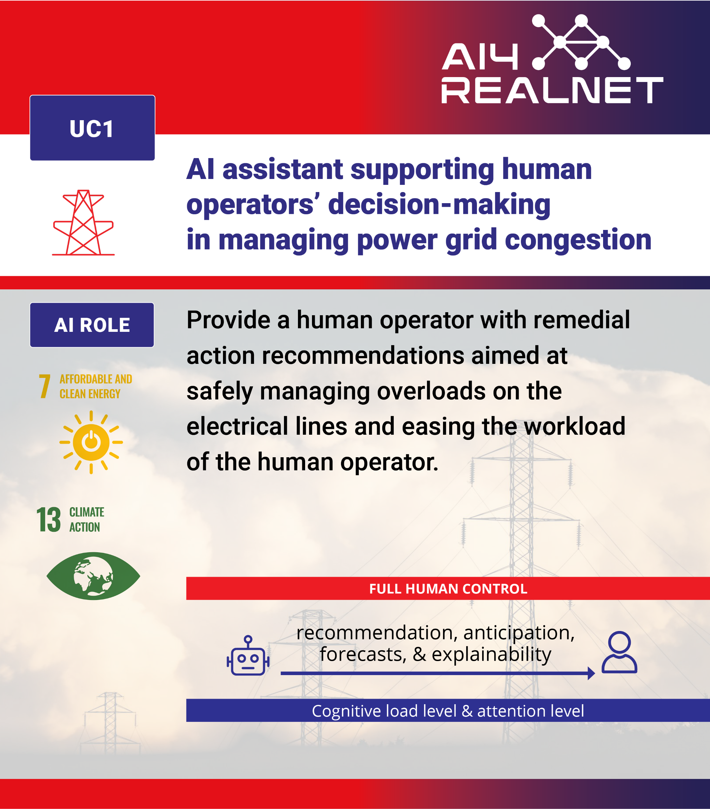
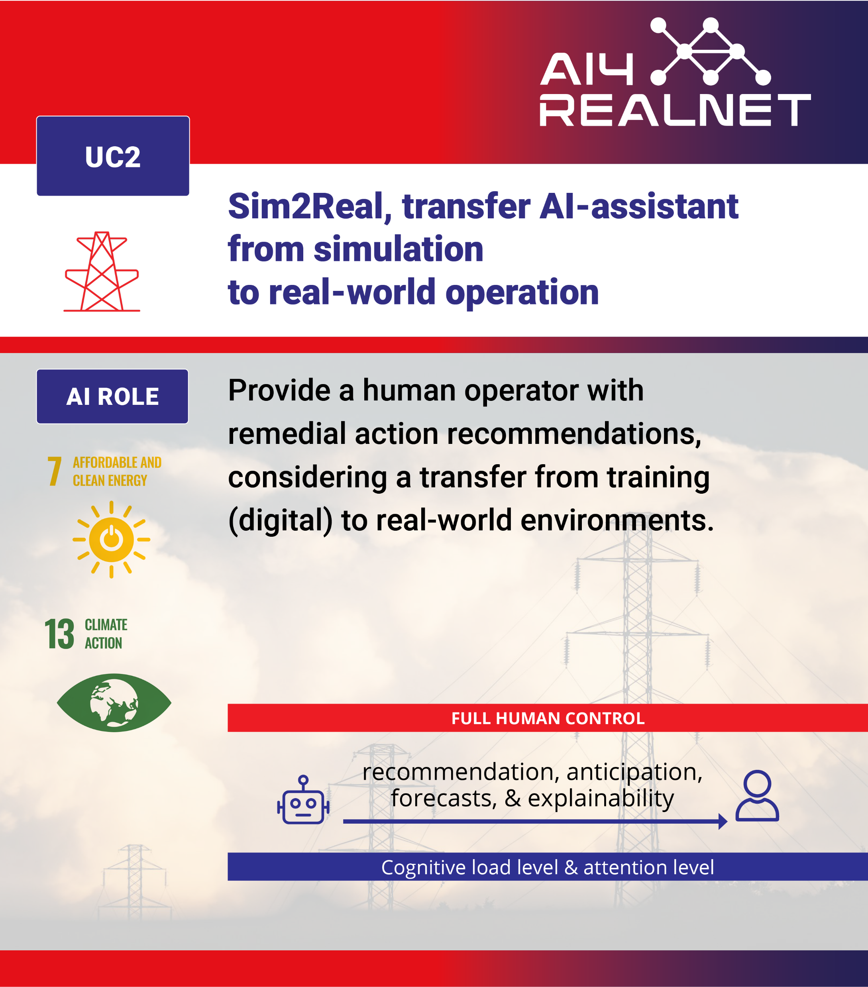
Use cases

Slide 13
AINETUS platform
OSS license: MPL-2.0
InteractiveAI [human-AI interface]
Grid2Op [environment]
AI Assistant
Reinforcement learning (RL) agents
Distributed RL
Co-learning
DeepQExpert
Safe RL
GNN power grid control
Alarm functions
Failure prediction
Uncertainty modelling and prediction
Explainability dashboard
Graph Neural Solver for power flow calculation

