Slide 1



Defence Topic Group
Krzysztof Lipiec – Łukasiewicz PIAP
Brussels 16/04/2026

Slide 2
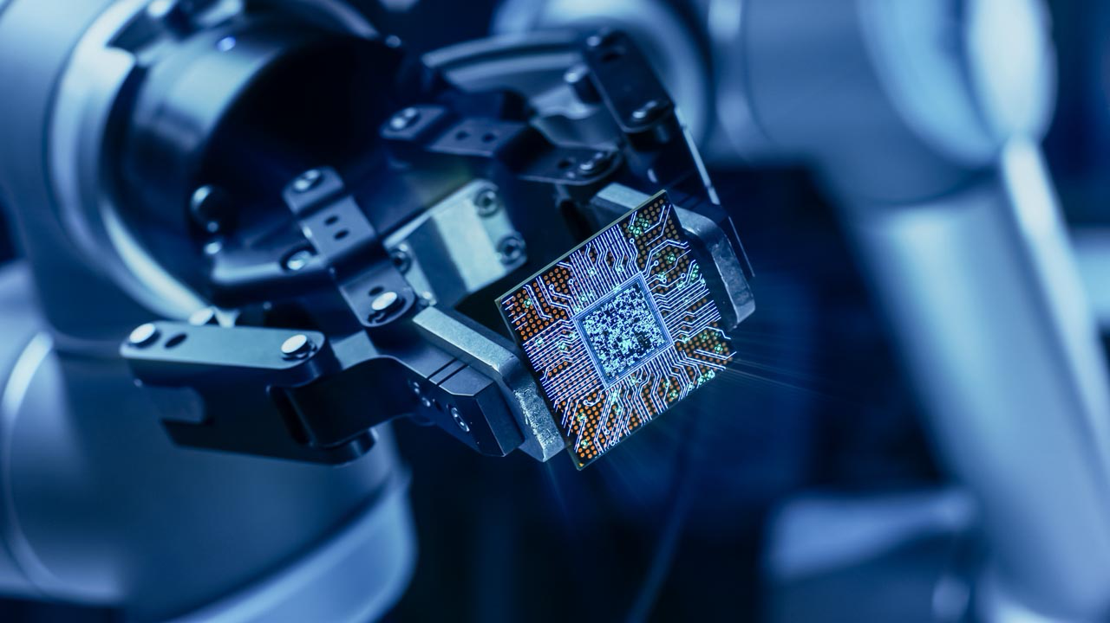
Why this Topic Group matters?
Context: Europe faces a lasting security shift. Technological capability, industrial capacity and strategic autonomy are now inseparable from defence and resilience priorities (incl. hybrid/cognitive threats and critical infrastructure).
Goals:
Strengthen the role of Europe’s AI, data and robotics community in defence, security and resilience.
Provide a structured platform linking research, industry, public authorities and end-users.
Translate technological and operational insights into research, innovation and policy input.
Bridge the gap between industrial demand, research capability and EU policy processes.
Hels members prepare for future European funding opportunities, including FP10.
We translate Europe’s civil tech strength into defence-relevant capability
2 |

Slide 3
What it delivers?
What we do?
Feed defence/dual-use perspectives into ADRA SRIA and roadmaps.
Run thematic workshops/webinars/matchmaking to support members’ readiness for upcoming funding opportunities (FP10 and complementary instruments).
Value for members:
A structured mechanism to articulate a shared, credible voice grounded in real industrial and end-user needs.
Translate ADR expertise into coherent research, innovation and policy inputs.
Recent Activities:
Online Panel: AI, Data and Robotics against Hybrid Warfare (10 February 2026)
Keynotes: Europe’s Defence today (Morten Irgens)
Why interoperability is a dangerous myth (Benoit Wintrebert)
Workshop: AI, Data, and Robotics for the Future of European Defence (23 September 2025)
3 |

Slide 4
TG focus topics
AI, data and decision superiority: AI/data for defence, command-and-control and situational awareness.
Operational concepts: multi-domain operations: MDO implications for capability development, interoperability, and procurement.
Cyber, cognitive and trustworthy security: Cybersecurity, cognitive security, and trustworthy AI (robustness, assurance, governance).
Defence industrial base: production, materials, sustainment: Manufacturing, advanced materials, logistics/supply chains/maintenance.
Resilience of critical infrastructure: Protection and continuity of essential assets (physical + digital).
Autonomous and unmanned systems for defence: Robotics, UxV, and automation adoption (barriers/opportunities), plus what’s actually deployed on the front line.
EU influence and funding pipeline: European defence strategy: Adra levers of influence + EDF 2026 work programme webinar.
4 |

Slide 5
Members
RTO: 37
Academia: 17
Industry: 16
Gov & NGO: 11
Steering Committee
TG Chair: Krzysztof Lipiec (Łukasiewicz-PIAP, Poland),
Emanuela Girardi (ADRA President, POP AI, Italy),
Morten Irgens (Oslo Metropolitan University, Norway),
Pascal Bisson (Thales, France),
Benoit Wintrebert (Inria, France) ,
Jesper Rindom Jesen (Aalborg University, Denmark)
5 |

Slide 6




Adra
Rue Belliard 40, Brussels 1040
Belgium
+48 667 707 262
krzysztof.lipiec@piap.lukasiewicz.gov.pl

