Slide 1


Future Ready 2026 – Harnessing AI, Data and Robotics for Next-Generation Innovation, April 16th, Brussels
Success Stories Showcase – AIDEAS project
Georgia Apostolou (CERTH), AIDEAS project coordinator
Fabrizio Defant (PAMA pilot)

Slide 2
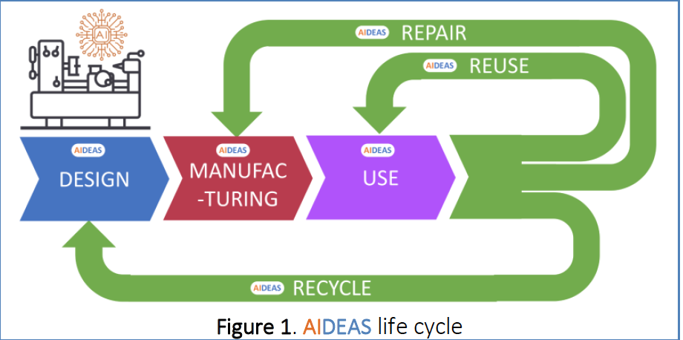
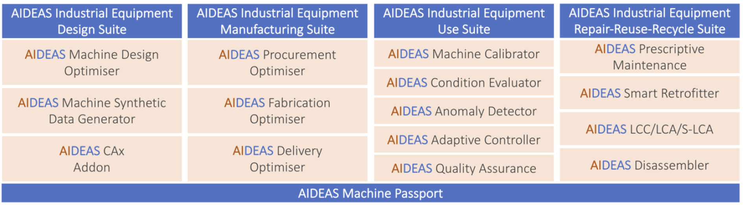
Project Summary
AIDEAS developed AI technologies for supporting the entire lifecycle (design, manufacturing, use, and repair/reuse/recycle) of industrial equipment as a strategic instrument to improve sustainability, agility and resilience of the European machinery manufacturing companies.
AIDEAS Project deployed 4 integrated AIDEAS Suites and 1 AIDEAS Machine Passport as Key Exploitable Results:
The 4 AIDEAS Suites composed by 15 AIDEAS Solutions for the improvement of a set of Key Performance Indicators (KPIs), linked with the AIDEAS specific objectives.

Slide 3

OUTCOMES
AIDEAS Solutions are applied to the entire industrial equipment life cycle:
DESIGN: to optimise the industrial equipment design with AI-assisted tools that generate product design suggestions for the optimal construction of machines, allowing companies to reduce waste and to increase the ability to respond to the changing needs of customers (resilience).
MANUFACTURING: to increase agility by operating in a predictable manner, even in the face of extreme complexity, with product delivery schedules predicted much more accurately to get much faster to market.
USE: to guarantee the proper industrial equipment installation and initial calibration, the fast machinery condition evaluation and anomaly detection combined with the adaptive control of industrial equipment, and to support the product quality guarantee and zero defects.
REPAIR-REUSE-RECYCLE: to support a circular production by AI-based solutions for repairing, reusing and recycling industrial equipment, achieving optimal productivity, recycling vs. downcycling, and optimising residual value of materials.

Slide 4
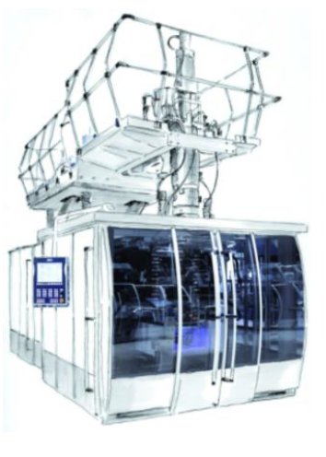
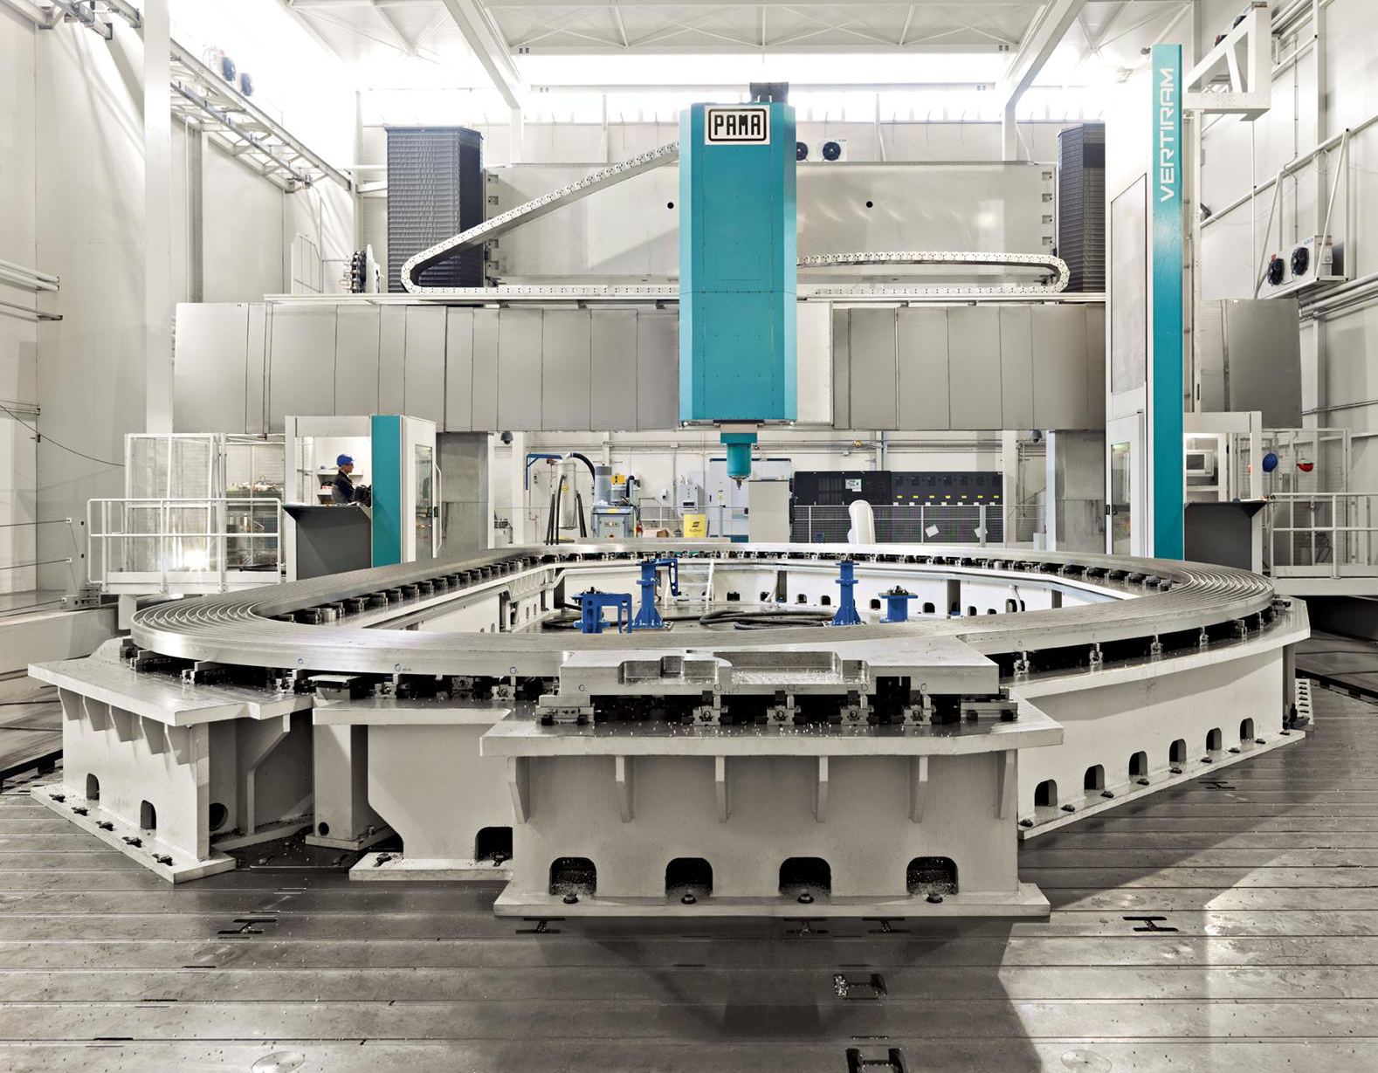
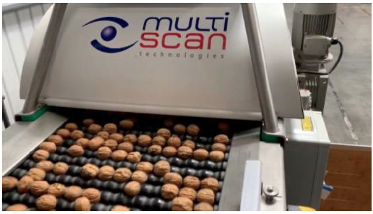
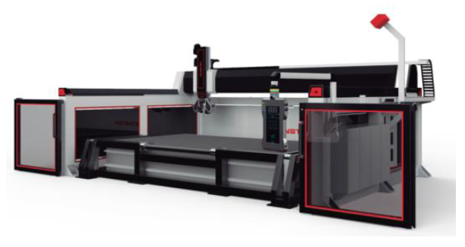
Pilots
The AIDEAS Solutions were demonstrated in 4 Pilots of machinery manufacturers that provide industrial equipment to different industrial sectors: metal, stone, plastic and food.
  PAMA SpA - AI for Machining Centres (metal sector)
  D2 Technology - AI for Cutting Machines (stone sector)
  BBM Maschinenbau - AI for Blow Moulding Machines (plastic sector)
  Multiscan Technologies - AI for Inspection Machines (food sector)

Slide 5

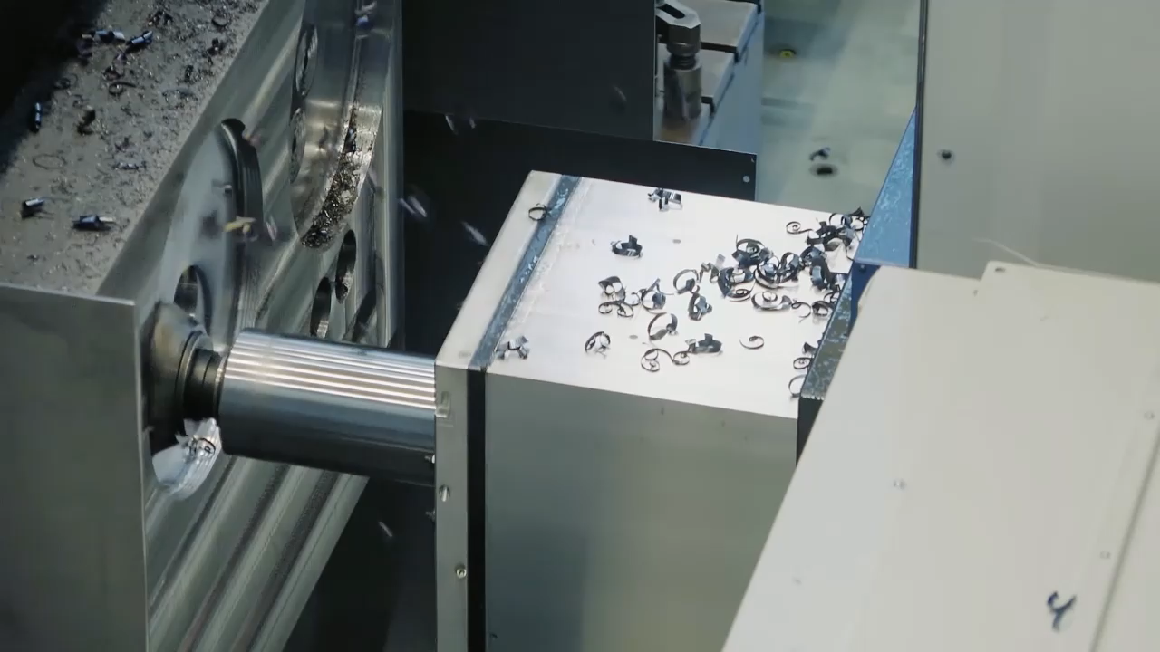
PAMA - AI for Machining Centres
Producer of large size milling and boring machine and machining centers, providing user-oriented services and solutions
www.pamamachinetools.com
Notes:
Large machine tools
Machines making machines
Remove material to shape final part

Slide 6
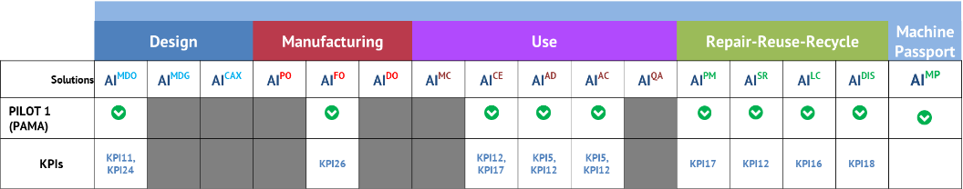
Challenges
Before AIDEAS (2022),
PAMA collects relevant process data and sensor signals from its machines (located at company shopfloors and at customers sites) and stores them in a centralized data lake
Only relevant data for production were extracted​
The knowledge about AI adoption in the industry was poor​
Challenges
Increase the understanding and knowledge about AI adoption and potential in industry, across the life-cycle phases: design, manufacturing, use and repair-reuse-recycle of PAMA equipment
Test solutions that provide added-value comparing competitors:
Reduction of delivery time
  Strong reduction of manufacturing time
  Smart maintenance planning
  Positioning as a circular-enabled manufacturer, offering sustainable and cost-effective end of life strategies

Slide 7
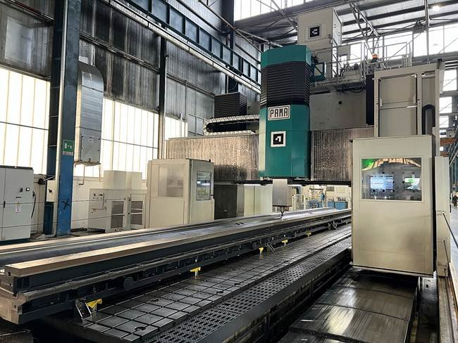
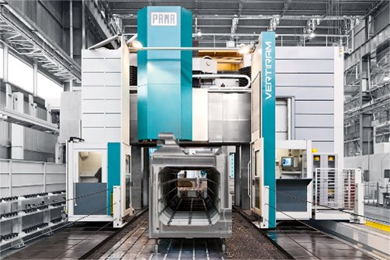
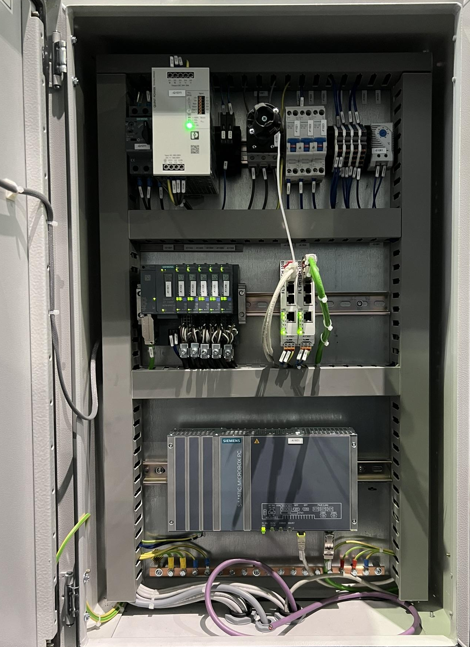
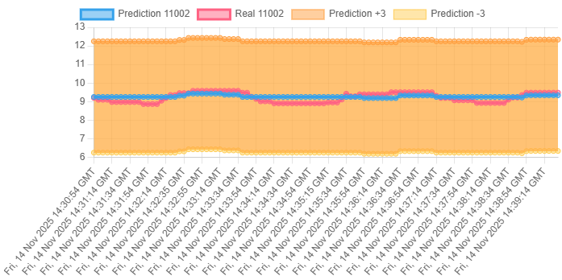
User Story – Rapair / Reuse / Recycle
BEFORE AIDEAS
Machines have not AI services
Cloud services for data acquisition
IMPACT​
The technological update of legacy machinary avoid obsolescence
It leads to >90% reduction of CO2 emission* with respect to a new installation
AI-SR data infrastructure enables the implementation of other AIDEAS solutions
No internet access​ or performant edge devices
Data Infrastructure
Old generation machines
AI-Smart Retrofitter (AI-enabler)
Data acquisition infrastructure (Hw and time series DB)
AI Solution with focus on energy consumption
  Metrics
  Consumption forecast
SR Hw
SR
Smart Retrofitter
REPAIR/REUSE/RECYCLE
*~260 t of cast iron structures
Notes:
SR is the enabler (scalability)
Need data --> plant life over 15 years (25-30)

Slide 8
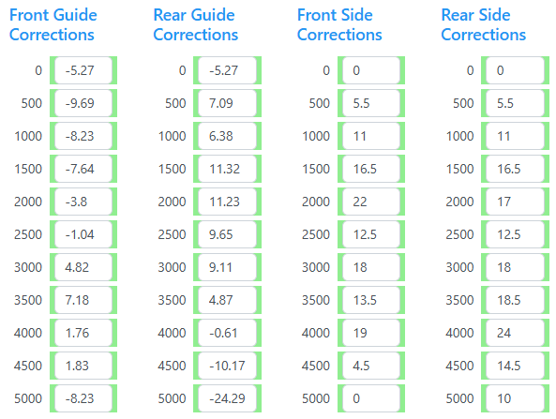
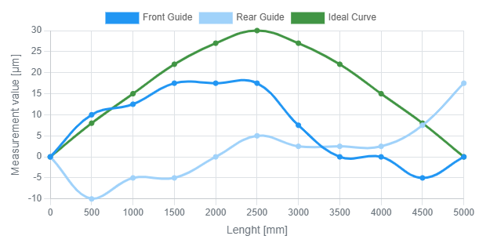
User Story – Manufacturing
MANUFACTURING
BEFORE AIDEAS
Tolerances are smaller than the precision of the machine
Many quality checks and re-machining were needed
FO
Fabrication Oprtimiser
Data Infrastructure
Column manufacturing process
AI-Fabrication Optimizer
Estimates the compensation path given the quality check report on relevant geometrical features
SR Hw
IMPACT​
As an average, the number of re-machining has decreased from 3 to 1
The current standard time has been reduced by 80 h
SR
Smart Retrofitter
REPAIR/REUSE/RECYCLE
Notes:
Operatore esperto azzecca correzioni, anche algoritmo AI lo fa

Slide 9
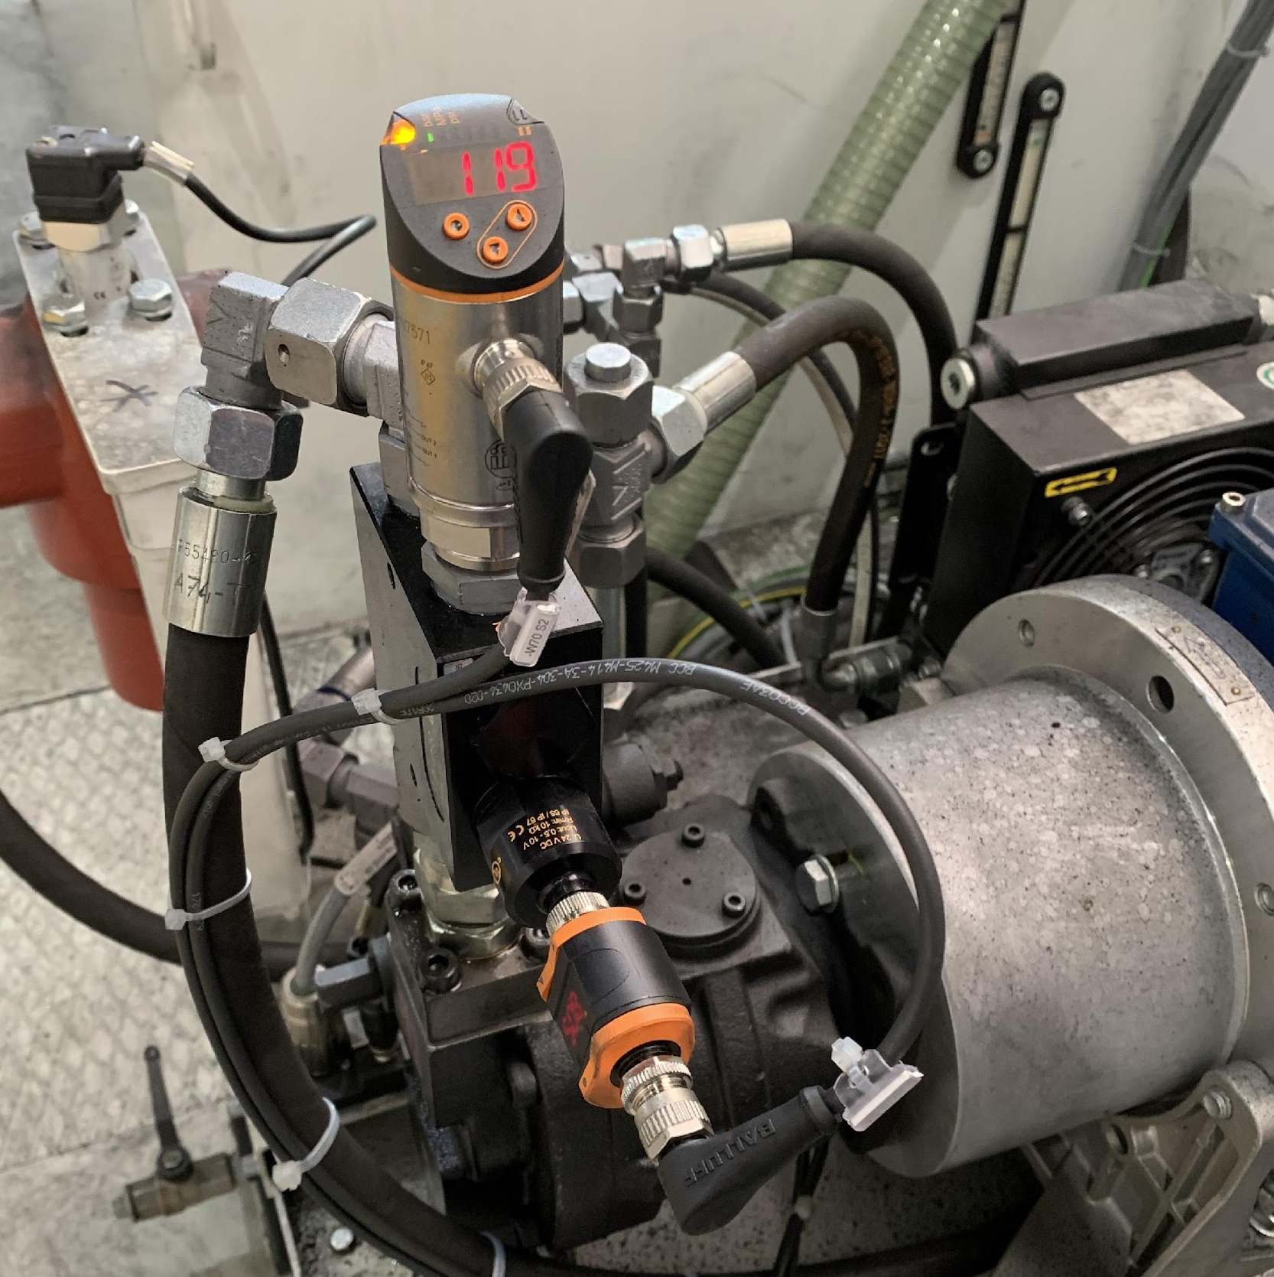
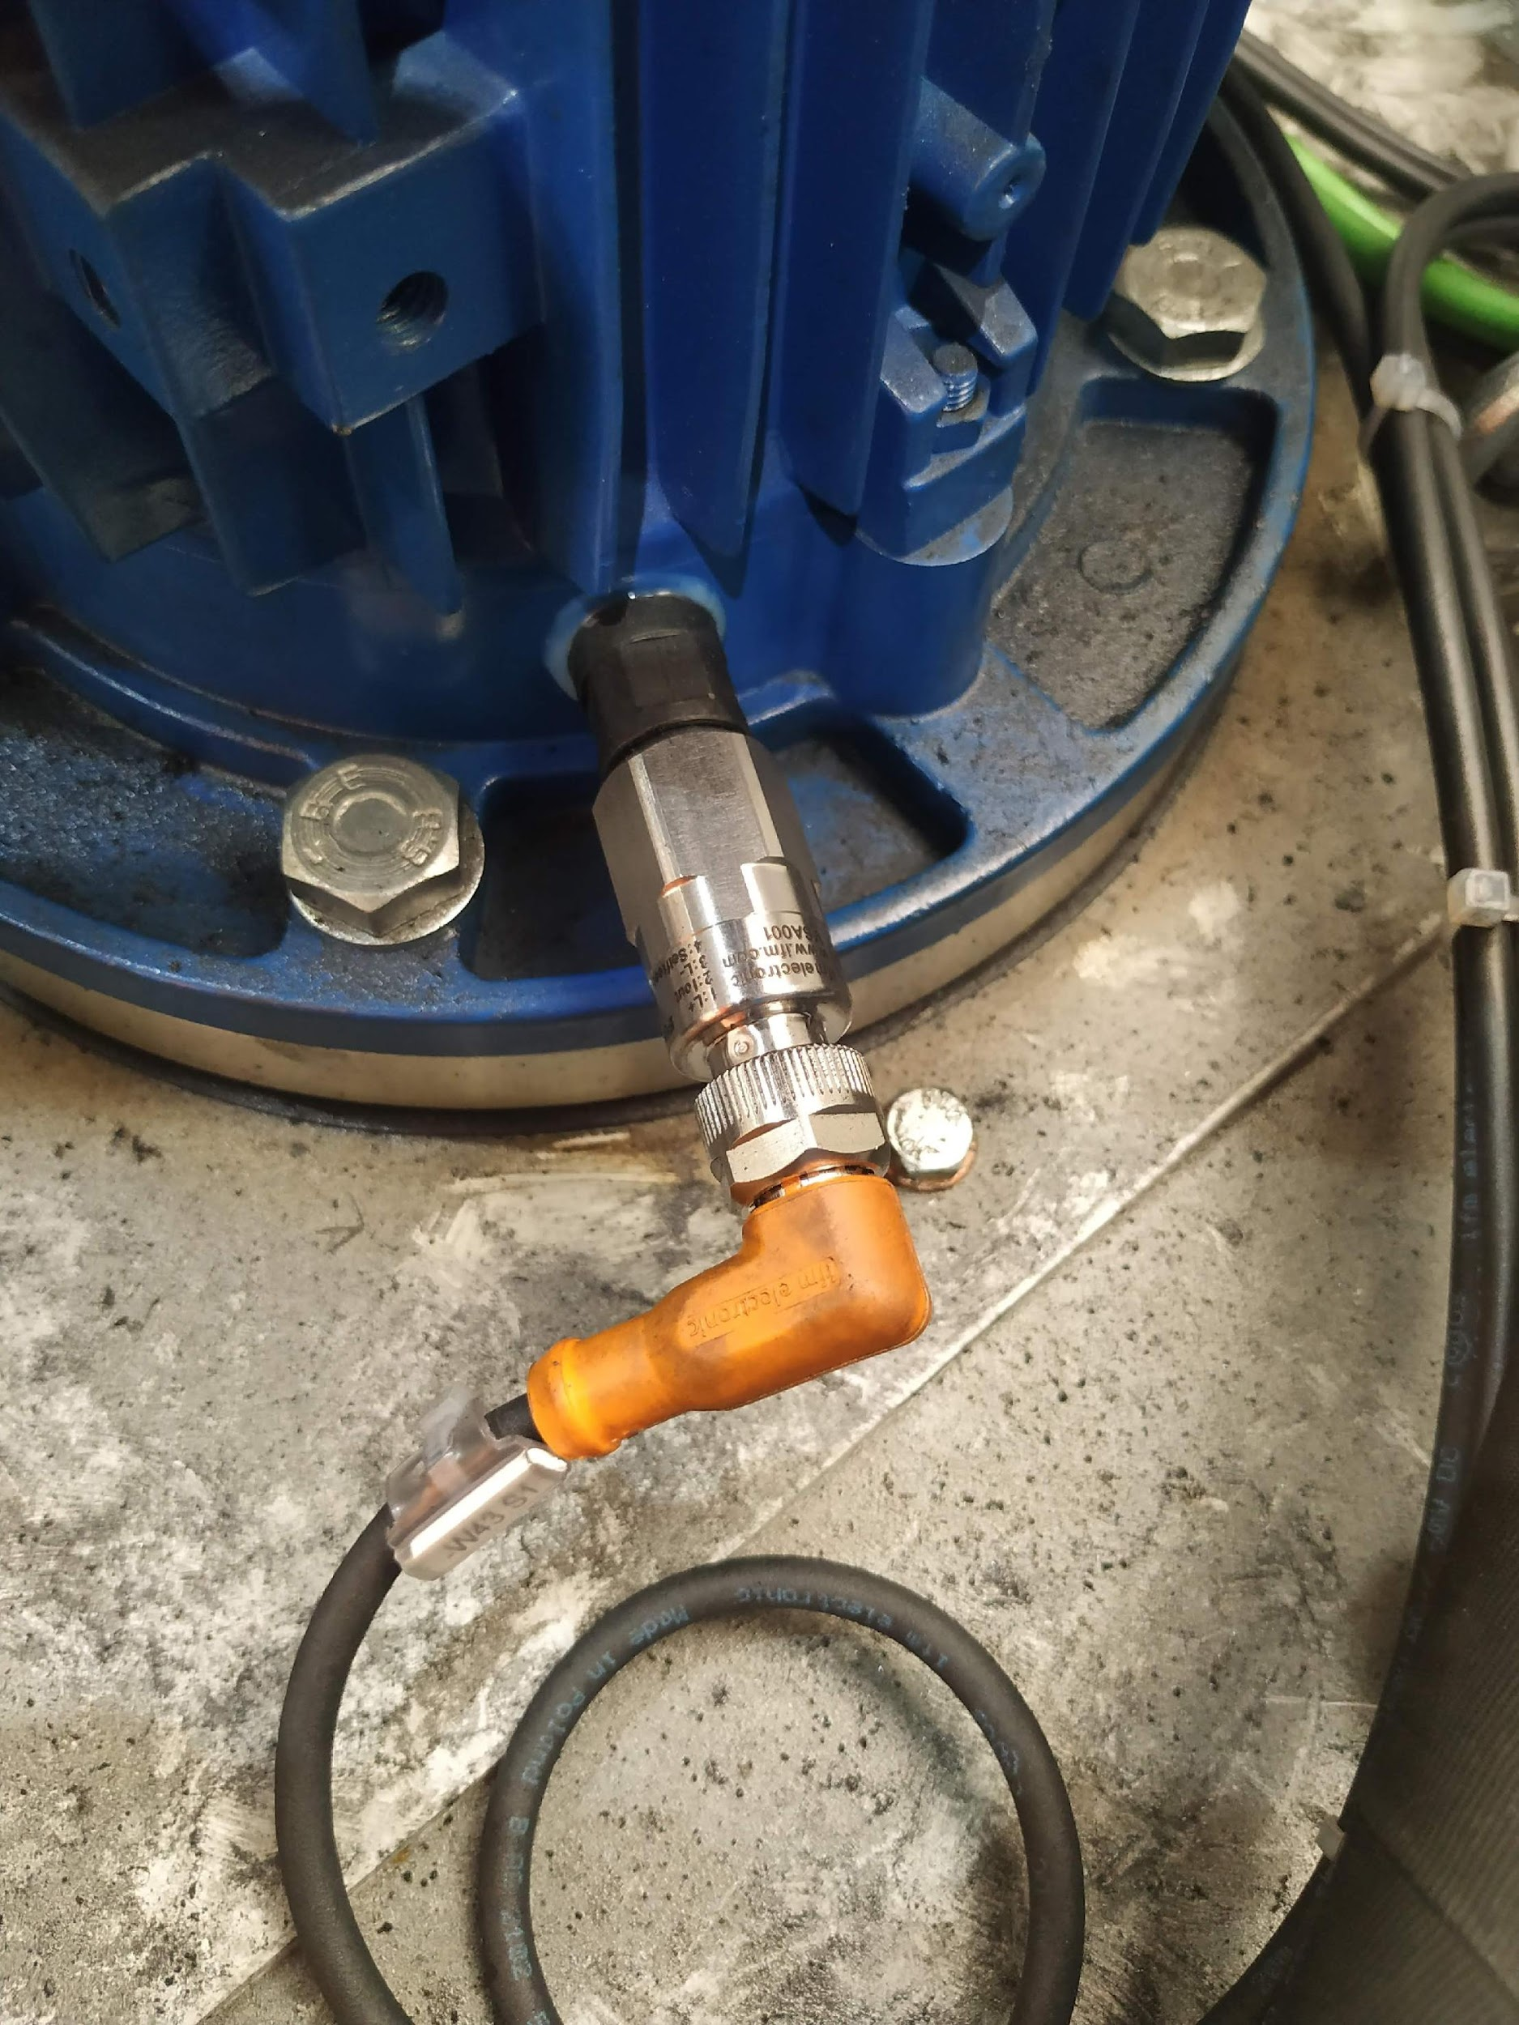
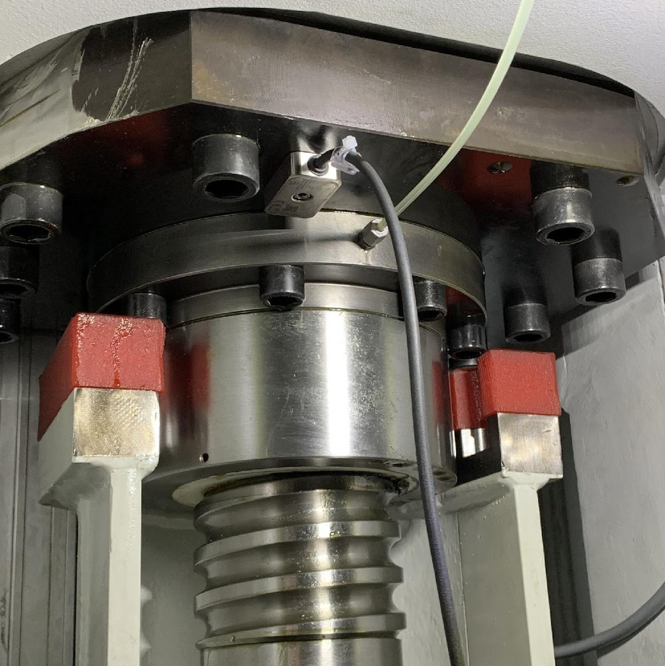
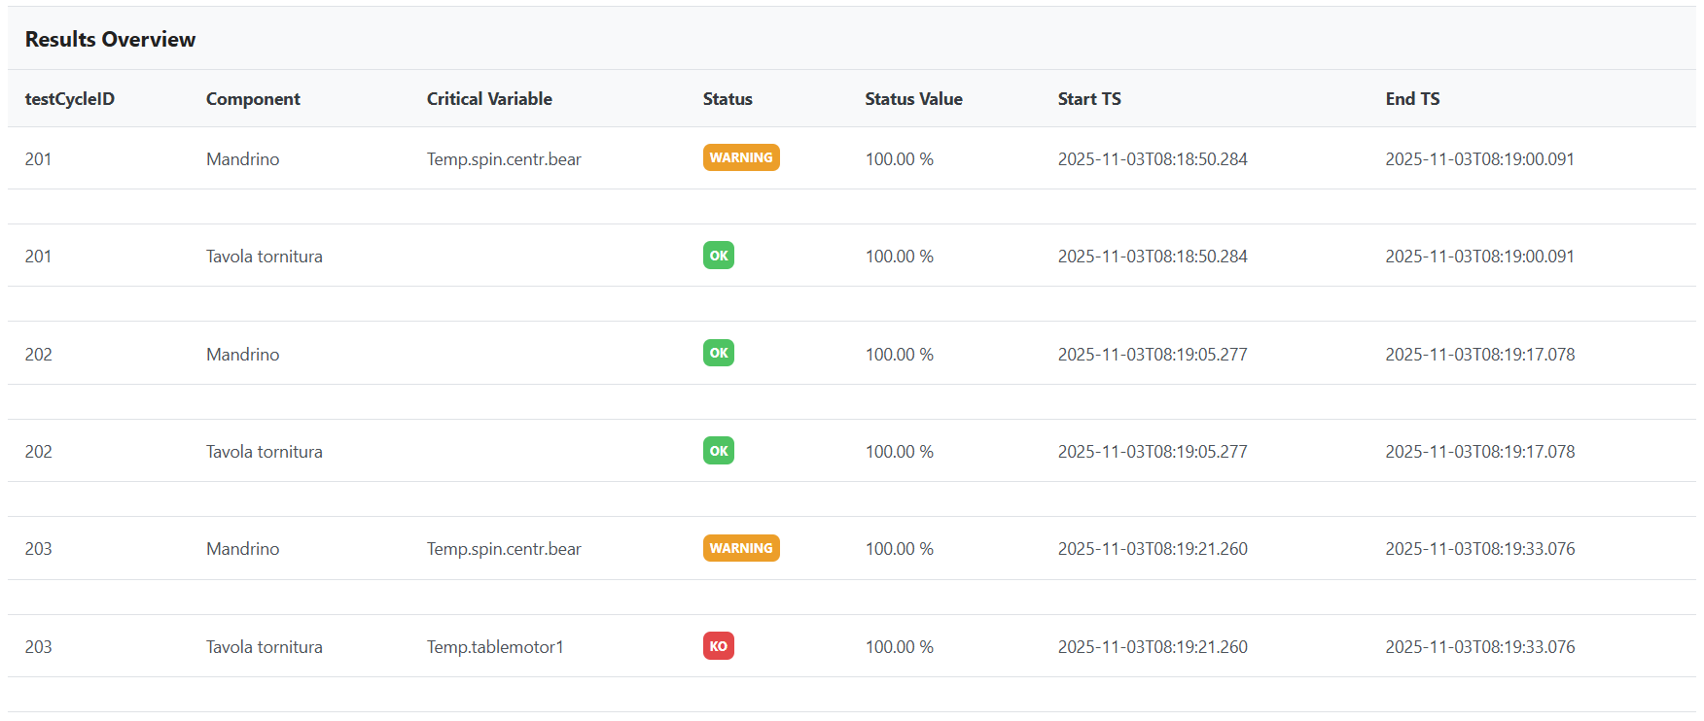
User Story – Use
BEFORE AIDEAS
Maintenance was completely reactive
Large workpieces could be damaged by critical failures; repair and re-machining were necessary and are energy demanding
Downtime could be long; even if spare parts and technicians are available, the intervention organization is time consuming
MANUFACTURING
FO
Fabrication Oprtimiser
Data Infrastructure
Pressure, flow & temperature
Accelerometers
USE
CE
Condition Evaluator
SR Hw
Bed line manufacturing process
IMPACT​
Condition based maintenance has been enabled
Energy saving up to 1.9 MWh/Detected failure (-69%)
Estimate downtime reduction around 20%
AI-Condition Evaluator
The AI-SR enables the acquisition from many other sources and sensors
The condition of critical components is evaluated over time
SR
Smart Retrofitter
REPAIR/REUSE/RECYCLE
Notes:
SR is the enabler (scalability)

Slide 10
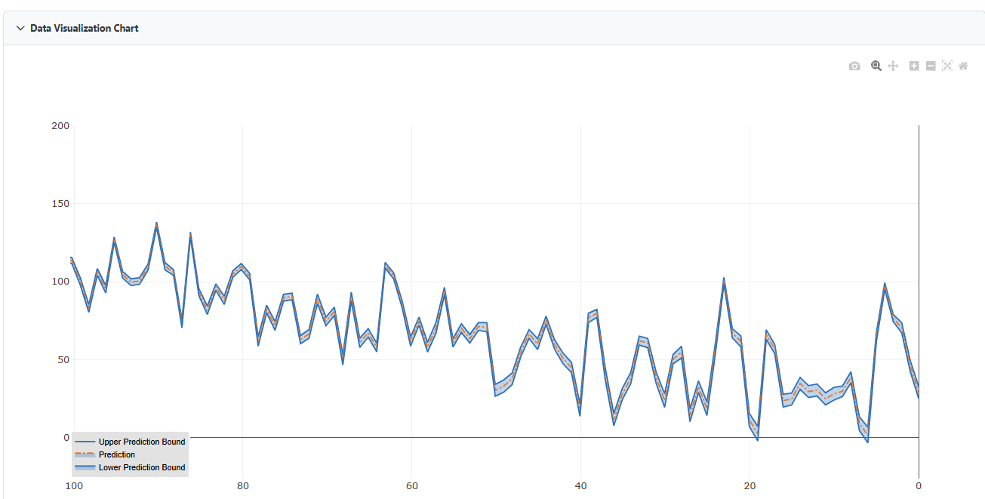
User Story – Repair / Reuse / Recycle
MANUFACTURING
BEFORE AIDEAS
Maintenance was completely reactive
Need of a spare parts warehouse to quickly face unexpected failures (in-house or from suppliers)
Expensive purchase of spare parts due to the need of quick supply
FO
Fabrication Oprtimiser
Data Infrastructure
Pressure, flow & temperature
Accelerometers
USE
CE
Condition Evaluator
SR Hw
PM
Prescriptive Maintenance
IMPACT​
Avoid conservative scheduling or unexpected failures
Estimate warehouse cost reduction around 10%
AI-Prescriptive Maintenance
The Remaining Useful Life is predicted, once the AI-CE detects a degradation
The training of the model needs failure data to achieve a good accuracy
SR
Smart Retrofitter
REPAIR/REUSE/RECYCLE
Notes:
SR is the enabler (scalability)

Slide 11
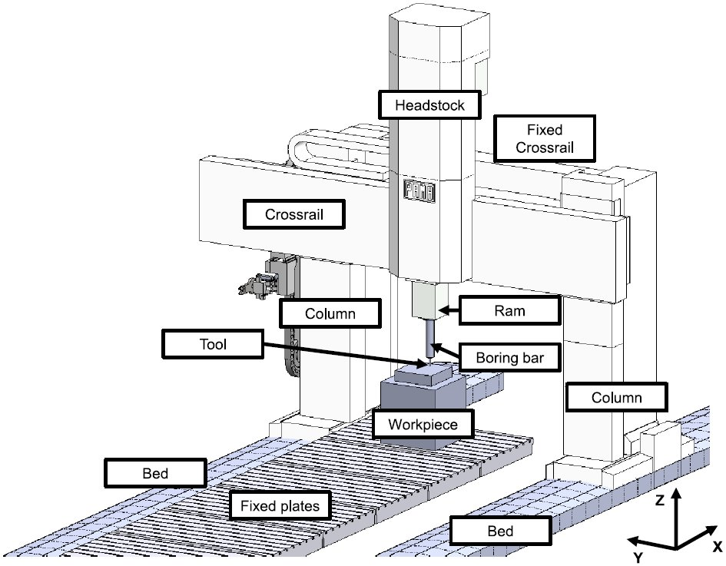
User Story – Design & Machine Passport
MANUFACTURING
BEFORE AIDEAS
Machines structures were re-designed according to the strokes and performances required by the customers
Modular design of machines (Pama Modular System – PMS) was under development
The selection of existing modules was based on experience
DESIGN
FO
Fabrication Oprtimiser
MDO
Machine Design Optimiser
Data Infrastructure
USE
MP
Machine Passport
Knowledge
CE
Condition Evaluator
Machine Passport (AI-enabler)
Up-to-date global picture of AI-Solutions
  Data sharing across solutions
  Facilitates decision making
SR Hw
IMPACT​
Reduction of the time needed to design the optimal solution
The combination with Design Automation has led to a design time of 1 day
Modules selection closer to real customers need, which leads to mass reduction around 3500 kg
AI-Machine Design Optimizer
Permit the optimal selection of PMS modules, according to real customers need
  Customer sector
  Similar machines
PM
Prescriptive Maintenance
SR
Smart Retrofitter
REPAIR/REUSE/RECYCLE
Notes:
SR is the enabler (scalability)

Slide 12

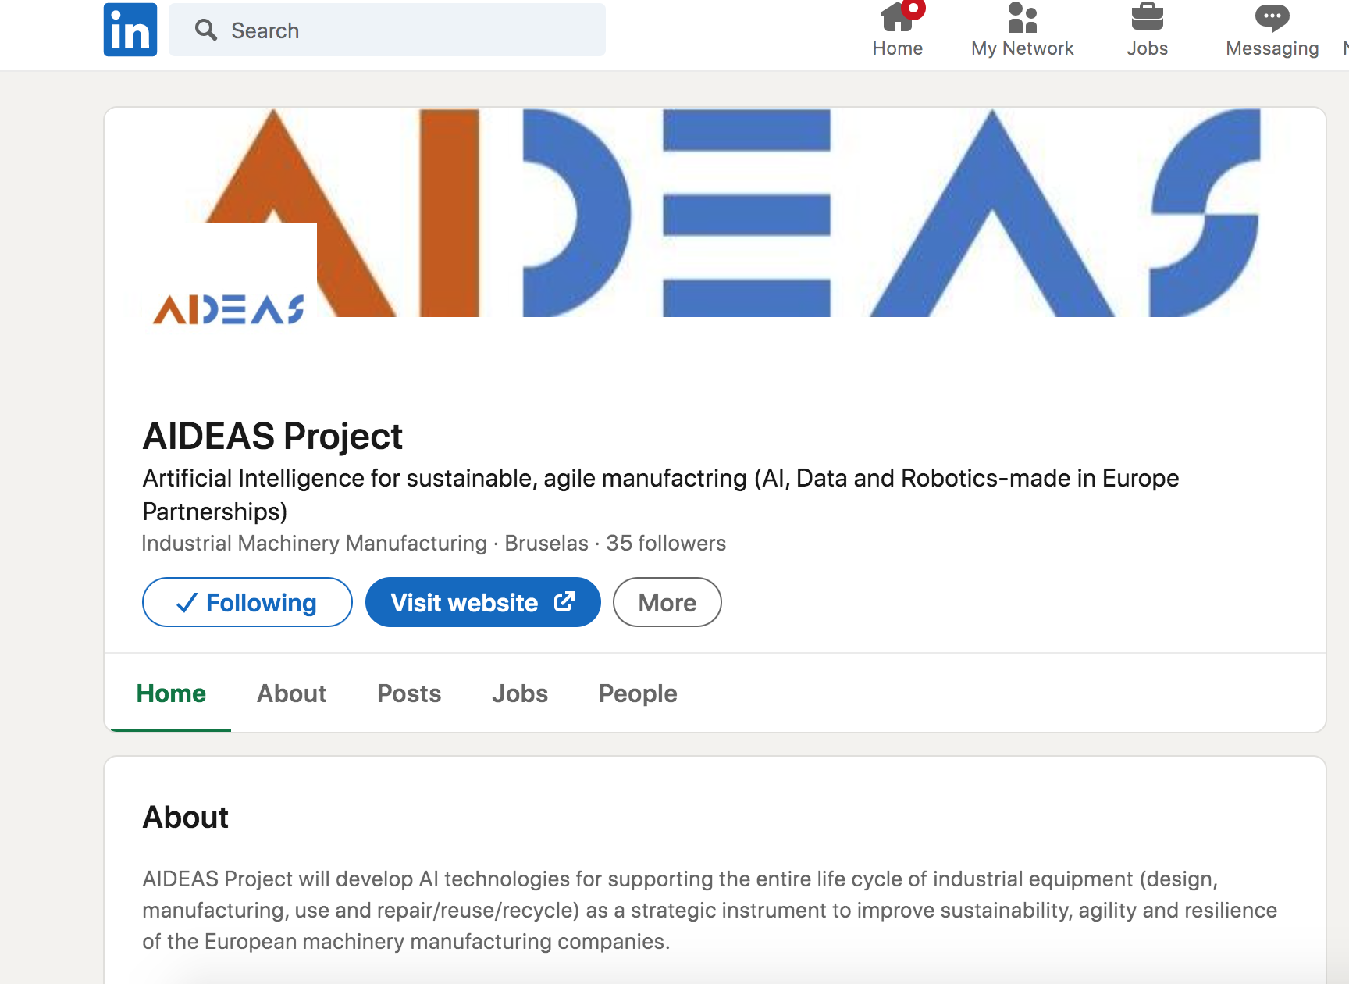


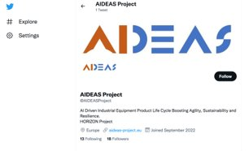
AIDEAS webpage and social media channels
https://aideas-project.eu/
https://www.facebook.com/AIDEASProject
https://twitter.com/AIDEASProject
https://www.linkedin.com/company/aideas-project/
https://www.youtube.com/@AIDEASProject

Slide 13
Dr.ir. Georgia Apostolou (CERTH)
AIDEAS Project Coordinator
gapostolou@iti.gr
Fabrizio Defant (PAMA)
Fabrizio.defant@pama.it

Slide 14
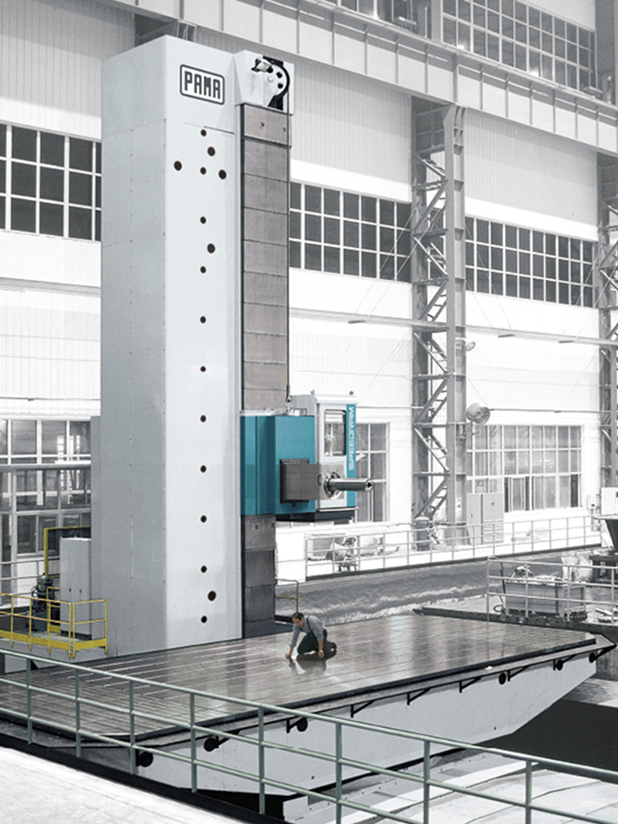
PAMA - AI for Machining Centres
Pama is an Italian company part of the Japanese NIDEC group
Headquarter in Rovereto (TN - Italy)
Production plants in Castel Mella (BS – Italy) and Shanghai (China)
Revenues 150M€ in 2024
Over the 75% of the production is exported overseas
Pama covers a strategic role in the industry
Supplier of the major players in Energy, Aerospace & Defence, Earthmoving, Naval, Railway, General Mechanics and Machinery
Strength points
  Modular design, enabling a high level of customization while ensuring quality and reliability
In-house machining of all large structures using Pama machines
The mechanical machining department is used as an R&D testing ground

