Slide 1
TG Mobility & Smart Urban Places
Margriet van Schijndel-de Nooij

Slide 2
TG Team
Coordinator: Margriet van Schijndel, TU/e
Co-coordinator: Oihana Otaegui, Vicomtech
ADRA Board member: Stefan van Baelen, imec
Expert panel:
Daniel de Klein, Helmond
Evelien Marlier , imec
Ovidiu Vermesan, SINTEF
Dena Kasraian, TU/e

Slide 3
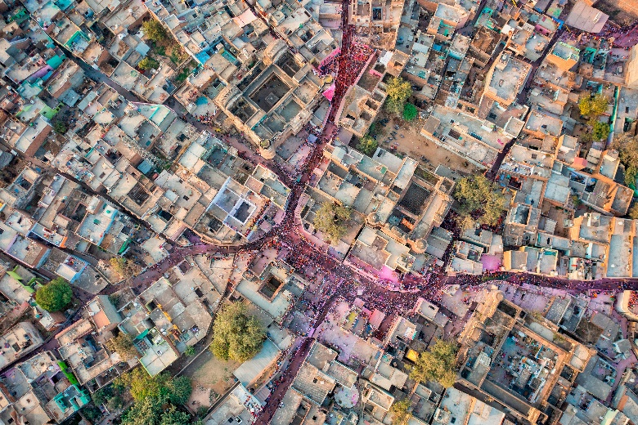


Introduction to the Topic Group
Mobility & Smart Urban Places:
Focus on the multifaceted challenges of urban life, mobility, inclusivity and sustainability, and the role of AI and data technologies.
Transformative and integrated solutions → create smarter, more liveable cities.
Focus on user acceptance, uptake of solutions, viable business models, societal benefits.
Extends to optimising (urban) energy systems, (scarce) resource management, systemic mobility approaches and solutions.

Slide 4

Introduction to the Topic Group; 7 key topics
Multimodal transport for people and goods
Urban development and connectivity between cities
Digital and green twinning
Connected, Cooperative, and Automated Mobility
Demographic changes and user acceptance
Urban energy systems and resource balancing
Multimodal hubs and smart places

Slide 5

Progress and activities
Bi-monthly online meetings
±10-15 participants
Mailing list: ± 40
Working towards a TG roadmap
Discussing collaboration opportunities
Taking into account the changing landscape
other Partnerships, ECAVA, …

Slide 6


Key insights
Working towards a TG roadmap
The need
The elements to be included
Challenges
Barriers
Risks
Main impact it can bring
Key topic 4 (Connected, Cooperative, and Automated Mobility): refocus
Include Software Defined Vehicle & go beyond the vehicle

Slide 7

Key insights – reoccurring topics
Working towards a TG roadmap
AI for systems’ optimization
Need to show added value of new digital technologies / new types of AI
Many data sources
Very diverse ecosystem (OEM, TIER, cities, service providers, research, …)
Impacts expected are quite diverse
Outlook on scalability and transition paths needed
City authority involvement is essential
User aspects in all key topics
What’s the right AI tool for the job…
Energy use of AI
Privacy, data use

Slide 8
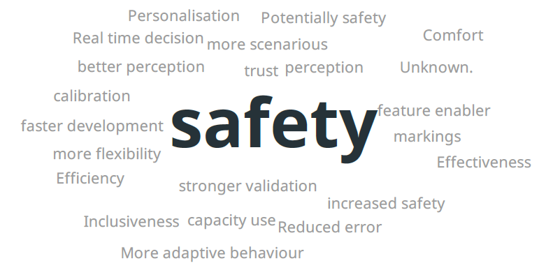
Key insights
How to define expected impact on e.g. a more sustainable overall mobility system, inclusivity, urban land use, affordability?
What positive effects of increasing levels of AI in CCAM do you foresee?
EUCAD conference, session on AI and CCAM
Where is the link to sustainable mobility?

Slide 9
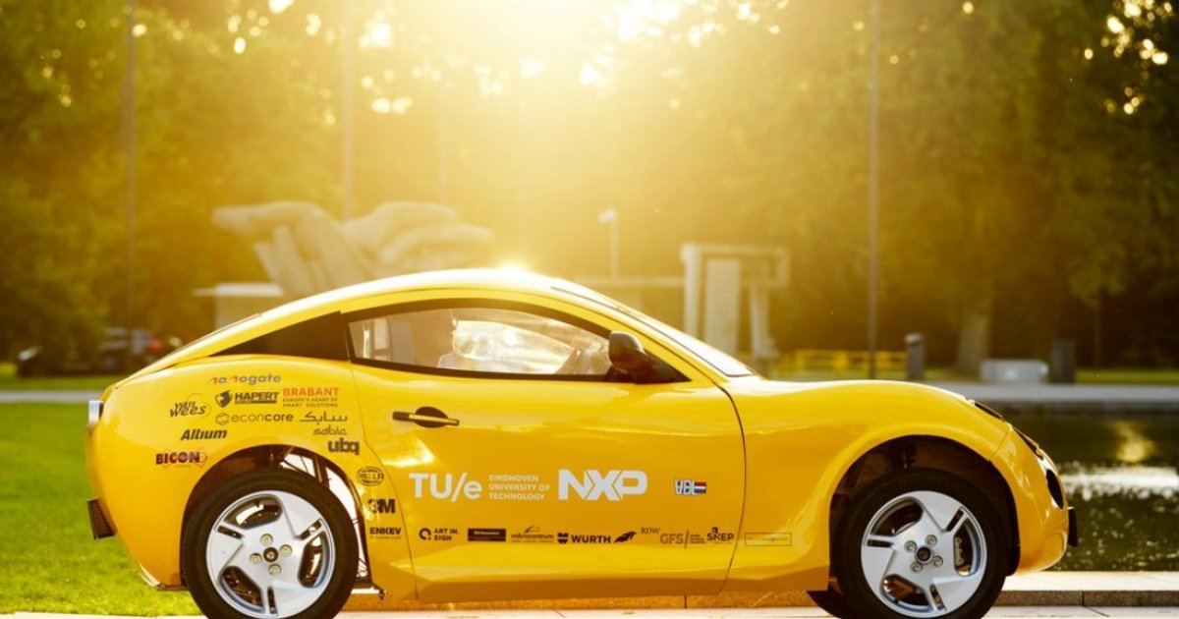
Next steps
Working towards a TG roadmap
6 out of 7 key topics: inputs gathered
Next: drafting 1-2 pages per key topic
Clarify: impact on a more sustainable overall mobility system, impacts on future mobility
Outlook on scalability and transition paths needed

Slide 10
AI made EAISI
Questions?

