Slide 1
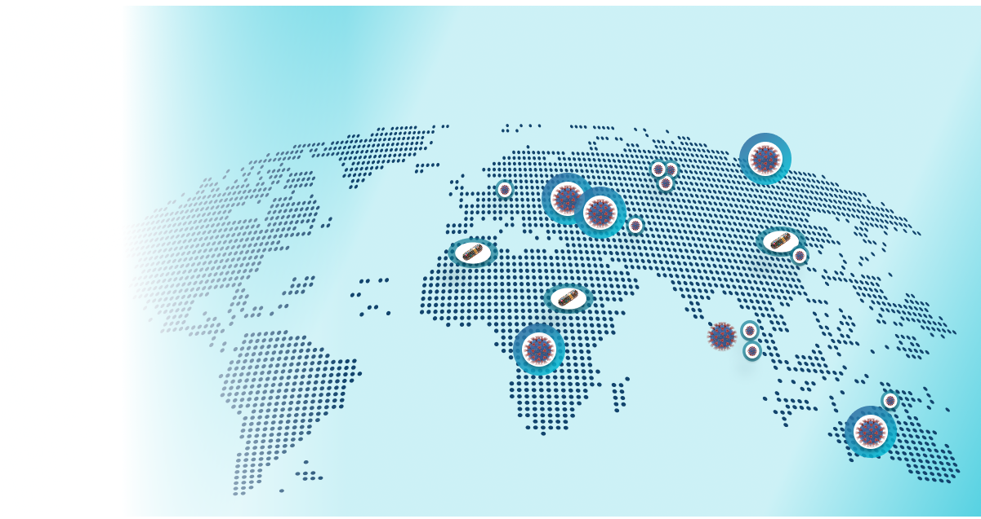
Health Gaps Amplified by Pandemics & Inequity
Why Smarter, Inclusive Healthcare Can’t Wait
Language barriers
Delayed diagnoses
Fragmented systems
Unprepared governance
Transform Patient support with smarter, globally accessible solutions

Slide 2
AI-Powered Health Access for All
AI-Powered Health Access & Intelligence Platform
Multilingual, culturally aligned virtual care
I-driven medical document analysis
Interactive health graphs & trend tracking
Predictive alerts & smart recommendations
Population-level analytics for public health
Personalized Care Global Reach Real-Time Impact

Slide 3
Advancing Equitable Health Through Global Collaboration
Cross-Border, Multidisciplinary Expertise
Our Impact Goals
AI, Ethics, Health & Inclusion
Global Public-Private Partnership
Public-private collaboration
Culturally-Aligned, Compliant Design
Preventive, Accessible Care Model
Ensure Equitable & Inclusive Access
Advance Predictive Health Insights
Strengthen Emergency Preparedness
Integrate Fragmented Care Systems
Empower Proactive Health Decisions
From Fragmentation to Coordination — Equity Starts with Access.
@My Health Today LTD. All Rights are Reserved
‹#›

