Slide 1
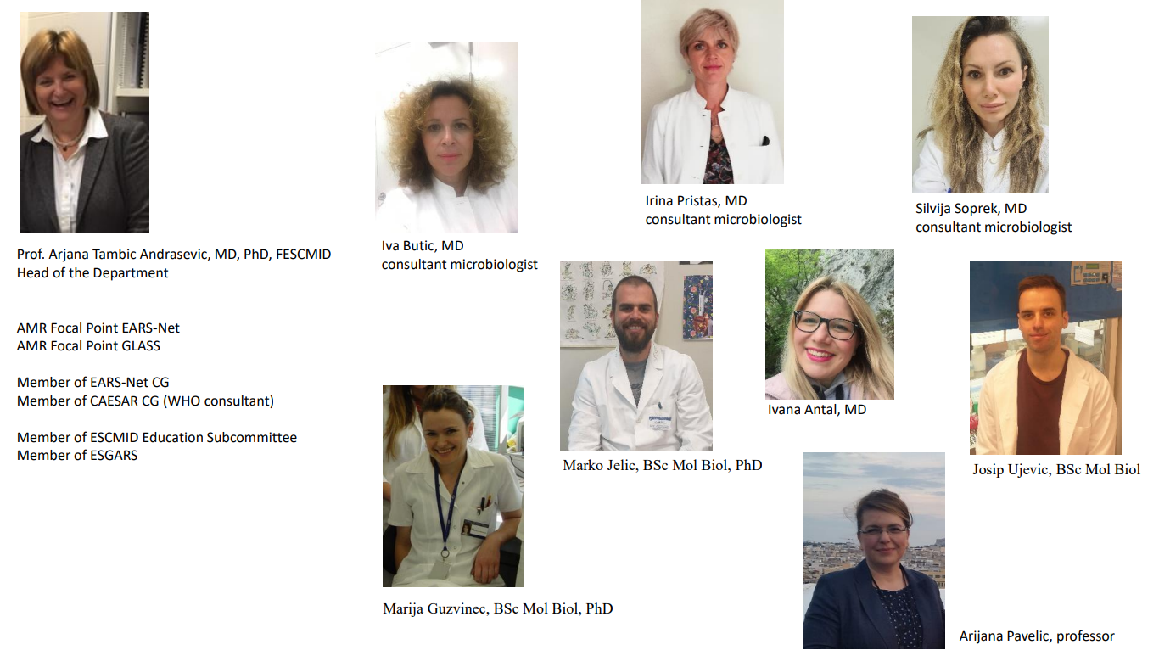
University hospital for infectious diseases, Zagreb Department od Clinical microbiology

Slide 2
Revolutionizing FMT with Generative AI

Slide 3
Key Innovations – AI Application & Personalized Therapeutics

