Slide 1
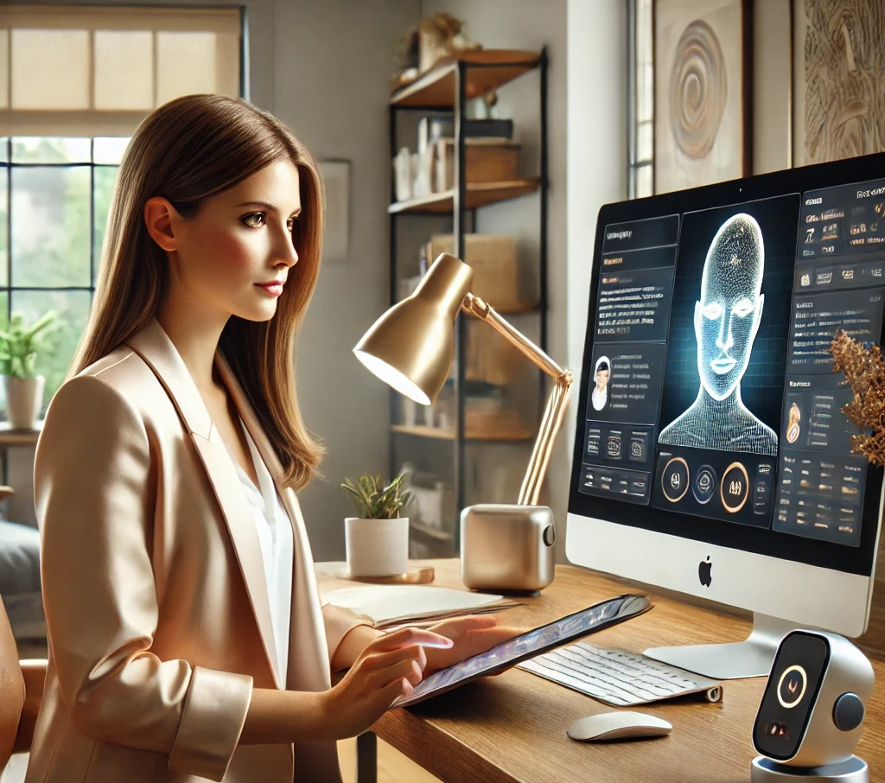
Happy Seniors
Introduction To The Nightingale System
Empowering Case Managers With AI-Assistant Automation Technology

Slide 2
Nightingale – Your Trusted Case Management Partner
Empowering Human Care Through AI Assistant Technology
To enhance professional case management by providing AI-powered tools that enhance efficiency, improve client outcomes, and enable case managers to focus on what matters most - human connection and support
Resource
Navigation
Specialized
Care Plans
Family Support
And Crisis
Management
Social Case
Management
Reporting and
Assessment
Tools
Automate
Red Tape
Manpower
Education
www.happyseniors.care

Slide 3
The Growing Challenges in Professional Senior Care Case Management
Global Aging Trends
The world’s rapidly aging population faces increasing chronic health challenges like dementia, diabetes, and cardiovascular diseases, straining global care systems
Professionals Shortage and Challenges
Average caseload has increased by 30% in past 5 years. Case managers spend up to 70% of their time on administrative tasks instead of direct client interaction
Desire for Independence
Most seniors wish to maintain their independence and age in place, but growing social isolation leads to mental health challenges like depression and anxiety
Financial and Technological Gaps:
Complex, time-consuming care management is exacerbated by rising costs and technological barriers that prevent many seniors from accessing quality-of-life improvements.
These challenges call for an innovative, scalable solution that can provide comprehensive, personalized care management over the long term

Slide 4
Our Solution: Nightingale Platform
1. 24/7 Client Knowledge Partner
Remembers every detail about each client
Instantly recalls case histories and interactions
Creates structured insights from unstructured data
Spots patterns and flags important developments
Provides real-time access to client information
2. Intelligent Administrative Support
Automates report generation and documentation
Handles complex form-filling across systems
Manages deadlines and follow-up tasks
Creates meeting summaries and action items
Streamlines compliance documentation
3. Professional Knowledge & Resource
Provides instant access to relevant resources
Suggests appropriate services and interventions
Offers evidence-based best practices
Recommends trusted third-party services
Ensures protocol compliance and quality standards
4. Management & Organization Tools
Quality Assurance & Standardization
Supervision & Oversight
Organizational Knowledge Management
Training & Development Platform
How It Works:
Nightingale works as your intelligent case management partner, automatically capturing and organizing client information while ensuring compliance with organizational standards. It handles administrative tasks, generates insights, and provides real-time support, allowing case managers to focus on direct client care.

Slide 5
Market Opportunity
Global Senior Care Market
$1.5 Trillion by 2025
Projected Market Growth
Annual Growth Rate
7.5% CAGR
Global 65+ Population by 2050
1.5 Billion
Key Markets
North America, Europe, Asia Pacific
TAM
$1.5T
Global senior care market
SAM
$300B
AI-enabled care management
SOM
$5B by 2034
Our target market share
Market Drivers:
Aging population and increasing life expectancy
Growing demand for personalized and tech-enabled care solutions
Shift towards home-based care and aging in place
Increasing adoption of AI and digital health technologies

Slide 6
Product Demo

Slide 7
Nightingale: Cutting-Edge AI Tech
AI Assistants based on LLMs and GenAI
Utilizes state-of-the-art tech (e.g., GPT-4, Sonnet, Perplexity) for human-like interactions, actions, and understanding complex contexts in senior care
Continuous Learning System
Implements a feedback loop for continuous model improvement, incorporating new data and user feedback to enhance accuracy and relevance over time.
Machine Learning for Personalization
Employs advanced ML algorithms to analyze user data, learning and adapting to individual needs over time for truly personalized care management
User-Centric Usability
Designed with a focus on intuitive interfaces and seamless interactions, ensuring the system is easy to use for non-tech case managers.
Privacy-Preserving AI
Implements federated learning and differential privacy techniques to ensure user data protection while maintaining AI model accuracy.
Cloud-Native Architecture
Built on a scalable, cloud-native infrastructure ensuring high availability, rapid updates, and seamless integration with various services and devices.
Key Technological Advantages
Adaptive Assistants: Learns and evolves with each user, providing increasingly personalized care over time
Multi-modal Interaction: Supports text, voice, and visual interfaces for inclusive user experience
Intuitive Design: User-friendly interface that's easily navigable by seniors and caregivers
Interoperability: Seamlessly integrates with existing healthcare systems and IoT devices

Slide 8
Business Model & Revenue Streams
Subscription Model
Tiered subscription plans for businesses, offering varying levels of AI assistance and features.
Premium Care Services
Additional revenue from advanced AI features, personalized care plans, and priority support options.
Marketplace Commissions
Revenue share from transactions on our integrated marketplace for senior care products and services.
Data Insights (B2B)
Aggregated, anonymized insights sold to healthcare providers, insurers, and researchers to improve senior care.
Key Business Model Advantages
Recurring Revenue: Subscription model ensures stable, predictable cash flow
Multiple Revenue Streams: Diversified income sources reduce business risk
Scalability: AI-driven model allows for rapid expansion with minimal marginal costs
Network Effects: Growing user base enhances marketplace value and data insights

Slide 9
Competitive Landscape
Feature / Element | Magic Notes by Beam | A Place for Mom | Care.com | Honor | HappySeniors
Founded | 2024 | 2000 | 2006 | 2014 | 2024
Investment into Platform | Unknown | $100 million+ | $111 million | $255 million | TBD
Main Business Model | Software as a Service (SaaS) for social work documentation | Referral service | Subscription-based | Home care services | Marketplace for senior care products and services, subscription for premium features
Revenues (2023) | Not applicable (launched in 2024) | $200 million | $211 million | Not publicly disclosed | TBD
AI-Powered Personal Assistant | Yes (AI-driven transcription and summarization) | No | Limited | Limited | Extensive, with personalized recommendations and task automation
Smart Home Integration | No | No | No | No | No
Health and Wellness | No | No | No | Yes, for home care management | No direct services; partnerships possible
Care manager and Business Tools | Yes (tools for social workers) | Yes (tools for partner facilities) | Yes (tools for caregivers) | Yes (tools for agencies and caregivers) | Extensive, including AI-driven management, and customer interaction
Community and Social Engagement | No | No | Yes (forum and community features) | No | Extensive, including social networks and intergenerational programs
Marketplace for Products and Services | NO | Limited (focused on care facilities) | Yes | No | Extensive, covering a wide range of senior-specific products and services
Financial and Legal Services | No | No | Limited (financial planning services) | No | Planned services for financial and legal assistance
Data Security and Privacy | Advanced (compliance with data protection regulations) | Moderate | Moderate | Advanced | Advanced.

Slide 10
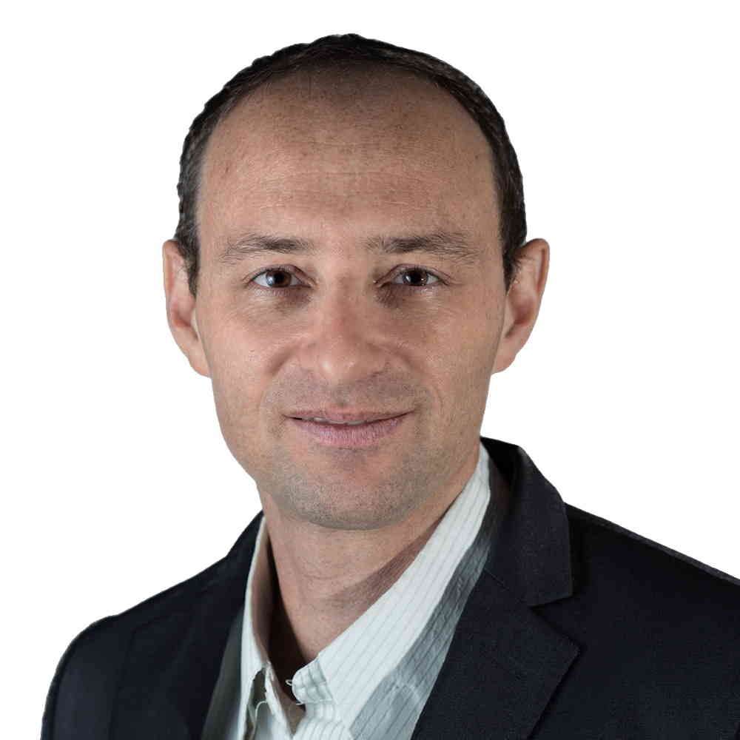
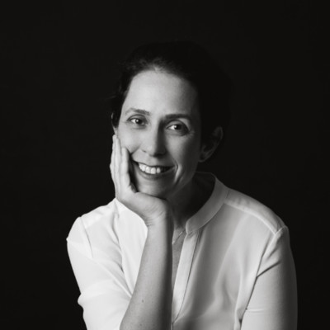
Core and Development Team
Irit Rabinovich
Co-Founder & CPO
MSc in Social Work, Haifa University
20+ years in senior care and social work
Pioneered innovative care management strategies
Avidor Rabinovich
Co-Founder & Co-CEO, CTO
BSc in EE, Technion; MBA, Haifa University
20+ years in tech leadership and AI development
Led AI initiatives at multiple successful startups
Neta Harel
Co-Founder & CSO
MSW, MHA
Expert in healthcare
Strategy & Partnerships
and Grants
Global Talent Pool
Development Team Based in India
Skilled in AI and machine learning
Expertise in cloud infrastructure
Agile development practices
UI/UX Team Based in Europe
Focus on senior-friendly design
Expertise in accessibility standards
User-centered design approach

Slide 11
Investments and Revenues
Funding Strategy
Pre-seed (2025): $2M grants
Seed (2026): $2.5M
Series A (2027): $7.5M
Series B (2029): $50M
Key Financial Metrics
Projected Revenue (2029): $25 million
Expected Break-even: Q4 2028
5-Year CAGR (2024-2028): 200%
Total Investment by 2029: $61.076 million
Investment Highlights
Efficient Capital Use: Leveraging grants and staged investments for growth
Rapid Scale: Projecting 200% CAGR over 5 years
Clear Path to Profitability: Break-even expected by Q4 2028
Strong Return Potential: Significant revenue growth projected post-Series B

Slide 12
Traction and Milestones
Market Traction
Serving dozens of families in Israel and abroad for senior care management
Israel Innovation Authority
Applied for initial funding, awaiting response
Strategic Partnerships
Established connections with partners and care companies for care management and caregiving
EU Horizon Program
Preparing application for consortium creation and funding
International Expansion
Initiated connections in international markets, including USA and Canada
User Base Expansion
Target 1000+ active users by end of 2024
Advanced AI Integration
Implemented cutting-edge LLMs and virtual assistants for feasibility testing
AI Case Manager Launch
Deploy fully functional AI-powered virtual social worker
Comprehensive Knowledge Base
Developed extensive information resources with AI-powered query assistance
Highlights
Dozens
Families Served
Multiple
Strategic Partnerships
Global
Market Validation

Slide 13
Join Us in Revolutionizing Senior Care
Why Invest in Happy Seniors Nightingale?
Tapping into $1.5T global senior care market
AI-driven platform with personalized care management
Projected 200 % CAGR over next 5 years
Experienced team with global development capabilities
Our Vision
Nightingale aims to become the leading AI-powered platform for comprehensive care management, enhancing the quality of life for millions of people and their families worldwide.
Investment Opportunity
We're seeking U.S. partners to join the BIRD Grant and gain a joint grant of $1M to develop the platform.
Contact Us
invest@happyseniors.care
+972 (54) 63096567
www.happyseniors.com
Become part of the solution to one of the most pressing challenges of our time

