Slide 1
Colorectal Cancer and Colonoscopy
Early detection with colonoscopy of colorectal cancer saves lives
but colonoscopy still faces limitations.
AI aided colonoscopy
9 patients out of 10
survive > 5 years if cancer is early diagnosed
€ 3.7M 5-year saving [1]
- 3.6% Mortality [2]
- 4.8% Incidence [2]
[1] Hassan et al., 2023
[2] Areia et al., 2022

Slide 2
Decision Support for Lesion Classification
The Role of M-LLMs
Current AI models for lesion classification output only the predicted class, without offering any clinical rationale.
Multimodal large language models (M-LLMs) offer a promising alternative by generating textual explanations that can enhance understanding and support clinical decision-making.
Commercial M-LLMs (GPT, Gemini, ..)
High performance in clinical tasks due to model’s extensive training data
Higher Explanation Quality wrt. Open Source Models
Reduced Hallucinations

Slide 3
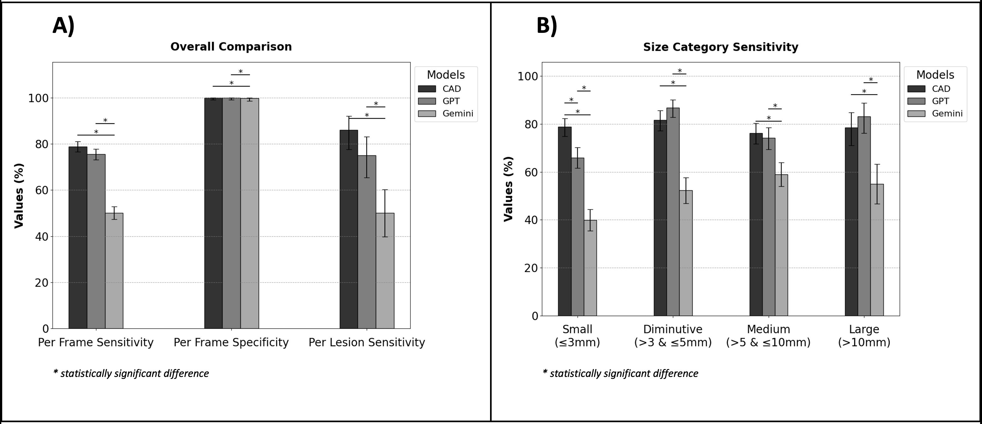
Decision Support for Lesion Classification
Lesion Detection Performances
Without any finetuning polyps detection performances are comparable to commercial AI aided classification devices devices (CADe)
Despite of this, classification performances are lower, this underlines the need of novel specific LLM
L. Carlini, D. Massimi, Y. Mori, G. Antonelli, T. Rizkala, M. Spadaccini, C. Lena, S. Parasa, R. Bisschops, D. von Renteln, S. O’Reilly, P. Sharma, D. K. Rex, M. Bretthauer, A. Repici, E. De Momi, and C. Hassan, "Large language models for detecting colorectal polyps in endoscopic images," Gut, vol. 0, pp. 1–3, 2025, doi: 10.1136/gutjnl-2025-335091.

