Slide 1


Slide 2
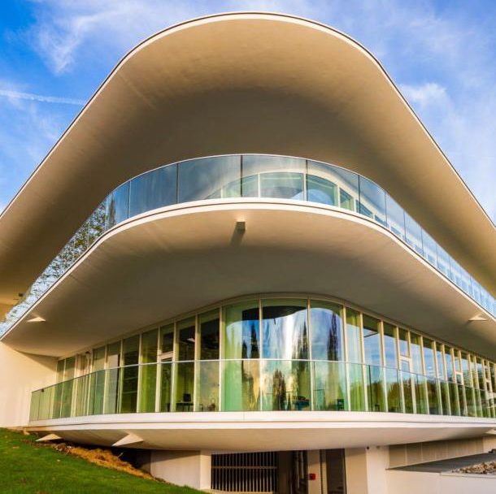
Institute Profile
Founded in 1996, the ESTIA INSTITUTE OF TECHNOLOGY is a general engineering French school training trilingual versatile engineers, to undertake positions such as product engineer, supply chain planner/manager, quality manager, production manager, and project manager.
The ESTIA campus is an ecosystem which includes:
Engineering courses & masters degrees
Research teams in technology
Technical platforms
A company incubator

Slide 3
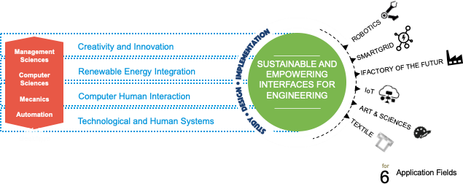
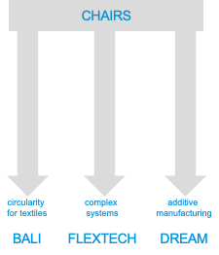
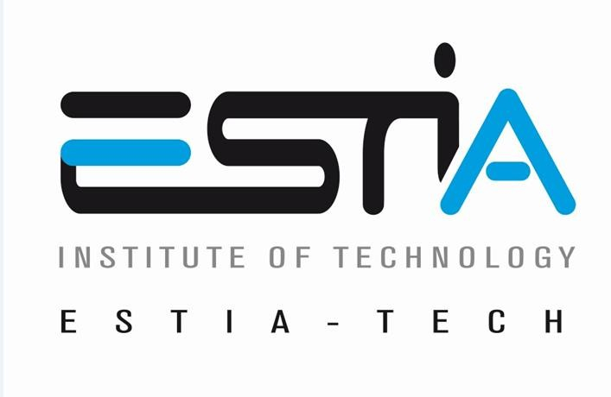
Lab Experience and Key Projects

Slide 4
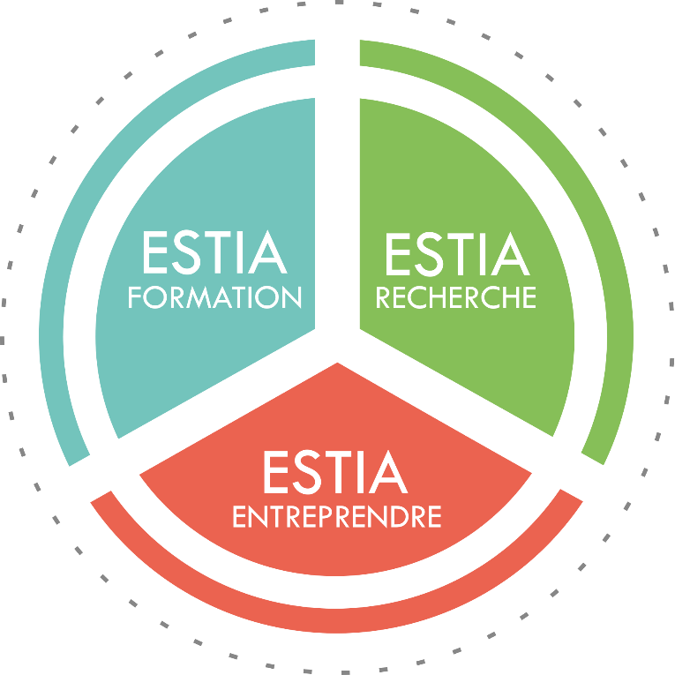

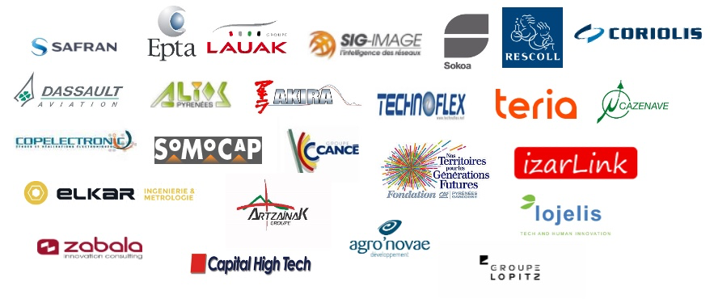

In the heart of the Campus
ENGYNEERING SCHOOL
BACHELOR of TECHNOLOGY
INTEGRATED PREPARATORY CLASS
MASTERS
~100 STUDENTS / YEAR
Staff as of September 1, 2024
ISO 9001, depuis 2010
& HCERES 2015 et 2021
RNSR n° 201420655V
90 People
31 EC of which 8 HDR - 6 Prof.
17 Associates (and Guests)
22 PhD Cand. et 1 Post-Doc
7 IE, 6 IR, 6 RA
ASSOCIATION AGREEMENT
DOCTORAL SCHOOLS
- Mathematics and Computer Science (39)
- Physical and Engineering Sciences (209)
- Business, Economics and Society (42)
In 5 Regional Research Networks
Dept. of Engineering and Digital Sciences
FONDATION
Partnership research
TERRITORY DYNAMICS INNOVATION
3 START-UP ACCELERATOR INCUBATORS
7 TECHNOLOGICAL PLATFORMS
1/4 industrial research training agreements
5 Industrial Chairs
Figures updated 14 December 2024
Mise à jour le 15/11/2022

Slide 5
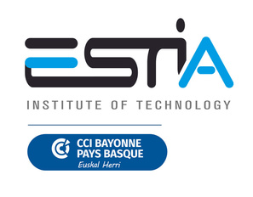

EU4Dual: Lighthouse Strategy https://eu4dual.education/
The EU4Dual Lighthouse Research Initiatives (LRIs) are high-impact, interdisciplinary research programs addressing critical societal and technological challenges in alignment with EU4Dual’s strategic priorities.
1. Business & Management for Green Transition
  Sustainable tourism and green logistics
  Local government leadership
  Circular economy and sustainable design in fashion and textiles
2. Engineering for Sustainable and Digital Industry
  Human-machine interaction
  Artificial intelligence applications
  Additive manufacturing and 3D printing
  Industrial circularity and resource efficiency
3. Health and Welfare Transition
  Nutrition, diabetes, and food systems
  Mental health and cognitive aging with VR
  Inclusive health for vulnerable populations
  Working conditions, motor skills, and health in the workplace
4. Interdisciplinarity in Social Sciences: A European Way of Life
  Workforce development and education
  Future skills and emerging technologies
  Social and ethical dimensions of digital transformation

Slide 6
What is ESTIA-TECH?
ESTIA-TECH promotes the links between ESTIA and companies looking for technological solutions, skills and training to develop innovative projects.
ESTIA-TECH helps ESTIA researchers and platforms to prepare winning proposals for funding projects calls and collaborative research offers with companies.
ESTIA-TECH represents ESTIA in clusters and other initiatives.
https://www.estia.fr/estiatech

Slide 7
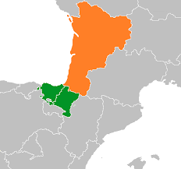
ESTIA-TECH – Strategic areas
Industry5.0
eHealth
Energy
Agri-food.

Slide 8



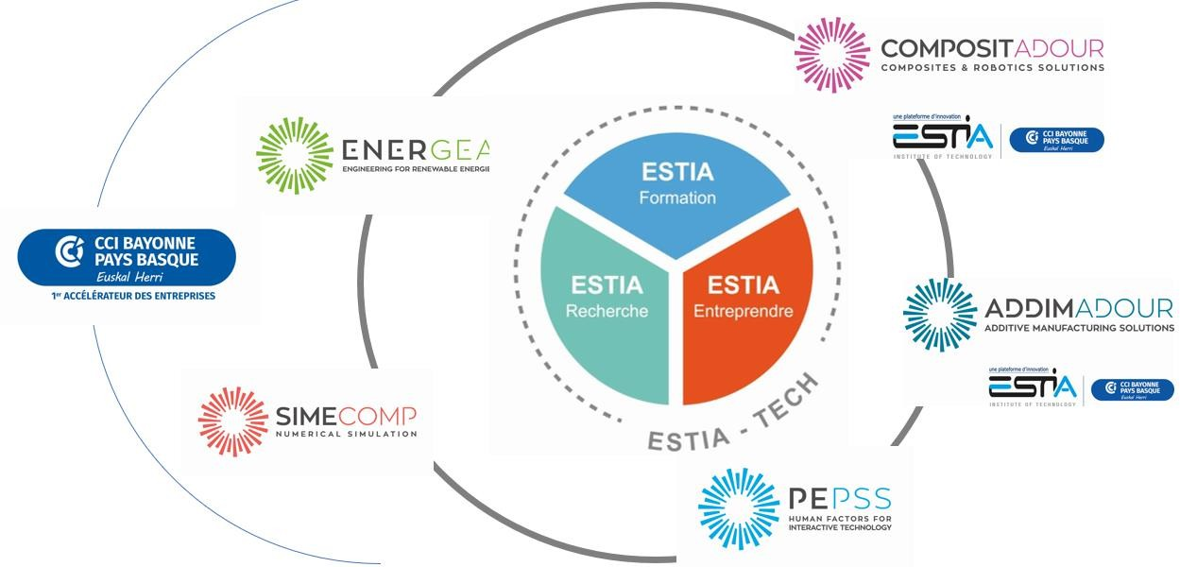







CETIA: high-performance systems to make textile recycling operations competitive
ENERGEA: Power and control electronics for hybrid energy storage systems, energy management & optimization, micro-grids.
COMPOSITADOUR: advanced processes, including composites and robotics
TURBOLAB: innovative, low-carbon, high-performance aeronautical propulsion systems
ADDIMADOUR: metal additive
manufacturing
DATALAB: R&D projects & training. Applied AI: agriculture, industry, satellite imagery
PEPSS: Prototyping and evaluation. Expertise in ergonomics, human-machine interaction, and human factors analysis.

Slide 9







7 technology platforms
Support for research activity
Support for teaching
Support for companies
Recyclability of textile and leather articles
Digital Innovation, Artificial Intelligence & Big-Data
spinoff de la chaire BALI en partenariat avec le CETI
2006
2010
2017
2021
2023
en partenariat avec AKIRA
Engineering for renewable energies
Human factors for interactives technology
Composites & Robotics solutions
Additive manufacturing solution
Innovative Aircraft Propultion

Slide 10

Lab Expérience - COMPOSITADOUR
Technical Plateform : COMPOSITADOUR (COMPOSITES ROBOTICS ADDITIVE MANUFACTURING) is a true
platform for experimenting with the Factory of the Future’s digital and robotic technologies. Compositadour provides high-tech equipment and mobilises its network of skills, from laboratories, SME’s and major industrial groups to develop innovative projects. To help businesses appropriate these new technologies, Compositadour carries out the following missions:
R&D :
In partnership with industry, Compositadour initiates and carries out R&D
programmes for new parts and manufacturing processes with outstanding research teams.
Training : In association with vocational training players, Compositadour provides courses for operators, technicians and engineers in composites, automating and robotising processes, and additive metal manufacturing.
Technology transfer : The platform’s teams helps industry (SME, ETI, large groups) to integrate new solutions developed.

Slide 11

Lab Expérience - ADDIMADOUR
Technical Plateform : ADDIMADOUR (ADDITIVE MANUFACTURING SOLUTIONS) is dedicated to metal additive manufacturing technology transfer, the Addimadour platform provides the Technocité Technology Park with innovative and efficient facilities for industrial projects.
Mechanical characteristics improvement of parts obtained by Additive Manufacturing:
Determination of optimal Key Process Parameters to obtainmaterial soundness.
Development of real-time instrumentation for monitoring and post-process control.
Development of deposition strategies tailored to Additive.
Manufacturing processes Multiphysics numerical simulation of Additive Manufacturing processes:
Thermal, mechanical and metallurgical simulationfor behaviour prediction (residual strains and deflection).
Topology optimisation (Finite Element Method structuraldesign for performance/weight ratio enhancement.

Slide 12

Lab Expérience - ENERGEA
Technical Plateform : ENERGEAR (COMPOSITES ROBOTICS ADDITIVE MANUFACTURING) is s a
research platform in power and control electronics for the integration of renewable energy sources and storage (hybrid energy storage systems), for energy management and its optimization, through the quality management of power supply and network stability, but also demand management.
Automatic
Power Energy
Control
Energy Storage
Smart Grid

Slide 13

Lab Expérience - PEPSS
Technical Plateform : PEPSS (HUMAN FACTORS FOR INTERACTIVE TECHNOLOGY) was created in 2010 by resarchers from ESTIA (N. Couture & S. Minel) and University Paris Descartes (R. Mollard & M. Wolff).
Human Centered Design
Prototyping innovative systems
Behavioral and Morphological Modeling
Facilitate the interaction between people and between a human and a system
Model human behavior: use, appropriation and emotion

Slide 14

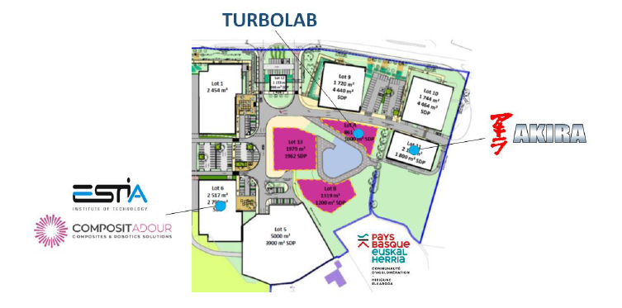
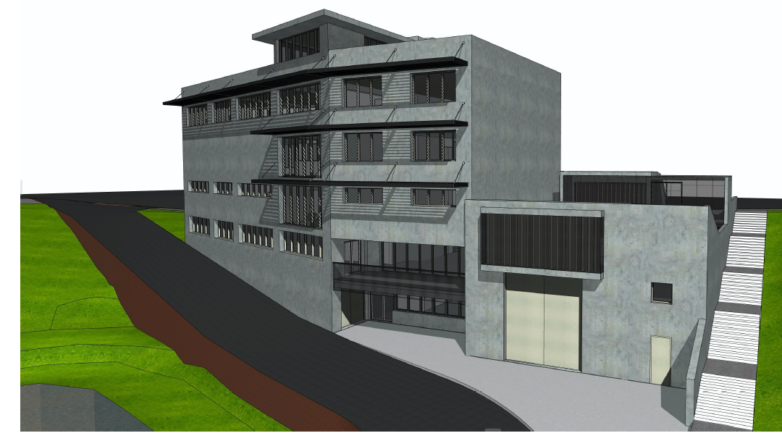

TURBOLAB
  TURBOLAB is a new plateform dedicated to innovative propulsion systems : Electric, Hybrid or Alternative Fuels (SAF and H2)
  Associating AKIRA expertise in innovative propulsion systems and ESTIA Compositadour Addimadour in Material and Processes

Slide 15

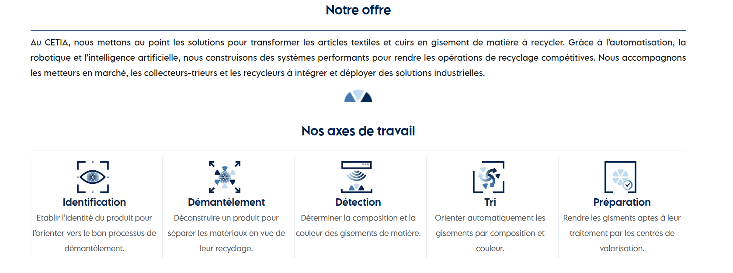
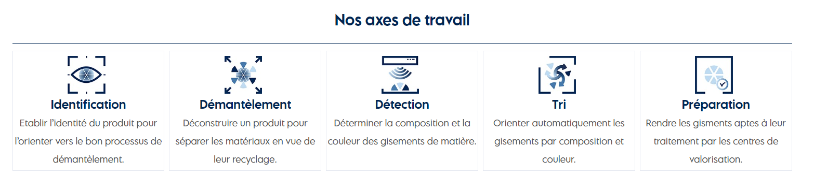

SOLUTIONS Automatisées et intelligentes
pour optimiser le recyclage des articles textiles et cuir
DECATHLON
GROUPE ERAM
ZALANDO
REVALOREM
Nos lignes
Nos clients

Slide 16
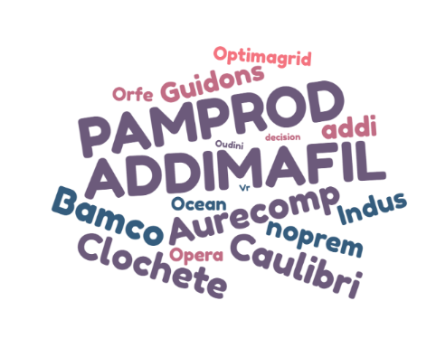

Ongoing collaborative projects https://www.estia.fr/recherche/projets-estiatech
EU projects
national projects
3 chairs
https://www.estia.fr/formations/les-chaires
Notes:
OLIVIER

Slide 17



Collaborative Networks
Notes:
OLIVIER

Slide 18
Thank you

