Slide 1
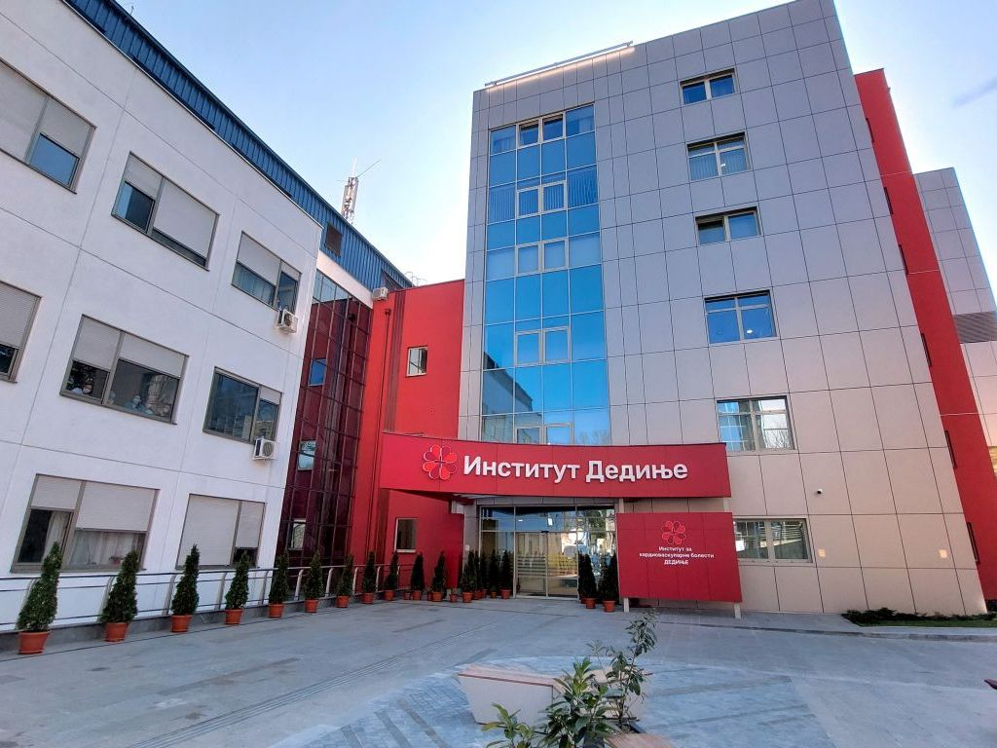
IKVBD for Horizon Europe - Work Programme 2025 - Health
Dragiša Radovanović, MD
Institute for Cardiovascular Diseases “Dedinje” (IKVBD – SR)
Institute for Cardiovascular Diseases “Dedinje” – Center of excellence
Heroja Milana Tepića 1, Belgrade, Serbia

Slide 2
WHO WE ARE
Dedinje Cardiovascular Institute (IKVBD), based in Belgrade (SR), is the largest university and cardiovascular Centre in South-Eastern Europe.
3,000+ cardiac surgeries
annually
1,000+ employees
2,000+ vascular and
endovascular surgeries annually
8,000+ diagnostic invasive cardiology procedures annually
2,000+ percutaneous angioplasty procedures annually
1,000+ complex electrophysiological procedures annually

Slide 3
WHO WE ARE
5 highly specialized clinics, expanded in January 2022 with a new state-of-the-art building to enable greater clinical capacity, including 58 ICU beds and 11 Operating Rooms
Cardiac surgery
Invasive diagnostics & treatment
Vascular surgery
Anaesthesia & intensive treatment
Cardiology

Slide 4
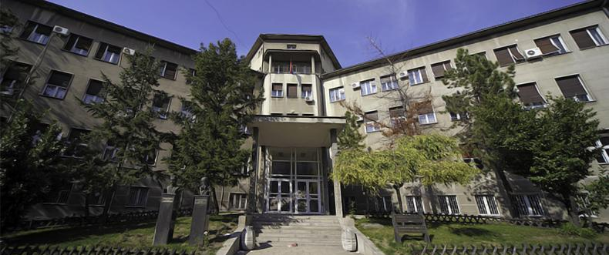
SCIENTIFIC WORK
IKVBD has 1060 Healthcare professionals, including 8 engineers and is currently involved in 28 scientific projects, publishing 74 scientific papers in the 2024.
International Educational programs
Teaching Base
University of
Belgrade, Banja Luka, Kragujevac
Scientific Research
Professional Development
Congress for Cardiovascular Diseases
Congress for Cardiovascular Prevention

Slide 5
HORIZON-HLTH-2025-01-CARE-01
What IKVBD can offer for the HORIZON-HLTH-2025-01-CARE-01 topic – End user-driven application of Generative Artificial Intelligence models in healthcare
Expertise relevant for the topic, such as development of Healthcare mobile applications (e.g. providing support to patients with a Total Artificial Heart (TAH) or Left Ventricular Assist Device (LVAD), application of next-generation technologies and gamification in health promotion and disease prevention, Machine Learning-Based Decision Support System in the Health domain (e.g. for Preoperative Coronary Angiography in Vascular Surgery Patients)
Access to patients and Healthcare professionals, with more than 15.000 patients treated annually (hospitalizations), 5000 procedures of vascular and cardiac surgery, 1000+ Healthcare professionals.
A meaningful Pilot using Gen-AI based virtual assistant solutions to address real complex decision-making process of Healthcare professionals, (as an example, for coronary angiography and revascularization prior to vascular surgery, particularly for high-risk patients.)

Slide 6
HORIZON-HLTH-2025-01-TOOL-03
What IKVBD can offer for the HORIZON-HLTH-2025-01-TOOL-03 topic - Leveraging multimodal data to advance Generative
Artificial Intelligence applicability in biomedical research
Expertise relevant for the topic, such as development of technologies to enhance cardiovascular disease prevention through digital health, enhancing advanced technology for accurate assessment of cardiovascular diseases and next-generation technologies for an interdisciplinary approach (advanced program for heart health monitoring, research into the genetic, gut microbiota in HFPEF, etc.) to researching specific diseases such as heart failure, aortic stenosis, unicuspid aortic valve (UAV), vascular stenosis, etc.
Access to patients and Healthcare professionals, with more than 15.000 patients treated annually (hospitalizations), 5000 procedures of vascular and cardiac surgery, 1000+ Healthcare professionals.
A meaningful Pilot using Gen-AI based solutions to address real complex decision-making process of Healthcare professionals, (as an example, for the early detection of deep vein thrombosis through the application of infrared thermography and artificial intelligence.)

Slide 8
GET IN TOUCH
https://www.ikvbd.org/en/
dragisa.radovanovic@institutdedinje.org
+381692945122
Heroja Milana Tepića 1, Belgrade, Serbia

