Slide 1
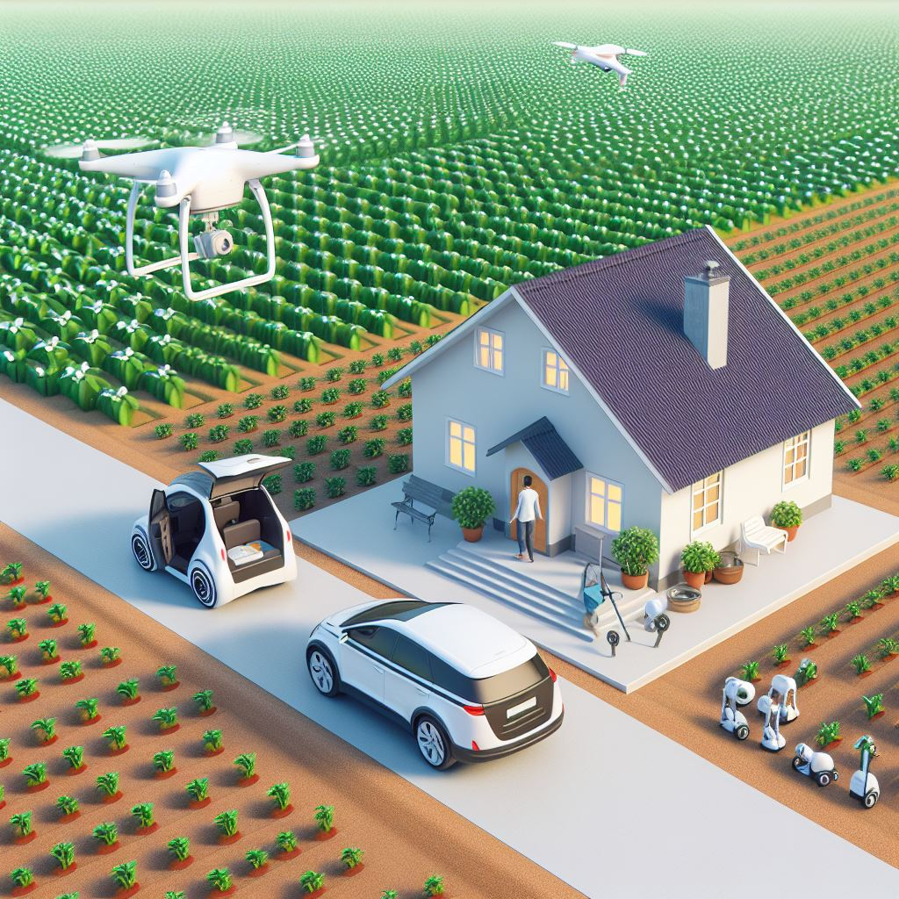
A Research Facility to test Robot, Human and AI behaviour in real-life Physical Environments
How will families live in 2100?
How will Robots,
AI and humans coexist?
diego.torricelli@csic.es

Slide 2
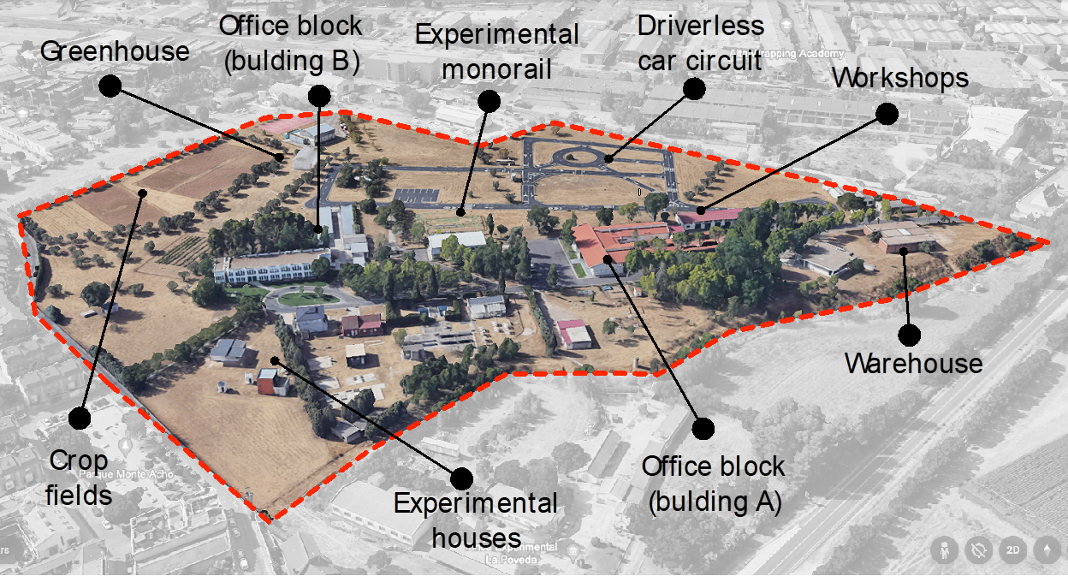
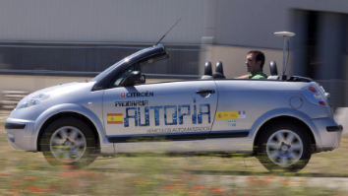
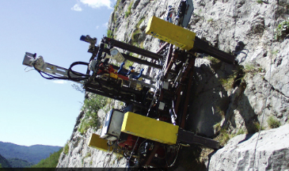
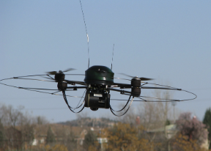
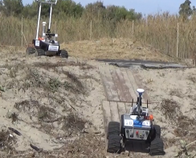
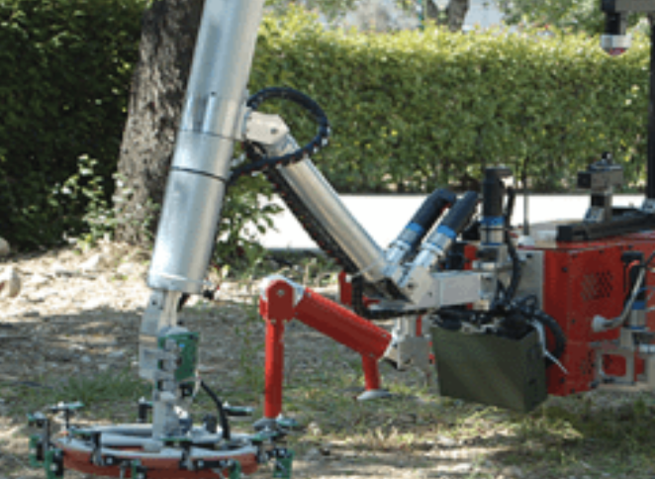
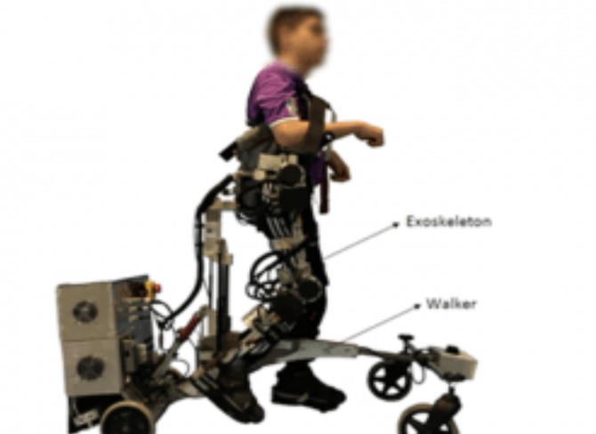
Centre for Automation and Robotics (CSIC)
Autonomous vehicles
Artificial Perception
Rehab Robotics
Robot for agriculture
Computation modeling of intelligence
Aerial Robots
Underwater robotics
Bio-inspired robotics
Outdoor & indoor testing zones:
Autonomous cars circuit
Experimental agriculture fields
Industry 5.0 production line
Smart House
Experience:
Benchmarking (EUROBENCH, NI)
Human Movement analysis (healthy and pathology)
Cobots (exoskeletons, industrial, agriculture, cars)
Intelligent Control and Perception
Human-machine interaction

Slide 3
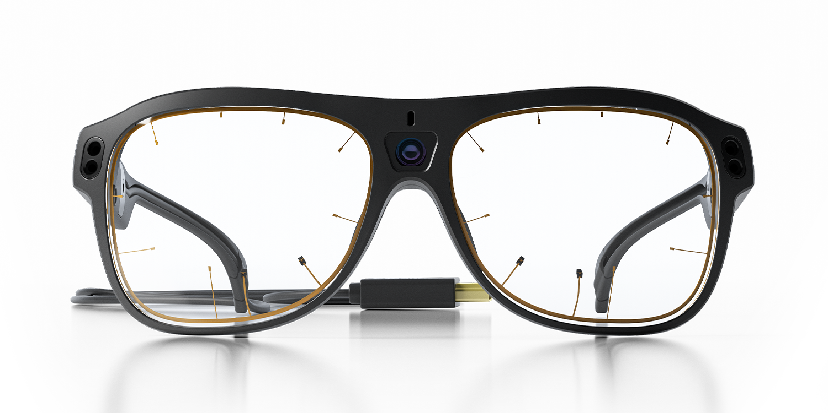
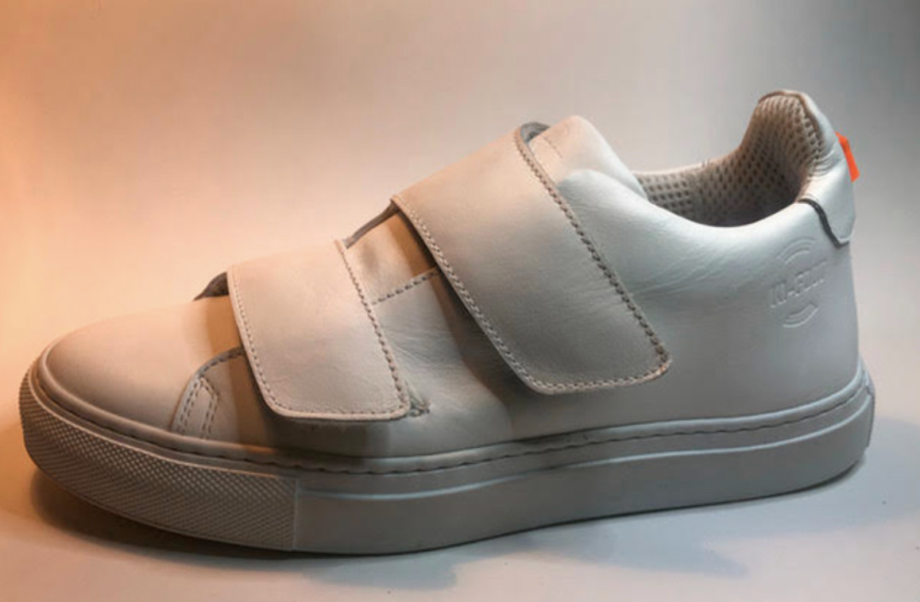
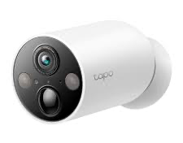
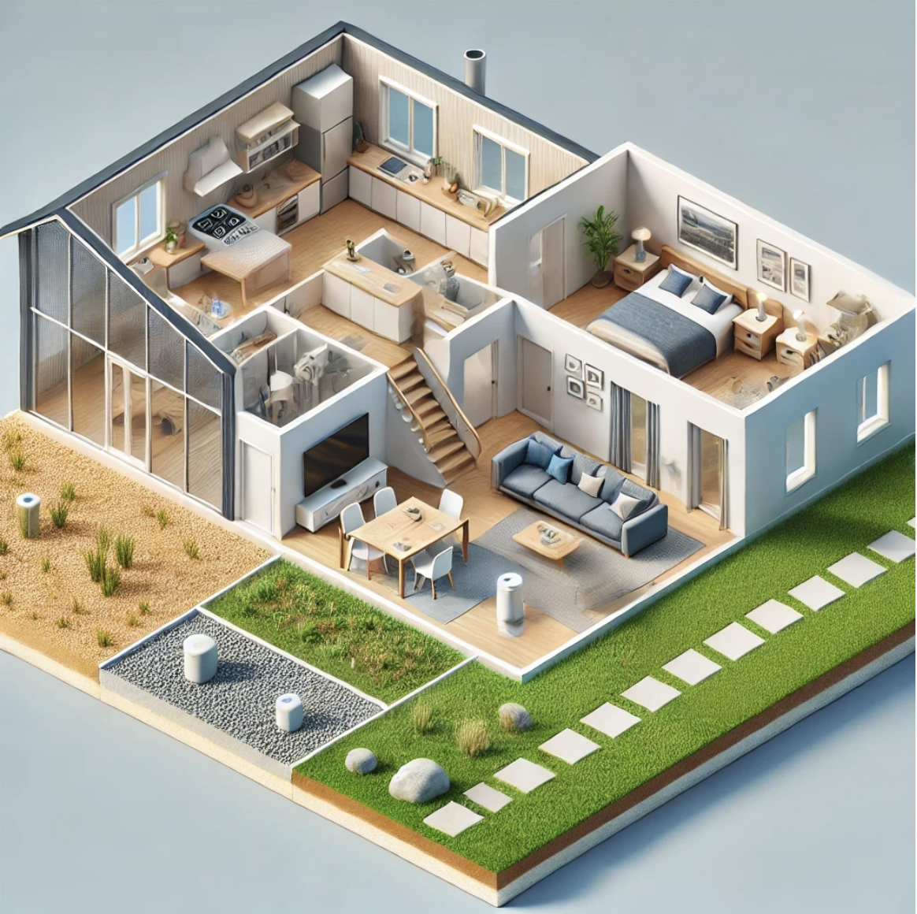
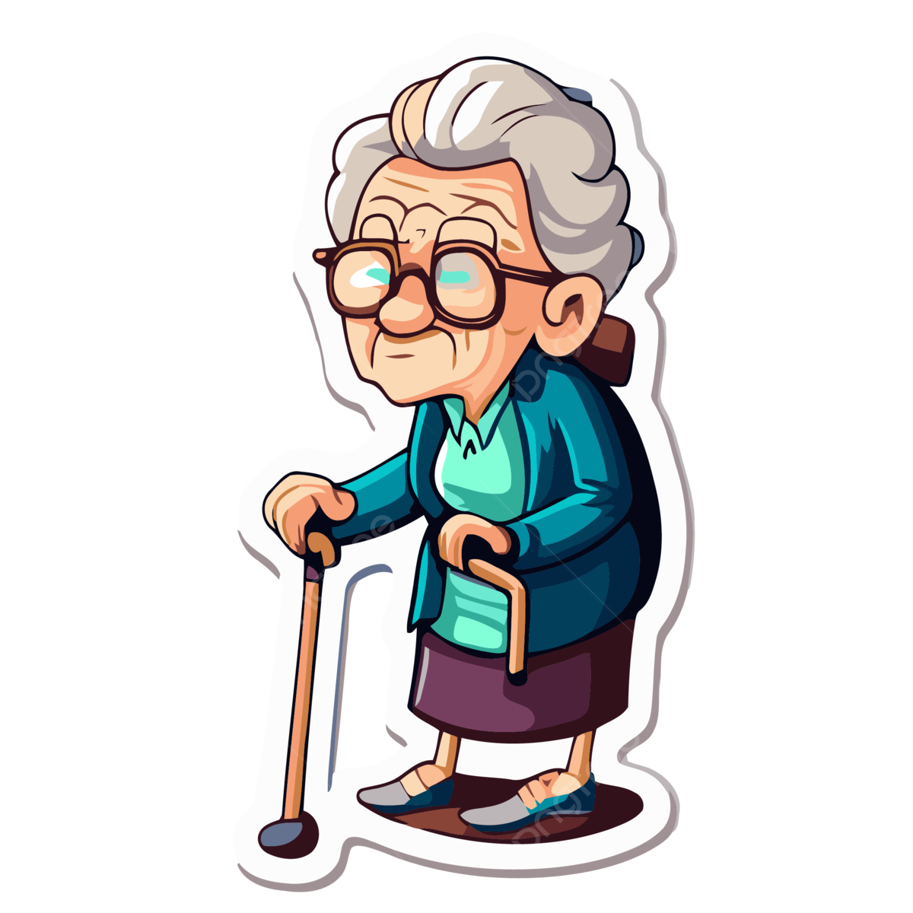
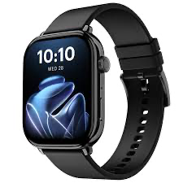
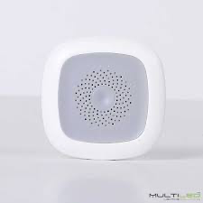
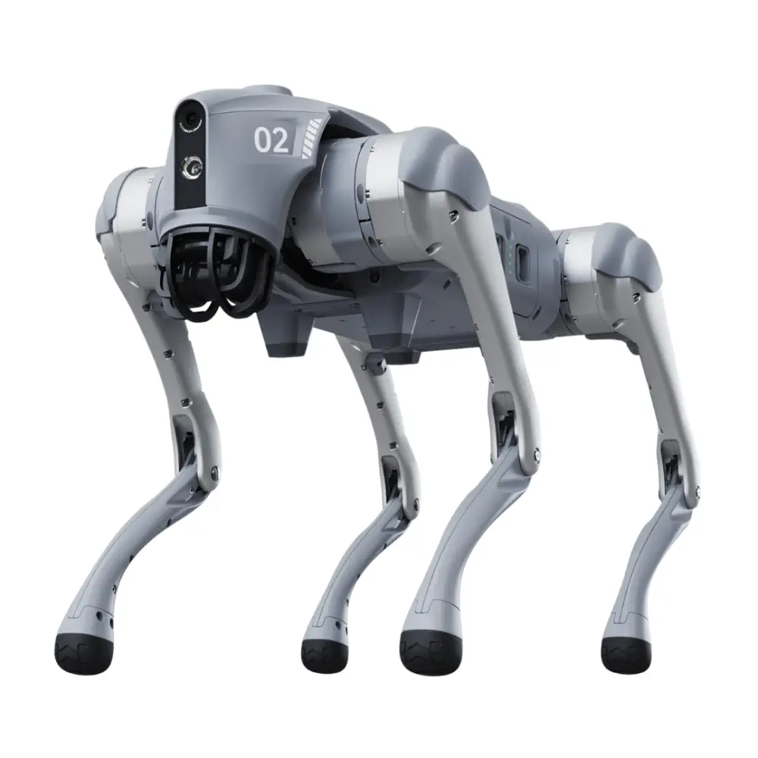
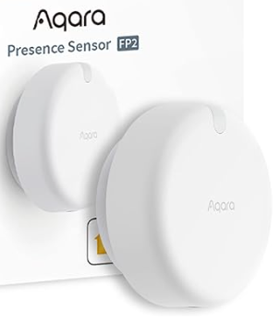
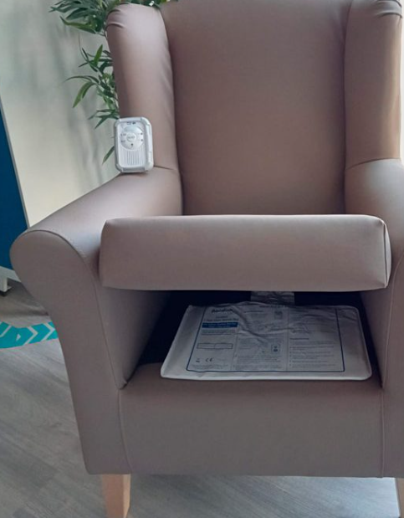
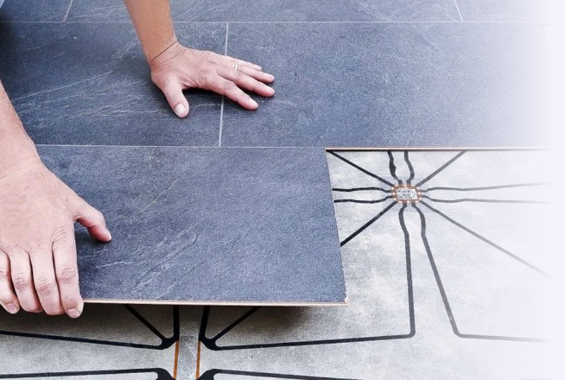
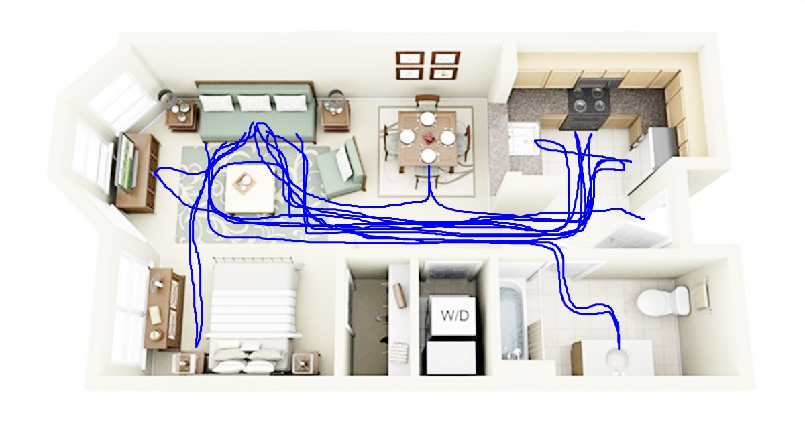
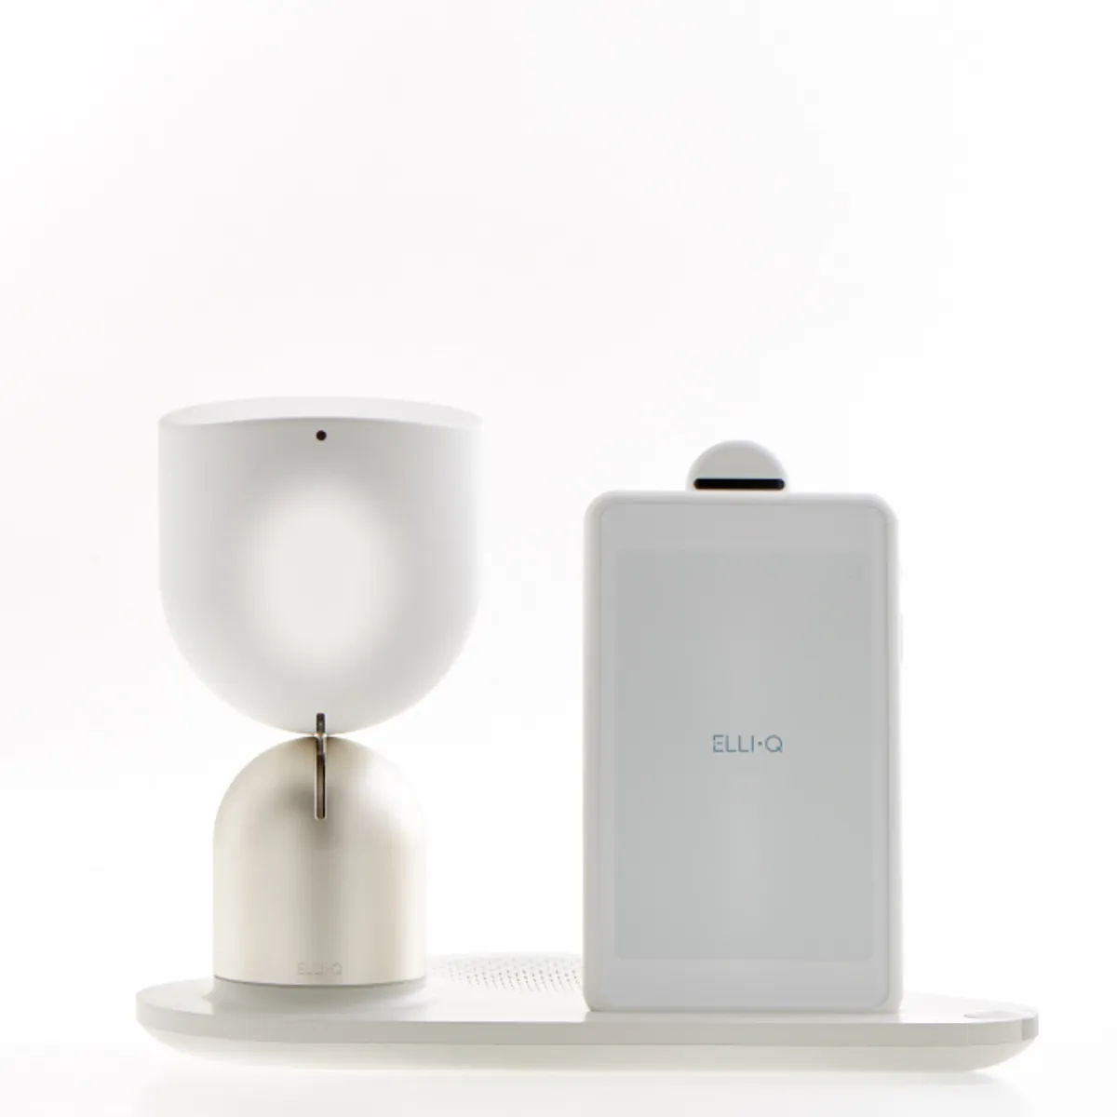
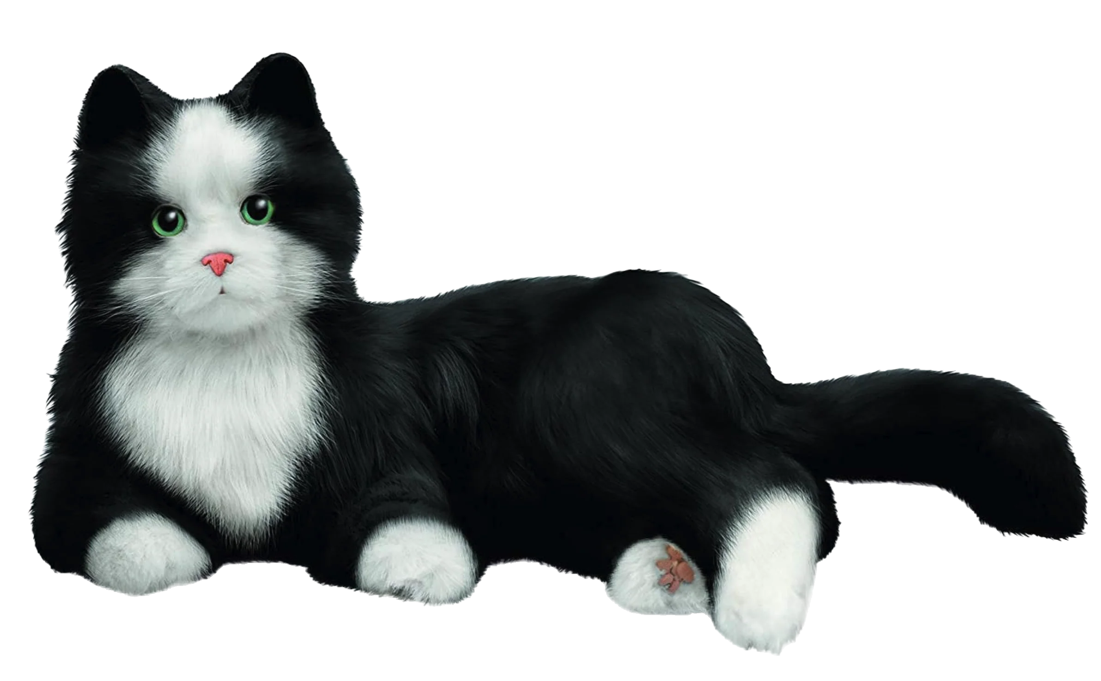
Smart House facility
Sensors
Motion capture y localization (cameras, wearables)
Physical interaction (force and pressure)
Cognitive state (eye tracking, EEG)
Environment (humidity, temperature, etc)
Robots & AIs
Assistive and rehabilitation robots
Social robots
Conversational AIs

