Slide 1

IDEAL-IST
NCP NETWORK FOR CLUSTER 4 DIGITAL
ADRA Info Day – 16th May 2025 – bcarnec@hub.brussels
Since 1996!
Notes:
Hello everyone,
My name is Judith Bloch from the Israeli Innovation Authority and I am the coordinator of the IDEALIST project.
"In just a few moments, I will be diving into the detailed presentation of the tools, services, and activities developed by IDEALIST. But before I do, I'd like to extend a big thank you to Ralf Koenig and all the active members of the GSF project for organizing this webinar exchange. I also want to express my gratitude to Maia Kim that will share with us her experience and vision of the IDEALIST project, as a Digital NCP from the Republic of Korea, / "non-associated non-EU country. despite the late hour in her timezone, so nice to meet you all and
"Ralf, the floor is yours again
Alright, let's begin, and if possible, let's move on to the next slide.

Slide 2





National Contact Points (NCPs)
Proposal development
Proposal submission
Project Execution
Project exploitation
Identifying opportunities
National Contact Points (NCPs) provide guidance, practical information and assistance on all aspects of participation in Horizon Europe.”
National structure financed by governments
Services are free of charge
NCPs offer personalized support on the spot
Our goal is to help you bring the best out of your proposal

Slide 3
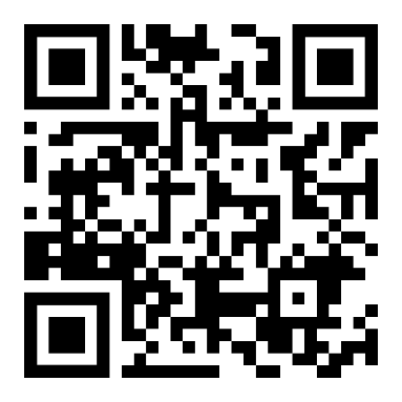

NCP Networks
NCP network projects are funded by the European Commission through Horizon Europe. Their key tasks are to support individual NCPs in their work and to provide additional services for you that a single NCP would have difficulty in organising alone.
Ideal-Ist is the Horizon Europe Cluster 4 digital National Contact Point (NCP) network
Find your NCP
for Horizon Europe Cluster 4!

Slide 4
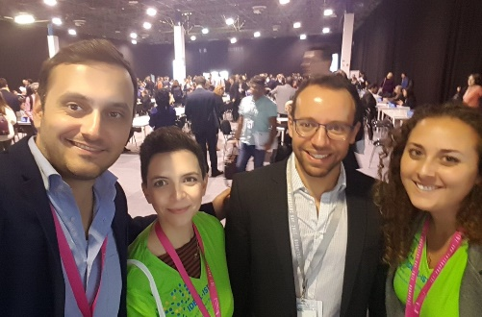






Fantastic services!
from 48+ countries!
Brokerage events
Trainings, seminars & webinars
Partner match/search
Full proposal check
&
Project idea check
Toolbox for
proposers
Personalised weekly notification
Topic Tree
Made up of individuals with lots of experience to help you!

Slide 5

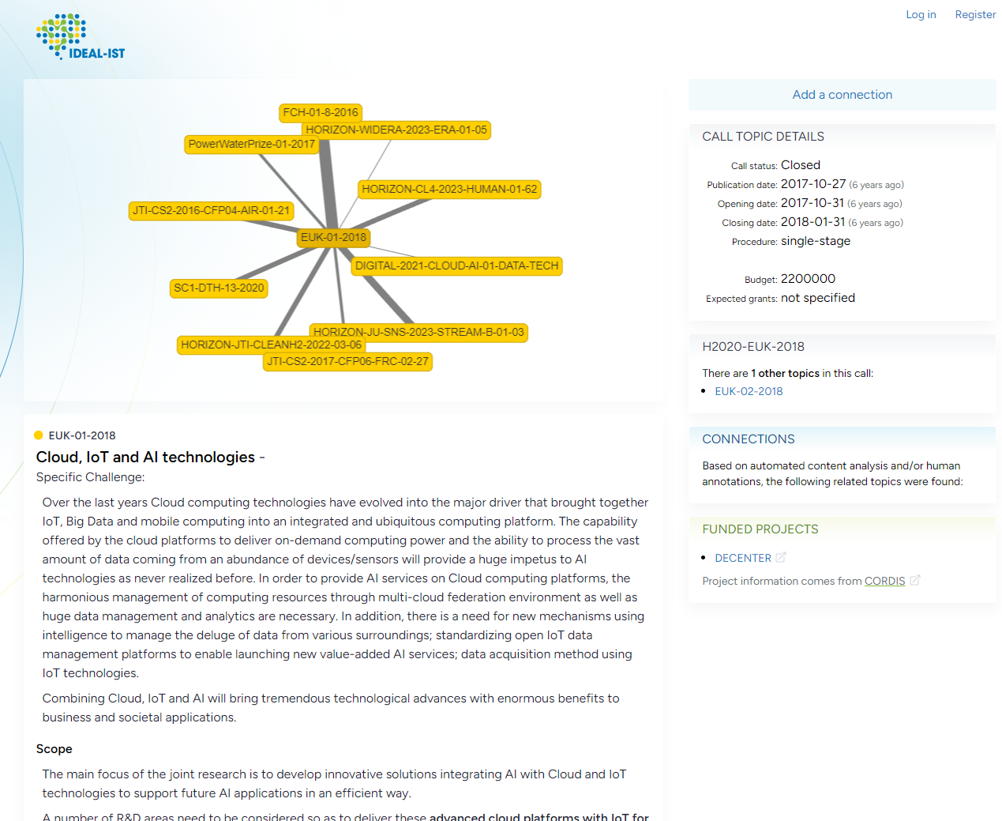
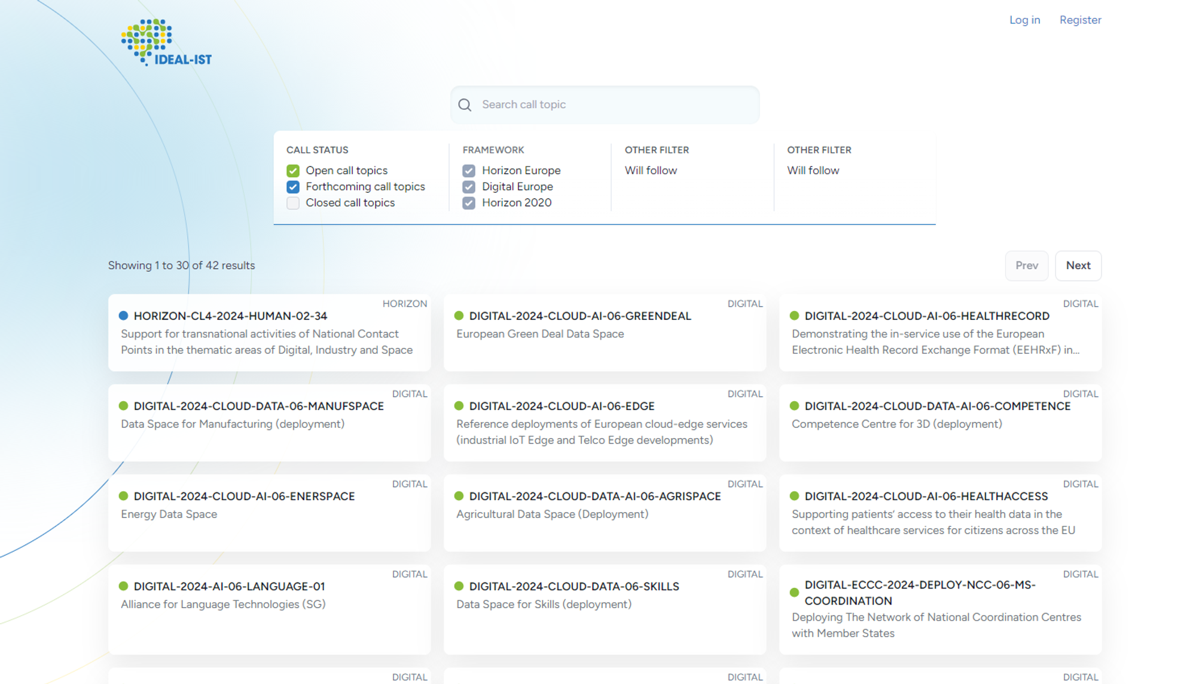
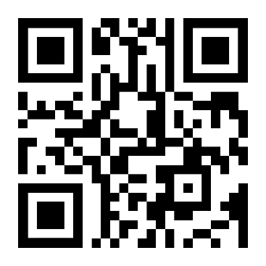
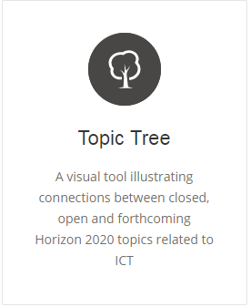
Ideal-ist Topic Tree
2025 topics coming soon!
How are call topics linked?
How have these areas evolved over the years?
What is the new focus this year?
http://www.topictree.eu

Slide 6
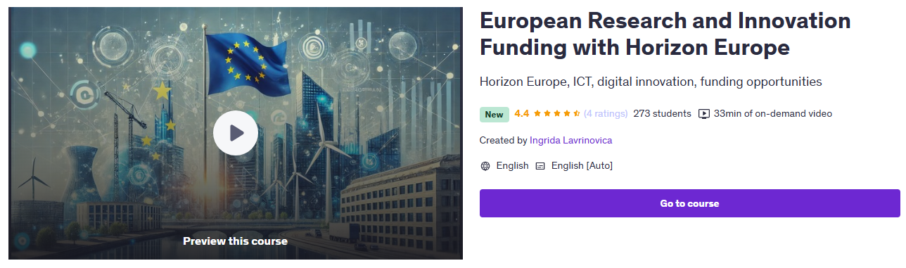
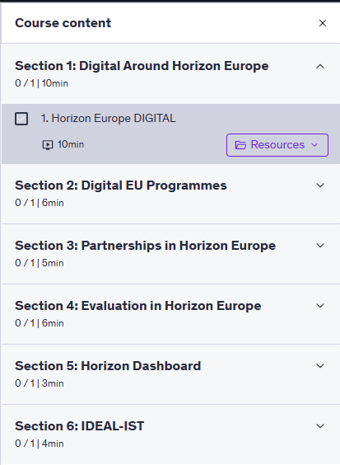
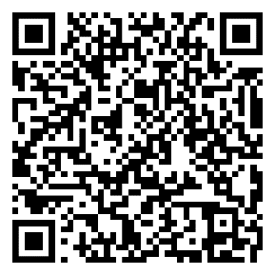
Online course on Digital in Horizon Europe
Click here for the Ideal-ist free online course on the Udemy platform
Register now and leave feedback for further improvements!

Slide 7
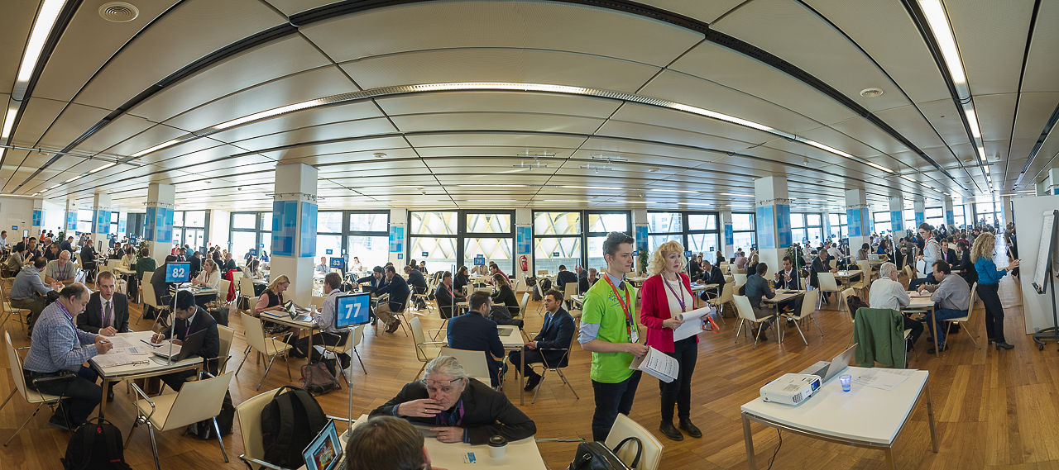
BROKERAGE

Slide 8
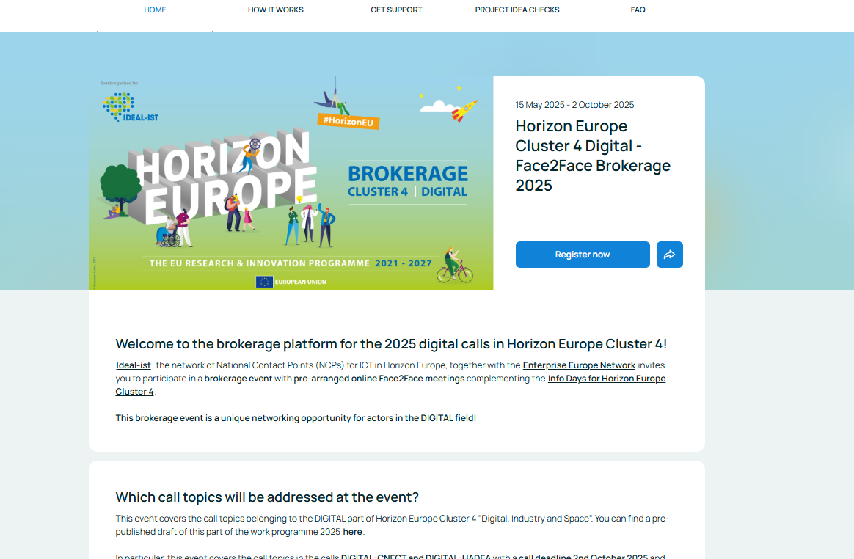



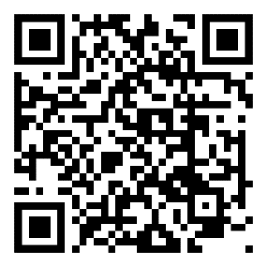

Online Brokerage Event
Register
Create a profile
Share cooperation offers
  Project ideas
  Expertise
  Requests
Find & contact partners
Online networking from May until October 2025
https://www.b2match.com/e/cl4-digital-2025

Slide 9
Your prefer onsite brokerage events to online?
Check out these events:
16th May in Brussels (BE): ADRA Info Day with Pitching and Matchmaking
20th May in Strasbourg (FR): KETs 2025 Brokerage Event
2nd/3rd July in Aalborg (DK): "The Future of Digital Investements in the EU"
will have onsite brokerage supported by EEN, IDEAL-IST and DEP4ALL, more information coming soon.

Slide 10
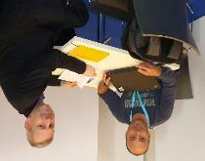
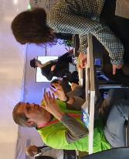
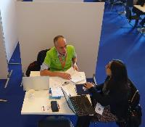
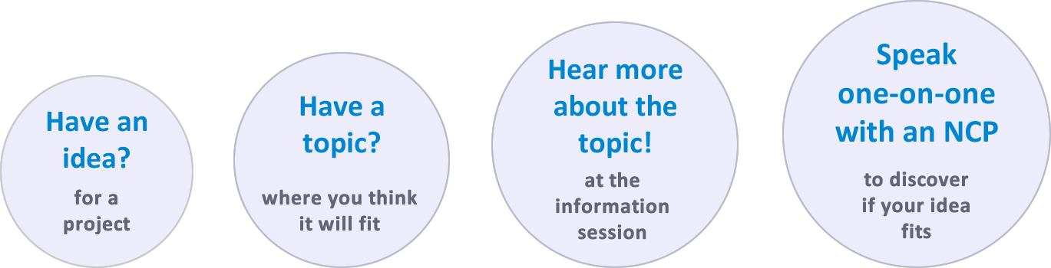
Project Idea Check
Have a proposal idea? Get early feedback
from experienced National Contact Points
Ideal-ist National Contact Points (NCPs) are available to review your project ideas. Discuss discretely with NCPs whether your idea fits the call topic you chose. Or get help to find another meeting.
When: any time or at specific events, e.g. 20th May or 2nd/3rd July
Where: Online or in person at specific events, e.g. Strasbourg or Aalborg

Slide 11

Ideal-ist
Full Proposal Check
Coming again soon …
September 2025

Slide 12
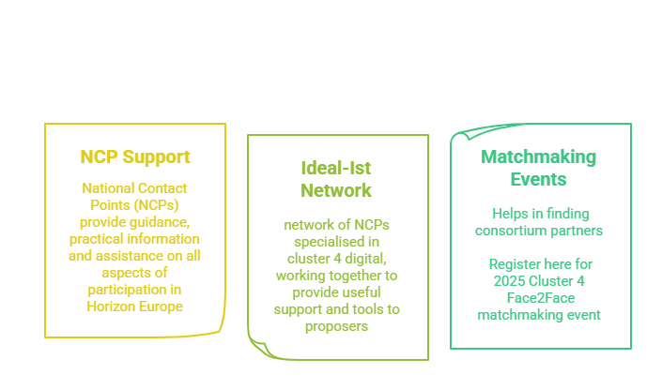
Key takeaways

Slide 13





Our Benefit
Supporting
Applicants
Together

