Slide 1





Accelerating European AI, Data, and Robotics sovereignty and competitiveness to address shared challenges.
16.05.2025
AI-DATA-ROBOTICS BROKERAGE
adr-association.eu

Slide 2
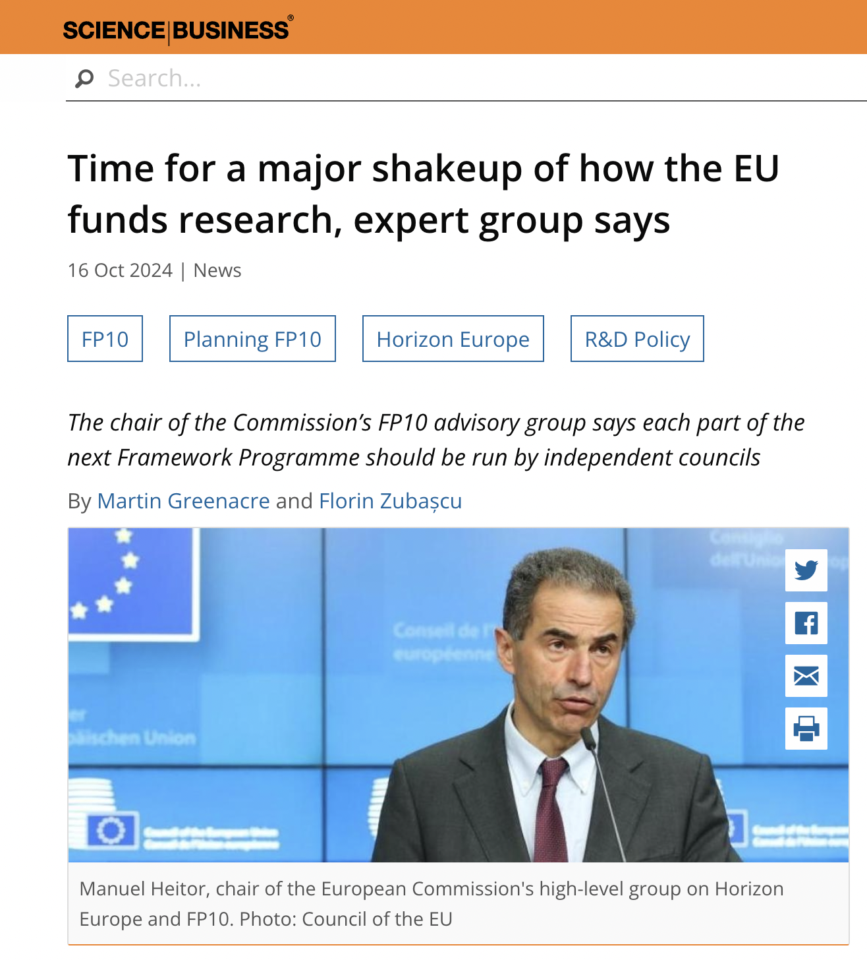
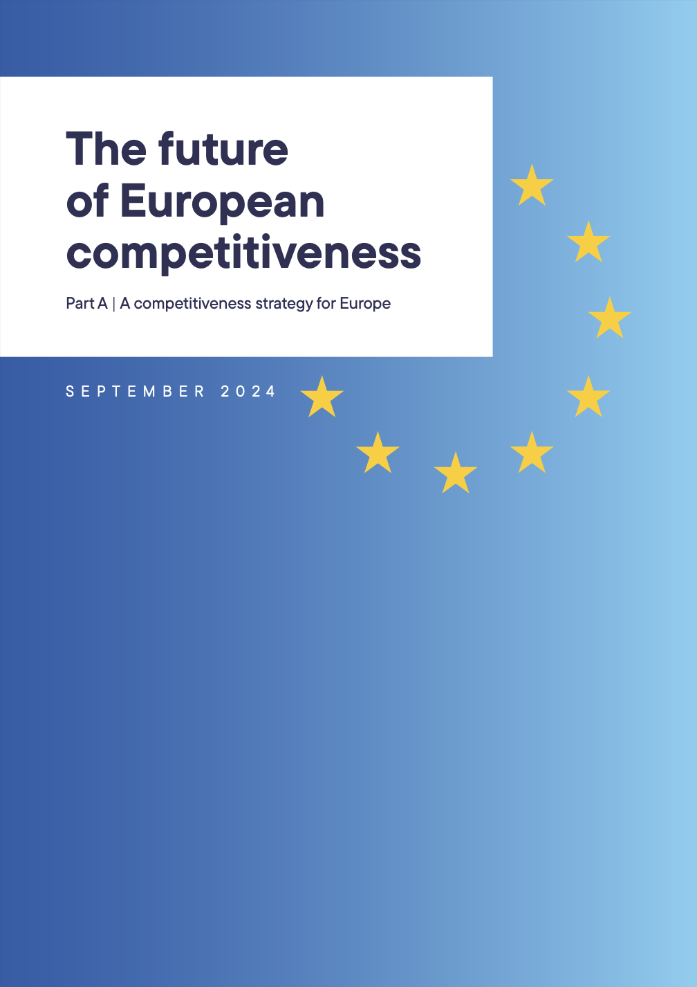
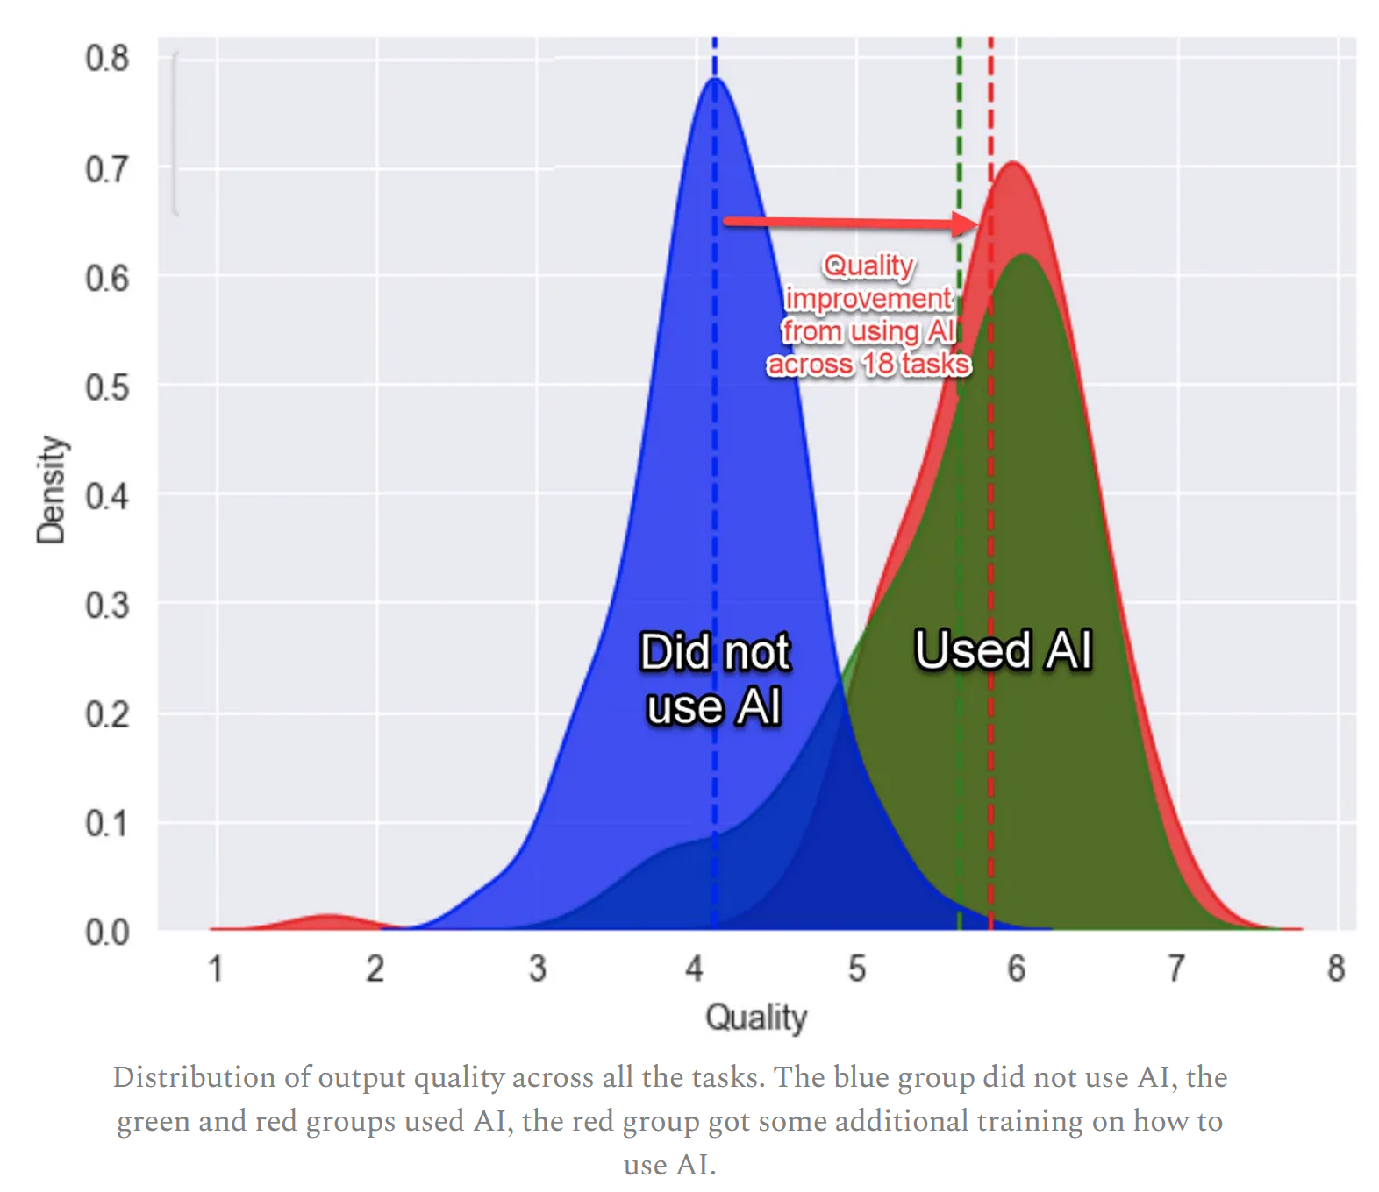

Notes:
The ongoing digital transformation, in which AI plays the key role, has triggered a global competition for tech leadership;
Europe is lagging, and unless it catches up with major regions on key technologies, it will be vulnerable across all sectors on growth and competitiveness; compromising the region’s record on sustainability and inclusion.
Europe is outpaced by North America in terms of R&D investments as a percentage of revenue, as shown by this figure.
Europe must capitalise on the market opportunity that AI, Data and Robotics technologies will deliver, and ensure that the technology that is developed also enshrines core European values - where no one is left behind, everyone enjoys freedom, protection and fairness.
Over the next two decades Europe will need to deal with Climate change, a demographic shift, a reduced career ratio and lower productivity, urbanisation, global competition from China and the US, all simultaneously. And that’s without the impact of black swan events like the Ukraine war.
artificial intelligence, Data and robotic technologies hold immense potential to improve people’s lives and significantly accelerate efforts to achieve the Sustainable Development Goals and address climate change.

Slide 3
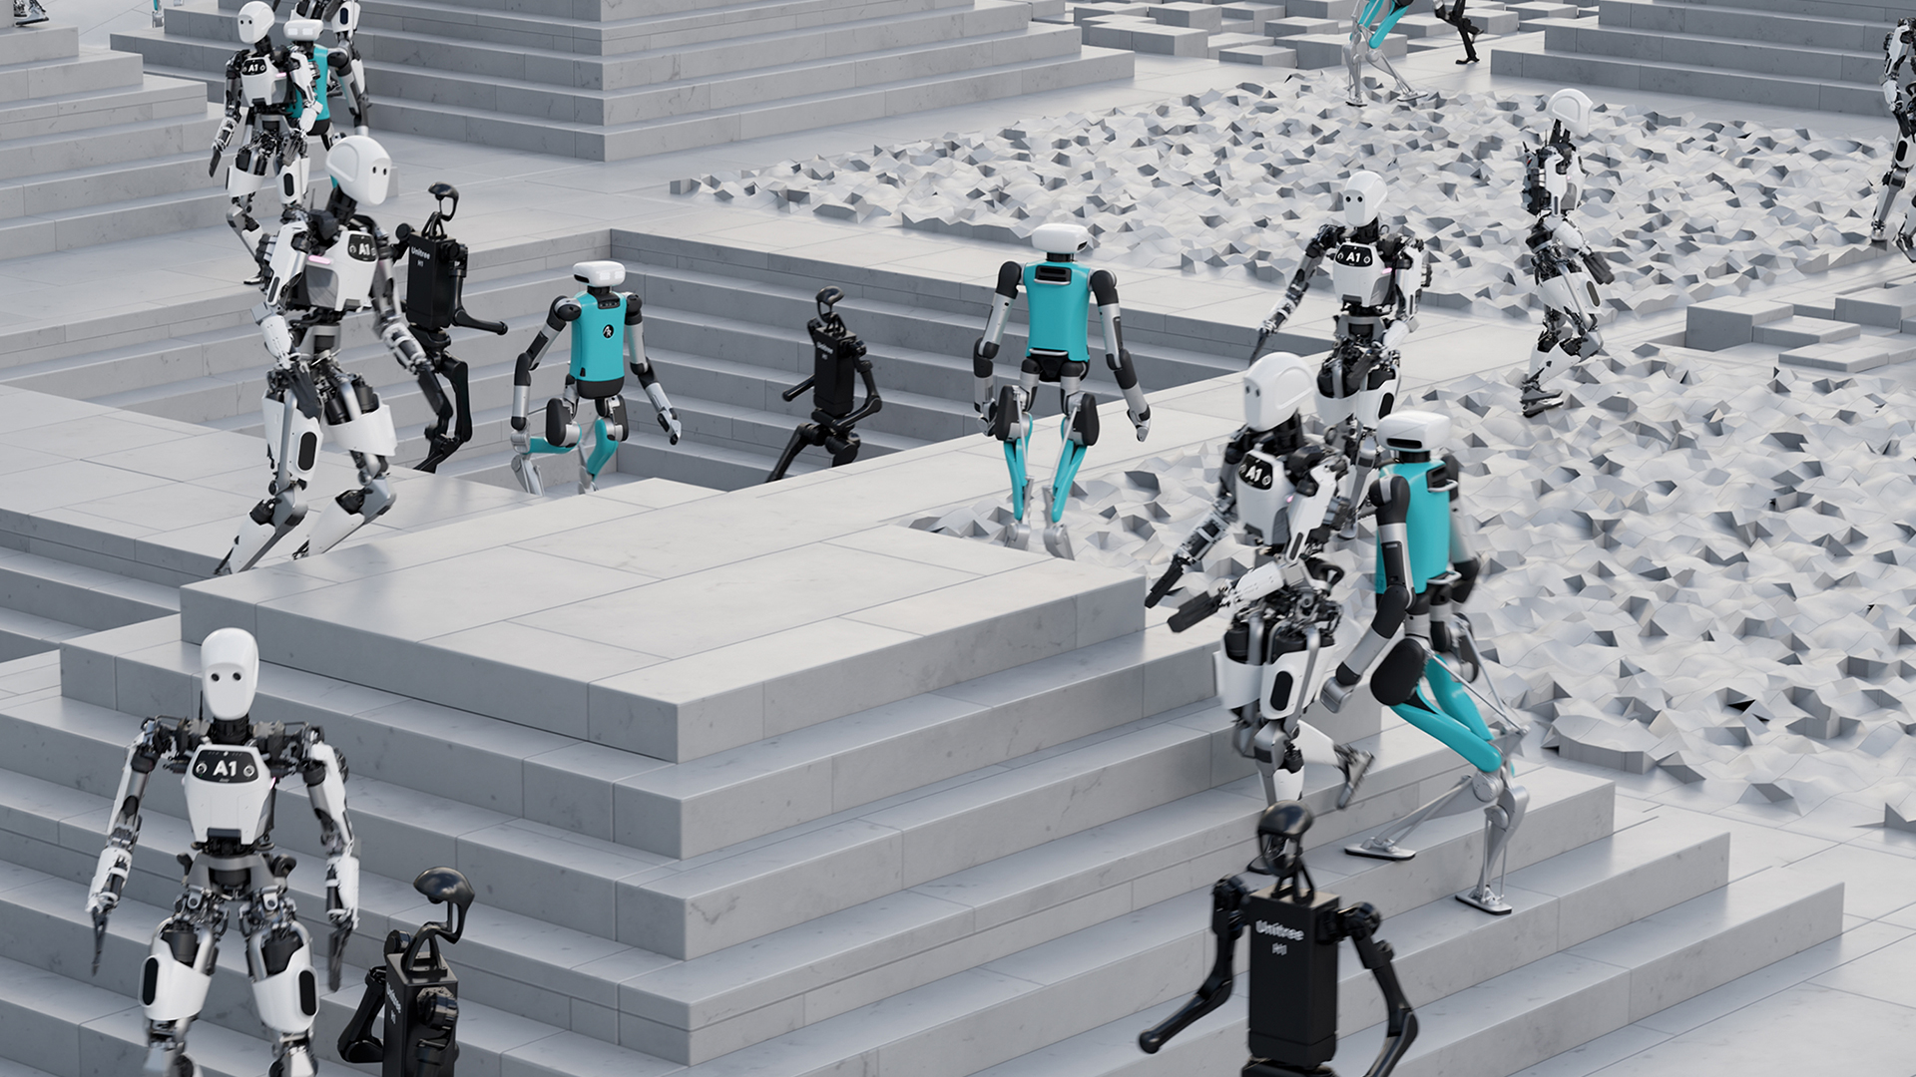
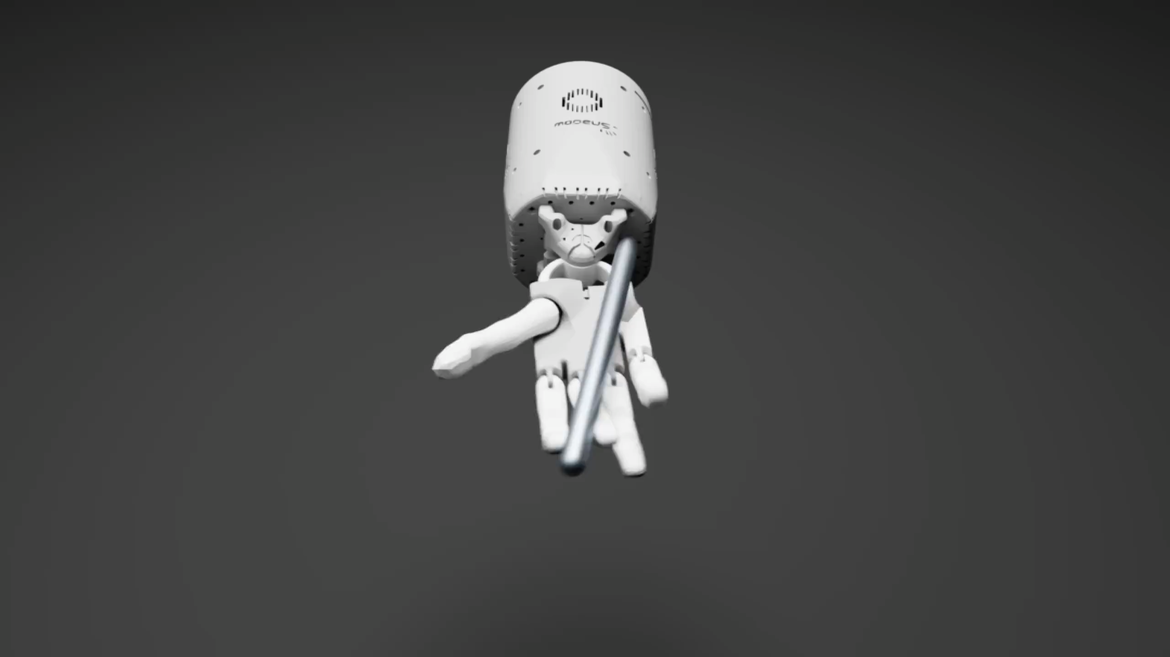
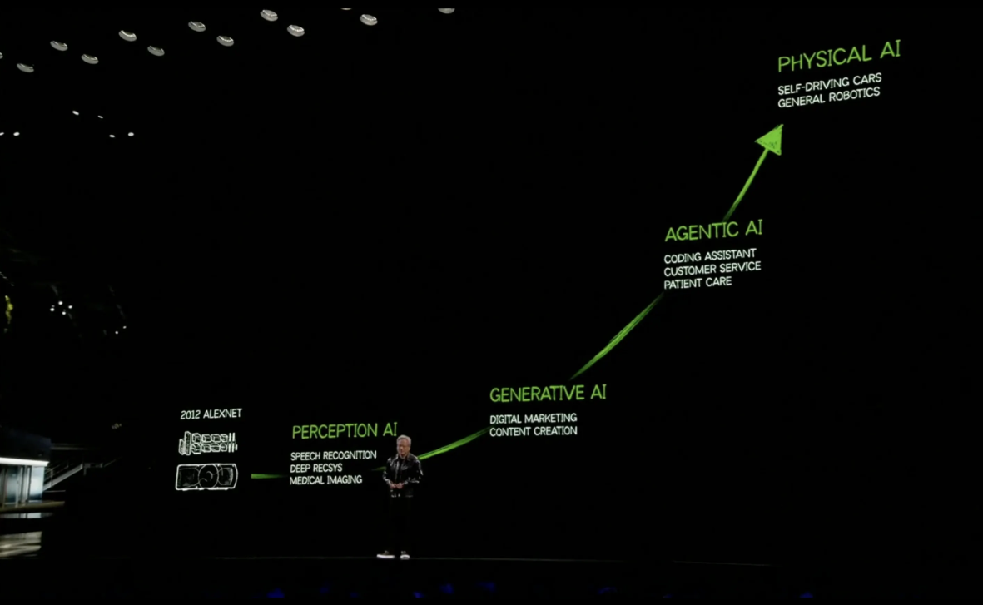
AI – powered robotics
Notes:
While the world is slowly figuring out the potential uses and misuses of large language models, new breakthrough are already appearing on the horizon.
DeepSeek – huge innovations in the model
OpenAI, NVIDIA are investing billions in developing new interfaces for foundation models. The images on the left shows NVIDIA’s Isaac gym, reinforcement learning for robots and the image on the right, show a robot learning to manipulate objects using the GPT4 large language model and reinforcement learning.
Important because:
1. LLM's can be successfully applied in the robotics domain, demonstrating the convergence between AI, Data, Robotics technologies. New applications are emerging all the time.
2. Research from OpenAI and NVIDIA are demonstrating innovations across the technology stack. Challenging existing paradigms and players in both robotics and AI.

Slide 4

Notes:
The European Union’s leadership in Artificial Intelligence, Data and Robotics innovation is pivotal for driving economic growth, digital sovereignty, and global competitiveness.
Adra want a vision for Europe in which the continent can lead in development and deployment of technology, where there is a seamless interaction between Human and technology. Where the interaction is safe and trusted.
This is a powerful vision, which require deep technology changes and the emergence of new, currently unavailable value chains in Europe and to do this.
To achieve this vision, the unification of ADR must be blended and create convergence across software and hardware.

Slide 5
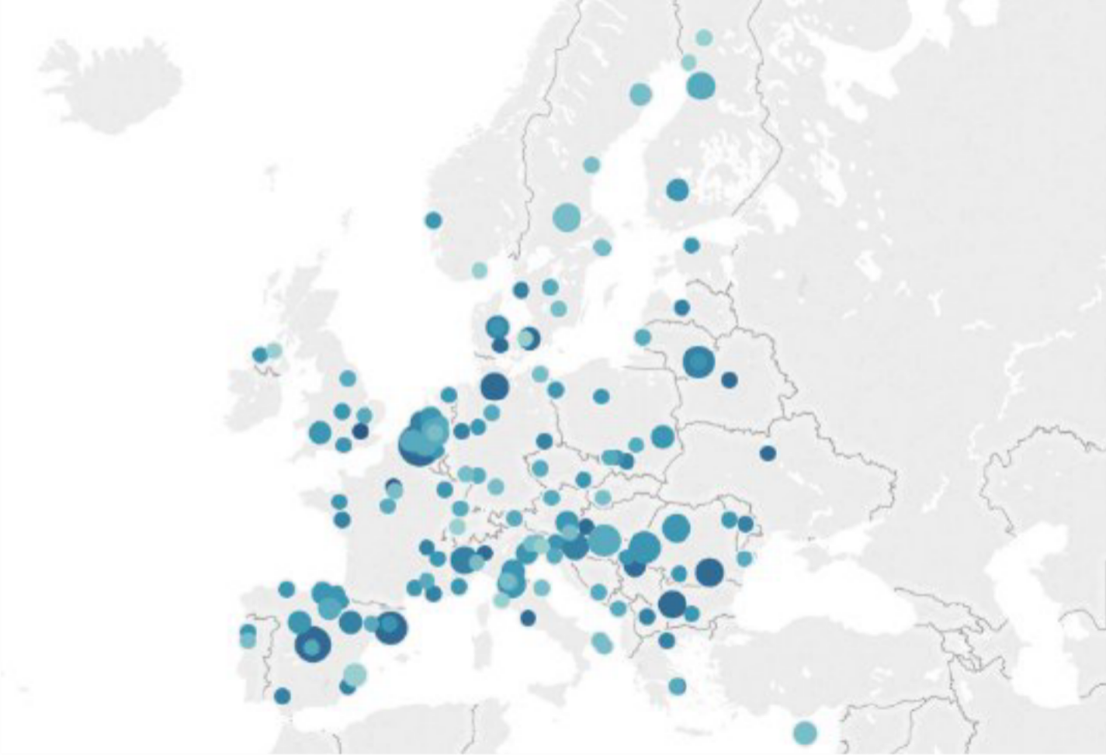

Building Europe’s ADR Innovation Ecosystem
A United Community of Excellence
Single point of contact: Adra is the EC’s primary partner for advancing AI, data, and robotics R&I in Europe
Integrated Network: Connecting AI, Data & Robotics expertise across Europe
Multi-Stakeholder Collaboration: Industry + Research +
Academia + Government
Research Excellence: Europe's top minds in ADR technologies
Industry Bridge: Transforming research into market solutions
Geographic Reach: Active presence across Member States
Rapid Mobilisation: Ready expertise for strategic initiatives

Slide 6



AI, Data and Robotics public-private partnership (2021-2030)
Co-Programmed
Partnership
European Commission
Public Side
Adra Association
Private Side
Sovereignty Secure European autonomy
in AI, Data & Robotics
Industry
Boost competitiveness through digital & green transformation
Research Achieve global research excellence
Social Impact Drive solutions for climate, health, energy & security
Notes:
In order to solve these challenges, alignment between public & private sector is required and might be a third-way, in the context of these global challenges.
Adra was founded to be the private side of the public-private partnership with the Commision (now the AI office) by 5 associations, BDVA, eu robotics , and 3 AI associations Claire, ellis and EurAI. All associations are granted seats in the governance board.
The European Commission have committed to invest 1,3 Billion euros into research in this sector through its Horizon Europe program. This means the EU launches around 200 hundred projects in this sector. Almost 100 are already running. The private side commits to match this with an equal sum of investment.

Slide 7
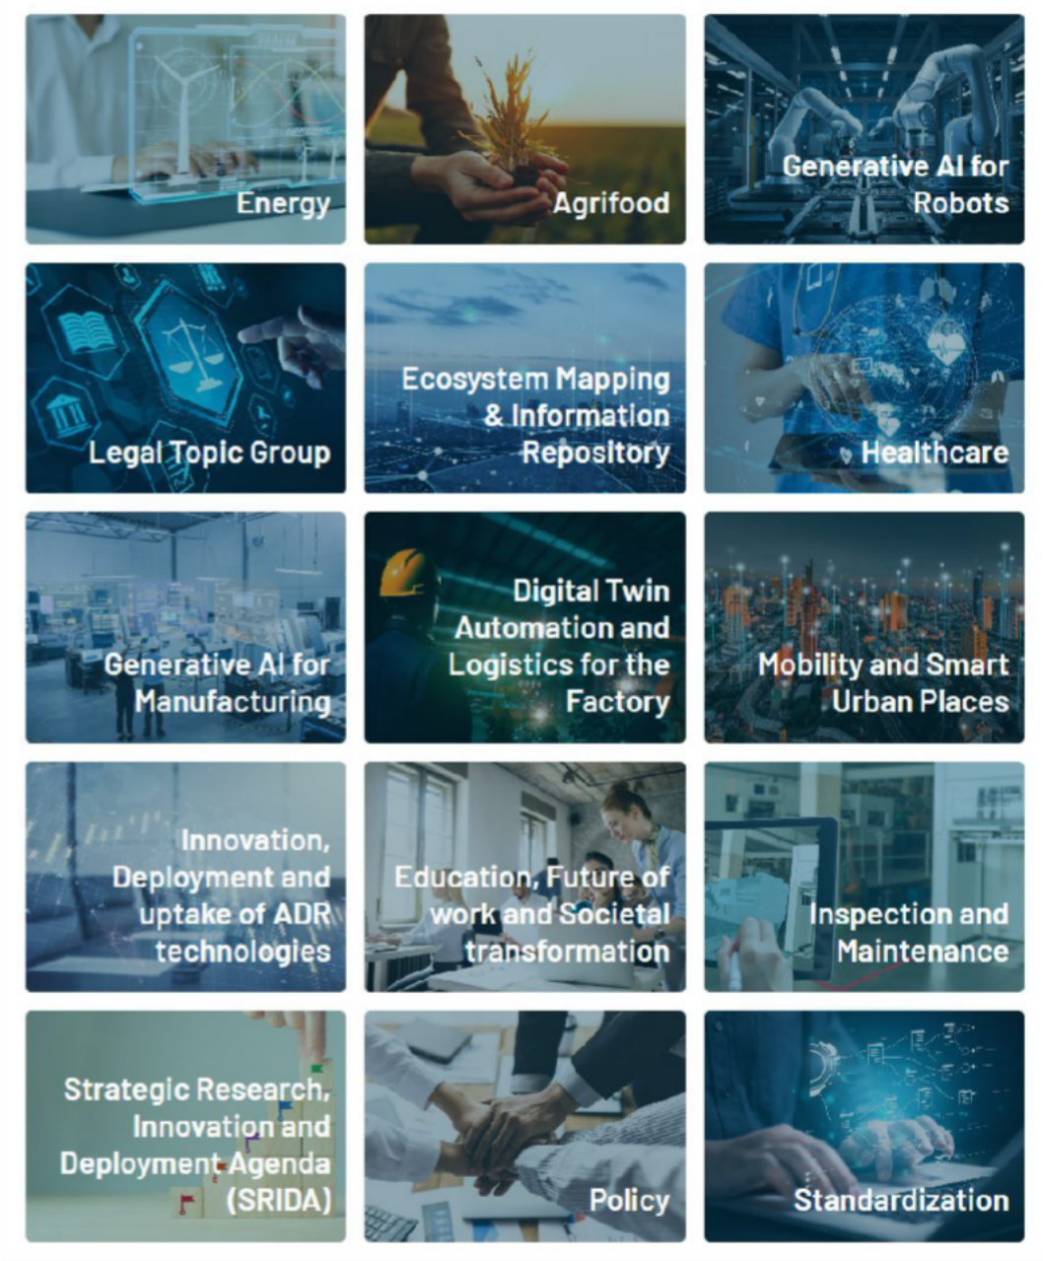



Focus Areas
Core Innovation Areas
Generative AI Applications
15
Topic groups
Manufacturing
Robotics
Sector-Specific Taskforces
Energy & Sustainability
Agrifood Systems
Healthcare Innovation
Legal & Regulatory
Digital Manufacturing (Factory Automation, Digital Twin, Logistics)
Cross-Cutting Groups
Ecosystem Mapping & Information Repository
Mobility & Smart Urban Solutions
Innovation & Technology Uptake
Education & Work Transformation
Inspection & Maintenance
Policy
Standardization
Strategic Coordination
SRIDA Implementation

Slide 8
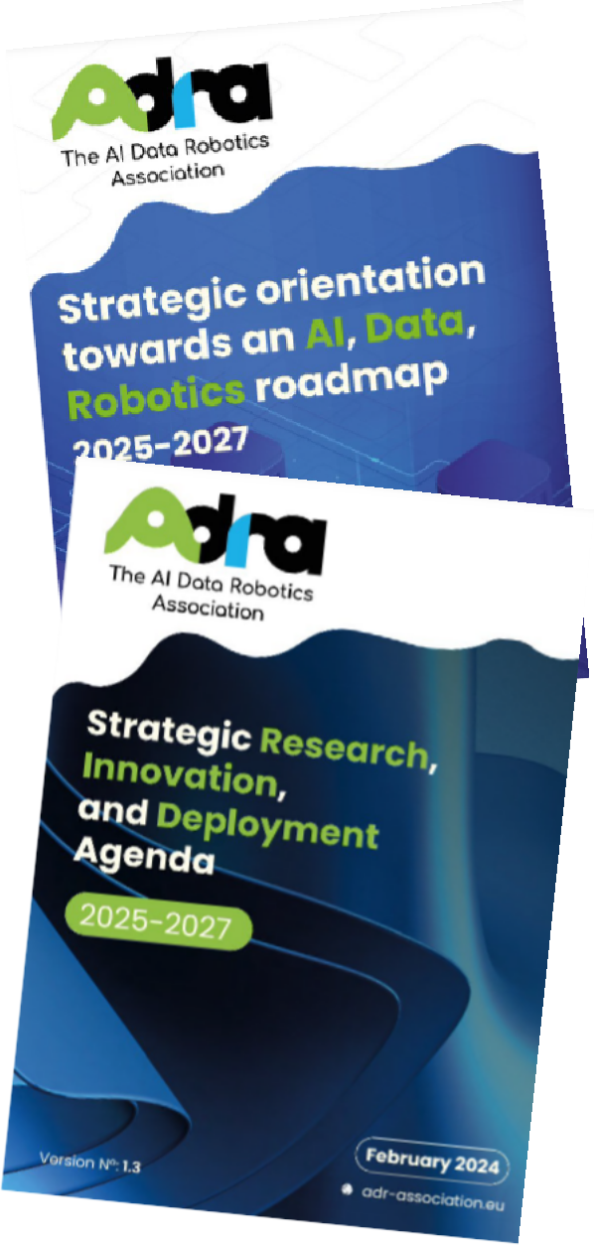






Strategic Research Innovation and Deployment agenda (SRIDA)
Big Tickets
#3: An interoperable and integrated framework for data and model ecosystems
#1: Ground-breaking technological foundations in ADR
#2: Effective and Trustworthy General- Purpose ADR
#4: Next generation smart embodied robotic systems
#5: Developing ADR technology for the sciences
#6: Research, innovation, and tools for compliance

Slide 9





Five Strategic Pillars to Enhancing European competitiveness and productivity
Strategic Research Innovation and Deployment Agenda (SRIDA)
•Vision (North Star) for Europe’s
Research and Innovation orientations
•Roadmap for developing a
resilient European ecosystem
High-impact pilots for industry: accelerating AI (software) – robot (hardware) convergence
Spur the development of sovereign AI technologies, foundational models and intelligent machines
European control over full
technology stack
Challenge-based(stage-gate) approach to grow champions
•Accelerate progress through
early TRL levels, application discovery and quicker deployment
•Bridge gap between applied
Research and Industry (end- user) needs and drives skills development
Leading on Harmonised/International Standards for Gen(AI) in robots
•Currently no international
standards, yet growing number of use-cases and market worth 10s billions EUR
•Huge opportunity for European
manufacturers to create and certify quality products and structure value chains.
Creating consonance across member state policies and ecosystems
•Overcome fragmentation in
priorities, funding, and policy to concentrate focus and investments
•Achieving multi-level alignment
of objectives across layers of European governance

Slide 10

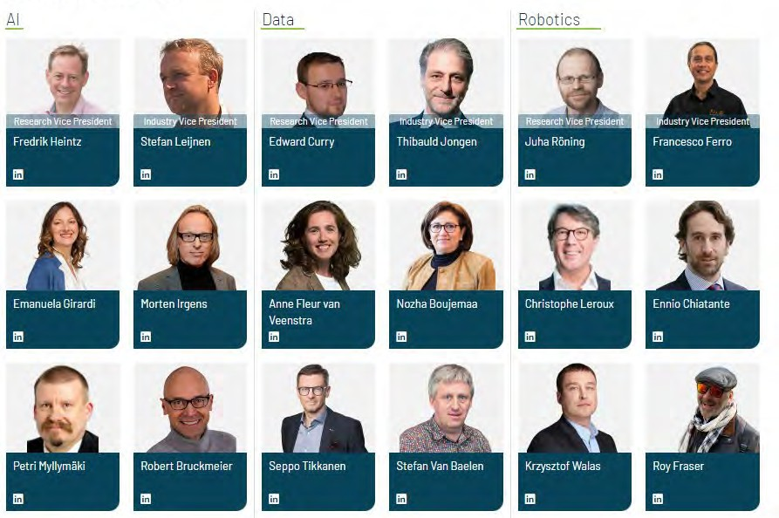





















Representing EU and Horizon Europe associated country innovation ecosystems
Slide 23

Slide 11

Summary
Building Europe's Innovation Ecosystem
Influence EU Policy & Standards: Shape supportive R&D roadmaps and legislation.
Forge Key Connections: Network across sectors and access shared R&D infrastructure
Fuel Innovation: Secure funding and resources to develop new technologies.
Driving Collaboration
Co-create Solutions: Access shared insights and co-design pioneering projects.
Innovate Collectively: Engage in pre-competitive R&D for shared IP and market understanding.
Unite for Impact: Build trusted networks to solve industry-wide challenges.
Advancing Strategic Initiatives
Direct EU Strategy: Shape policy and strategic R&D agendas for future growth
Gain Strategic Advantage: Leverage EU insights and support for your key projects
Lead Market-Driven Innovation: Use early intelligence to design impactful initiatives.
Empowering Impact
Achieve Tangible Results: Generate new business, IP, services, and market success.
Enhance Performance: Implement best practices, boost efficiency, and accelerate your strategy.
Magnify Your Voice: Solve critical challenges and strengthen collective industry influence.

Slide 12
GET IN TOUCH

Slide 13
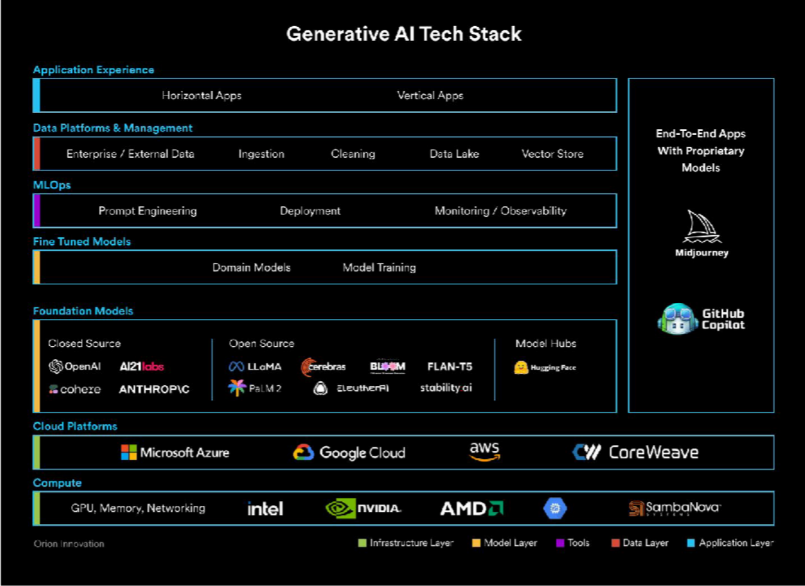
Strategic Direction: SRIDA
Focus Areas
The full AI stack sovereignity
Trustworthy GenAI development
Robotics – AI ecosystem integration
Advanced R&D Research: Neurosymbolic AI – Learning and reasoning
Industrial Strategy
Strengthening EU competitiveness
Build comprehensive AI Factories
Support supply chain resilience
Foster research-industry collaboration
Key Investments
Large-scale testbeds and deployment
Foundation models reflecting EU values
Human-centric innovation and skills
Cross-border coordination

Slide 14
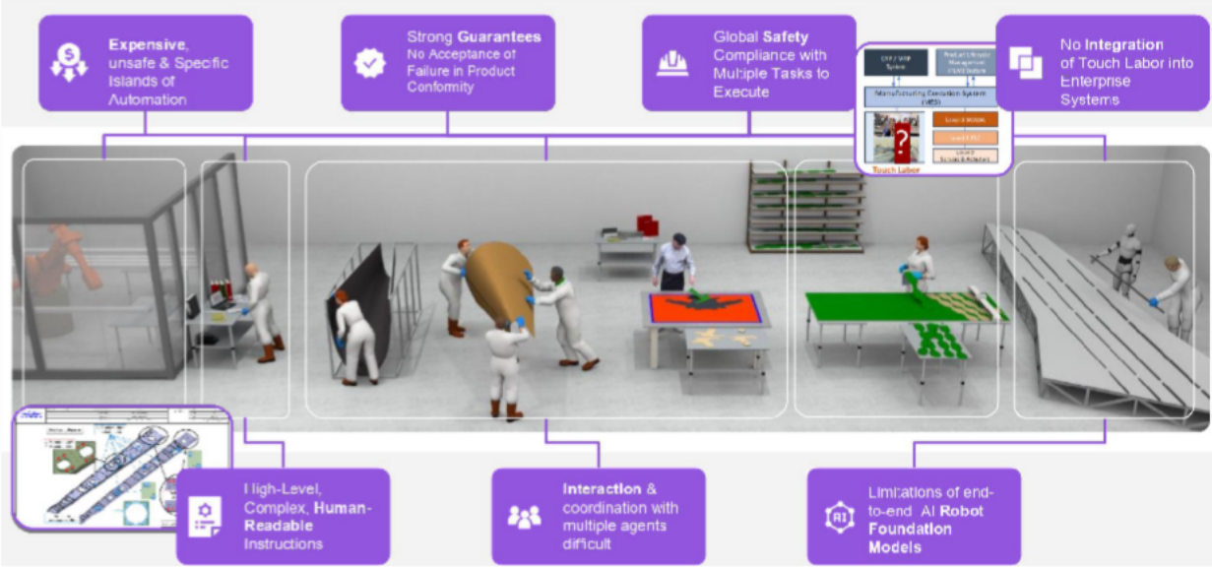
High-Impact Pilots & Applications: Embodied intelligence for industry
Objective
en)AI-enable anufacturing
for Europe Roadmap
Identify high-impact applications of (Gen)AI-enabled robotics in the manufacturing industry to serve as reference points for Europe’s Intelligent Robotics Roadmap
Deliverables
Broad consultation on representative industrial ecosystem (end-users !)
Market Pull in complement to Technology Push
High-impact challenges for competitiveness, societal development, and European autonomy
Required pre-competitive technology capabilities & infrastructures
A challenge : improving productivity of manual work in the manufacturing industry through AI-powered robotics !

Slide 15
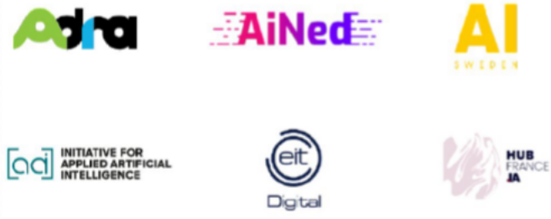
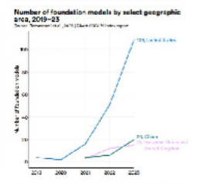
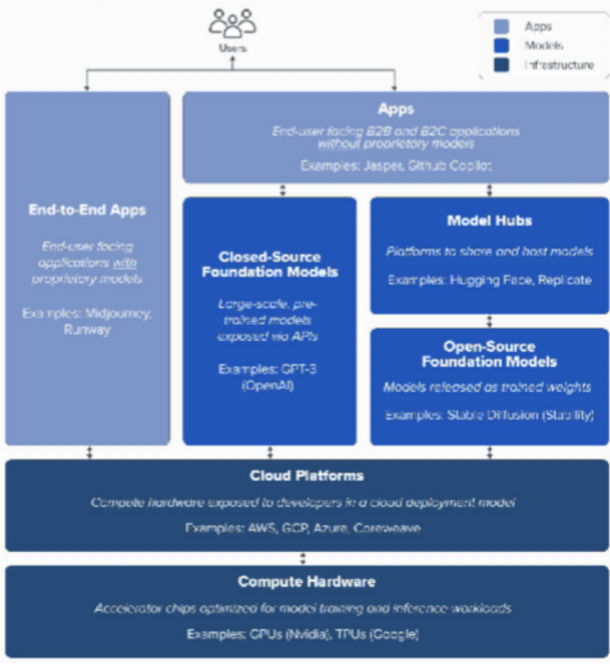


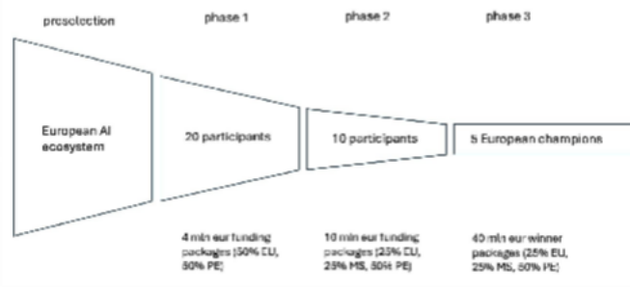
The European Challenge: Sovereign Foundation Models
Strategic Imperative
Foundation models are becoming critical infrastructure
Current dependency on non-EU technologies creates risks
Need for European values-aligned AI development
Establishment of Adra Generative AI Taskforce in 2023
Key Insights
Fostering a more open and competitive market requires investable European champions in generative AI
Downstream effects, enabling rise and development of large AI-based
industrial ecosystems in Europe
Challenge-based instruments create delivery-based competitiveness
Key Results of GenAI Taskforce
Support for launch of the AI Innovation package (January 2024)
Alignment with Draghi report “Future of European Competitiveness”
Support for AI BOOST challenge mechanism
Proposal for establishing a challenge-based generative AI incubator in ALT-EDIC (LLM-BRIDGE)
Building Europe's AI future through sovereign foundation models

Slide 16




Supporting AI Act Implementation and international standards
Harmonised Standards (HS) under development
European Commission
Initial AIA draft
scrutiny and revision
Revised AI Act
European Legislation
Compliance to HS by Providers conveys presumption of conformity
Develop new European standards
Harmonised Harmo^{S}n^{ta}is^{n}e^{d}d^{ards}
HarmoSntisaend ards Standards
Harmonised
Standards
Harmonised Standards Request to JTC 21
European Standardisation
Adopts/adapt ISO/IEC specs
ADRA's Strategic Role
ISO/IEC JTC1 SC42: Artificial Intelligence
ISO/IEC Standards ISO/IEC Standards
Create awareness on the importance of standard
Bridging industry expertise with
regulatory requirements
Supporting development of domain-specific standards
Facilitating consensus between
stakeholders
ISO/IEC Standards
Others: security, software, safety, conformance
ISO/IEC Standards
International Standardisation

Slide 17
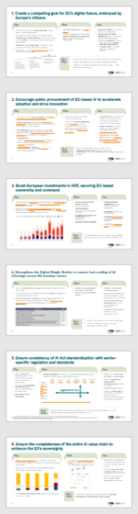
Member state initiatives to innovate and secure global competitiveness of the EU
Details in backup
1. Create a compelling goal for EU‘s digital future, embraced by Europe’s citizens
Long term aspiration
Overall economic growth and prosperity
Global competitiveness
Sovereignty
Common Health and Wellbeing
Sustainability
Safety and European Values
2. Encourage public procurement of EU-based AI to accelerate adoption and drive innovation
3. Boost European investments in ADR, securing
EU-based ownership and command
Requires
EU’s
digital
success
4. Strengthen the digital single market to ensure fast scaling of AI offerings across EU member states
5. Ensure consistency of AI Act standardization with sector-specific regulation and standards
6. Ensure the completeness of the entire AI value chain to enhance the EU´s sovereignty

