Slide 1
GenAI for Virtual Worlds
Horizon Europe WP25
Context and call
Anne Bajart, Deputy Head of Unit
Adelina Dinu, Project Officer
DG CONNECt – Dir G Data
Unit G2 Interactive Technologies, Digital for Culture and Education

Slide 2
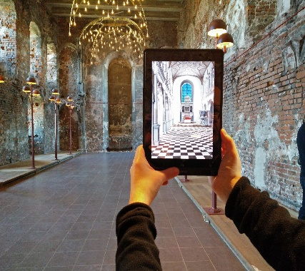
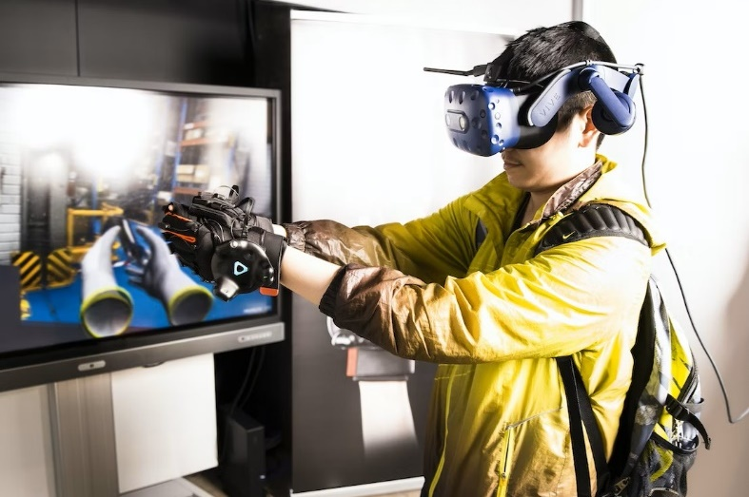
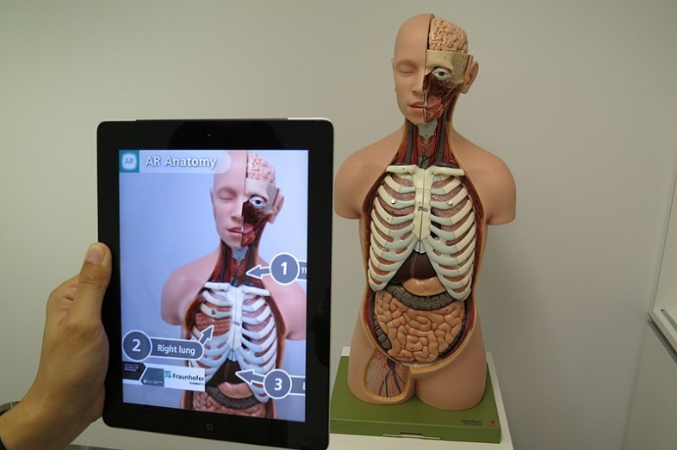
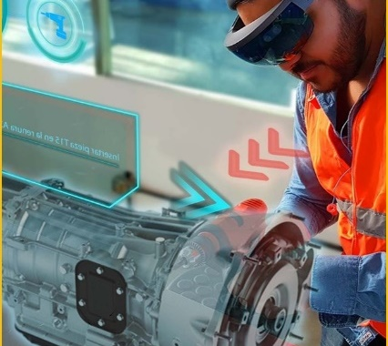
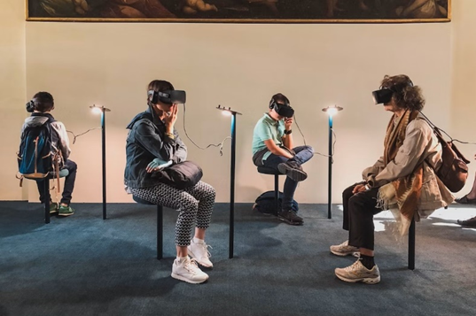
Web 4.0 and virtual worlds
Manufacturing
Virtual worlds
Persistent, 3D, real-time, immersive environments, blurring the line between real and virtual, for socialising, working, learning, making transactions, playing and creating.
WEB 4.0
A wider, long term technological transition where physical and digital worlds will seamlessly blend, and smart devices will communicate to each other to perform complex tasks.
WEB
2.0
centralised
Mainly 2D worlds, basic immersion, enabled by traditional input/output interfaces. Marketing/branding.
Health
WEB
3.0
decentralised
3D web, generalised use of Digital Twins, enhanced user interfaces, mainstream XR devices.
Education
WEB
4.0
distributed
Seamless blending of real and virtual worlds, natural user interfaces, real-time sensor data, generalised AI, ubiquitous computing and distributed control.

Slide 3
EU Initiative on Web4,0 and Virtual Worlds A head start in the next technological transition
Web 4.0 and virtual worlds:
that reflect EU values, principles and fundamental rights
where people can be safe, confident and empowered and where people’s rights as users, consumers, workers or creators are respected
where European businesses can develop world-leading applications, scale up and grow
that are open and interoperable giving freedom of choice for users
where sustainability is at the core of technological developments.
COM(2023) 442
1: People and
skills
2: Business and industrial
ecosystem
3: Government
4: Governance
Slide 3

Slide 4
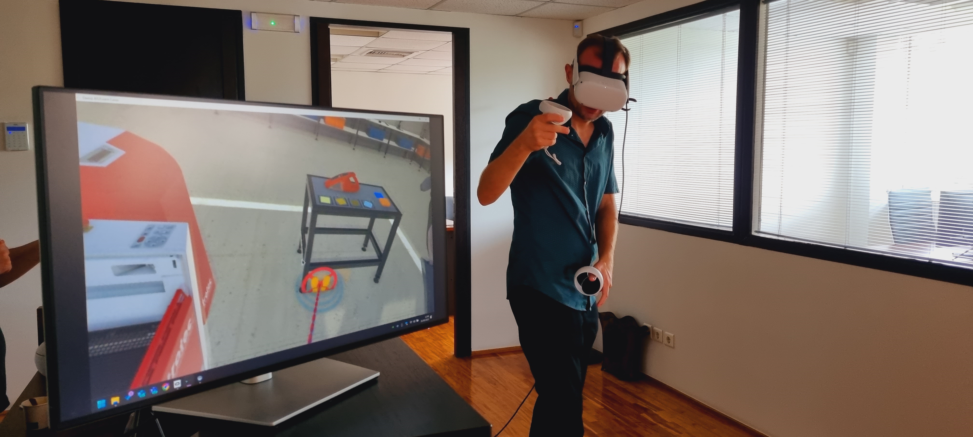
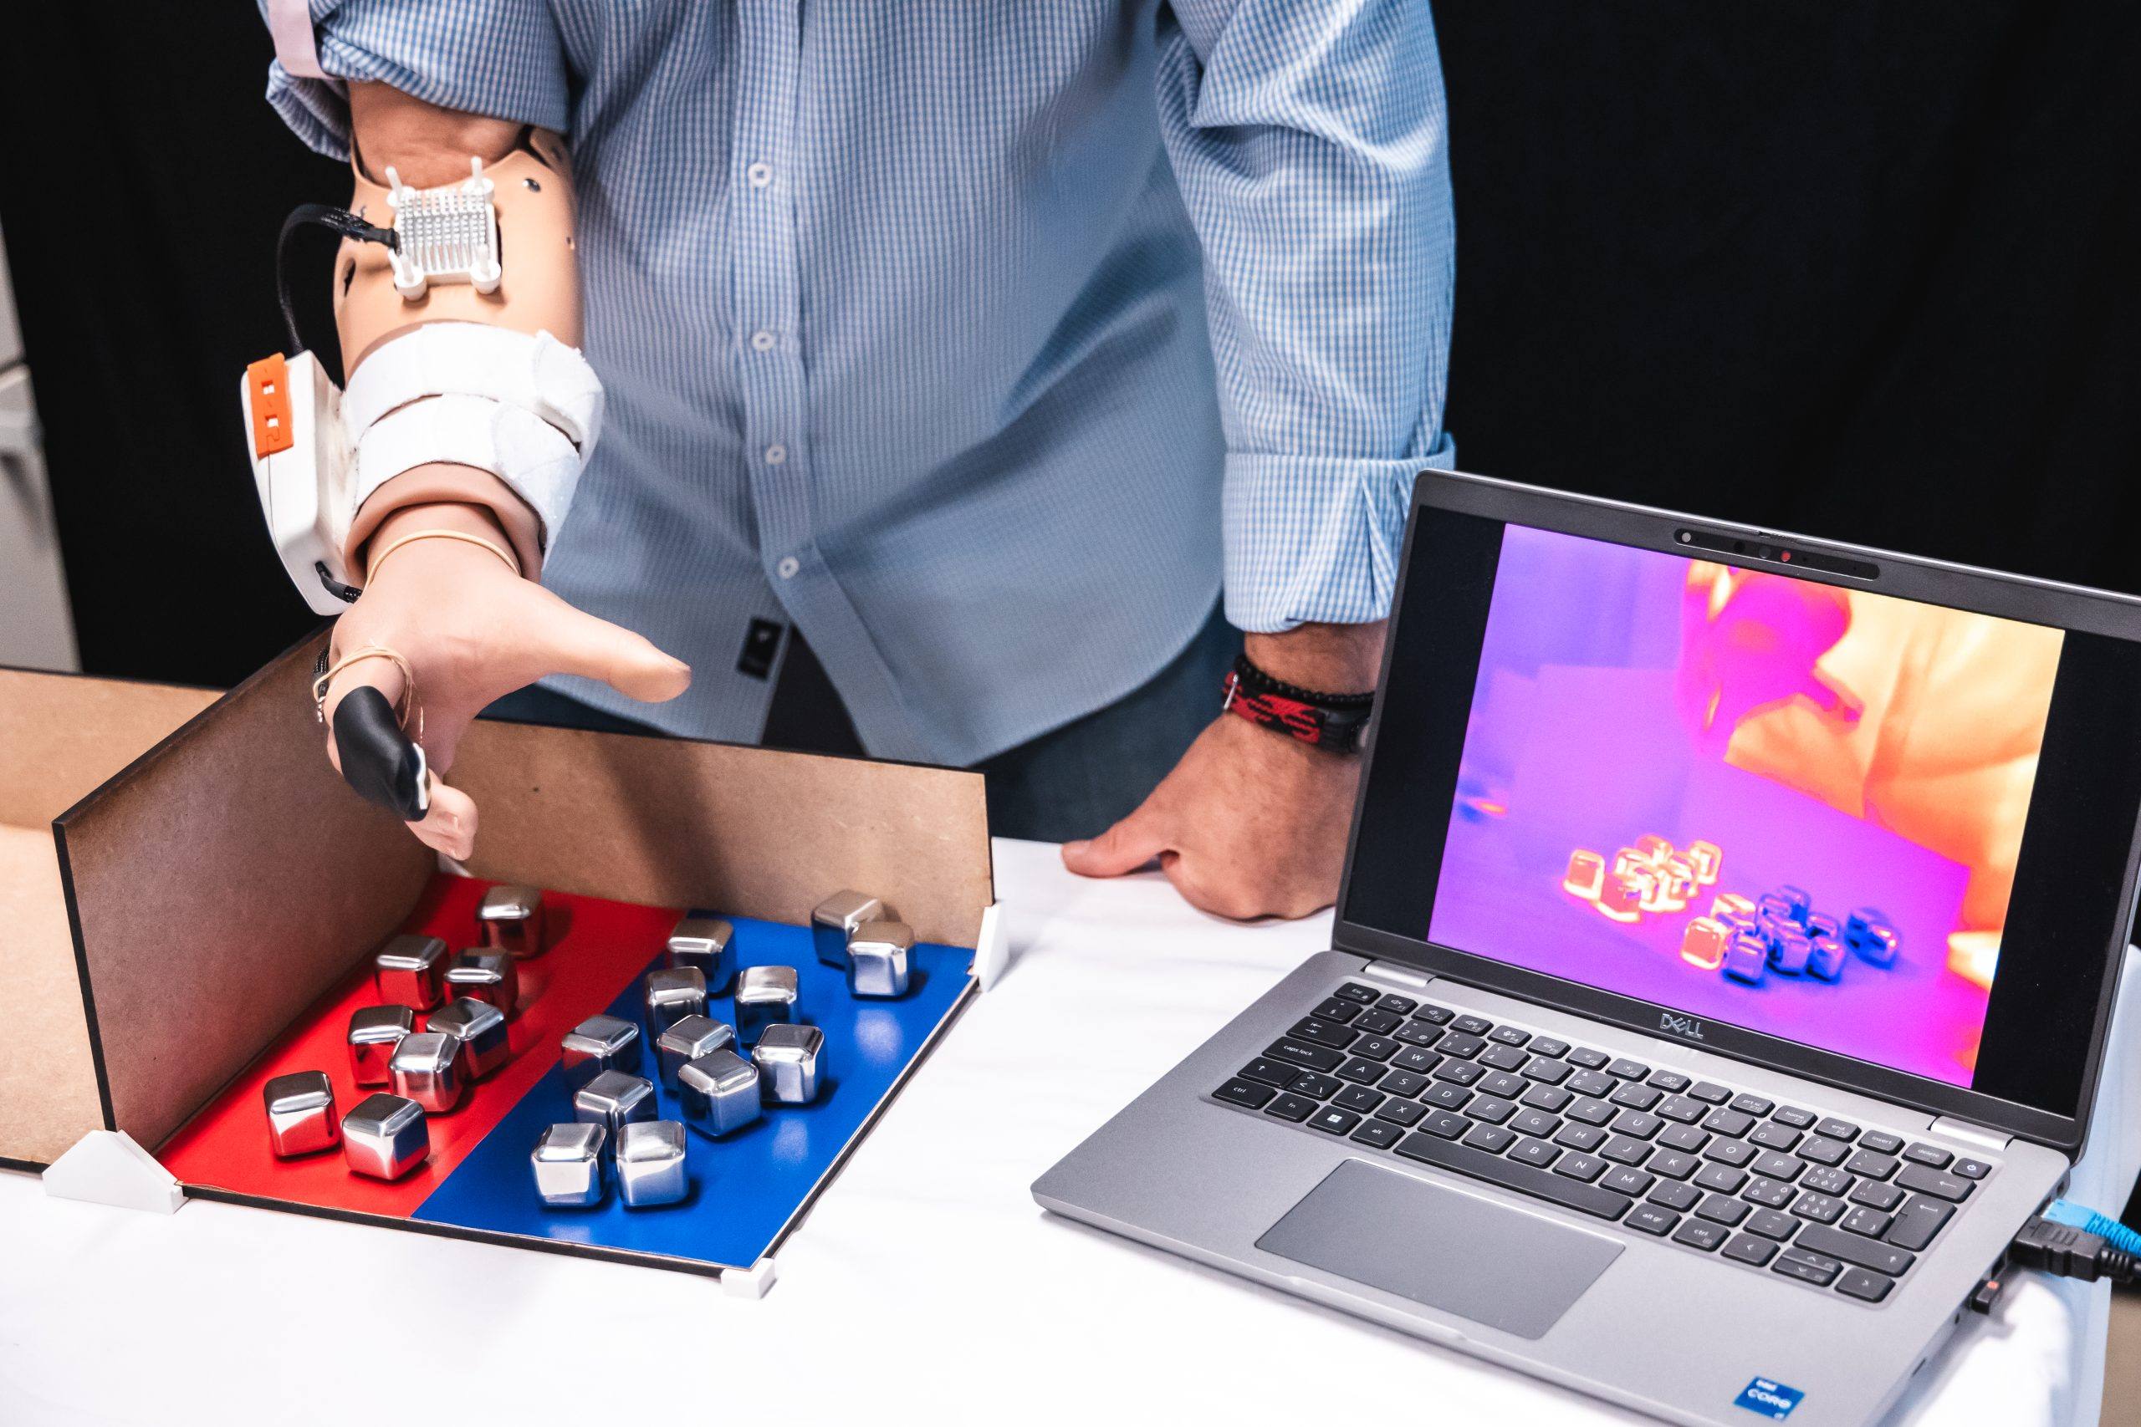
Virtual Worlds Partnership
A strong and multi-disciplinary Partnership,
to develop and promote a thriving industrial and end-user ecosystem, covering all aspects of the Virtual Worlds value chain, while actively engaging with people and society
XR2Learn – XR2Learn
https://www.sun-xr-project.eu/
Open standards
Interoperability: metadata, ontologies, protocols, APIs
Open, accessibility and inclusivity
R&I Technology building blocks
XR, sensors, electronics, photonics, optics, 3D…
AI, IoT, HPC, edge computing, clouds
Tools to develop, test and integrate technologies
Digitalisation of Cultural content
Copyright, IP, Blockchain and NFTs
Digital twins (modelling, data analytics, visualisation)
Testing solutions in real-world environments
Policies, human and ethics
Ethical & regulatory questions
data (generated and collected), blockchain, cybersecurity, labour works, illegal activities, digital identity, children protection, diversity…
Awareness & social acceptance, skills, exploitation of research results…

Slide 5
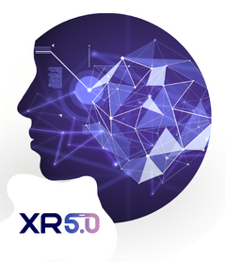
EU-funded projects
Openverse (OPEN and co-created ViRtual worldS for Europe)
https://www.open-verse.eu/
XR5.0 (Human-Centric AI-Enabled Extended Reality Applications for the Industry 5.0 Era)
https://xr50.eu/
XR2Industry (Tailoring eXtended Reality to Industry's needs)
https://xr2industry.eu/
Presence (A toolset for hyper-realistic and XR-based human-human and human-machine interactions)
https://presence-xr.eu/
Luminous (Language Augmentation for Humanverse)
http://luminous-horizon.eu/
Motivate XR (Maintenance, Support & Operation Training using Immersive Virtual and Augmented Technology for Efficiency with XR)
https://motivatexr.eu/
XTREME (Mixed Reality Environment for Immersive Experience of Art and Culture)
https://xtremeitu.dk/
https://europa.eu/!7kJMmJ
Popular (PRESCRIPTION OPTICS PROVIDING A UNIVERSAL LENS FOR AUGMENTED REALITY EYEWEAR)
POPULAR (popular-project.eu)
Indux-R (Transform European industrial ecosystems through eXtended Reality enhanced with human-centric AI and secure, 5G-enabled IoT)
https://indux-r.eu/
HEAT (Hybrid Extended reality)
https://www.immersion.fr/heat-hybrid-extended-reality/
HEurope projects

Slide 6
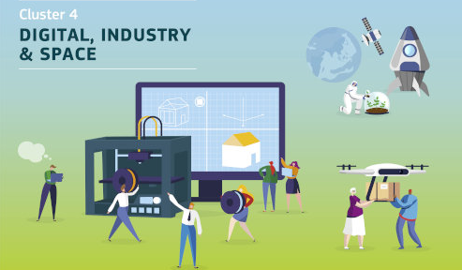
HEurope Work Programme 2025
TOPICS | TYPE OF ACTION | BUDGETS (MEUR) | EXPECTED EU CONTRIBUTION PER PROJECT (MEUR)
HORIZON-CL4-2025-03-HUMAN-14: Core technologies for virtual worlds (RIA) (Virtual Worlds and Photonics Partnerships) | RIA | 43.00 | 5.00 to 6.00
HORIZON-CL4-2025-03-HUMAN-15: GenAI4EU: Generative AI for Virtual Worlds: Advanced technologies for better performance and hyper personalised and immersive experience (IA) (AI/Data/Robotics & Virtual Worlds Partnerships) | IA | 20.00 | 4.00 to 5.00
HORIZON-CL4-2025-03-HUMAN-16: Drive the evolution of the internet towards open and interoperable Web 4.0 and Virtual Worlds: building blocks in priority areas (RIA) (Virtual Worlds Partnership) | RIA | 14.50 | 1.00 to 3.00
HORIZON-CL4-2025-03-HUMAN-17: Specific support for the Virtual Worlds Partnership and the Web 4.0 initiative (CSA) (Virtual Worlds Partnership) | CSA | 2.50 | 2.50 MEUR
Destination 6:
Digital and industrial technologies driving human-centric innovation
https://europa.eu/!j4gQ6D
HE Cluster 4 info days taking place on 13 - 14 May 2025
https://europa.eu/!jpBR8V

Slide 7
HORIZON-CL4-2025-03-HUMAN-15
Generative AI for Virtual Worlds: Advanced technologies for better performance and hyper personalised and immersive experience (IA)
Budget: 20 MEUR​
TRL: 4-6
Project size: 4-5 MEUR
Innovation Action
Expected outcome
Realistic, creative and innovative characters, user-tailored artefacts, and Virtual Worlds for a better immersion and significantly improved user experience.
Smart digital assistants and 3D chatbots for a safe and inclusive navigation.
Joint Effort from Virtual Worlds/ADRA Partnerships

Slide 8
HORIZON-CL4-2025-03-HUMAN-15
Generative AI for Virtual Worlds: Advanced technologies for better performance and hyper personalised and immersive experience (IA)
Scope:
1. Realistic, creative and innovative characters, user-tailored artefacts, and Virtual Worlds for a better immersion and significantly improved user experience.
Use Generative AI to:
create either safe and inclusive virtual spaces, realistic environments, or creative and beyond reality ones,
develop dynamic storytelling and scenarios to enable creative personalised content,
enable generation of personalised avatars to provide seamless and more realistic immersive interaction.
2. Smart digital assistants and 3D chatbots for a safe and inclusive navigation.
to enhance training and education,
to remove language barriers or language disorders through instant translation,
to remove barriers to persons with disabilities,
to offer sentiment analysis and behavioural decision support systems,
to enable users to adapt to interlocutors from various cultures, languages and backgrounds.

Slide 9
